Slide 2
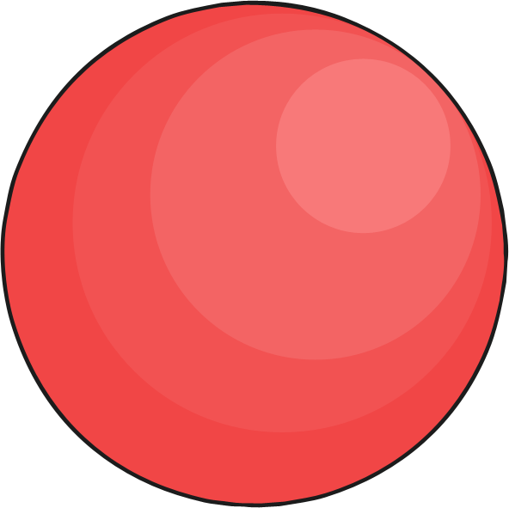

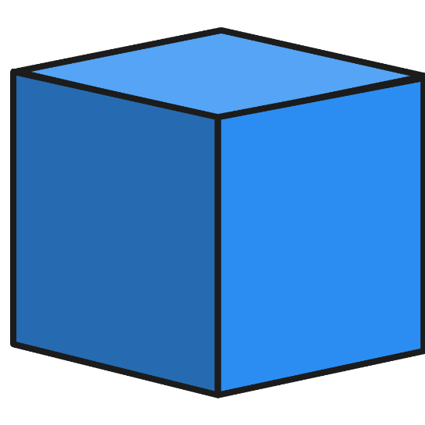
Can you find the cube?

Slide 3

Never mind. Keep trying!

Slide 4

Yay! Correct!

Slide 5
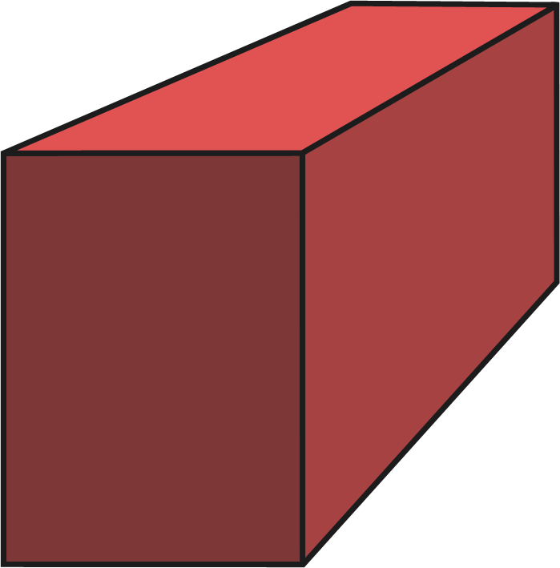
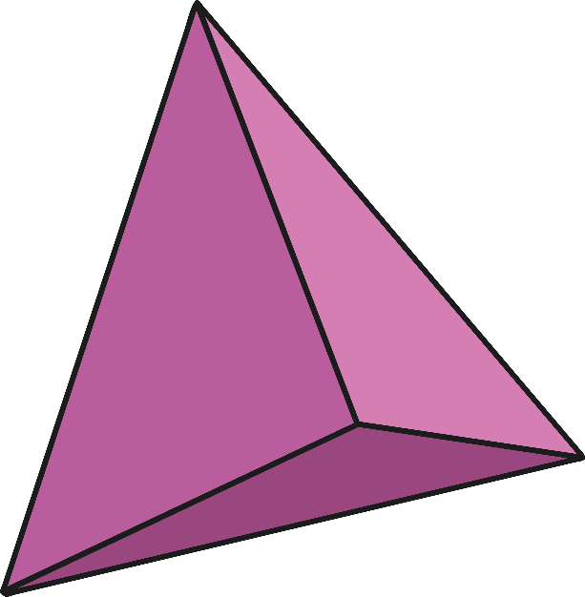
Can you find the cuboid?

Slide 6
Never mind. Keep trying!

Slide 7
Yay! Correct!

Slide 8
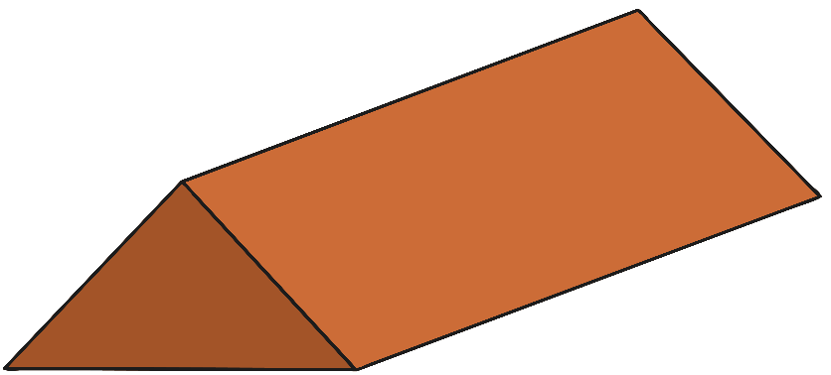
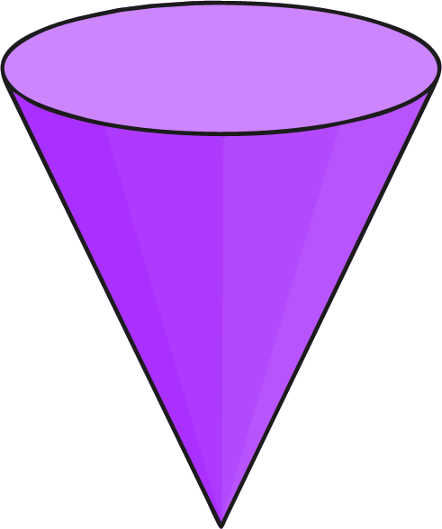
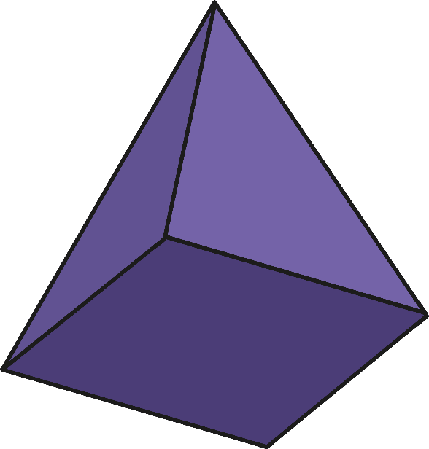
Can you find the square-based pyramid?

Slide 9
Never mind. Keep trying!

Slide 10
Yay! Correct!

Slide 11
Can you find the sphere?

Slide 12
Never mind. Keep trying!

Slide 13
Yay! Correct!

Slide 14
Can you find the triangular prism?

Slide 15
Never mind. Keep trying!

Slide 16
Yay! Correct!

Slide 17
Can you find the cylinder?

Slide 18
Never mind. Keep trying!

Slide 19
Yay! Correct!

Slide 20

Can you find the cone?

Slide 21
Never mind. Keep trying!

Slide 22
Yay! Correct!

Slide 23












Well done!

