Slide 1


Year 6 – Summer Block 1 – Geometry – Angles in a Triangle – Missing Angles
About This Resource:
This PowerPoint has been designed to support your teaching of this small step. It includes a starter activity and an example of each question from the Varied Fluency and Reasoning and Problem Solving resources also provided in this pack. You can choose to work through all examples provided or a selection of them depending on the needs of your class.
National Curriculum Objectives:
Mathematics Year 6: (6G4b) Recognise angles where they meet at a point, are on a straight line, or are vertically opposite, and find missing angles
More Year 6 Properties of Shapes resources.
Did you like this resource? Don’t forget to review it on our website.
© Classroom Secrets Limited 2018

Slide 2
Year 6 – Summer Block 1 – Geometry
Step 7: Angles in a Triangle – Missing Angles
© Classroom Secrets Limited 2018

Slide 3
Introduction
Find three pairs of numbers that make 180, and three pairs of numbers that make 360.
239
95
265
76
34
121
104
192
28
146
168
152
© Classroom Secrets Limited 2018

Slide 4
Introduction
Find three pairs of numbers that make 180, and three pairs of numbers that make 360.
104
152
146
76
28
34
121
168
95
239
192
265
© Classroom Secrets Limited 2018

Slide 5
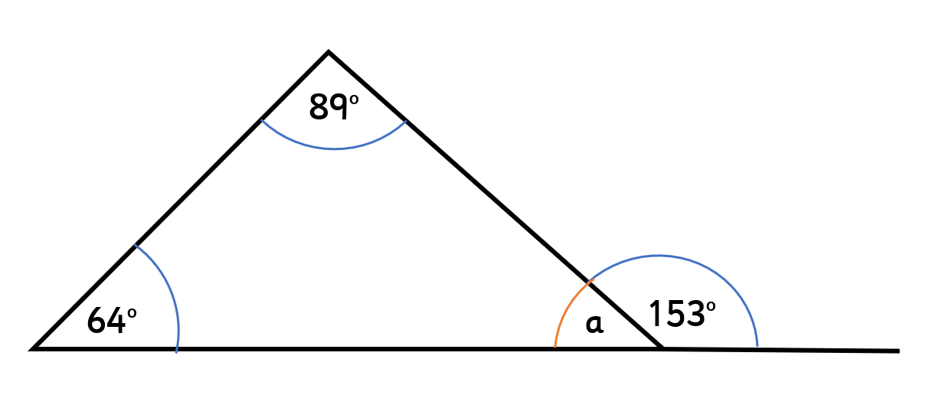
Varied Fluency 1
Calculate the missing angle.
© Classroom Secrets Limited 2018

Slide 6
Varied Fluency 1
Calculate the missing angle.
Angle a = 27º
© Classroom Secrets Limited 2018

Slide 7
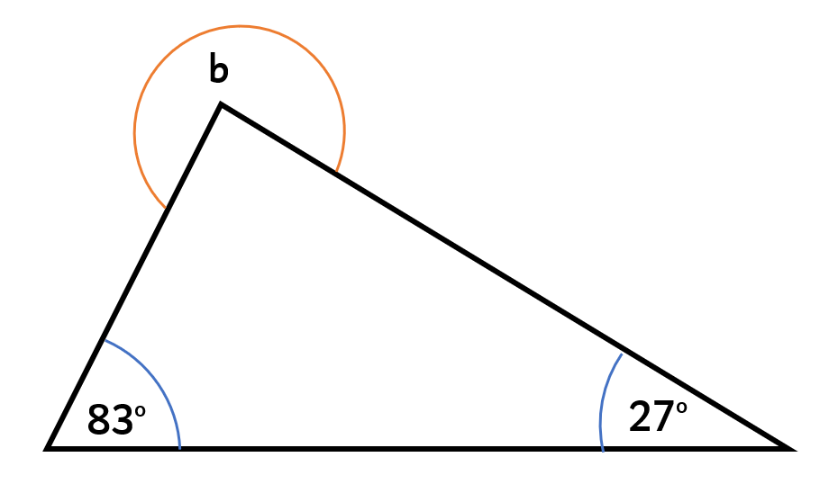
Varied Fluency 2
Calculate the missing angle.
© Classroom Secrets Limited 2018

Slide 8
Varied Fluency 2
Calculate the missing angle.
Angle b = 290º
© Classroom Secrets Limited 2018

Slide 9
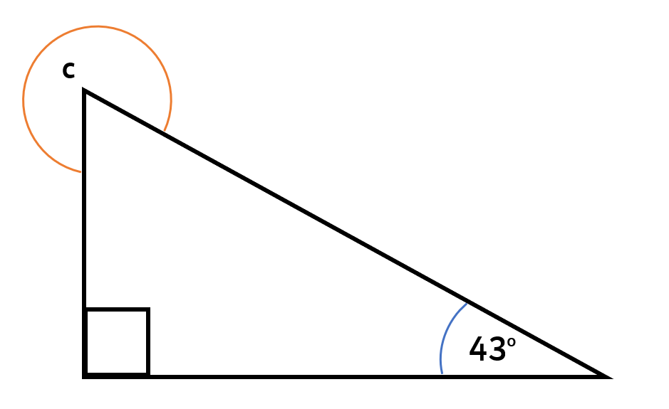
Varied Fluency 3
Calculate the missing angle.
© Classroom Secrets Limited 2018

Slide 10
Varied Fluency 3
Calculate the missing angle.
Angle c = 313º
© Classroom Secrets Limited 2018

Slide 11
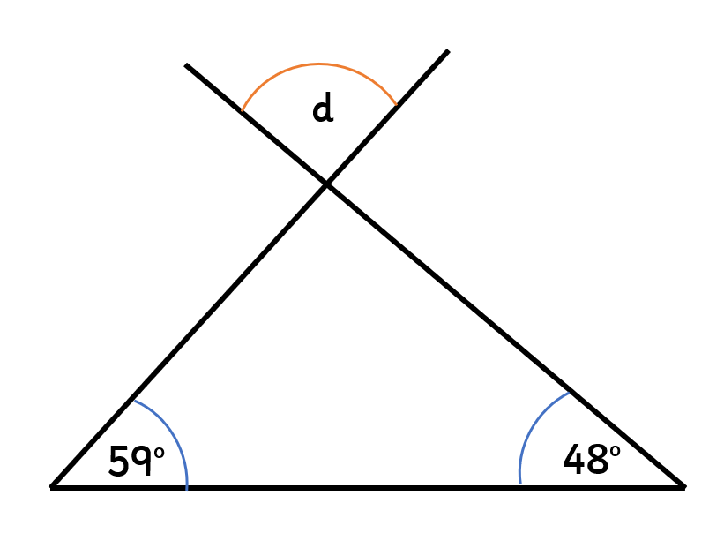
Varied Fluency 4
Calculate the missing angle.
© Classroom Secrets Limited 2018

Slide 12
Varied Fluency 4
Calculate the missing angle.
Angle d = 73º
© Classroom Secrets Limited 2018

Slide 13
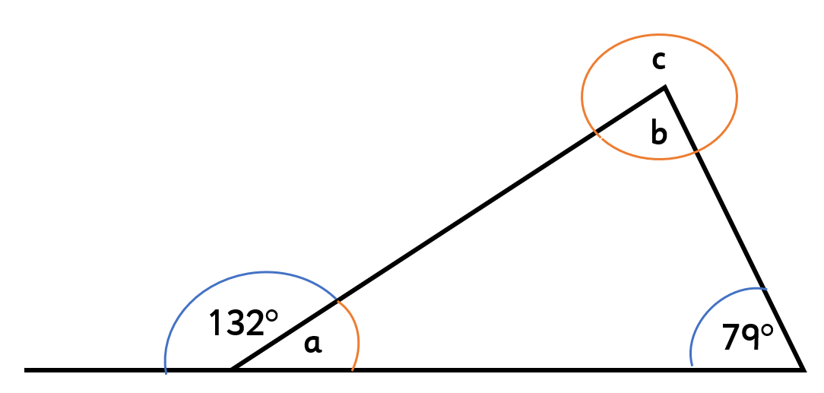
Reasoning 1
Sunil says:
Is Sunil correct? Explain why.
I can calculate some, but not all of the missing angles.
© Classroom Secrets Limited 2018

Slide 14
Reasoning 1
Sunil says:
Is Sunil correct? Explain why.
a = 48º, b = 53º and c = 307º.
Sunil is wrong. Angle a can be calculated using knowledge that the angle of a straight line is 180º. Angle b can then be calculated using knowledge that the angles in a triangle total 180º. Angle c can then be calculated using knowledge that the angle of a complete circle is 360º.
I can calculate some, but not all of the missing angles.
© Classroom Secrets Limited 2018

Slide 15
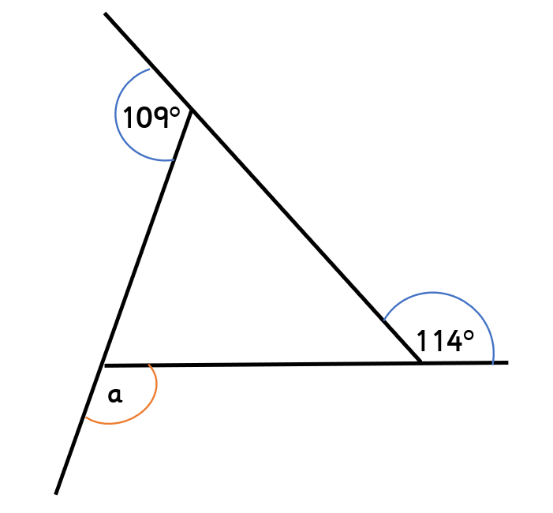
Reasoning 2
Morgan thinks that angle a measures 137º.
Cassie thinks that angle a measures 43º.
Who is correct? Explain why.
© Classroom Secrets Limited 2018

Slide 16
Reasoning 2
Morgan thinks that angle a measures 137º.
Cassie thinks that angle a measures 43º.
Who is correct? Explain why.
Morgan is correct. He has used his knowledge of angles on a straight line to calculate 2 of the missing angles in the triangle. He has then used his knowledge that angles in a triangle total 180º to calculate the 3rd missing angle. Then he could work out angle a by calculating 180º – 43º.
© Classroom Secrets Limited 2018

Slide 17
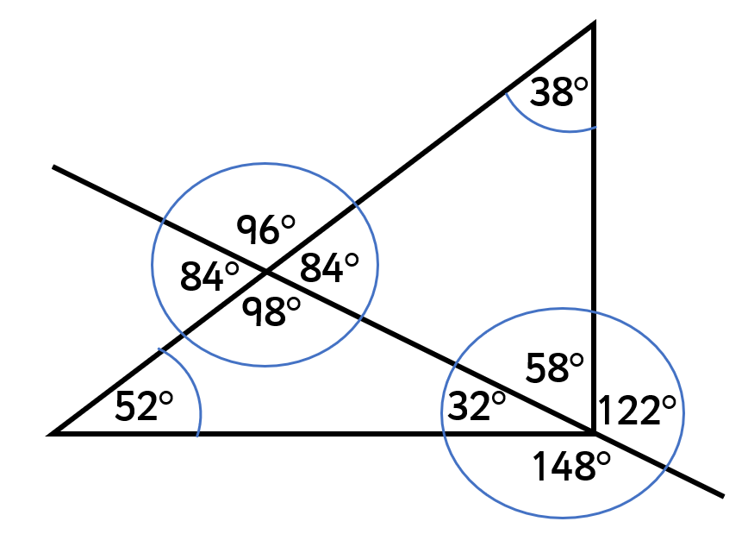
Problem Solving 1
One of these angles is wrong. Find and fix the mistake.
© Classroom Secrets Limited 2018

Slide 18
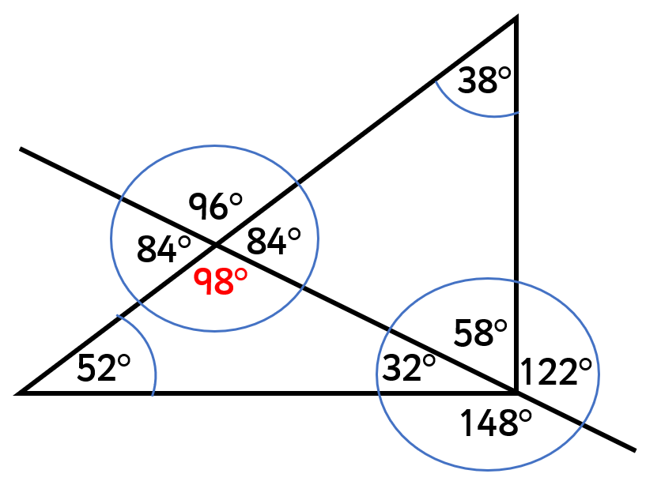
Problem Solving 1
One of these angles is wrong. Find and fix the mistake.
98º should be 96º.
The angles of the triangle need to total 180º and vertically opposite angles should be equal.
© Classroom Secrets Limited 2018

