Slide 1



LIFE/work balance
We have started a #LIFEworkbalance campaign and we need your help to complete our LIFE/work balance survey.
We hope to publish the results soon, so please give 15 minutes of your time to help us get a true picture of school life.
Want to be a part of this campaign? Take the survey on our website and share it with your colleagues!
© Classroom Secrets Limited 2019

Slide 2
Year 6 – Summer Block 1 – Geometry – Angles in a Triangle 2
About This Resource:
This PowerPoint has been designed to support your teaching of this small step. It includes a starter activity and an example of each question from the Varied Fluency and Reasoning and Problem Solving resources also provided in this pack. You can choose to work through all examples provided or a selection of them depending on the needs of your class.
National Curriculum Objectives:
Mathematics Year 6: (6G4a) Find unknown angles in any triangles, quadrilaterals, and regular polygons
Mathematics Year 6: (6G2a) Compare and classify geometric shapes based on their properties and sizes
More Year 6 Properties of Shapes resources.
Did you like this resource? Don’t forget to review it on our website.
© Classroom Secrets Limited 2019

Slide 3
Year 6 – Summer Block 1 – Geometry
Step 6: Angles in a Triangle 2
© Classroom Secrets Limited 2019

Slide 4
Introduction
How many triangles can you see?
© Classroom Secrets Limited 2019

Slide 5
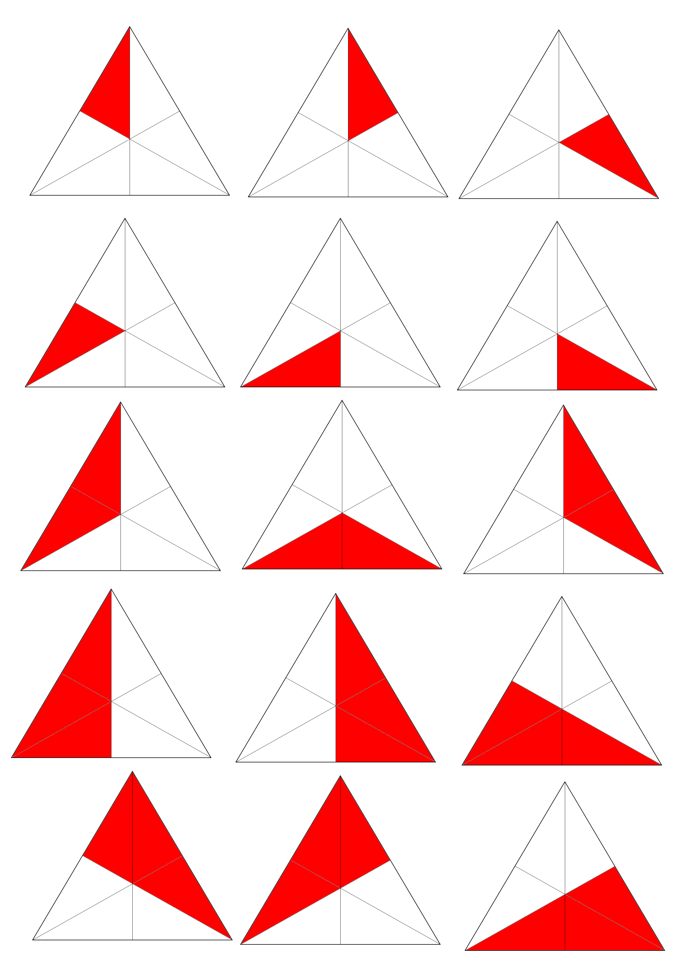
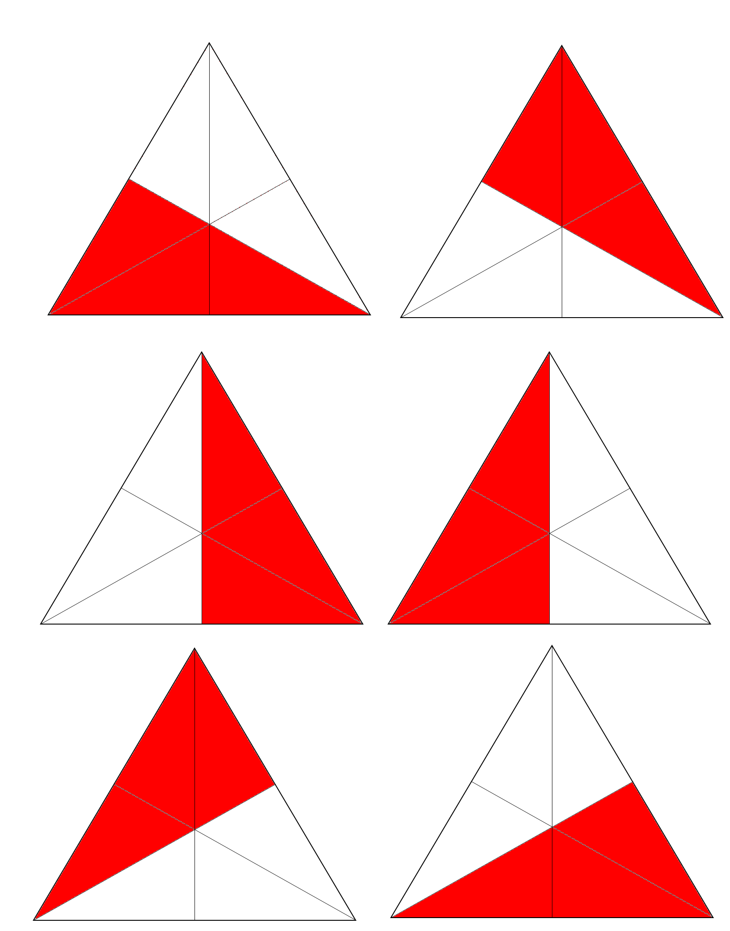
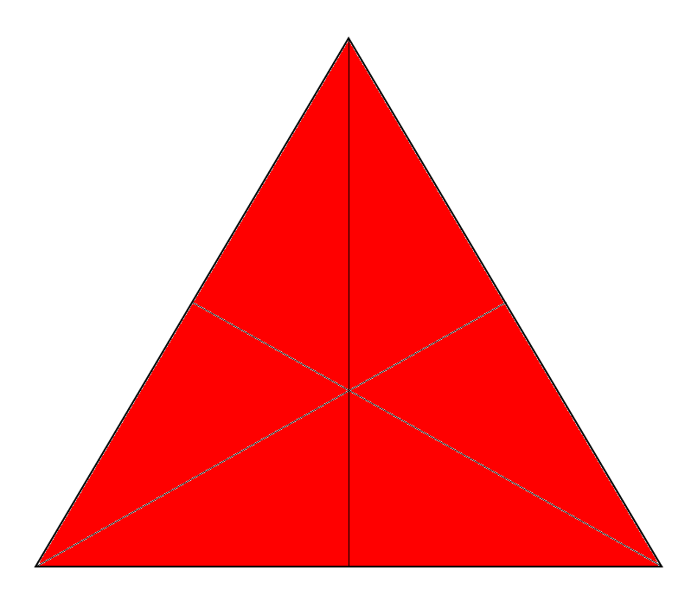
Introduction
How many triangles can you see?
16 triangles
© Classroom Secrets Limited 2019
© Classroom Secrets Limited 2018

Slide 6
Varied Fluency 1
Draw on the markings for the equal length sides.
50˚
50˚
40˚
65˚
80˚
50˚
65˚
70˚
70˚
Triangles not drawn to scale.
© Classroom Secrets Limited 2019

Slide 7
Varied Fluency 1
Draw on the markings for the equal length sides.
50˚
50˚
40˚
65˚
80˚
50˚
65˚
70˚
70˚
Triangles not drawn to scale.
© Classroom Secrets Limited 2019

Slide 8
Varied Fluency 2
Find the missing angles in this triangle.
65˚
Triangles not drawn to scale.
© Classroom Secrets Limited 2019

Slide 9
Varied Fluency 2
Find the missing angles in this triangle.
50˚
65˚
65˚
Triangles not drawn to scale.
© Classroom Secrets Limited 2019

Slide 10
Varied Fluency 3
Which triangle is the odd one out?
B
C
A
Triangles not drawn to scale.
© Classroom Secrets Limited 2019

Slide 11
Varied Fluency 3
Which triangle is the odd one out?
B
C
A
Triangles not drawn to scale.
© Classroom Secrets Limited 2019

Slide 12
Varied Fluency 4
Label the missing information on this triangle.
75˚
Triangles not drawn to scale.
© Classroom Secrets Limited 2019

Slide 13
Varied Fluency 4
Label the missing information on this triangle.
30˚
75˚
75˚
Triangles not drawn to scale.
© Classroom Secrets Limited 2019

Slide 14
Reasoning 1
Nikki says,
Could she be correct?
Explain why or why not.
I have drawn an isosceles triangle. The angles are 55 degrees, 45 degrees and 80 degrees.
© Classroom Secrets Limited 2019

Slide 15
Reasoning 1
Nikki says,
Could she be correct?
Explain why or why not.
Nikki is not correct because …
I have drawn an isosceles triangle. The angles are 55 degrees, 45 degrees and 80 degrees.
© Classroom Secrets Limited 2019

Slide 16
Reasoning 1
Nikki says,
Could she be correct?
Explain why or why not.
Nikki is not correct because two of the angles need to be equal for this to be an isosceles triangle.
I have drawn an isosceles triangle. The angles are 55 degrees, 45 degrees and 80 degrees.
© Classroom Secrets Limited 2019

Slide 17
Problem Solving 1
Match each triangle to the best description.
1. This triangle has a missing 50 degree angle marking.
2. This triangle is missing equal length side markings.
3. This triangle is missing a 70 degree angle marking.
60˚
40˚
B
C
A
60˚
60˚
65˚
65˚
70˚
Triangles not drawn to scale.
© Classroom Secrets Limited 2019

Slide 18
Problem Solving 1
Match each triangle to the best description.
1. This triangle has a missing 50 degree angle marking. B
2. This triangle is missing equal length side markings. A
3. This triangle is missing a 70 degree angle marking. C
60˚
40˚
B
C
A
60˚
60˚
65˚
65˚
70˚
Triangles not drawn to scale.
© Classroom Secrets Limited 2019

Slide 19
Problem Solving 2
Fill in the missing details about this triangle.
This triangle has _____ equal sides.
The missing angles are both _________ degrees.
180 = 50 + _____ + _____
50˚
Triangles not drawn to scale.
© Classroom Secrets Limited 2019

Slide 20
Problem Solving 2
Fill in the missing details about this triangle.
This triangle has 2 equal sides.
The missing angles are both 65 degrees.
180 = 50 + 65 + 65
50˚
Triangles not drawn to scale.
© Classroom Secrets Limited 2019

