Slide 1


Year 6 – Summer Block 1 – Geometry – Angles in Quadrilaterals
About This Resource:
This PowerPoint has been designed to support your teaching of this small step. It includes a starter activity and an example of each question from the Varied Fluency and Reasoning and Problem Solving resources also provided in this pack. You can choose to work through all examples provided or a selection of them depending on the needs of your class.
National Curriculum Objectives:
Mathematics Year 6: (6G3a) Draw 2-D shapes using given dimensions and angles​
Mathematics Year 6: (6G2a) Compare and classify geometric shapes based on their properties and sizes​
Mathematics Year 6: (6G4a) Find unknown angles in any triangles, quadrilaterals, and regular polygons
More Year 6 Properties of Shapes resources.
Did you like this resource? Don’t forget to review it on our website.
© Classroom Secrets Limited 2018

Slide 2
Year 6 – Summer Block 1 – Geometry
Step 7: Angles in Quadrilaterals
© Classroom Secrets Limited 2018

Slide 3
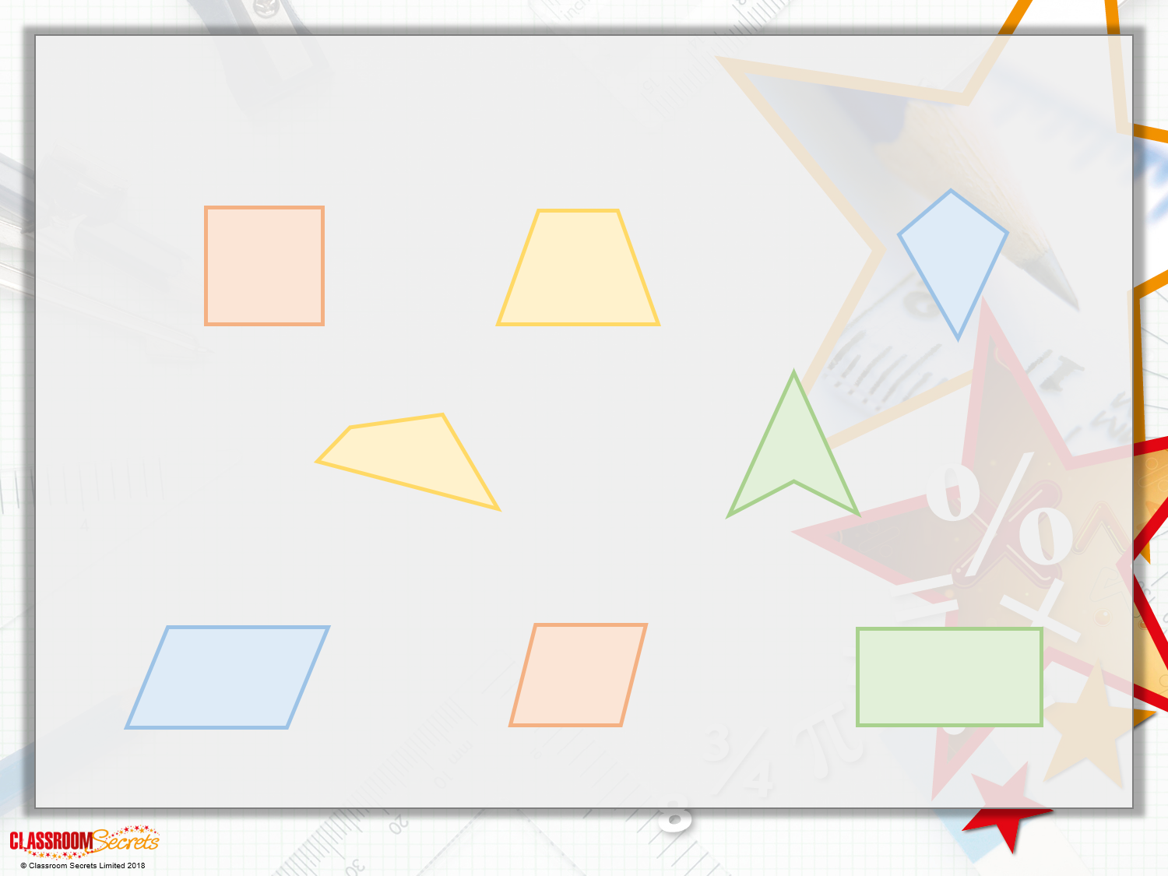
Introduction
The labels have been mixed up. Name each quadrilateral.
arrowhead
irregular
parallelogram
rectangle
kite
rhombus
trapezium
square

Slide 4
Introduction
The labels have been mixed up. Name each quadrilateral.
square
trapezium
kite
irregular
arrowhead
parallelogram
rhombus
rectangle

Slide 5
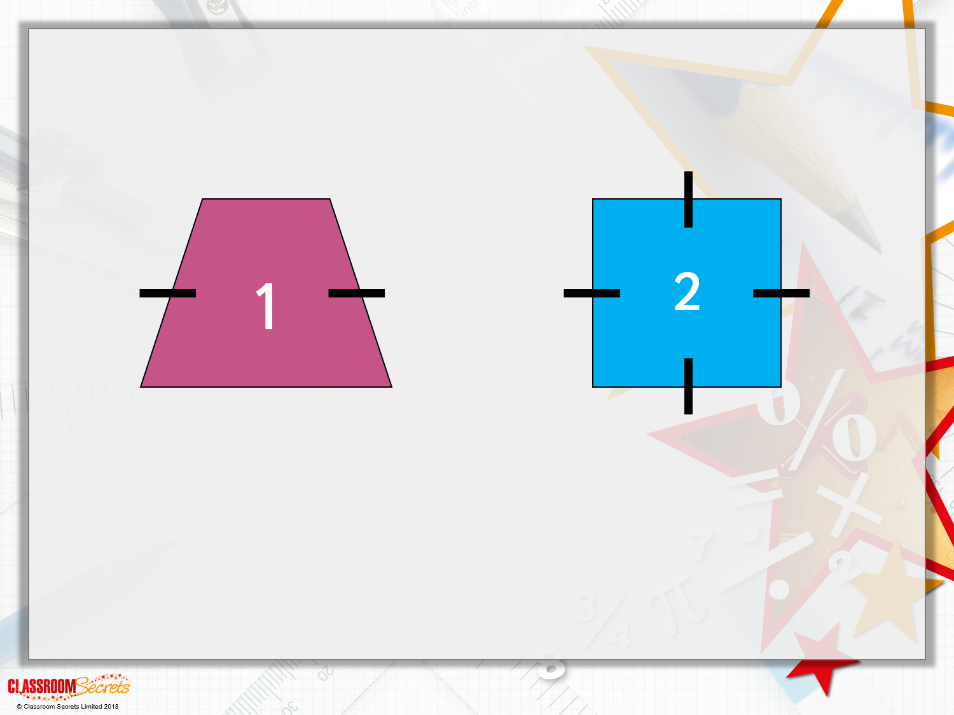
Varied Fluency 1
Find 3 differences and 3 similarities between these two shapes.
What are the names of the shapes?

Slide 6
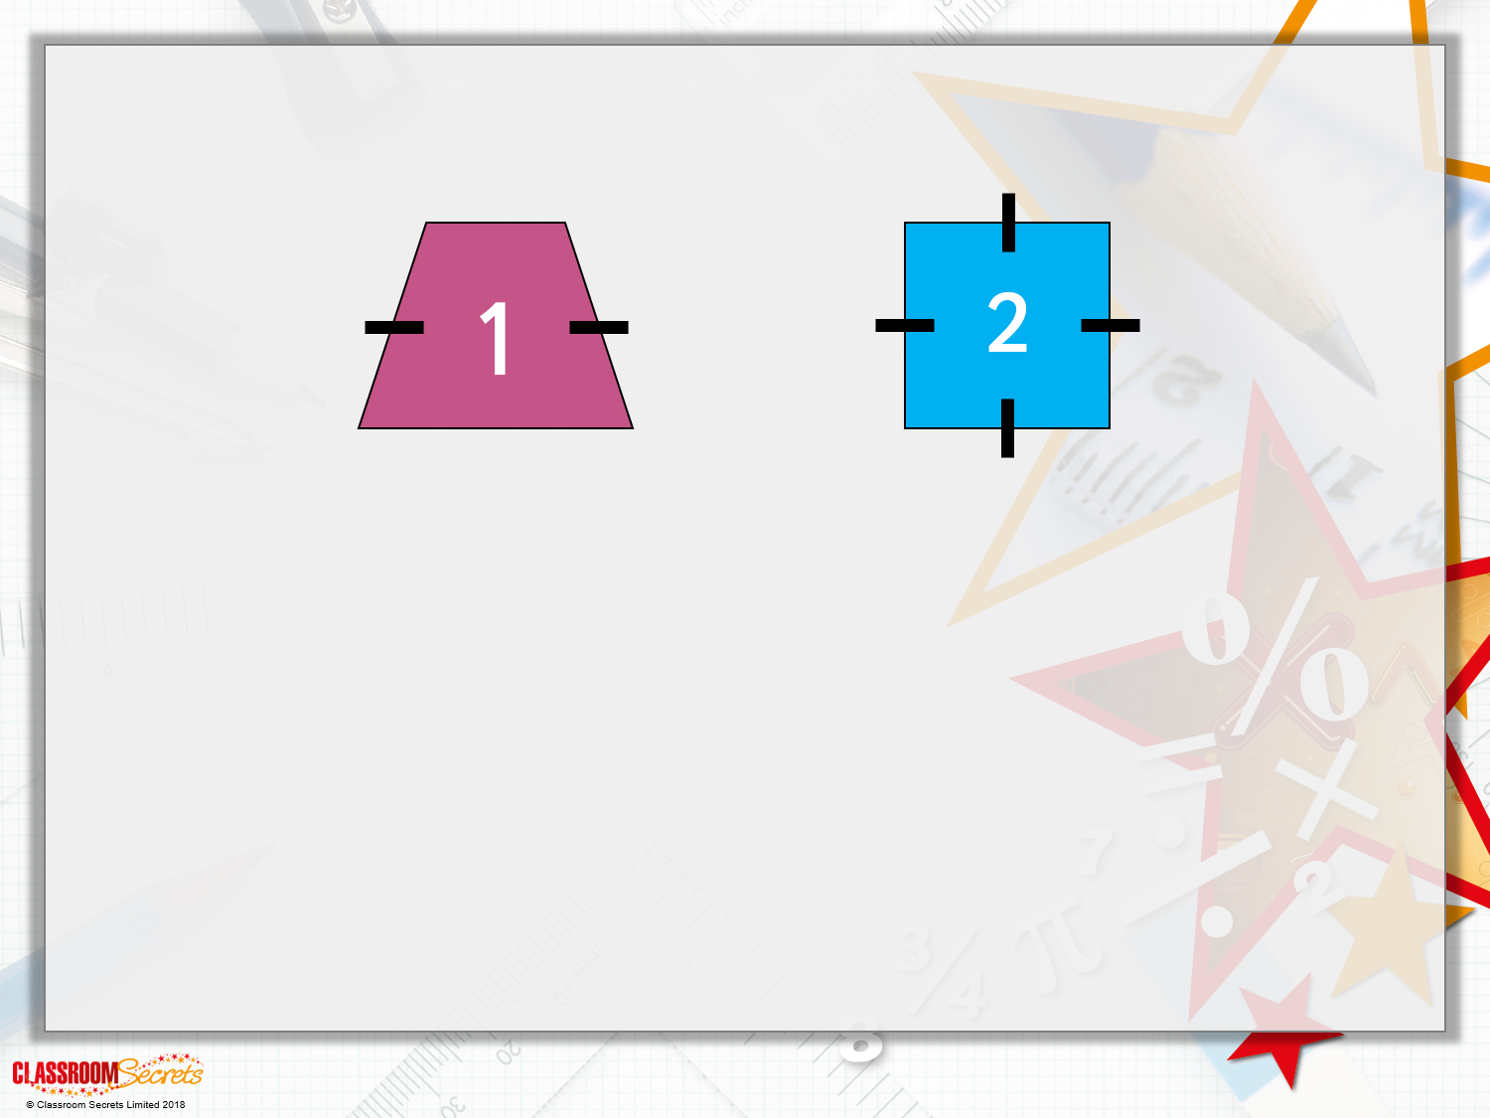
Varied Fluency 1
Find 3 differences and 3 similarities between these two shapes.
Differences:
Shape 1 has 2 acute and 2 obtuse angles, shape 2 has 4 right angles.
Shape 1 has only 2 equal sides, shape 2 has 4 equal sides.
Shape 1 has only one pair of parallel sides, shape 2 has 2 pairs.
Similarities:
Both shapes have four sides.
Both shapes have interior angles that add up to 360º.
Both shapes can be dissected into triangles.
What are the names of the shapes?
Trapezium and Square

Slide 7
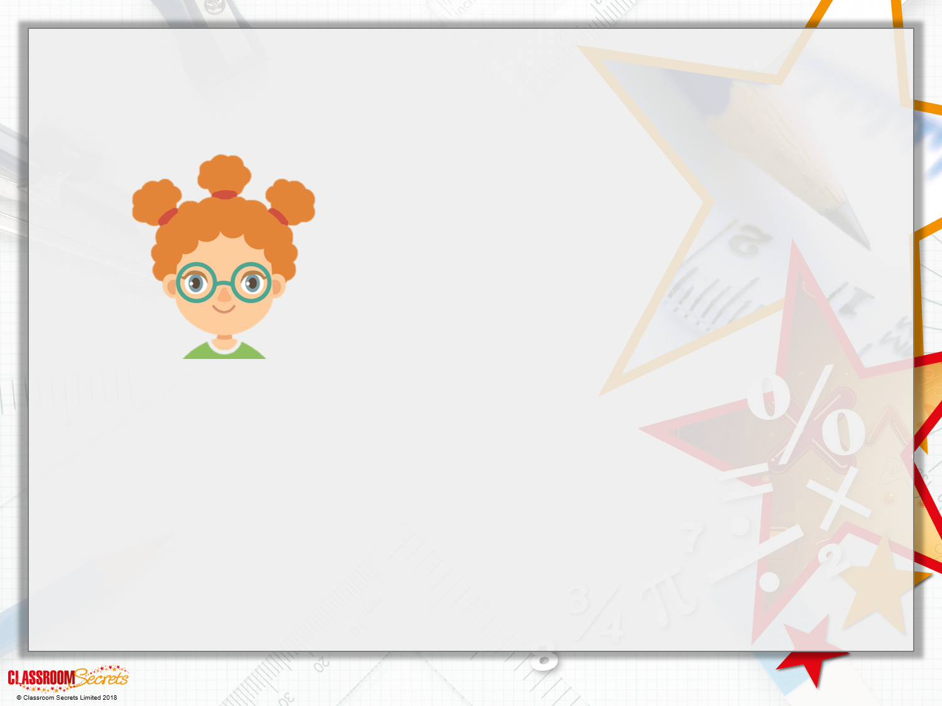
Varied Fluency 2
Millie says,
Is she correct?
Quadrilaterals always have 4 angles of 90º

Slide 8
Varied Fluency 2
Millie says,
Is she correct?
I know Millie is incorrect because...
Quadrilaterals always have 4 angles of 90º

Slide 9
Varied Fluency 2
Millie says,
Is she correct?
I know Millie is incorrect because squares and rectangles have angles of 90º, however other quadrilaterals have acute and obtuse angles, such as:
Quadrilaterals always have 4 angles of 90º

Slide 10
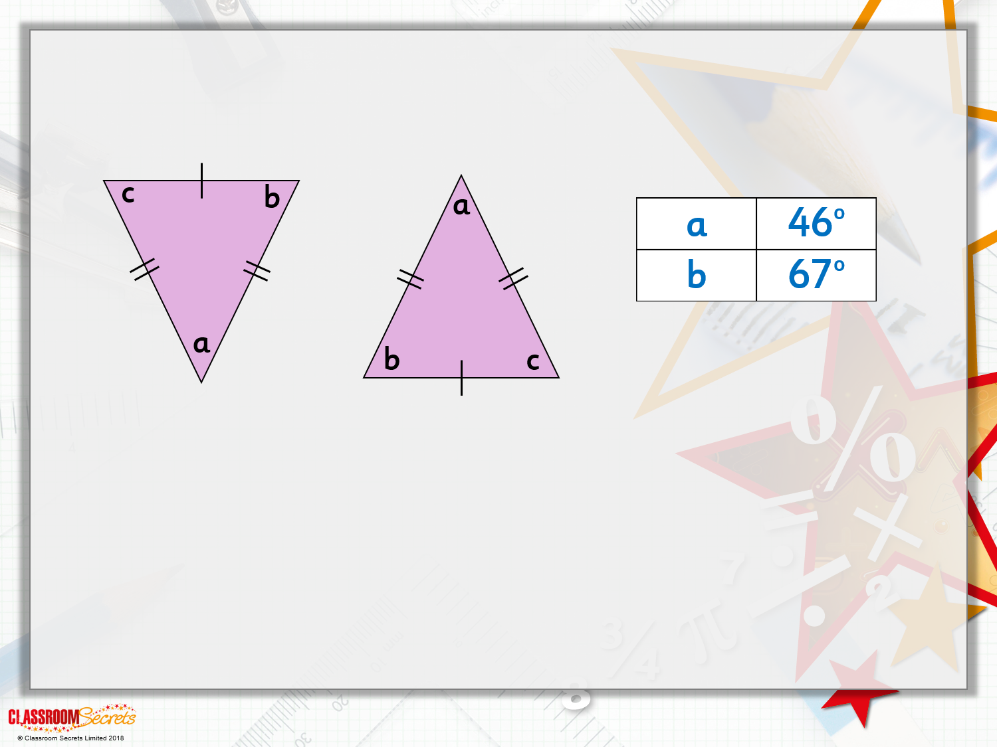
Varied Fluency 3
These two triangles are used to make a quadrilateral.
Calculate the size of the angles of the quadrilateral.

Slide 11
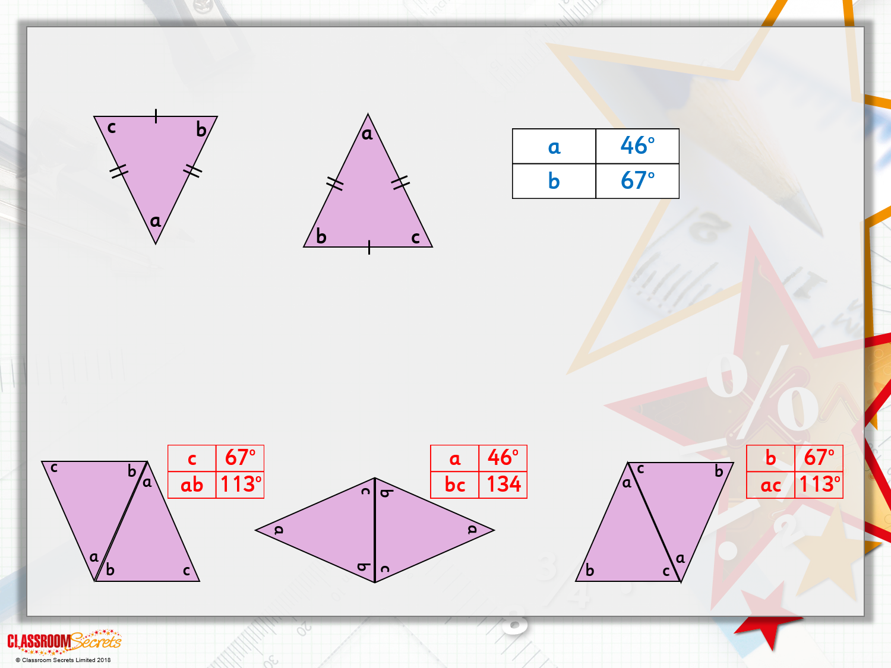
Varied Fluency 3
These two triangles are used to make a quadrilateral.
Calculate the size of the angles of the quadrilateral.
The markings tell us the triangle is isosceles; it has 2 equal sides and 2 equal angles. Which 2 angles will be equal? (b and c)
If a = 46º what would b and c equal? (180º – 46º) ÷ 2 = 67º
Create quadrilaterals and calculate angles by adding.

Slide 12
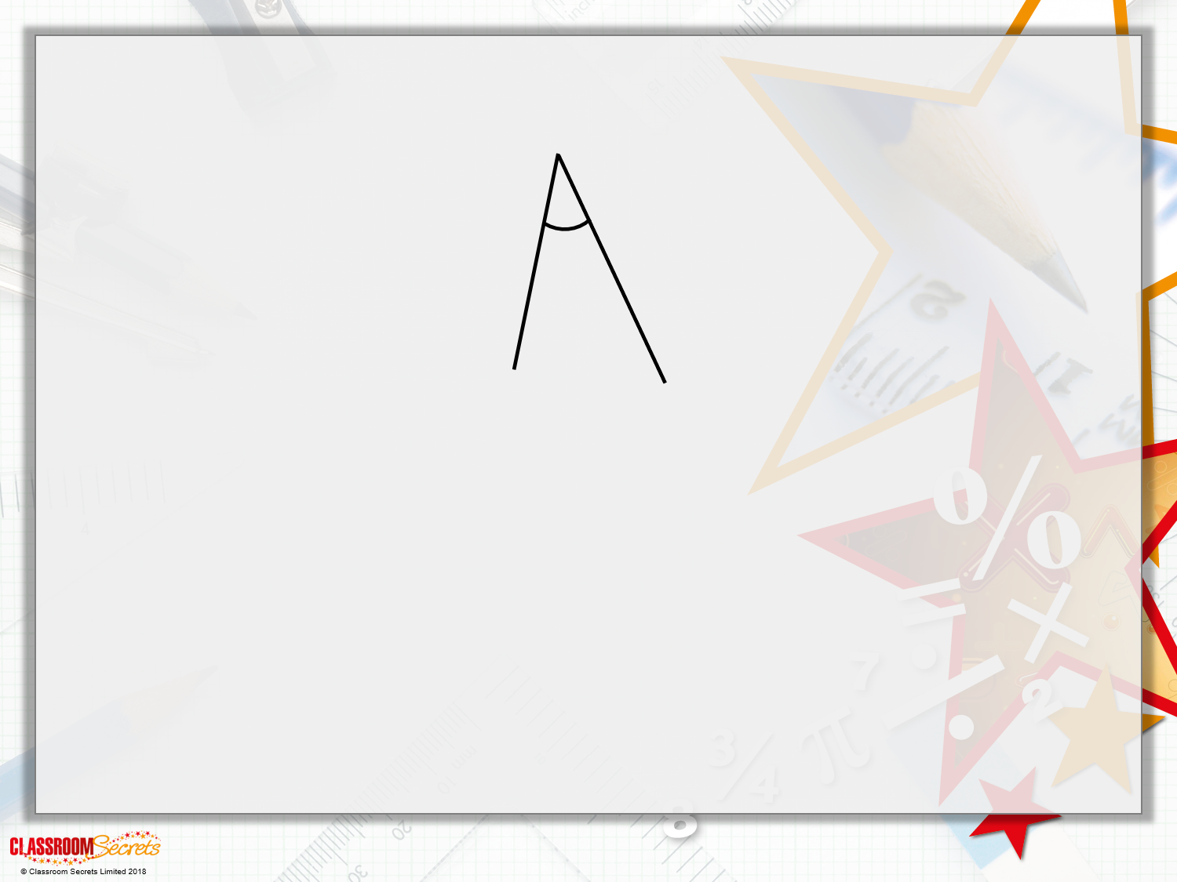
Varied Fluency 4
Complete the drawing to create a quadrilateral.
Label all the angles, e.g. O: obtuse; A: acute; RA: right angle; R: reflex.

Slide 13
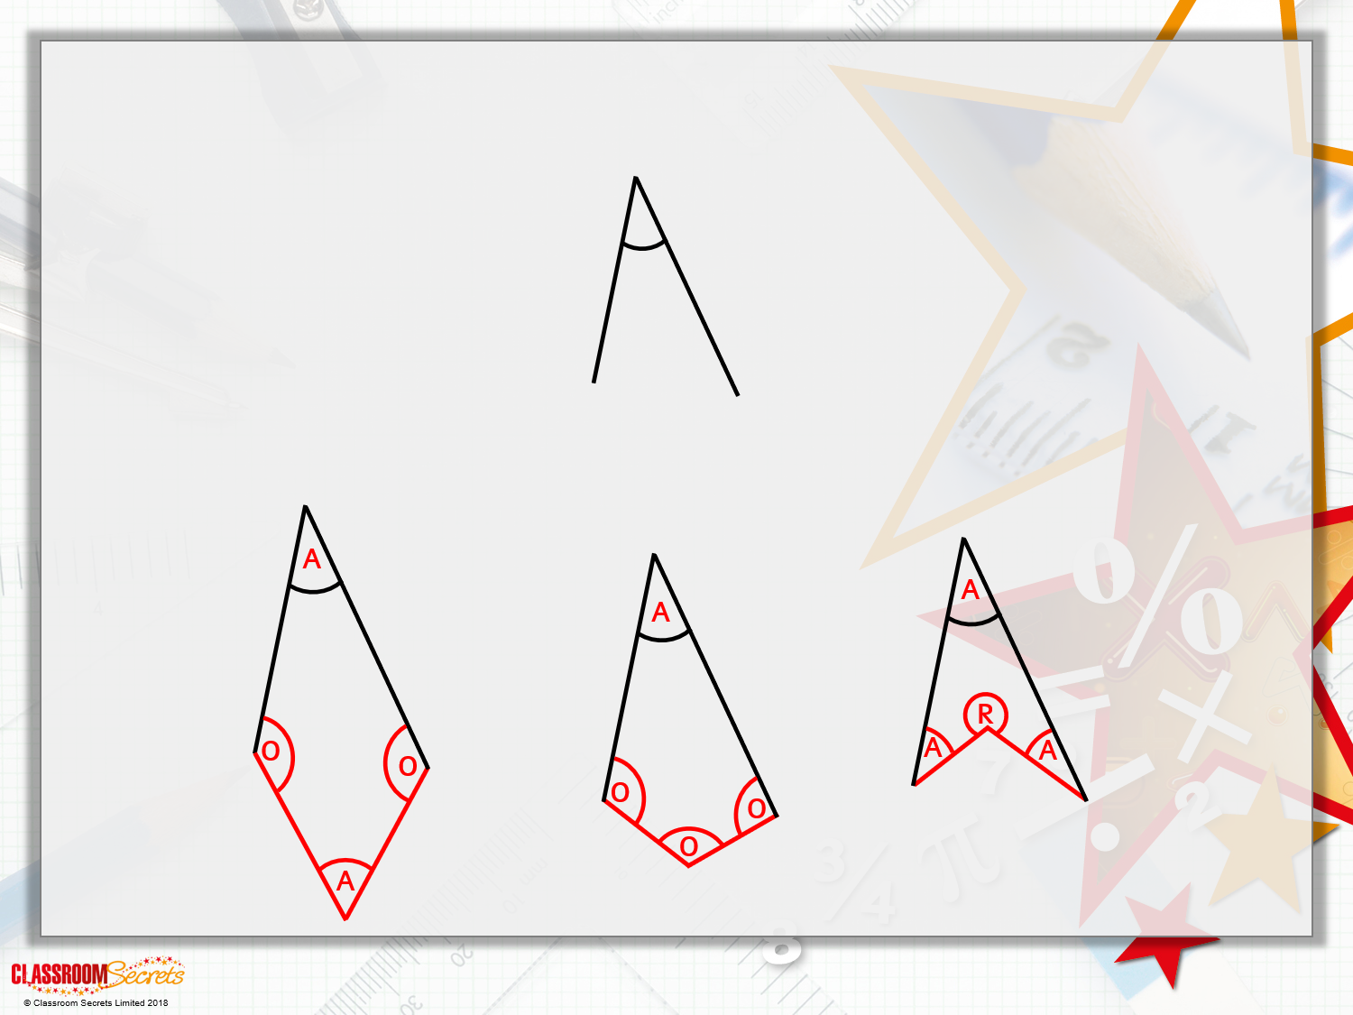
Varied Fluency 4
Complete the drawing to create a quadrilateral.
Label all the angles, e.g. O: Obtuse; A: Acute; RA: Right Angle; R: Reflex.
Various answers, for example:

Slide 14
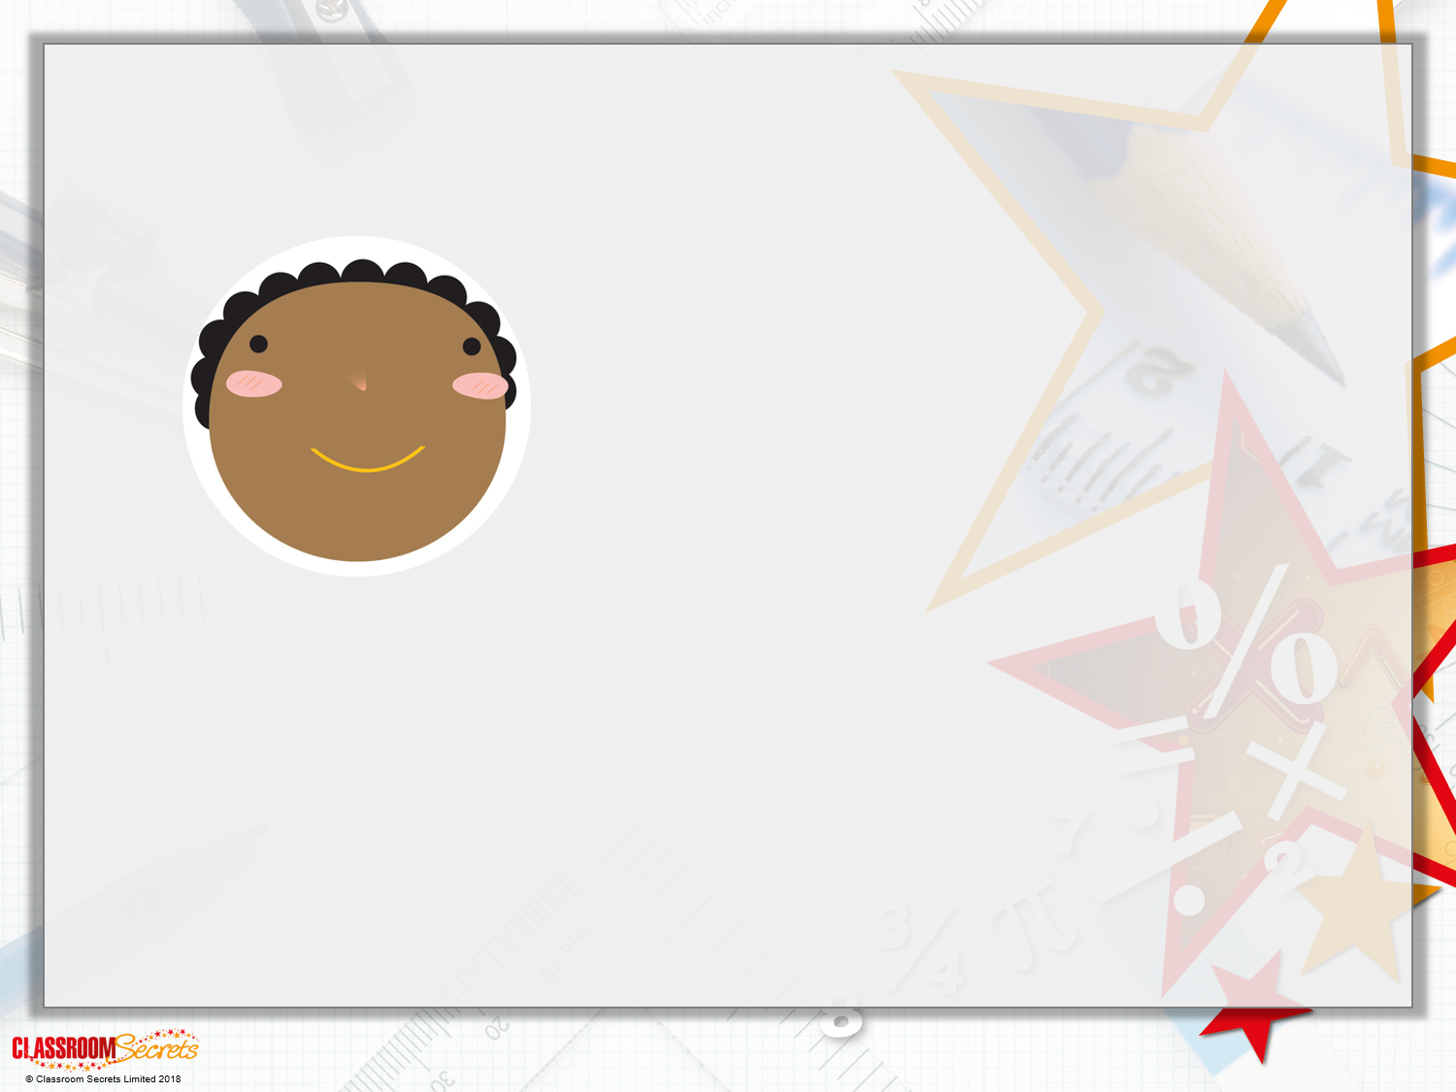
Reasoning 1
True or false?
Explain your answer.
Quadrilaterals always have 2 acute and 2 obtuse angles.

Slide 15
Reasoning 1
True or false?
Explain your answer.
False, because...
Quadrilaterals always have 2 acute and 2 obtuse angles.

Slide 16
Reasoning 1
True or false?
Explain your answer.
False, because quadrilaterals can have a variety of angle combinations e.g. a square has 4 right angles as does a rectangle. An arrowhead can have three acute angles and a reflex angle.
Quadrilaterals always have 2 acute and 2 obtuse angles.

Slide 17
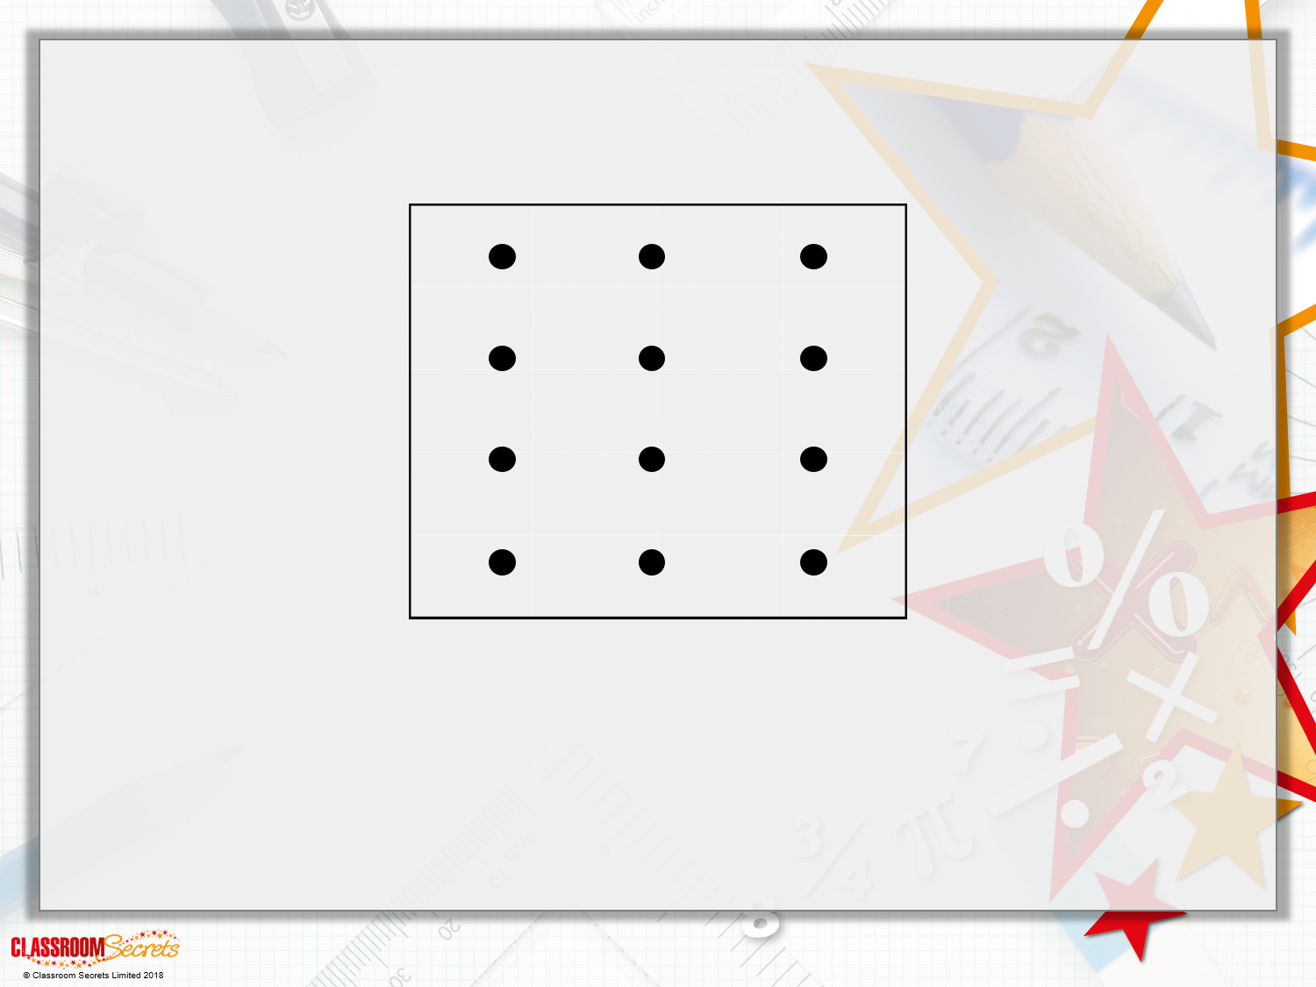
Problem Solving 1
Draw 2 different quadrilaterals on the geoboard below.
Shapes may share pegs but sides should not cross.

Slide 18
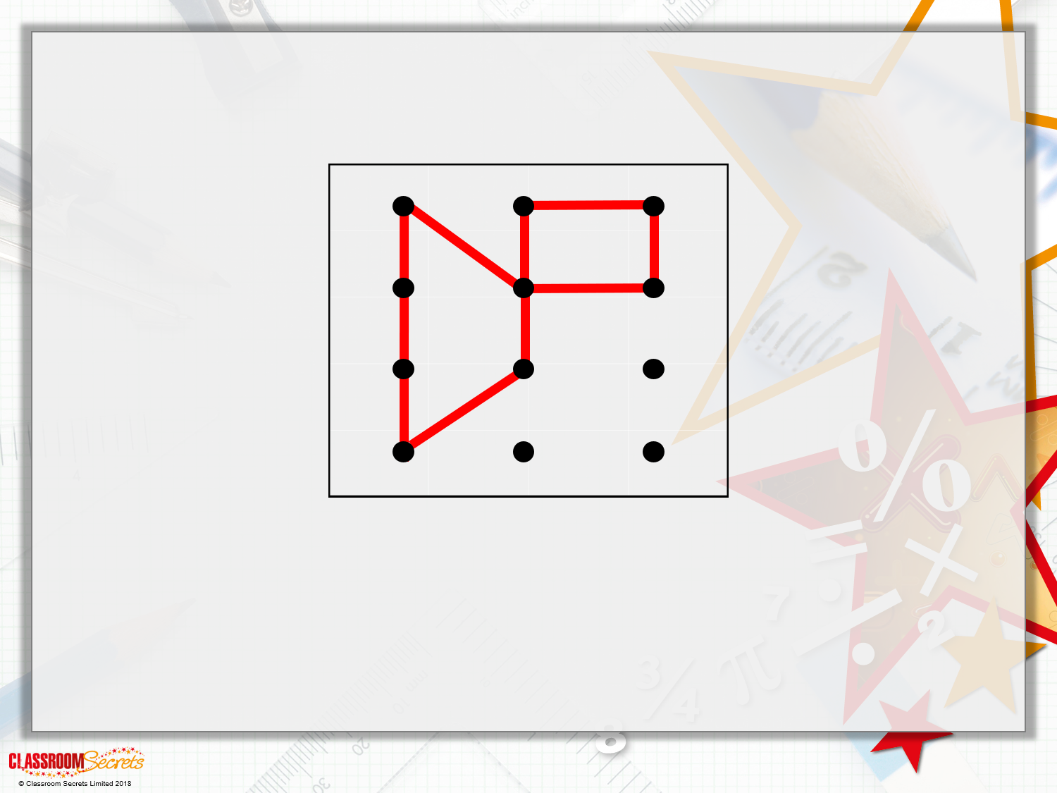
Problem Solving 1
Draw 2 different quadrilaterals on the geoboard below.
Example:
Shapes may share pegs but sides should not cross.

Slide 19
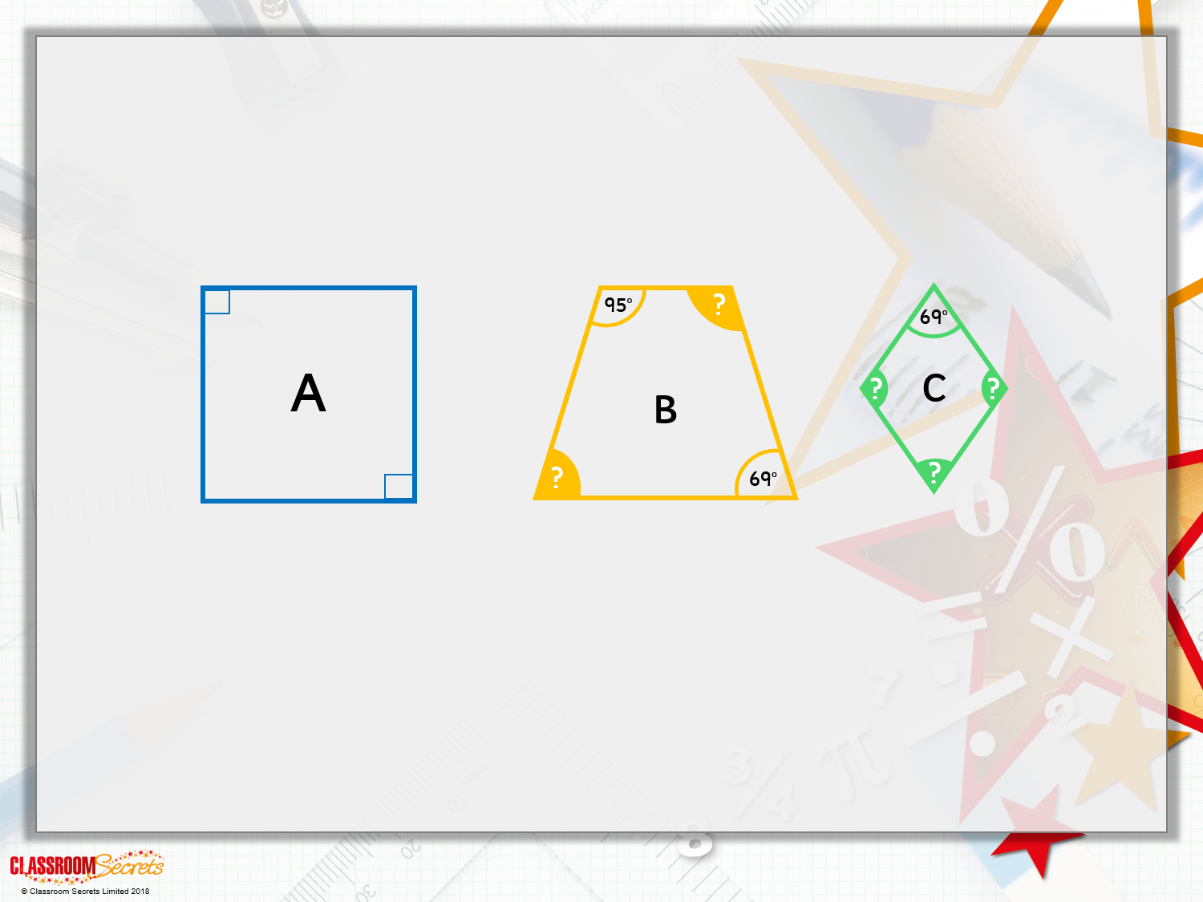
Problem Solving 2
Find the shape being described.
The shape has 4 lines of symmetry. All angles are equal and the diagonals intersect to create angles equal to those of the shape.
Calculate the angles marked with a ‘?’.

Slide 20
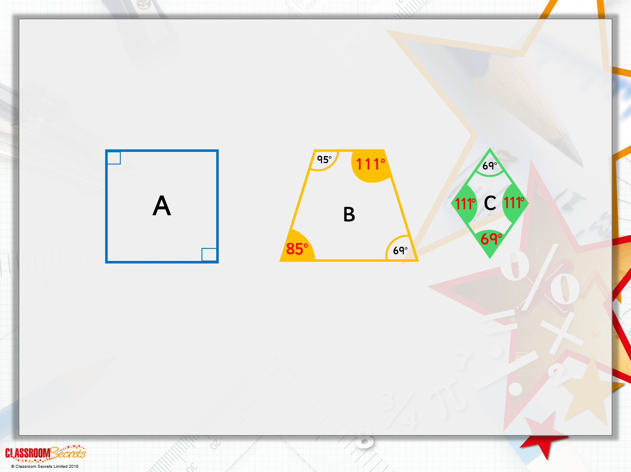
Problem Solving 2
Find the shape being described. Shape A: Square
The shape has 4 lines of symmetry. All angles are equal and the diagonals intersect to create angles equal to those of the shape.
Calculate the angles marked with a ‘?’.
Shape B linked rule: trapezium opposite angles crossing parallel lines have a sum of 180º
Shape C linked rule: opposite angles crossing parallel lines have a sum of 180º, plus opposite internal angles of two crossing parallel lines have a sum of 180.

