Slide 1
Maths Warm Ups
If you would like to warm up your maths brain before you tackle your main task, have a go at the arithmetic questions. There is one set of questions per day and the answers to follow.

Slide 2
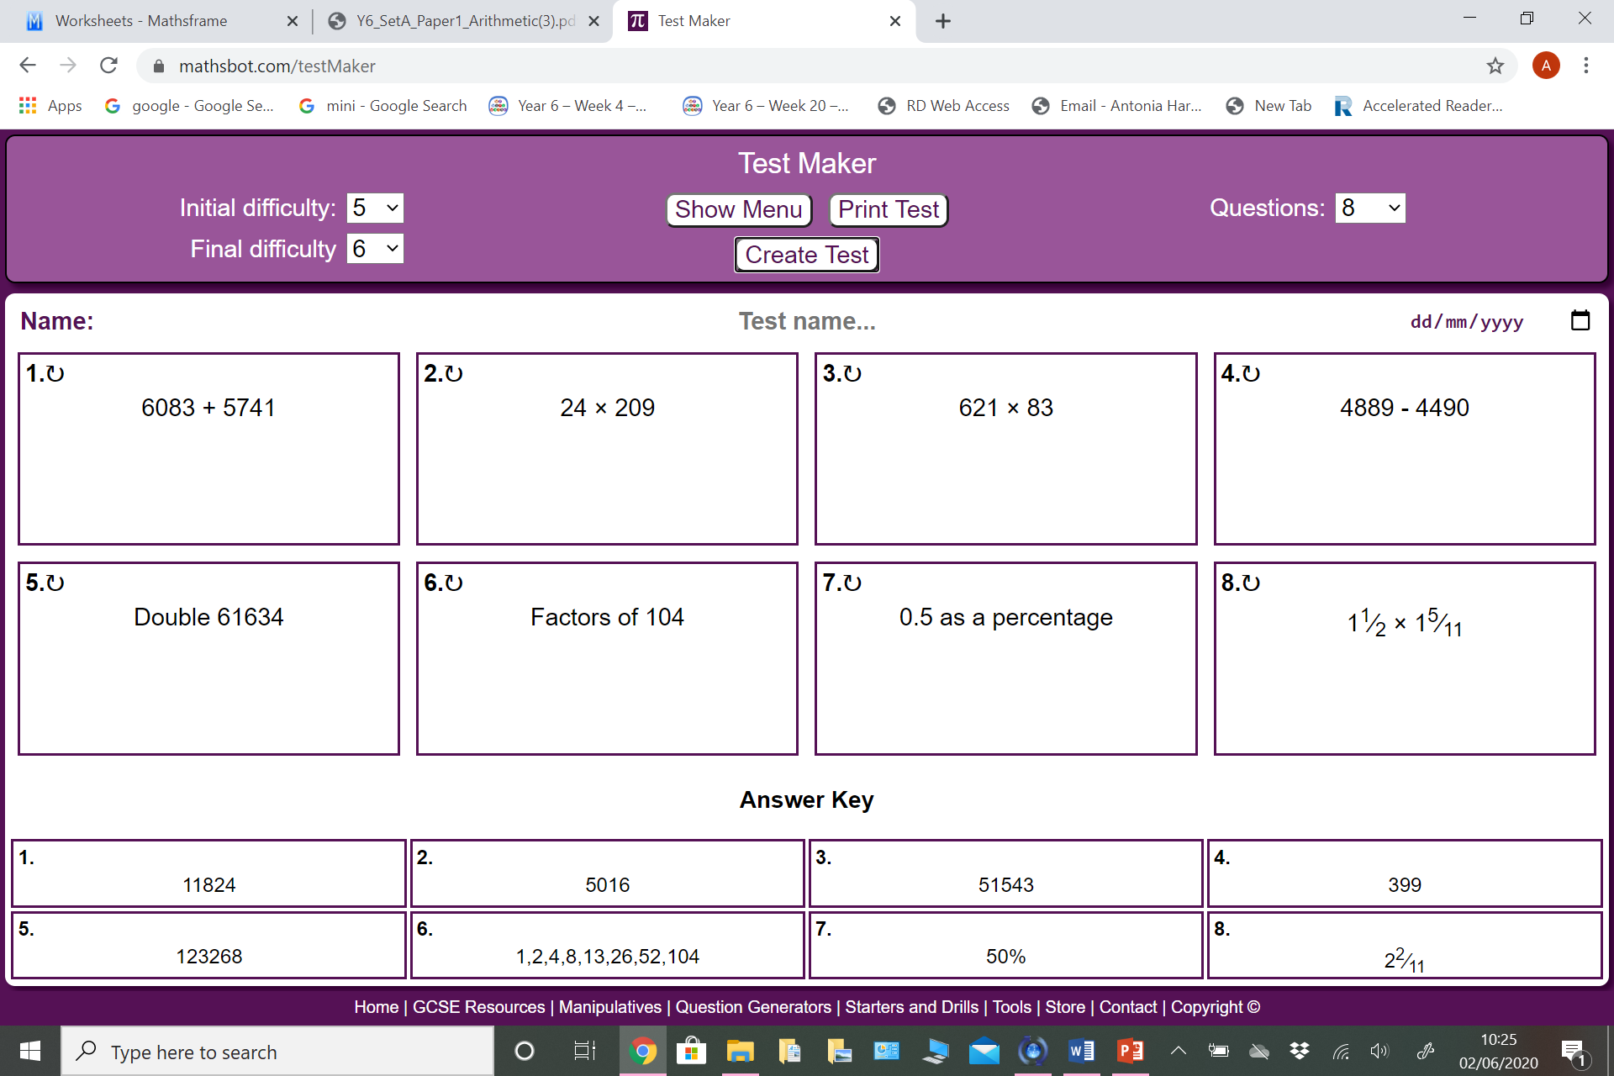
Monday - Questions

Slide 3
Monday - Answers

Slide 4

Tuesday - Questions

Slide 5
Tuesday - Answers

Slide 6

Wednesday - Questions

Slide 7
Wednesday - Answers

Slide 8
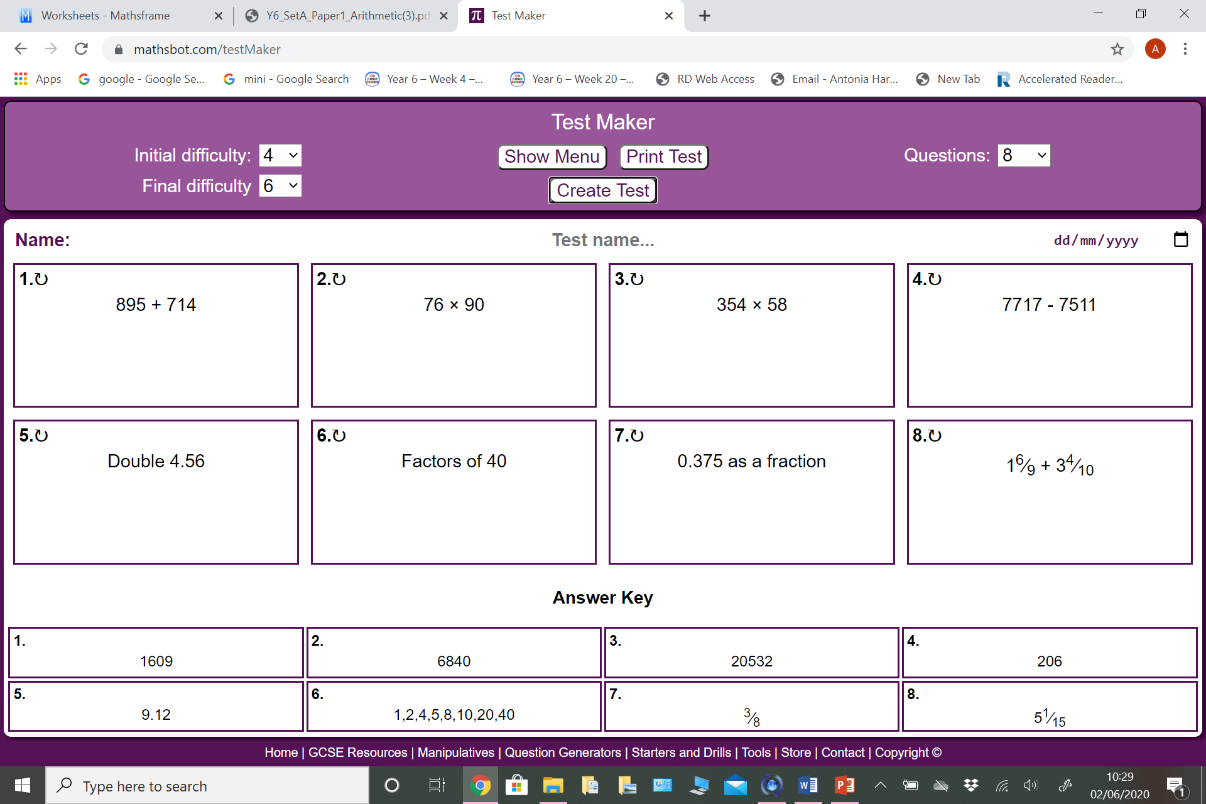
Thursday - Questions

Slide 9
Thursday - Answers

