Slide 2
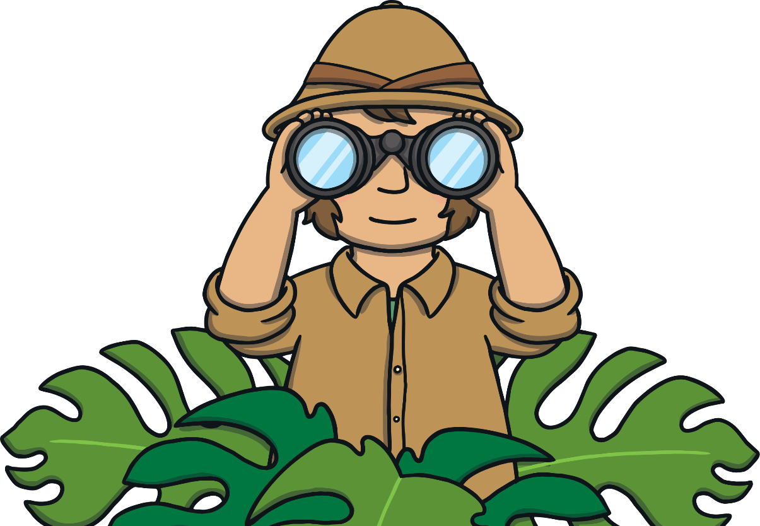
Remember to Practice Safely
Adapt: Make poses easier if your breathing isn’t smooth.
Breath evenly: Take easy breaths in each pose.
Enjoy it: Move in a way that feels good.
Keep safe: Don’t touch others and you support where necessary.

Slide 3
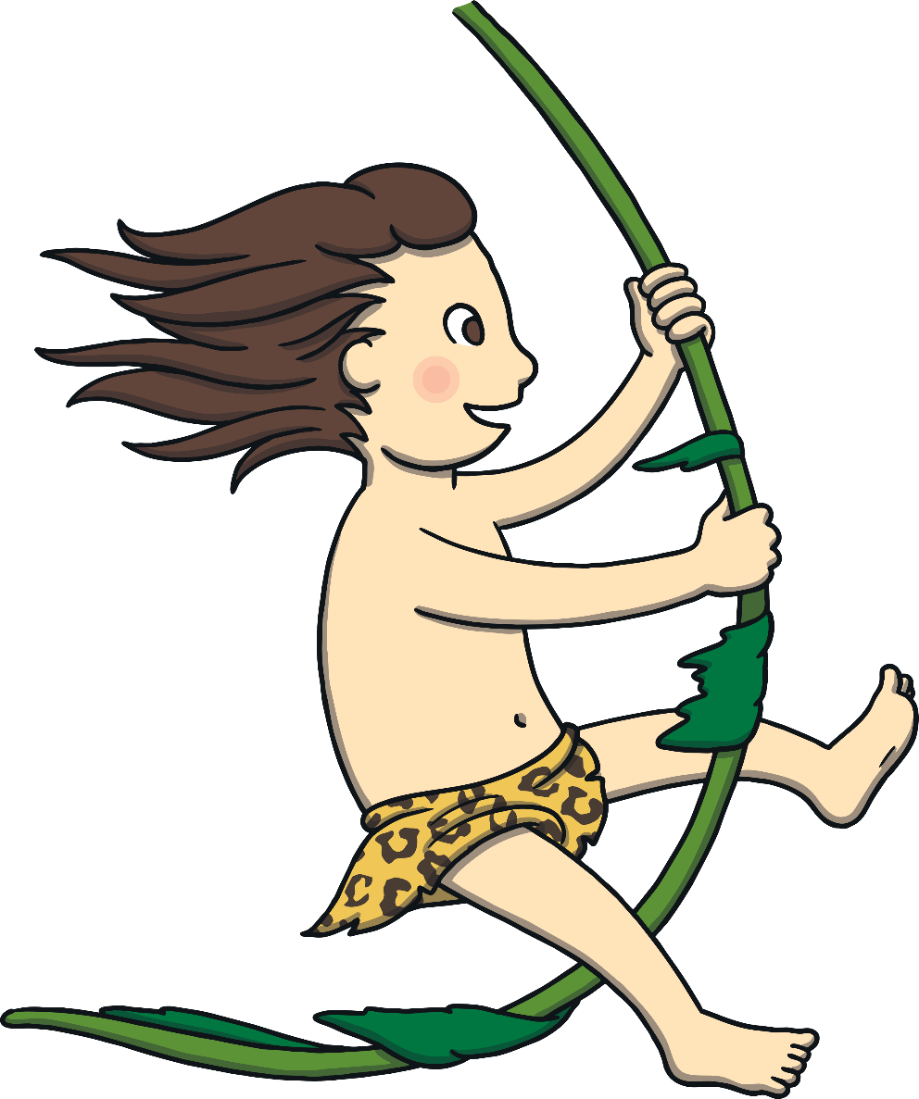
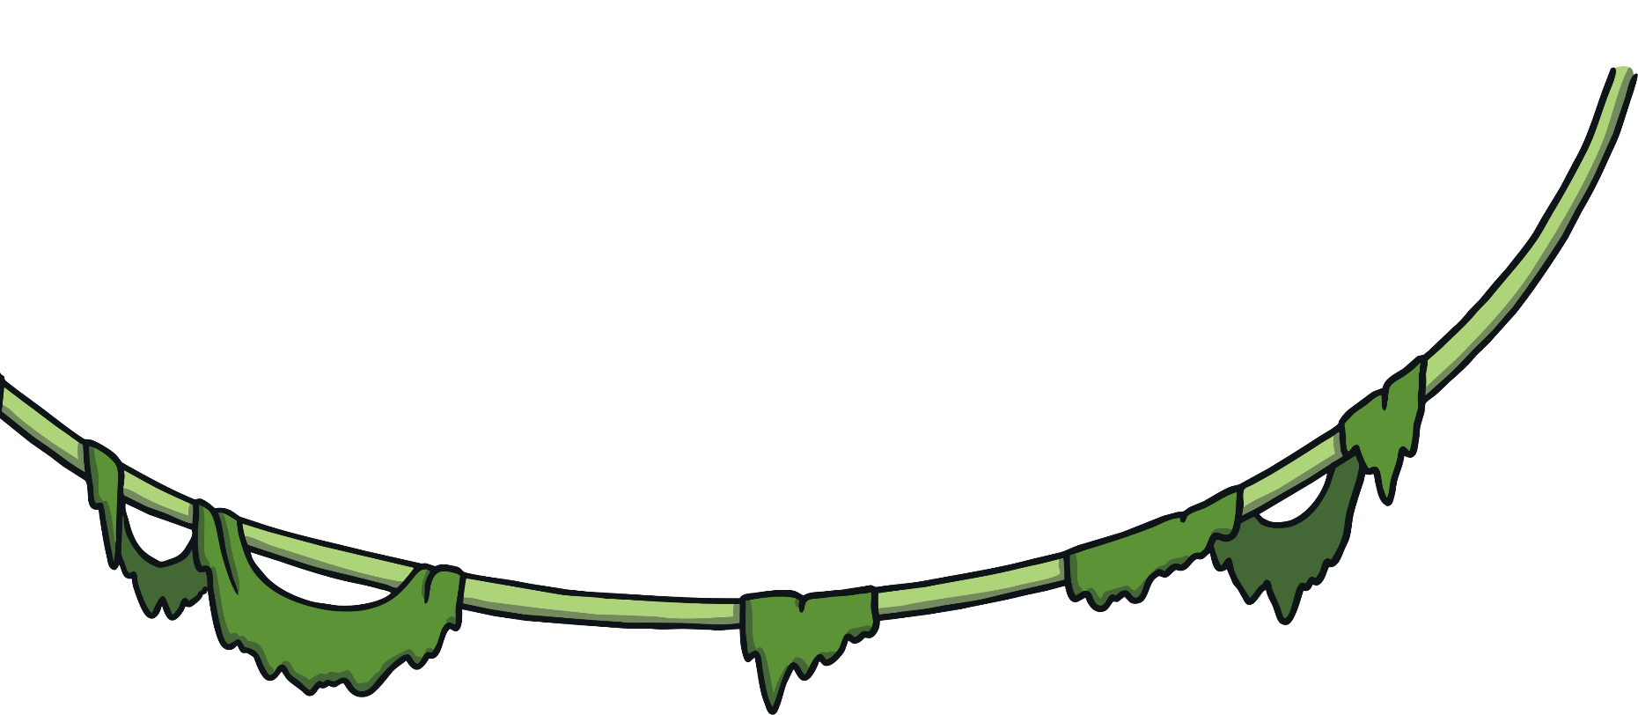
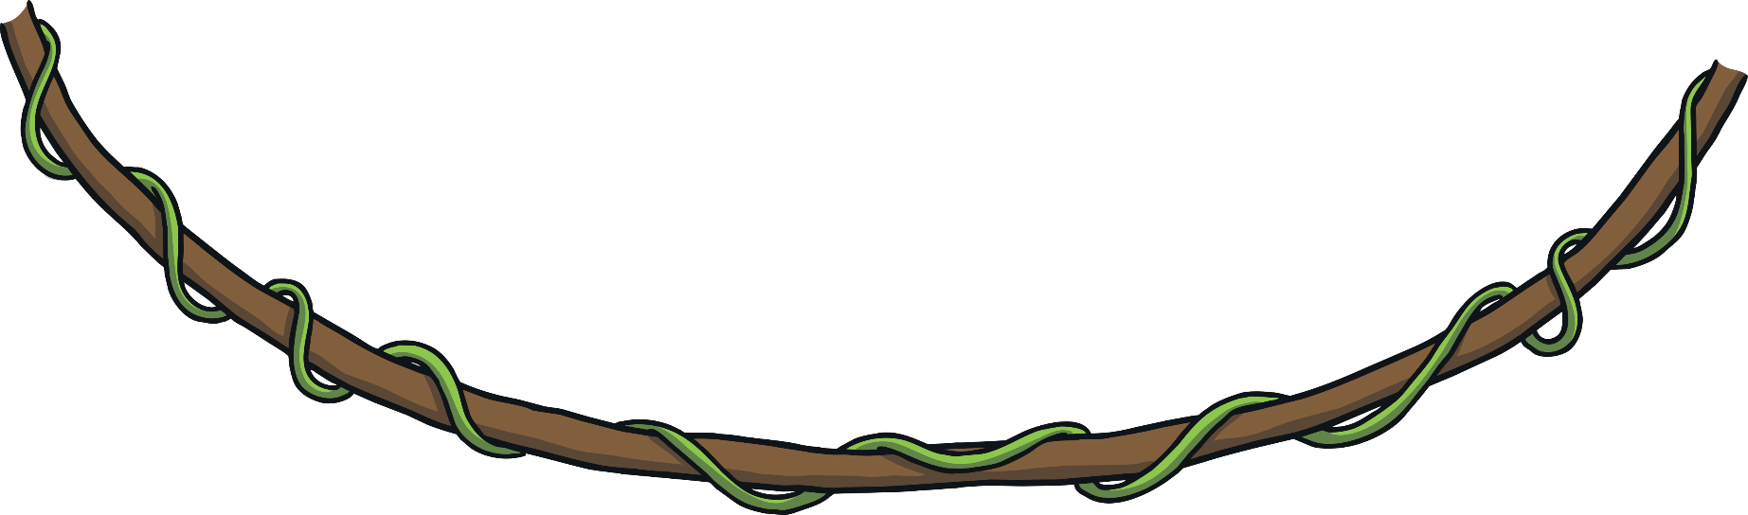
One day, Tarzan was swinging through the jungle to get to his
secret stash of marshmallows.

Slide 4
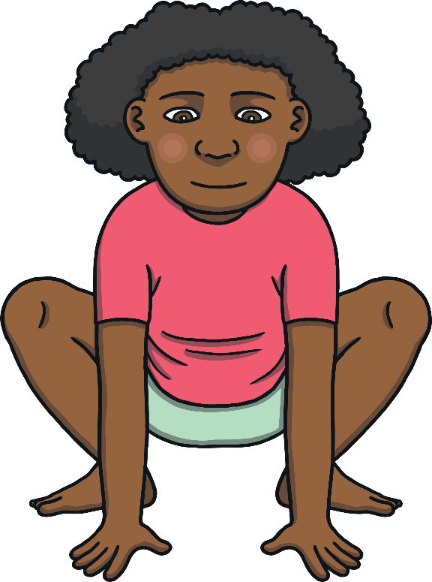
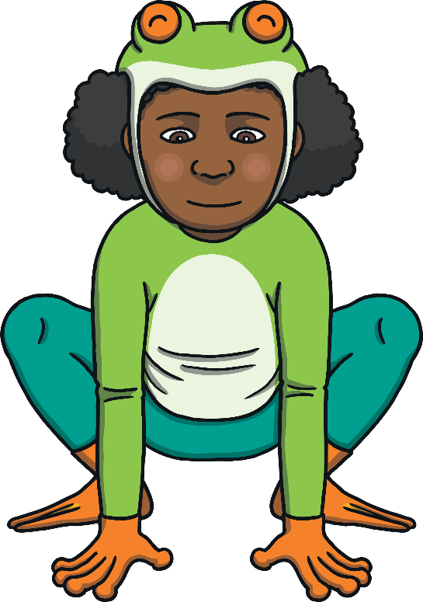
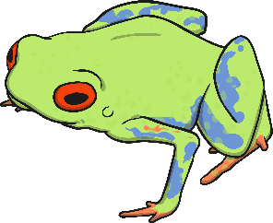
When he got there, there were no marshmallows! “Did you eat them?”
Tarzan asked the frog. “No, maybe it was the lion - she’s a great hunter,”
replied the frog.

Slide 5
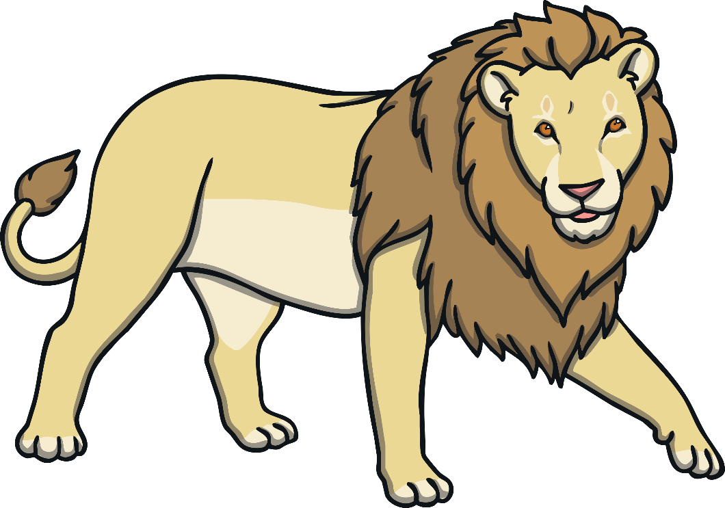
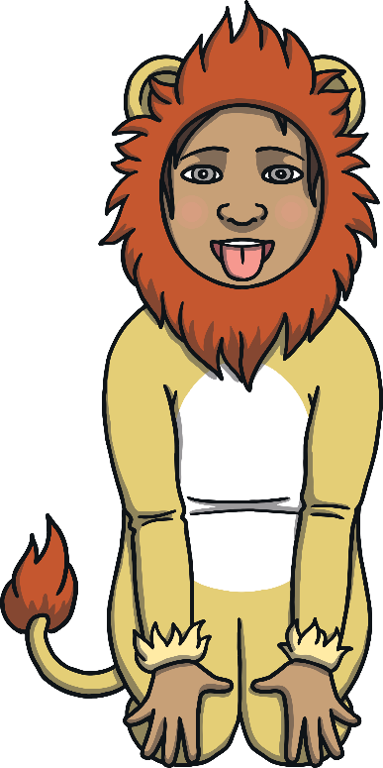
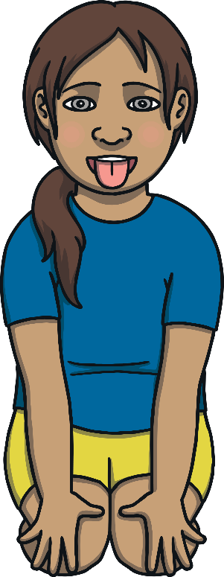
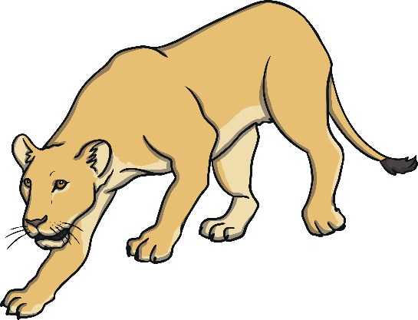
“It wasn’t me,” said the lion, proudly. “Try the crocodile, he’s quick to
snap things up!”

Slide 6
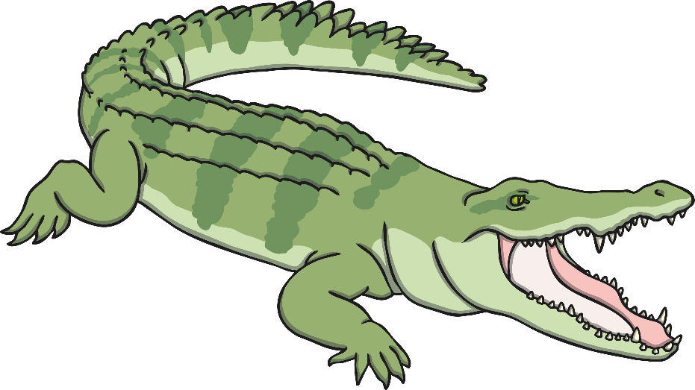
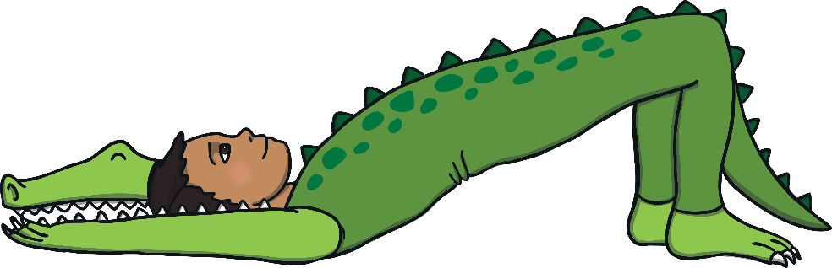
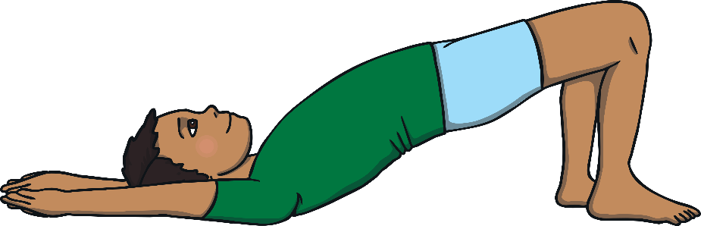
“Not me, no way - I hate them,” said the crocodile. “Try the snake, she can
get into anything.”

Slide 7
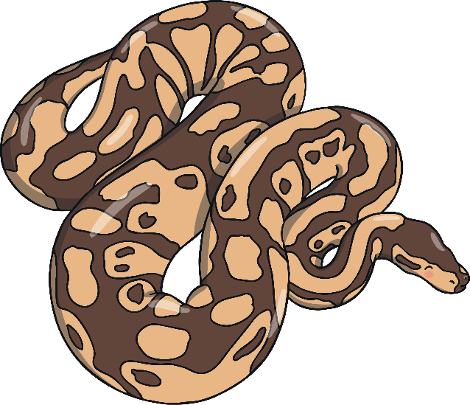
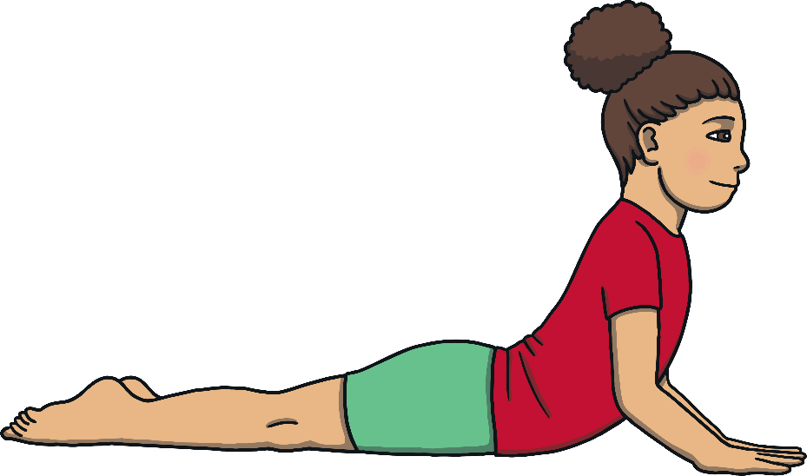
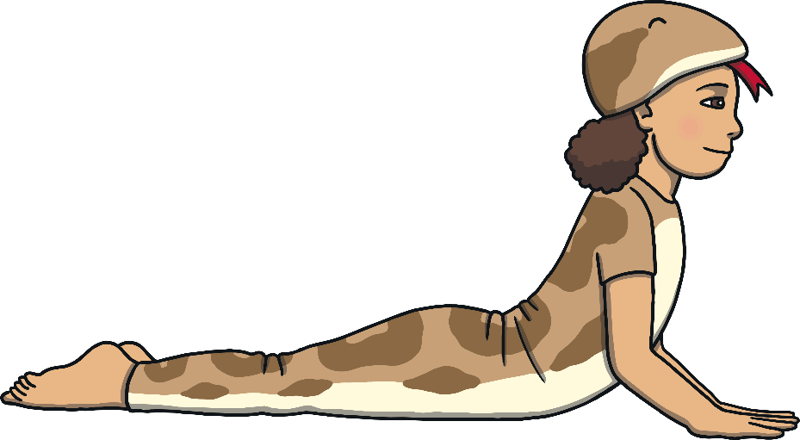
“I could have got the marshmallows, but I didn’t,” said the snake. “Try the giraffe, she can see places that others can’t.”

Slide 8
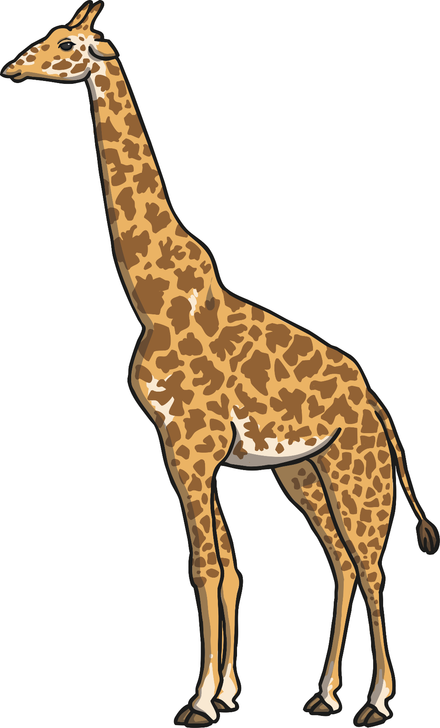
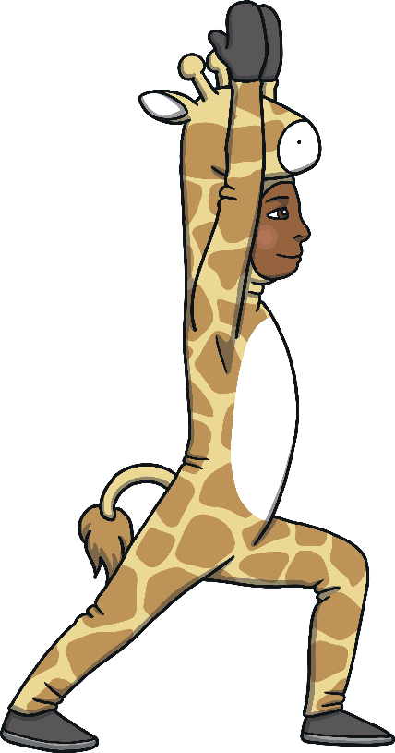
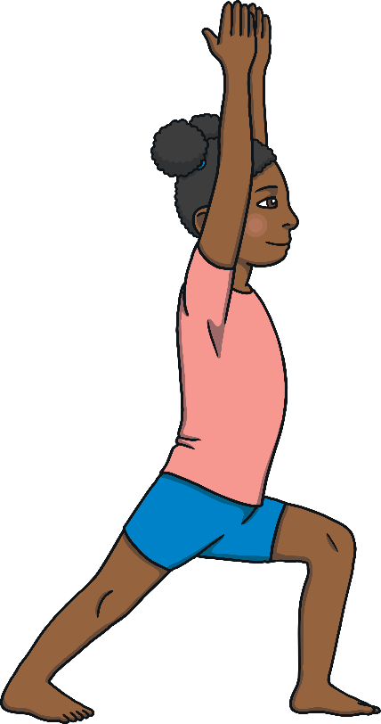
“I cannot believe you think I would do this!” sulked the giraffe and she refused to say anything more.

Slide 9
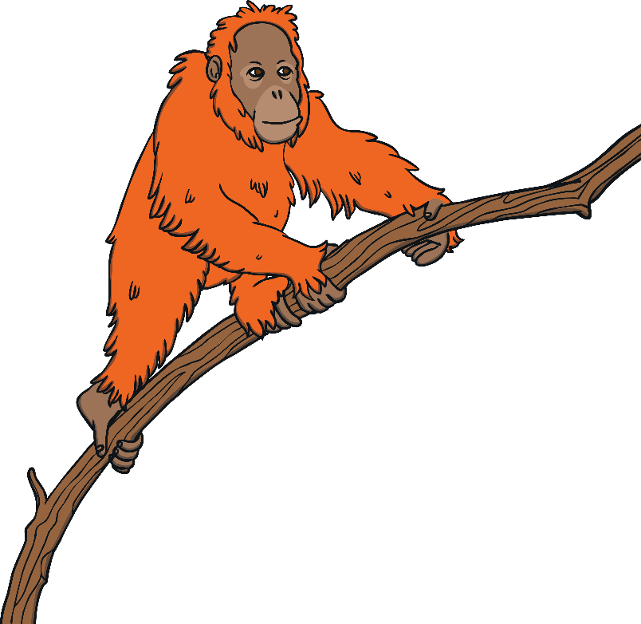
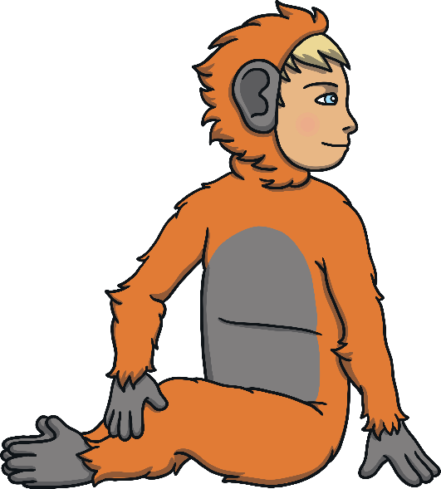
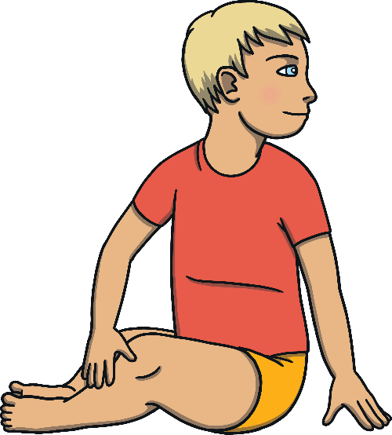
Then, Tarzan decided to ask the orangutan. “No, no, no, I like
liquorice sweets,” said the orangutan. “Although, I did see the
elephant with some marshmallows.”

Slide 10
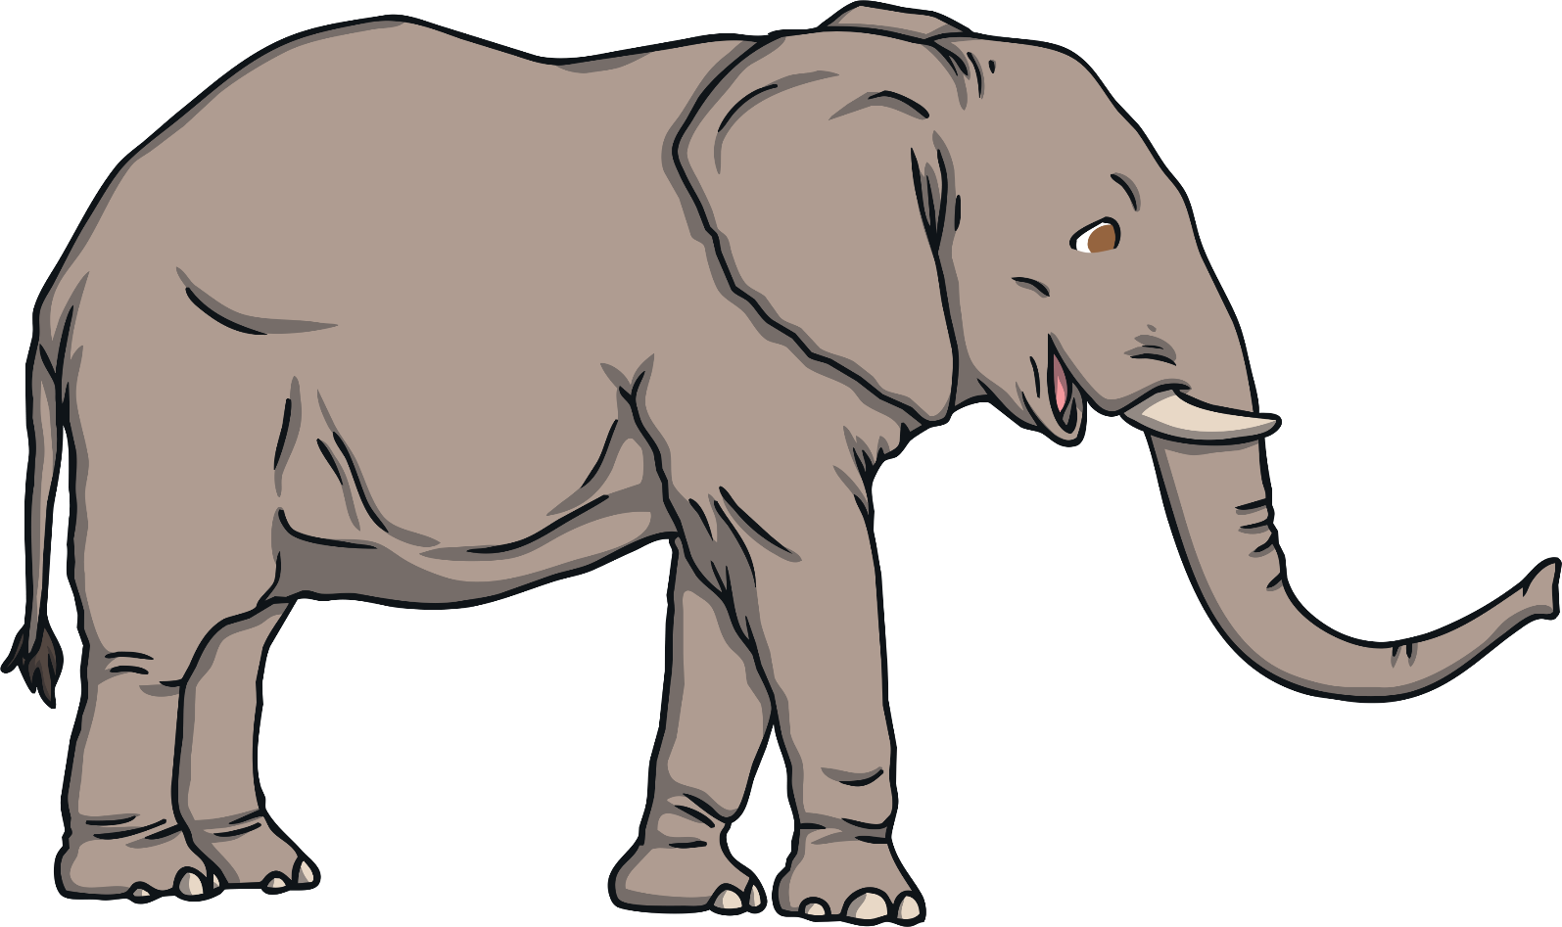
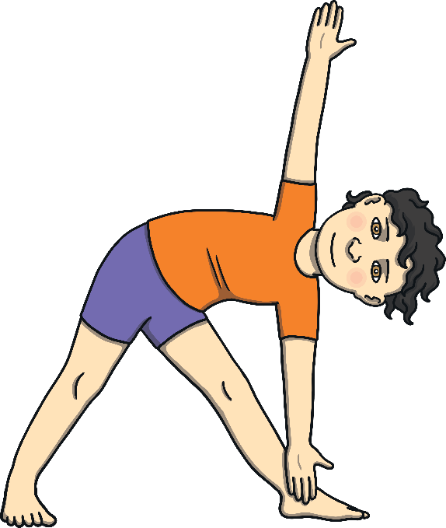
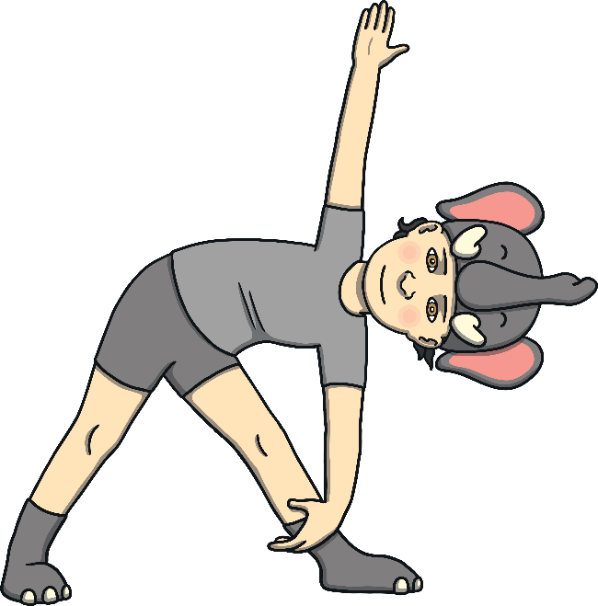

Tarzan found the elephant with a trunkful of marshmallows. “I found these and I was looking for you, Tarzan, as I know how much you like them,”
said the elephant.

Slide 11
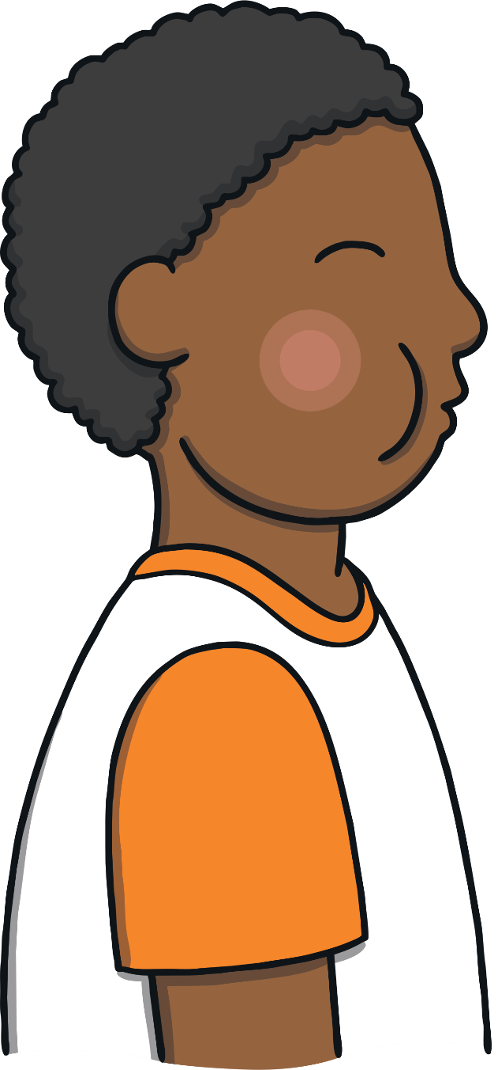
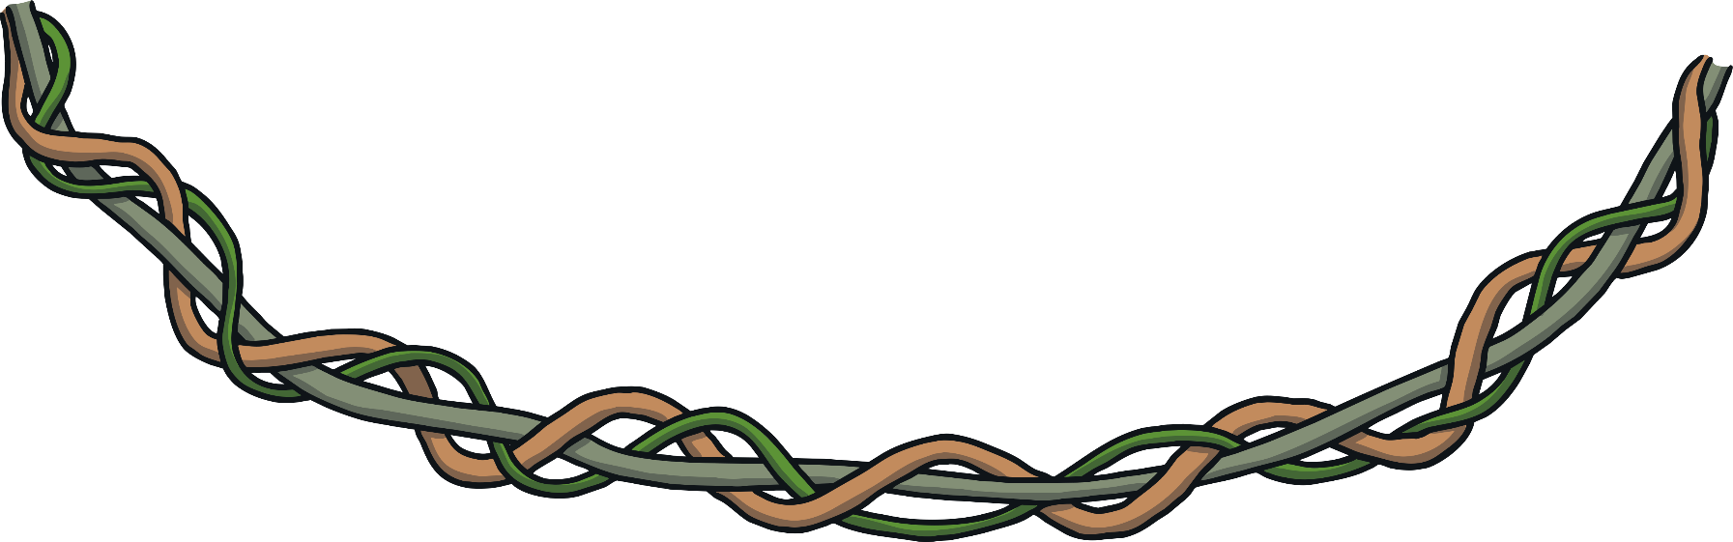
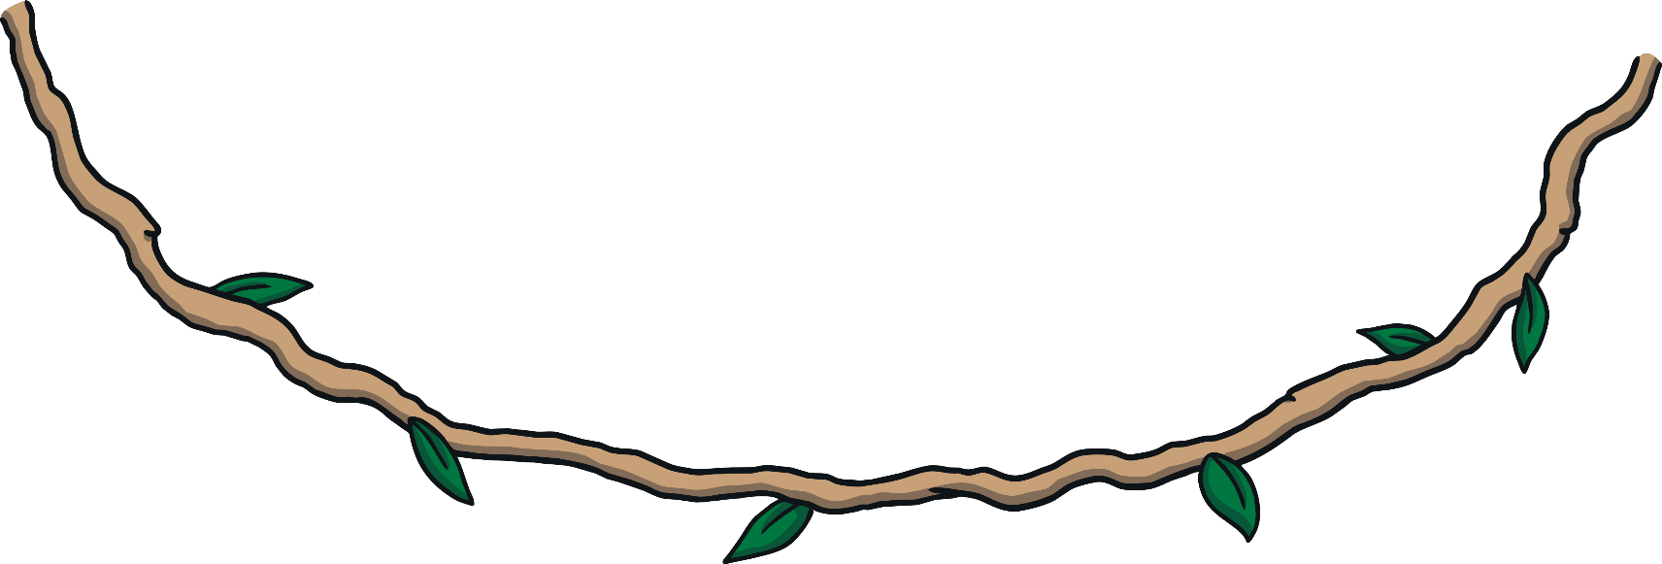
Tarzan was so delighted, he yodelled.

Slide 12
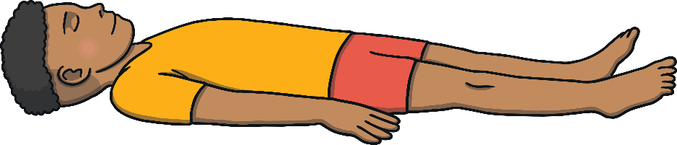


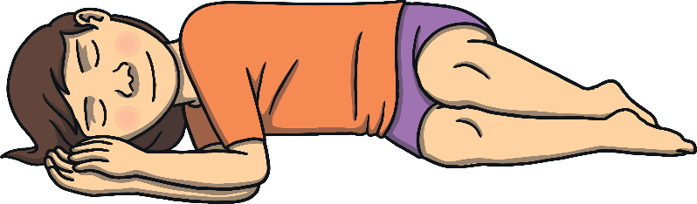

Tarzan shared his marshmallows with the elephant and then they both had a happy nap.

Slide 13

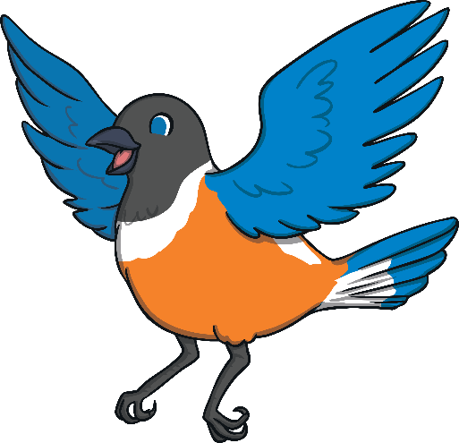


As they napped, the birds told them a beautiful story.

Slide 14
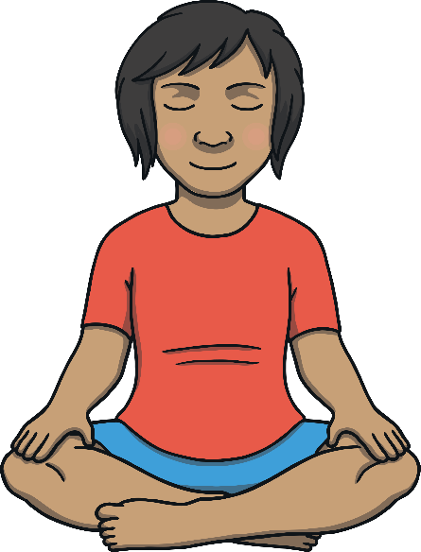
After the story, Tarzan was so relaxed, he decided to sit and be happy.

Slide 15

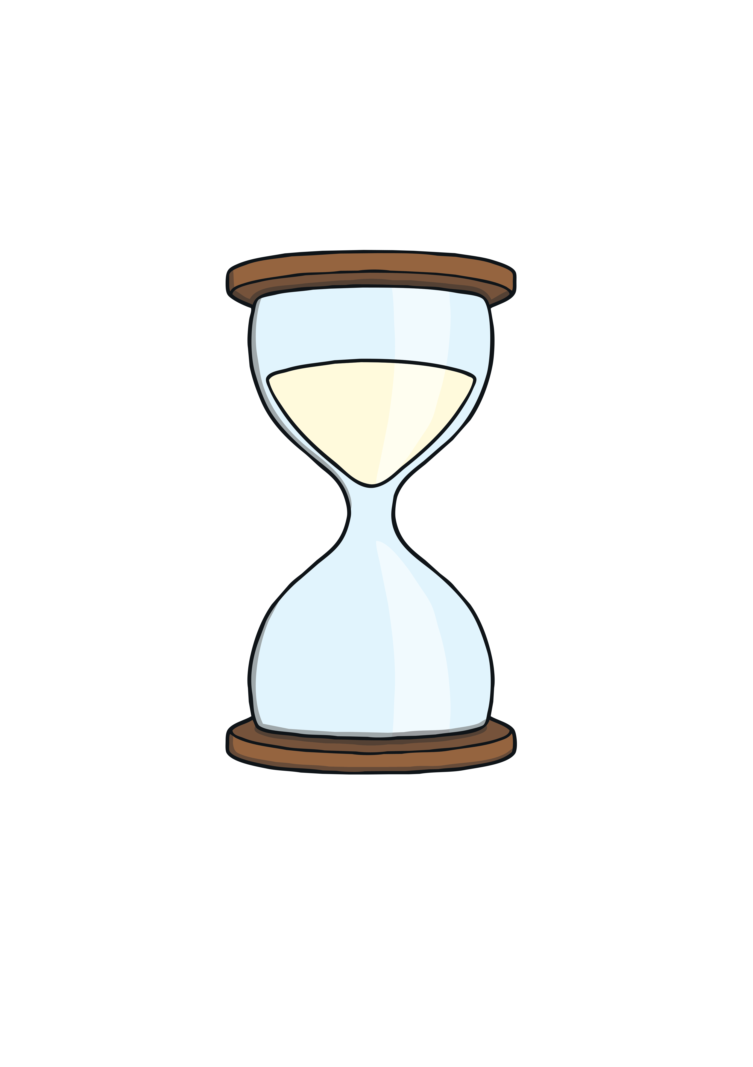
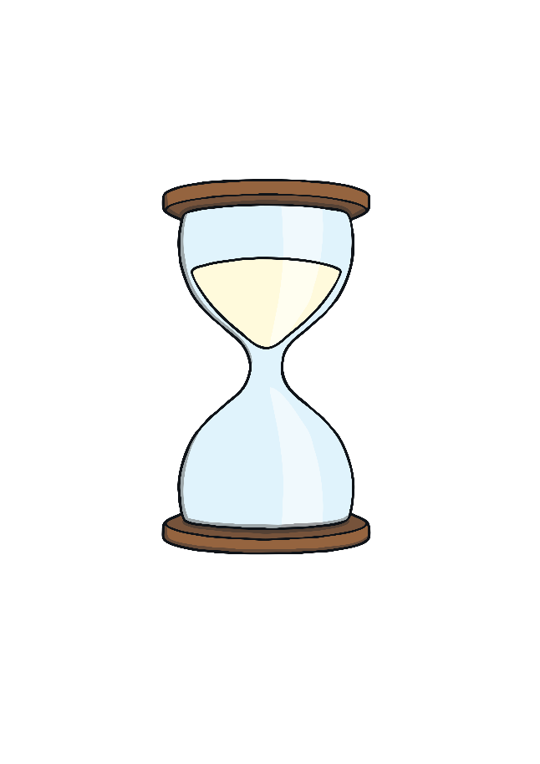
Start Timer

Slide 16
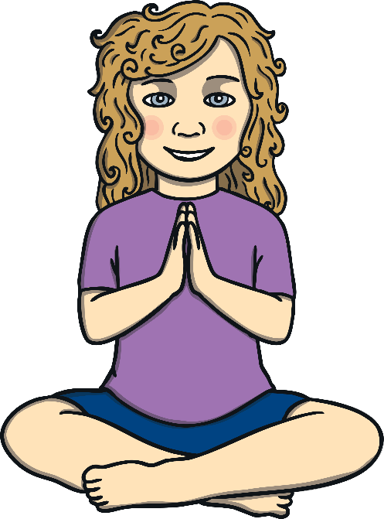
Namaste

