Slide 1
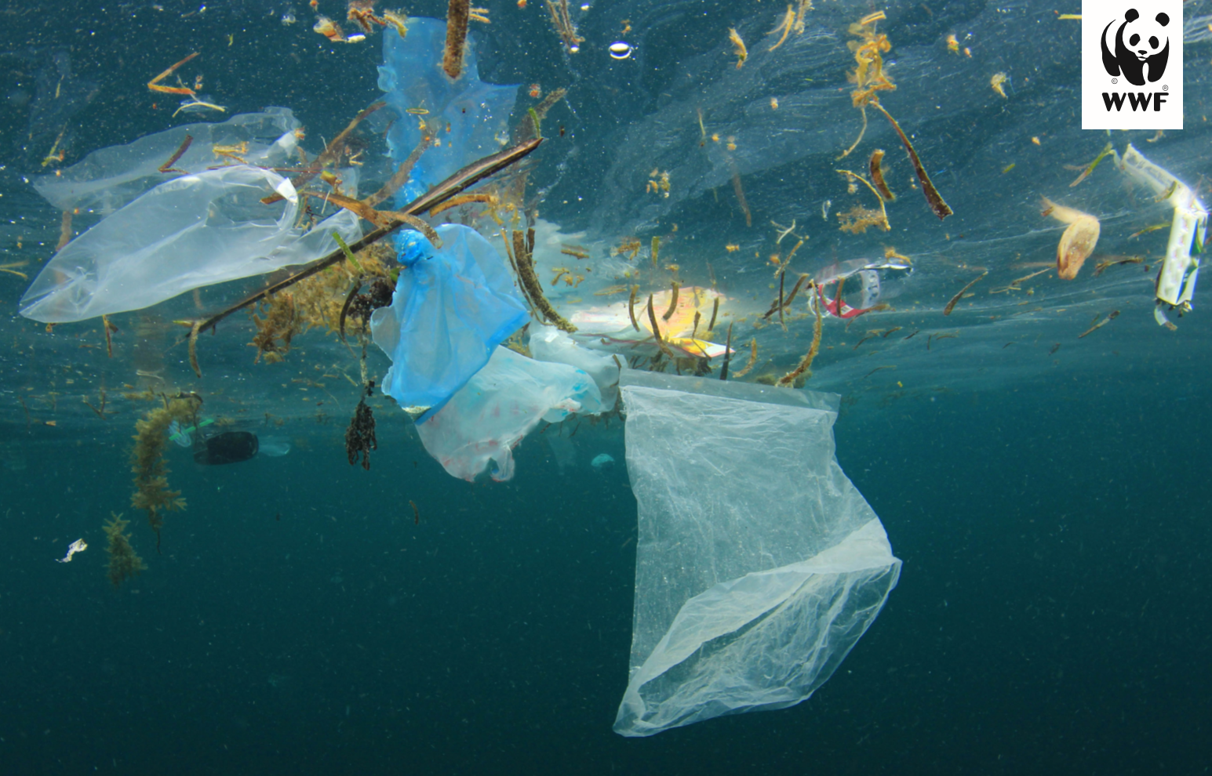
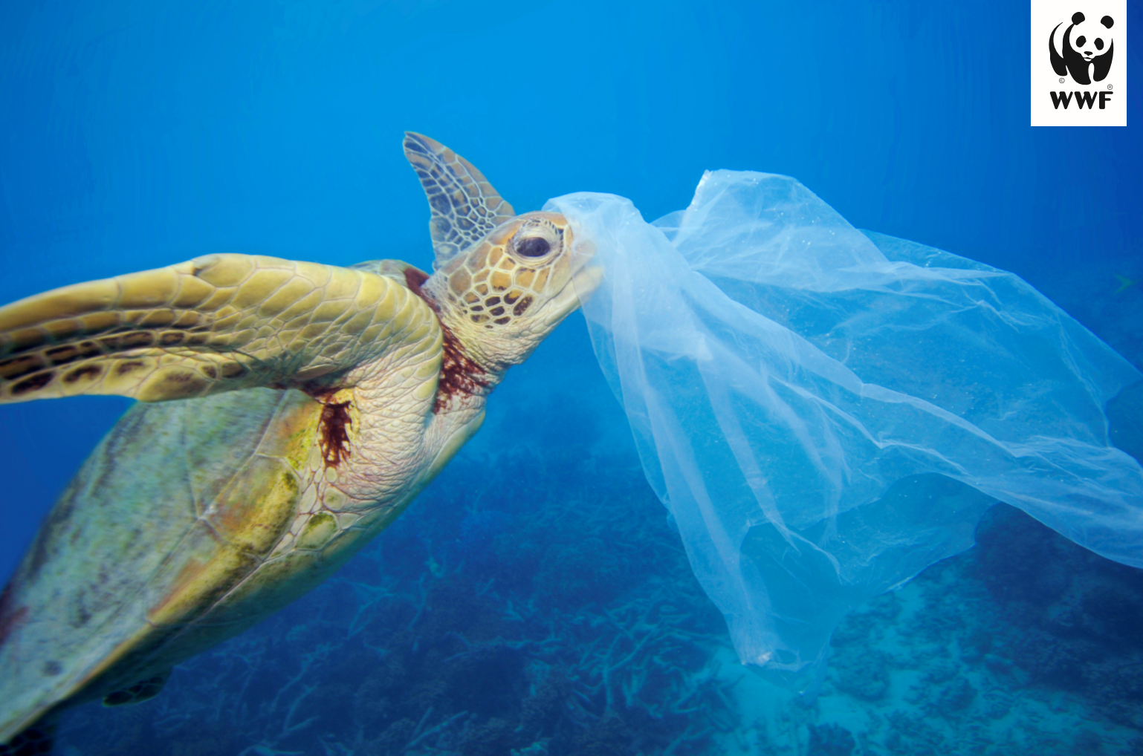
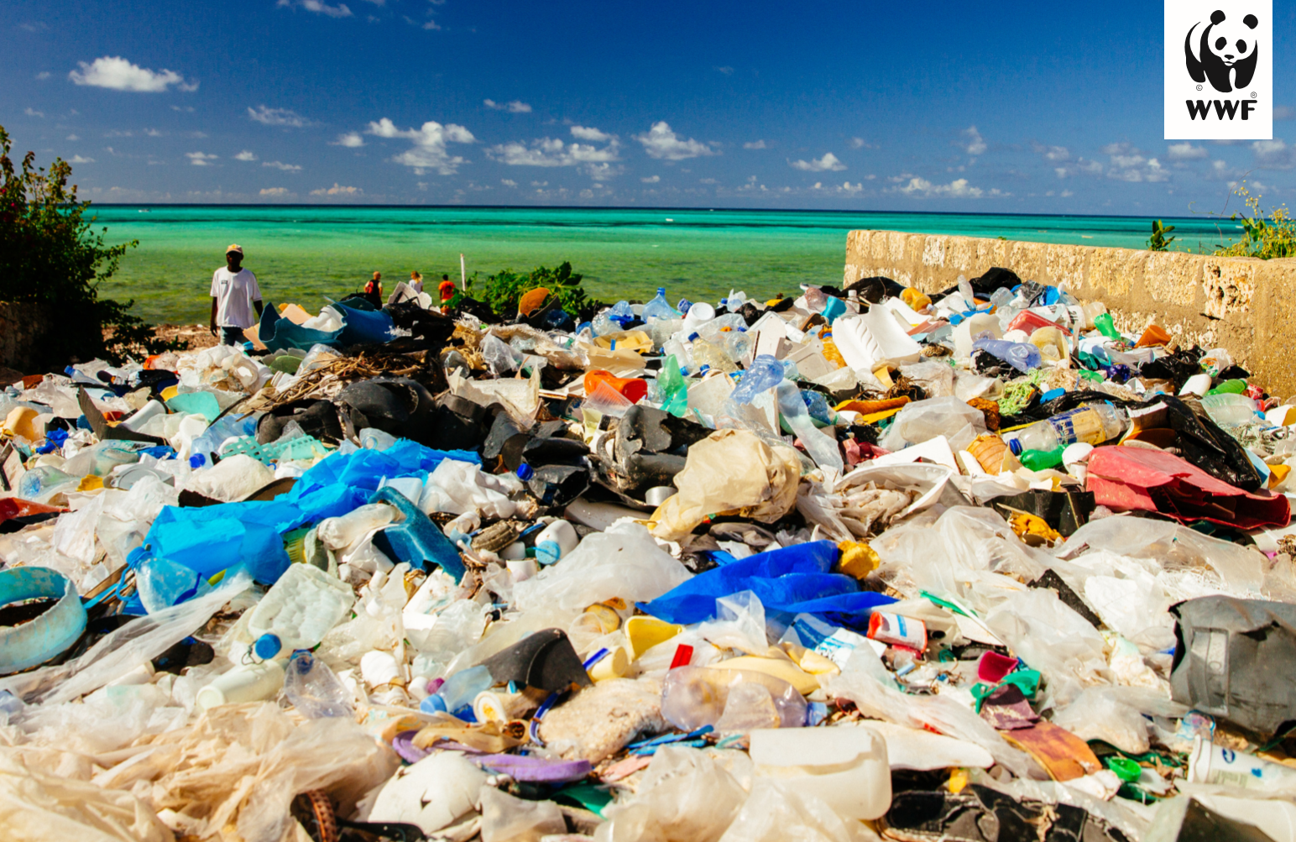
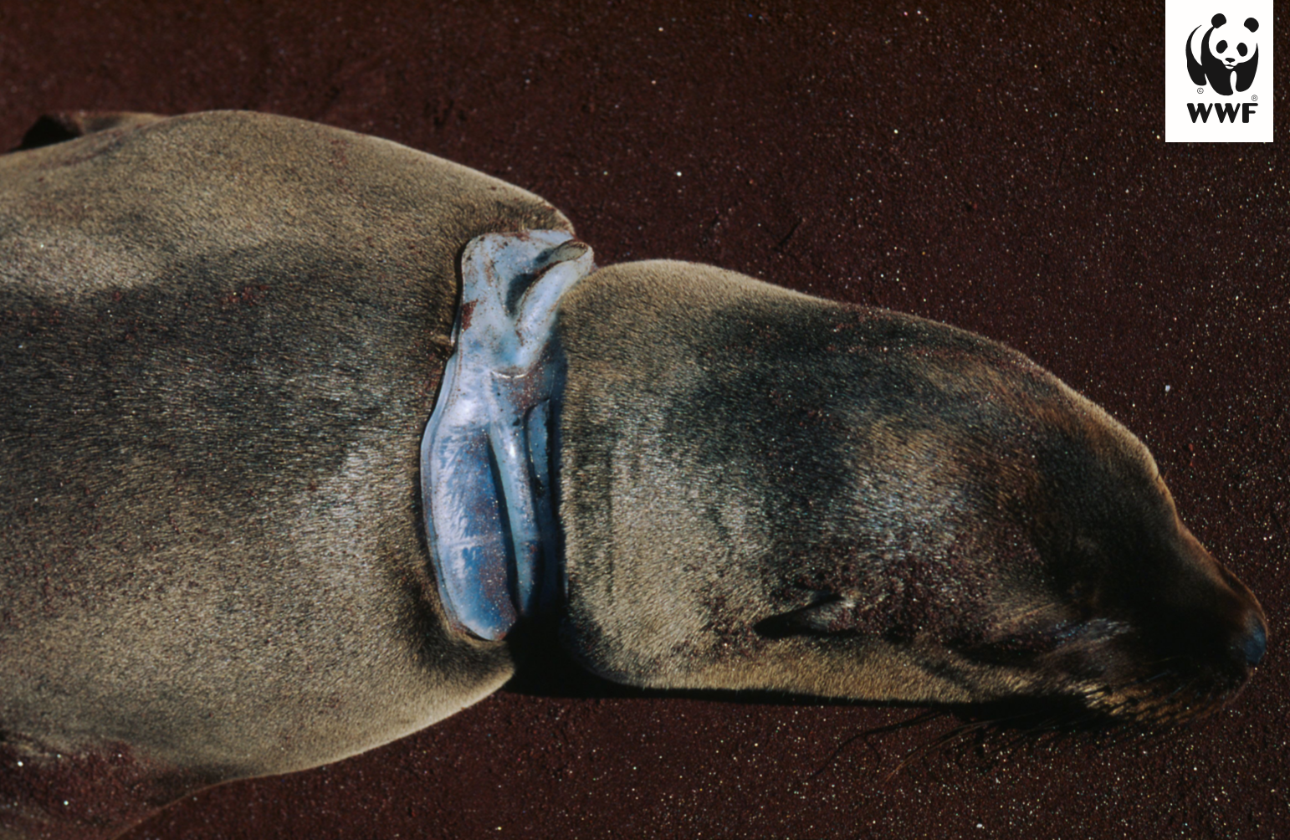

Slide 2
Choose a picture from the previous slide.
How does the picture make you feel?
What questions would you like to ask?

Slide 3
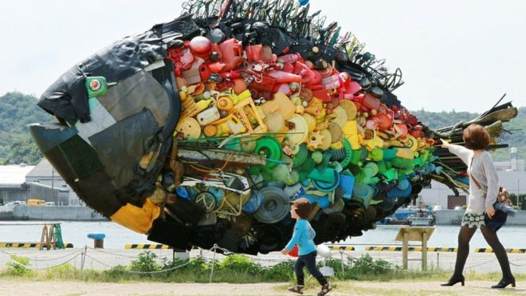
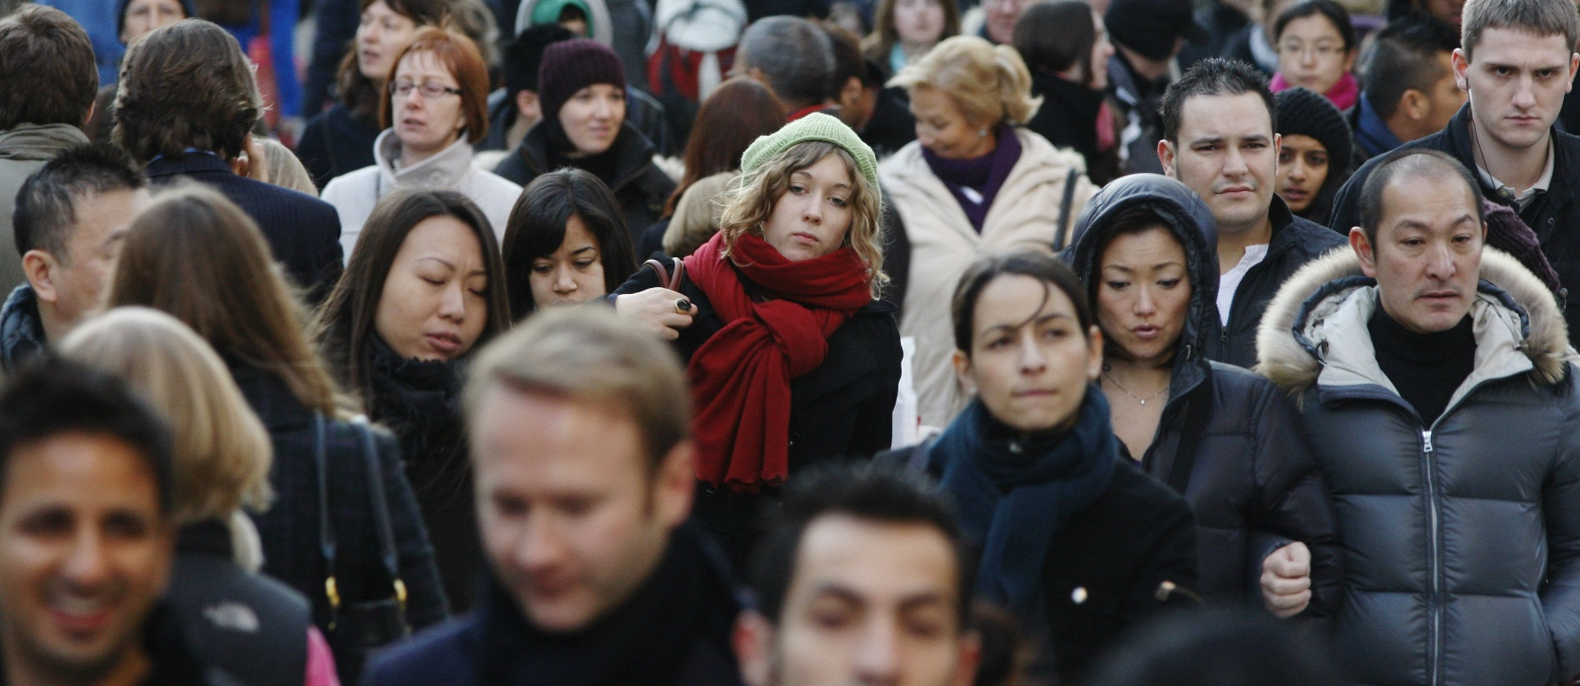

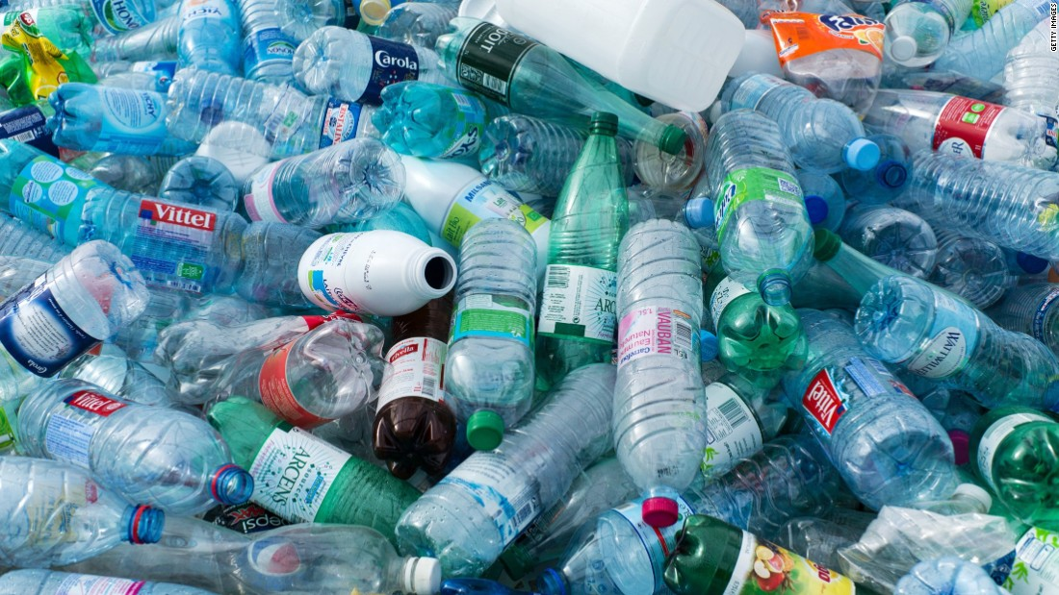
What do these pictures have in common?
Write down any ideas you have, quietly discuss with your partner.

Slide 4
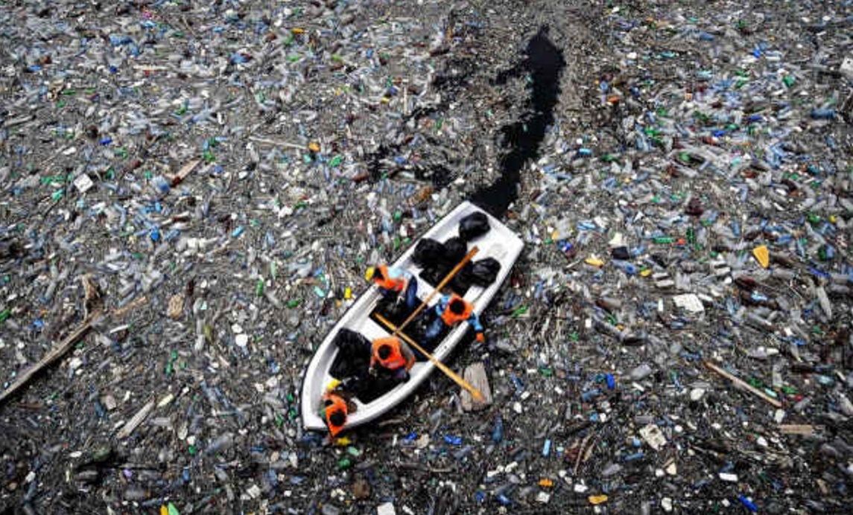
Our oceans are slowly turning into a plastic soup!!!

Slide 5
I have attached the link below - the power point was too large to be uploaded with the video as part of the document.
https://www.youtube.com/watch?v=xLx4fVsYdTI

Slide 6
How do you feel after watching the video?
How can you make a change?

Slide 7
Research
Research can sometimes be presented in a boring way, today we would like you to record your research in the form of an acrostic poem.
OCEAN PLASTIC POLLUTION
For example:
Over 8 million tonnes of plastic is dumped into the oceans
Oceans receive 8 million tonnes of plastic each year
Oceans are homes to millions of animals and therefore should be protected

Slide 8
Websites – also see research document 1 and 2
https://www.bbc.co.uk/newsround/42810179
https://www.bbc.co.uk/newsround/47979998
https://www.bbc.co.uk/newsround/47445196
https://www.wwf.org.uk/updates/plastics-why-we-must-act-now?pc=ATC001002&ds_rl=1263542&pc=ASF001002&ds_rl=1263542&gclid=EAIaIQobChMImbqRhqKh6AIVF-DtCh0sWAklEAAYAyAAEgK4fvD_BwE&gclsrc=aw.ds

Slide 9
Choose an animal
Next lesson, you are going to be writing a diary entry from your chosen animal’s perspective.
Audience: Year 5/6 children + your teacher
Purpose: to inform – about plastic pollution. To persuade – encouraging others to use less plastic.
Firstly, you need to learn about your chosen animal:
Habitat
Diet
Physical Characteristics
How plastic pollution could impact this animal?

