Slide 1
Maths Warm Ups
If you would like to warm up your maths brain before you tackle your main task, have a go at the arithmetic questions. There is one set of questions per day and the answers to follow.

Slide 2
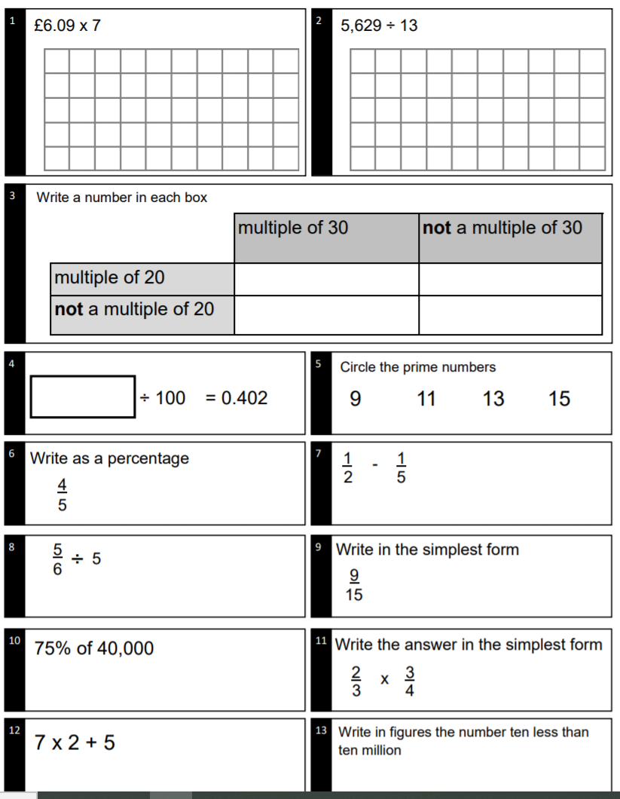
Monday - Questions

Slide 3
Monday - Answers
£42.63
2) 433
3) check if they fit
4) 40.2
5) 11, 13
6) 80%
7) 3/10
8) 1/6
9) 3/5
10) 30,000
11) 1/2
12) 19
13) 9,999,990

Slide 4
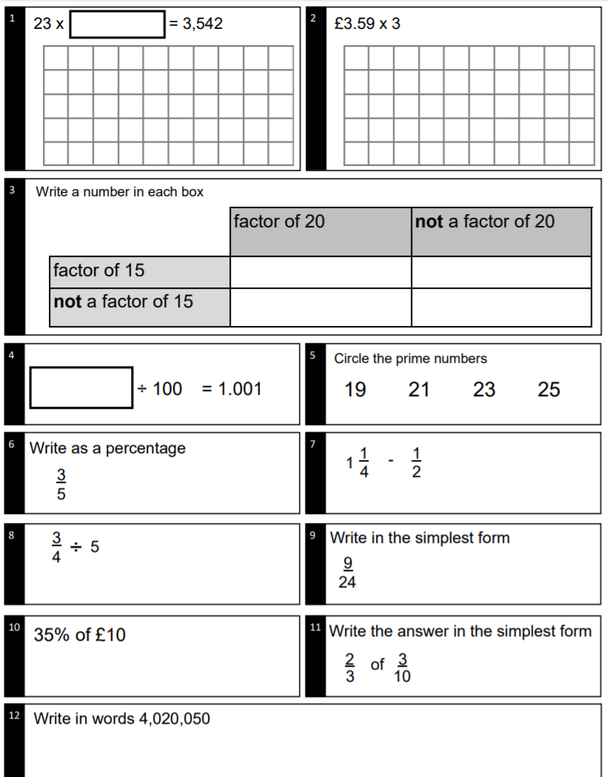
Tuesday - Questions

Slide 5
Tuesday - Answers
154
2) £10.77
3) check if they fit
4) 100.1
5) 19, 23
6) 60%
7) 3/4
8) 3/20
9) 3/8
10) £3.50
11) 1/5
12) four million, twenty thousand and fifty

Slide 6

Wednesday - Questions

Slide 7
Wednesday - Answers
325
2) £8.13
3) check if they fit
4) 4080
5) 29, 31
6) 55%
7) 7/10
8) 3/14
9) 3/4
10) £3.25
11) 4/5
12) two million, four hundred and two thousand and eight

Slide 8
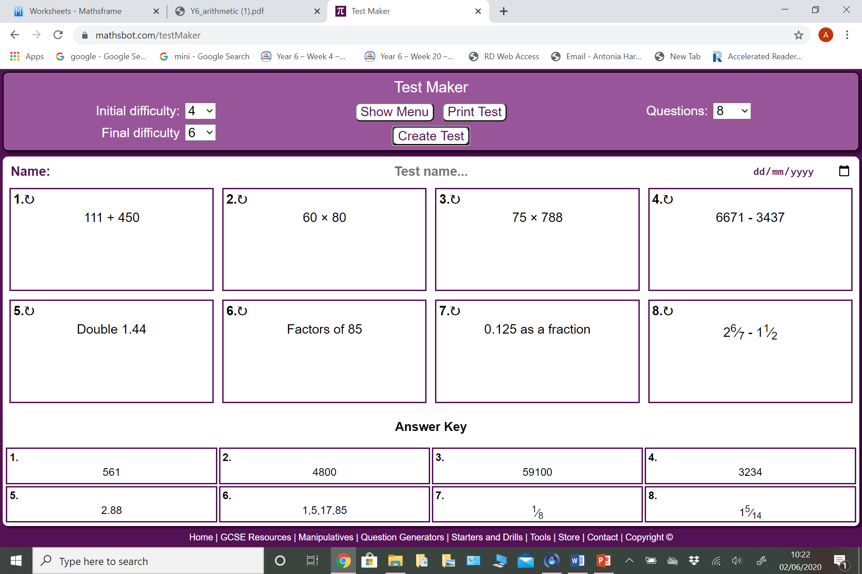
Thursday - Questions

Slide 9
Thursday - Answers

