Slide 2



Can you help Ted read some sentences?
Read the sentence.
Then, click on the paw prints to show the picture.
Hello!
I am Ted.
Which option would
you like?
with sound buttons
without sound buttons

Slide 3


The tap is on.

Slide 4
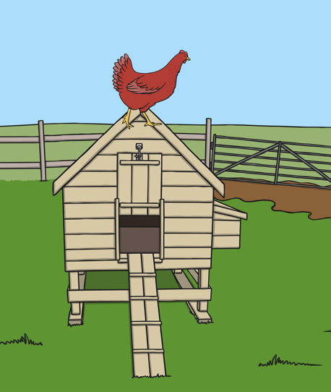
The red hen is on the hut.

Slide 5
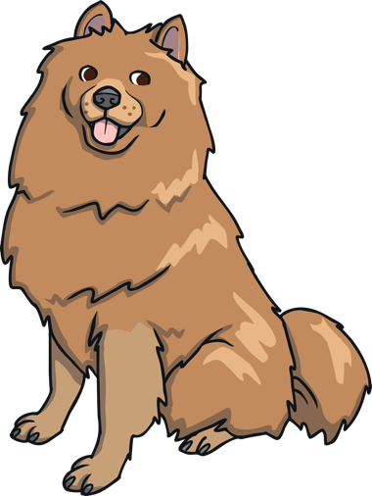
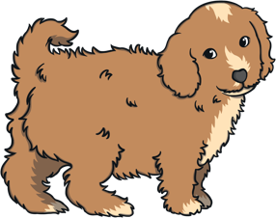
The dog has
a pup.

Slide 6

The pen is red.

Slide 7

This time,
read the sentence
and click on the matching picture.

Slide 8


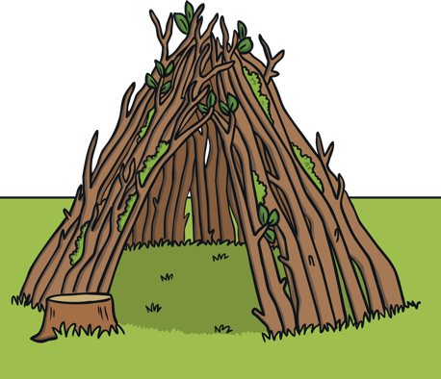

Ted is on top of the den.
Well done!

Slide 9

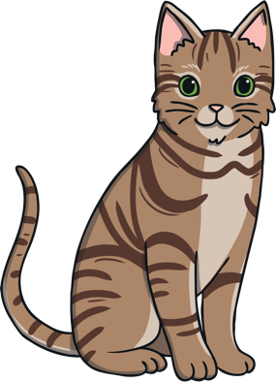
The cat has a hat.
Well done!

Slide 10
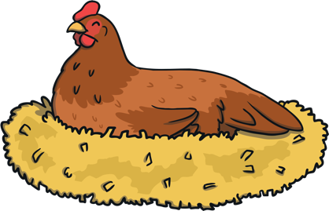


The hen had an egg.
Well done!

Slide 11
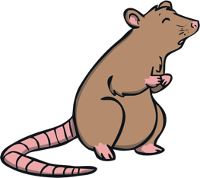

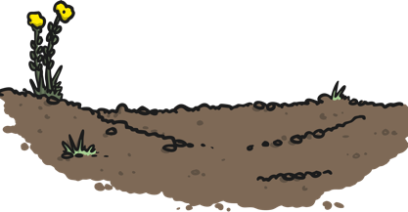

The pet rat is in the mud.
Well done!
finish

Slide 12
The tap is on.

Slide 13

The red hen is on the hut.

Slide 14
The dog has
a pup.

Slide 15
The pen is red.

Slide 16
This time,
read the sentence
and click on the matching picture.

Slide 17
Ted is on top of the den.
Well done!

Slide 18
The cat has a hat.
Well done!

Slide 19
The hen had an egg.
Well done!

Slide 20
The pet rat is in the mud.
Well done!

Slide 21








Well done –
super reading!

