Slide 2








Next
I
no
the
to
go
into
Click the basket to reveal a word.

Slide 3
Next
he
me
she
we
Click the basket to reveal a word.

Slide 4

Next
be
her
you
are
Click the basket to reveal a word.

Slide 5
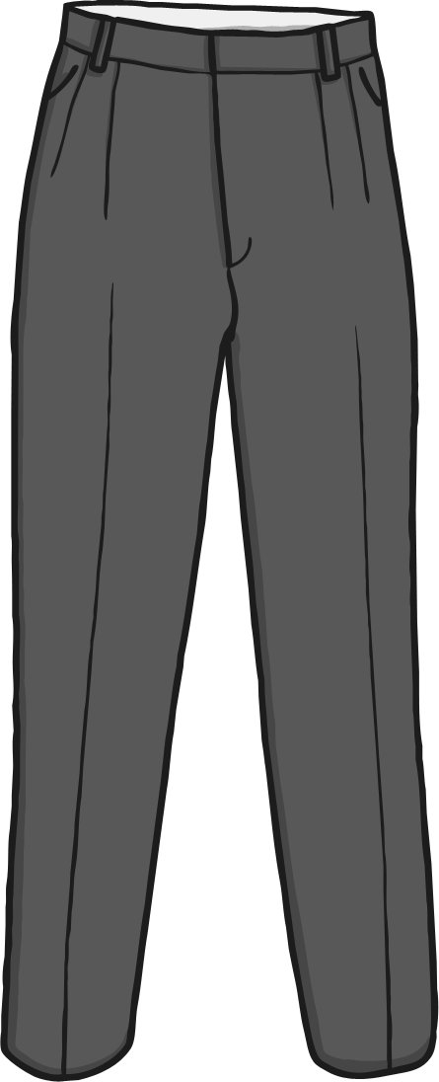
Finish
be
her
you
are
Click the basket to reveal a word.

