Slide 1
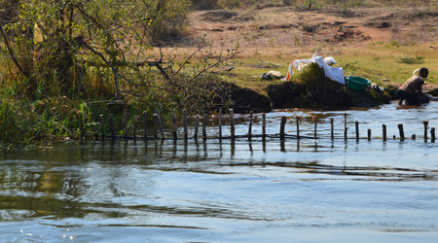
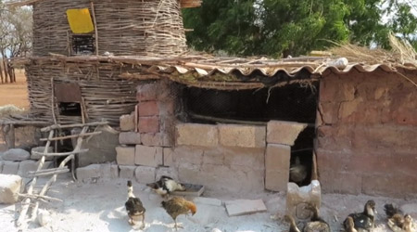
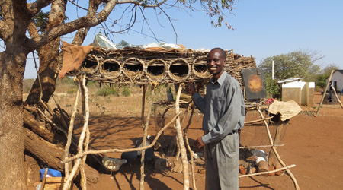
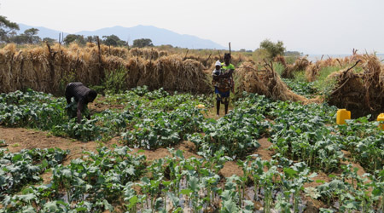
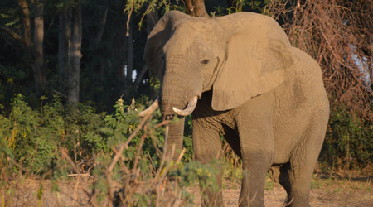
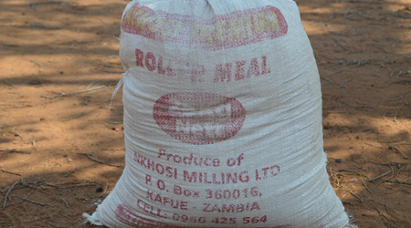
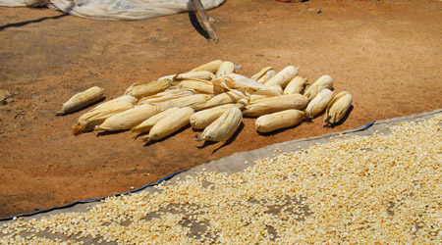
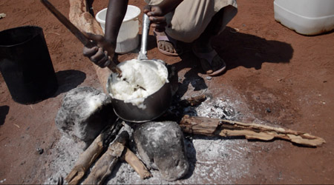
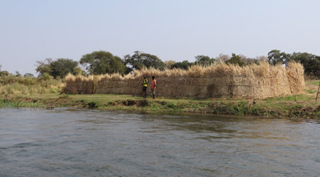
What type of farming do they do in Mugurameno Village?
Subsistence farming is a type of farming where nearly all of the crops or livestock raised are used to maintain the farmer and the farmer’s family, leaving little, if any, surplus for sale or trade.
Animals in Mugurameno Village
Animals are mainly kept to provide the villagers with food, but some dogs are kept as pets.
Crocodile fence
Weather in Mugurameno Village.
It only rains in Zambia for a few months every year, so when it is dry, river water is diverted from the Zambezi to help plants in the fields and gardens produce a good harvest. Of course, the fields have to be close to the river.
People also fish in the river for food.
People who live in the village have to take care at the water’s edge, because there are crocodiles in the river. The villagers build special fences in the river to make a safe area, close to the bank, in which to work.
Chicken hutch
Chickens and ducks
Mugurameno is close to the Lower Zambezi National Park. The park is home to many wild animals. There is no fence around the National Park, so the animals can wander out, into the village, in search of crops to eat.
The river is used to water vegetables and a cereal called maize that people in the village grow for food.
Farming for food in Mugurameno Village.
A staple food is something that is eaten most days. It gives people a lot of the energy they need to work and play.
In Mugurameno, the staple food is nshima. It’s a bit like porridge or polenta, but it’s made with maize or sorghum flour.
Nshima is cooked in a pan over a fire. Mealie-meal (maize or sorghum flour) is slowly added to boiling water and carefully stirred. You don’t want lumps in your nshima! Maize, knowzn in some countries as corn, is grown in fields around the village.
Elephants and hippos can destroy growing food crops, so the people of the village have come up with a number of clever ways of protecting their fields. One way is to build a wall made of grass and reeds around the fields, to keep hippos out.
A sack of mealie-meal
Nshima cooking on the fire
After the maize has been picked, and the husk (the outer covering of leaves) has been removed, the ears (cobs) are dried in the sun. Next, the tiny kernels are taken off the cob and ground in a mill to make maize flour or mealie-meal. This is the flour people in Mugurameno use to make nshima.
Drying maize
Hippo proof fence

