Slide 1
Maths Warm Ups
If you would like to warm up your maths brain before you tackle your main task, have a go at the arithmetic questions. There is one set of questions per day and the answers to follow.

Slide 2
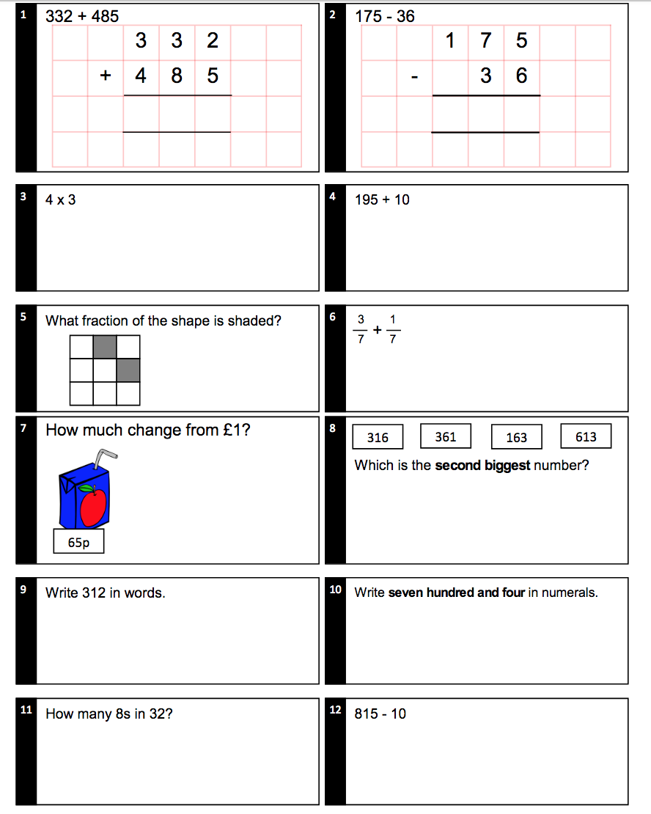
Monday - Questions

Slide 3
Monday - Answers
8 1 7
1 3 9
12
19.5
2/9
4/7
35p
316
Three hundred and twelve
704
4
805

Slide 4
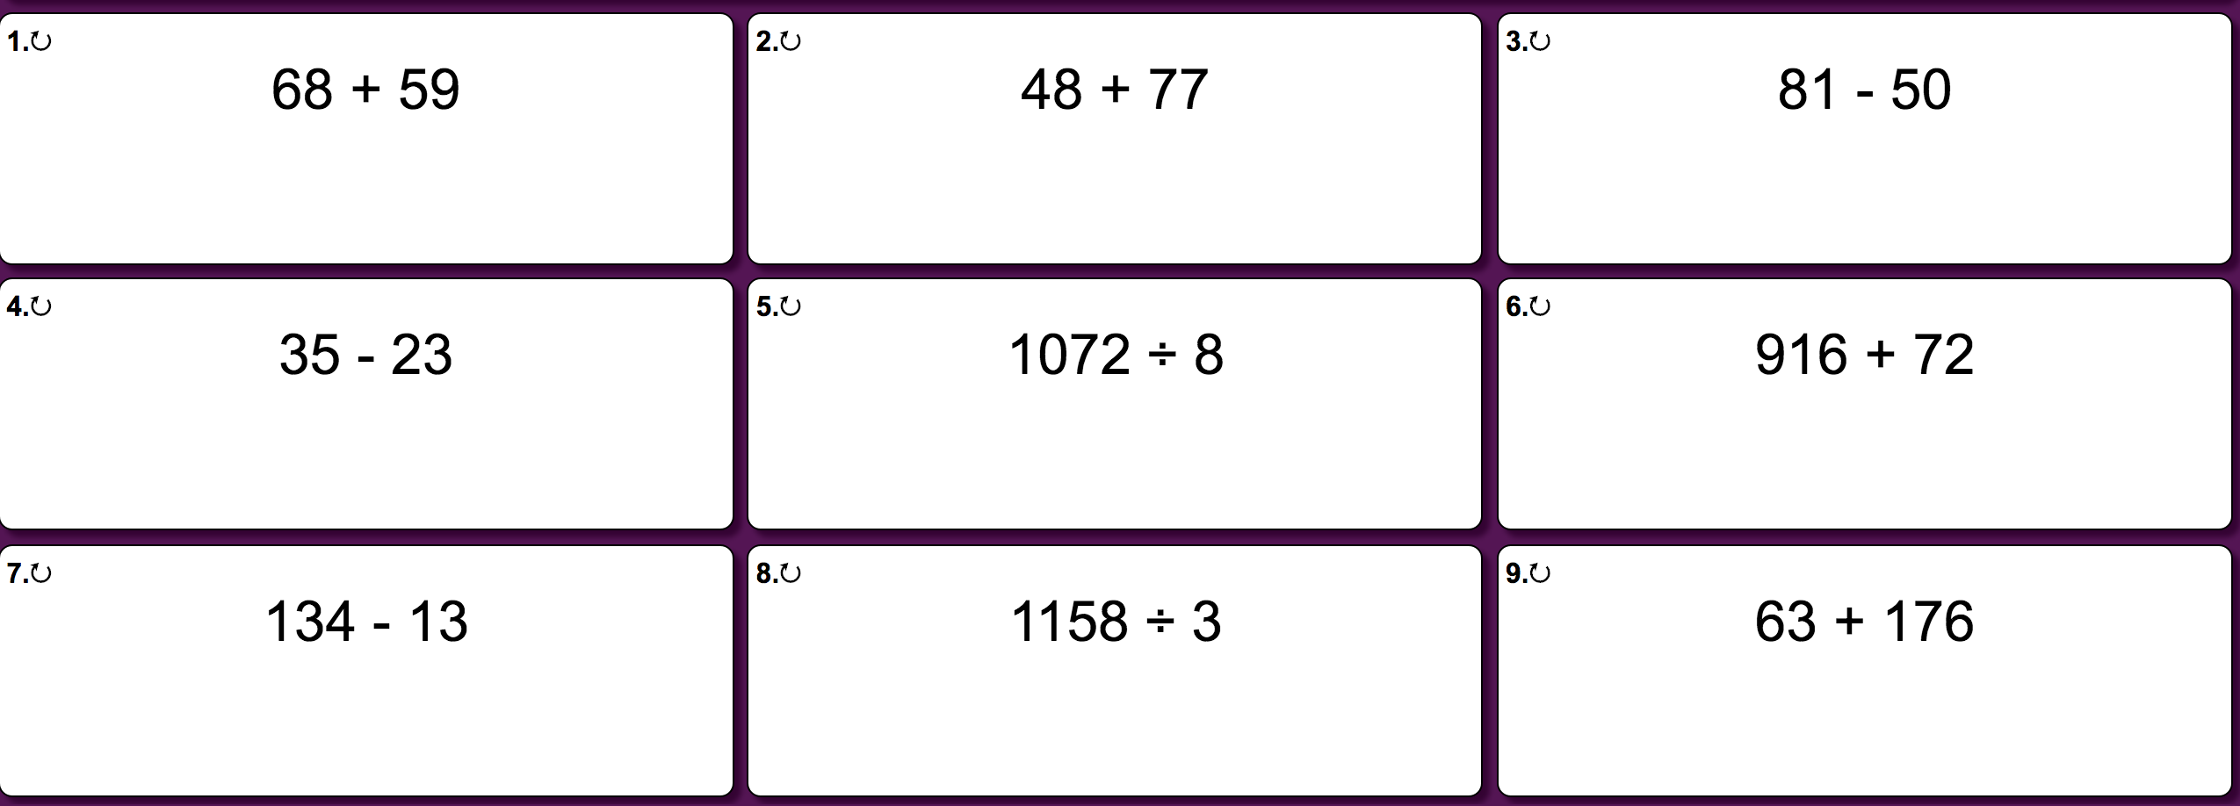
Tuesday - Questions

Slide 5
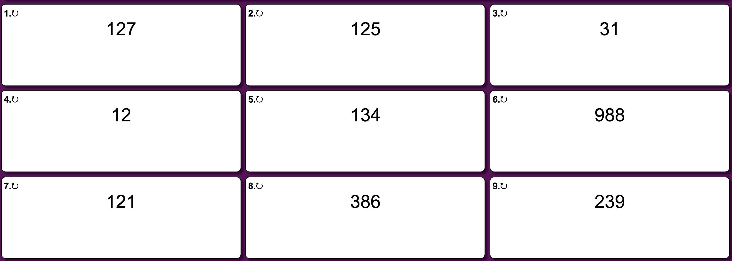
Tuesday - Answers

Slide 6
Wednesday
Have a go at the game below -
https://www.topmarks.co.uk/maths-games/hit-the-button

Slide 7
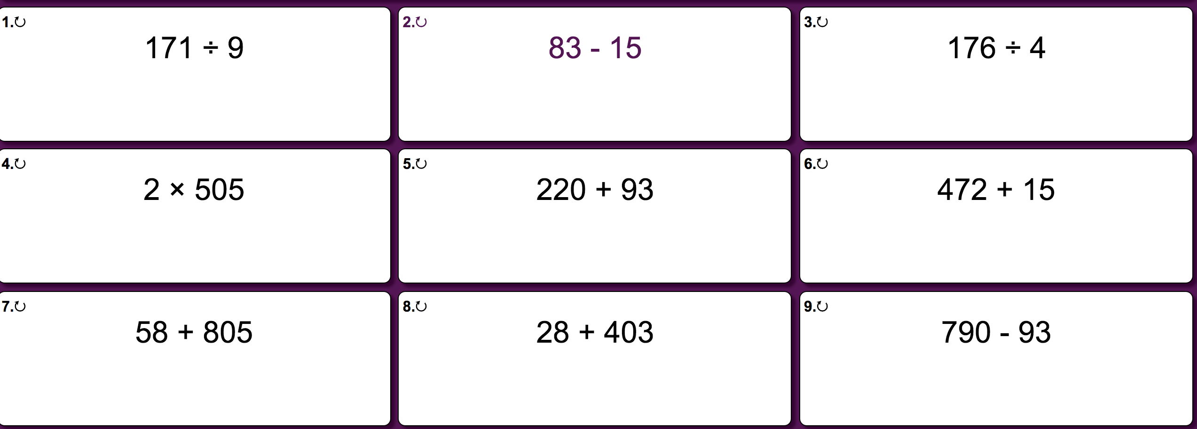
Thursday - Questions

Slide 8
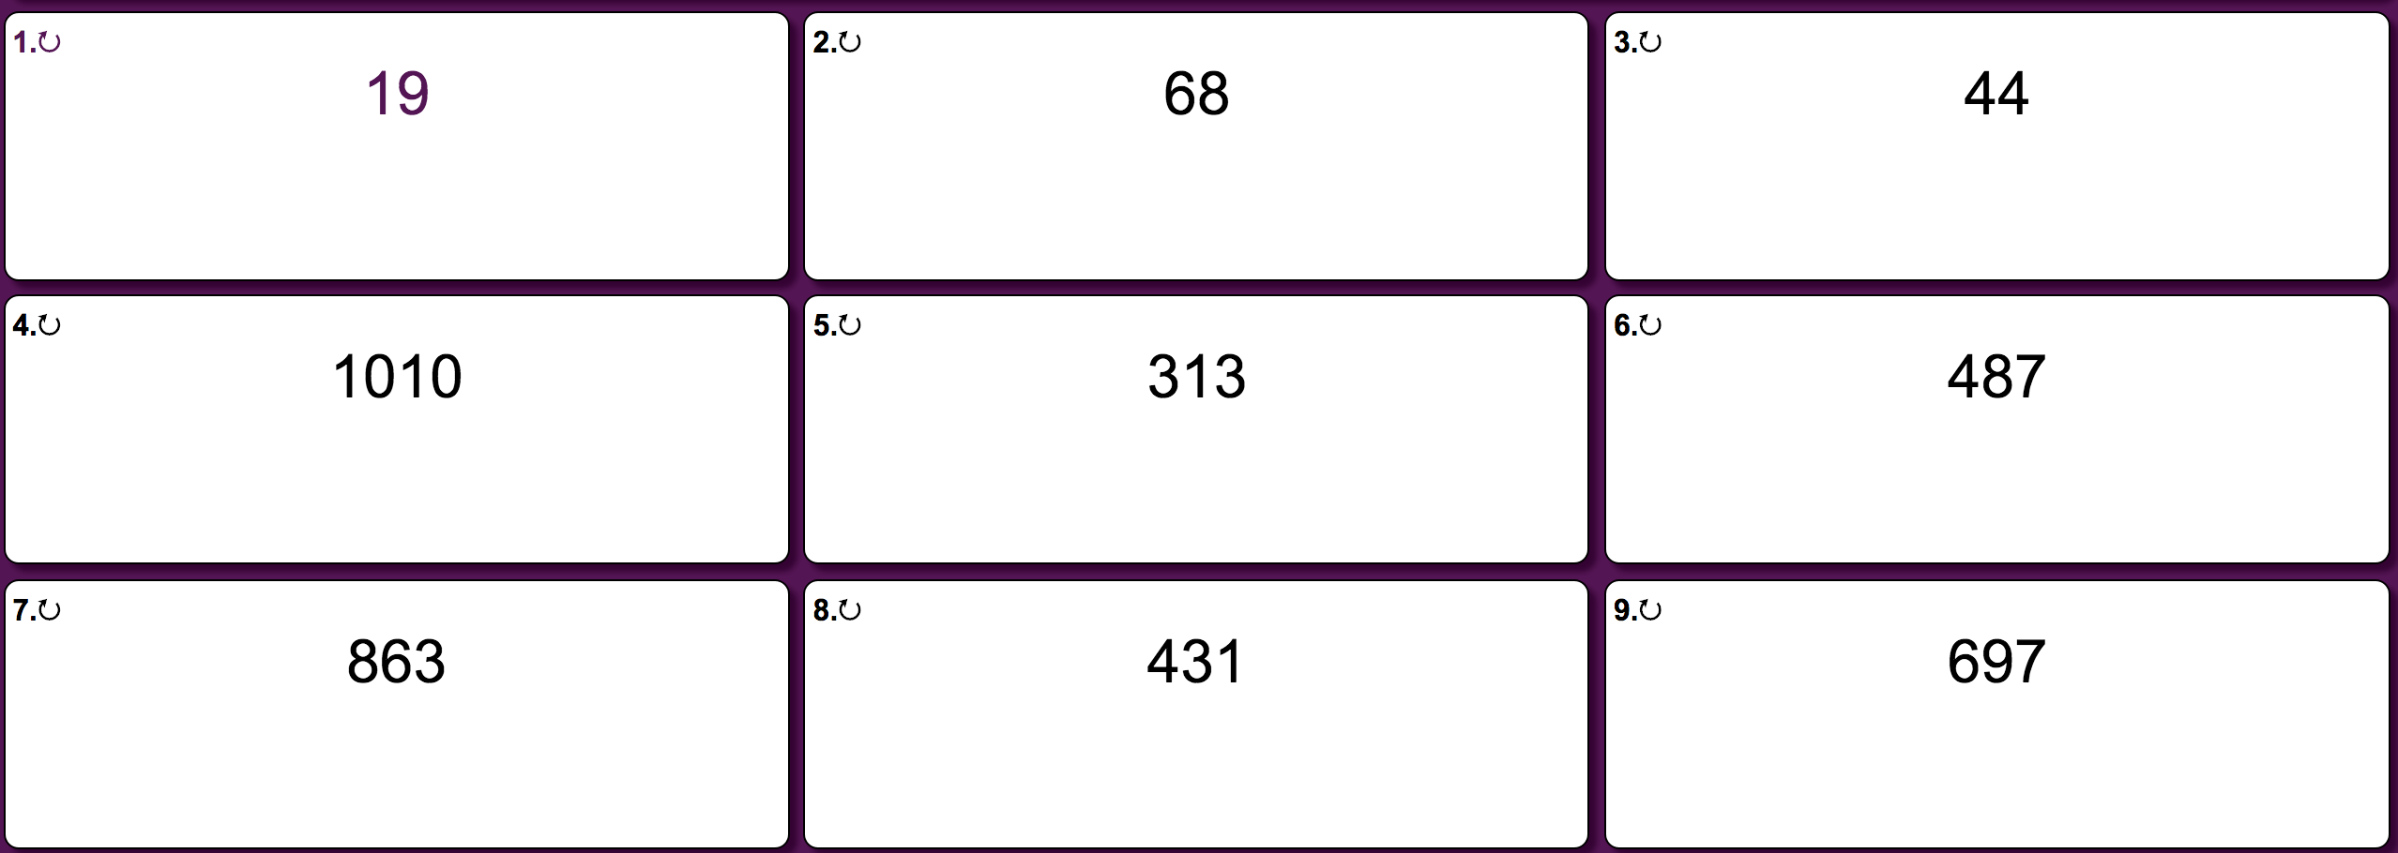
Thursday - Answers

Slide 9
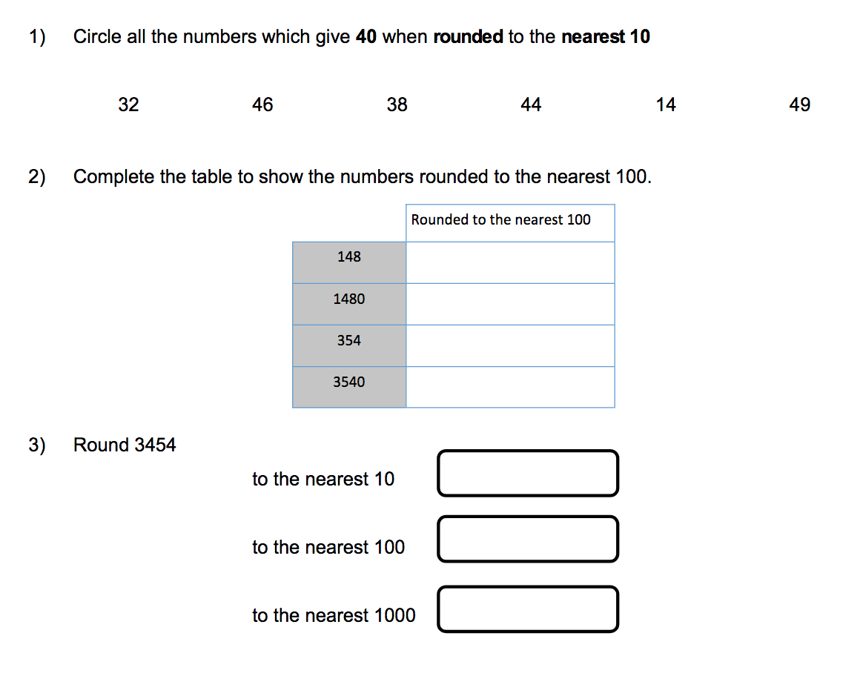
Friday - Questions

Slide 10
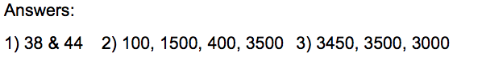
Friday - Answers

