Slide 1






Guidance for Video/Audio in PowerPoints
1. Open the folder and copy all the files.
2. Paste the copied files into a new folder.
3. Open the PowerPoint file, enable editing and enter presentation mode (start the slide show).
Please note the embedded audio may not be compatible with early versions of PowerPoint.
You may wish to delete this slide before beginning the presentation.

Slide 3




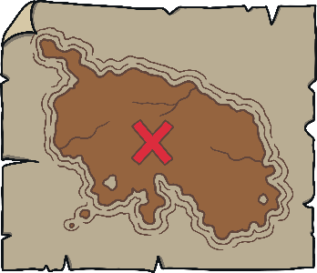




Revisit and Review
Let’s practise Sam’s Sounds and Tricky Words!
w
v
j
y
qu
zz
z
ch
x
me
be
she
we
he

Slide 4




Letter Leaves
Revisit and Review
Listen to the letter name. Can you find the right letter leaf?
X
Support children's recognition of lowercase and capital letters by practising saying the letter names (as well as the letter sounds).
Click me for Kit’s teaching tips!

Slide 5


Revisit and Review
G
C
P
Play

Slide 6
Revisit and Review
A
E
D
Play

Slide 7
Revisit and Review
D
F
B
Play

Slide 8
Revisit and Review
B
D
P
Play

Slide 9
Revisit and Review
E
L
F
Play

Slide 10
Revisit and Review
F
P
E
Play

Slide 11
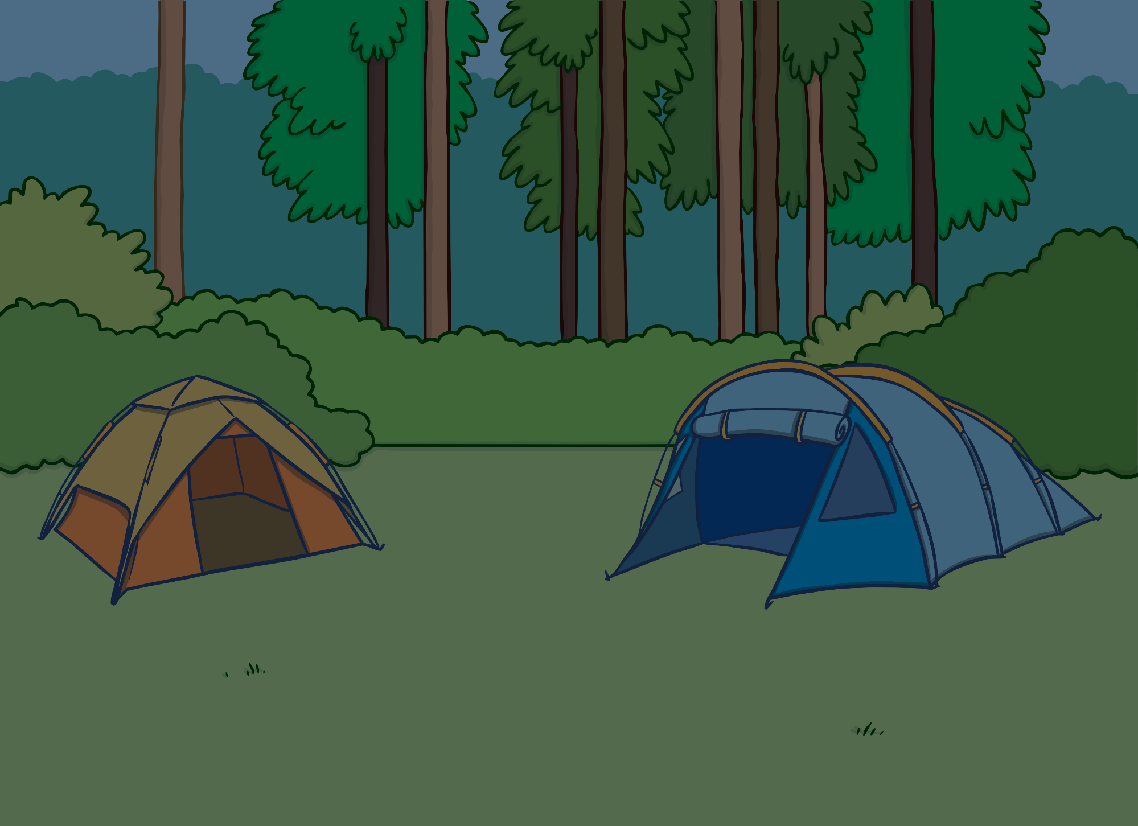





Teach
The family were on a camping trip. They had set up the tent and unpacked their things. It was becoming night time. “Here is a torch each so you can explore in the dark,” said Mum.

Slide 12

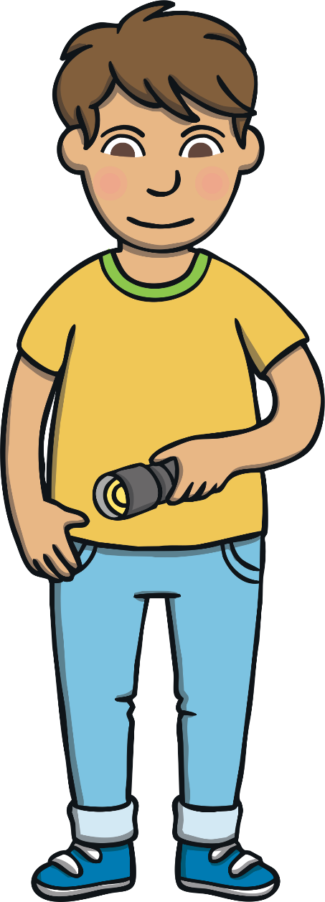
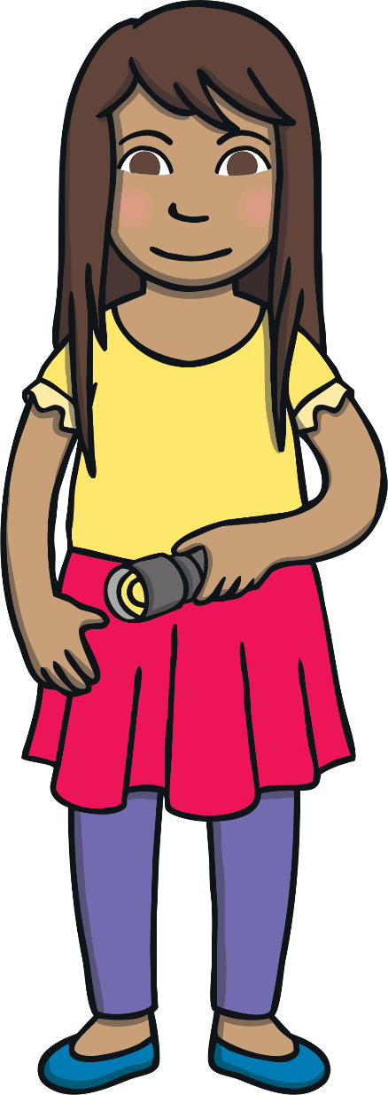

Teach
Once it had gone dark, Kit and Sam switched on the torches. “Look at the moths,” they said as several flew into the beams of light.

Slide 13
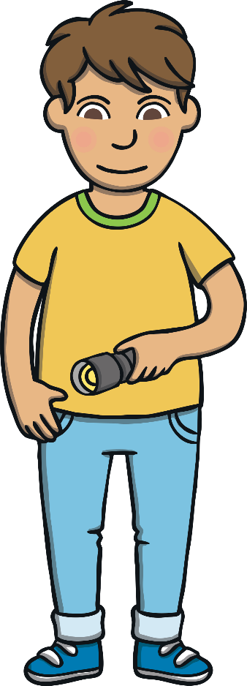


Teach
“They like the light,” explained Mum. They all listened to the soft th noises of the moths’ wings as they gently bumped the torches.

Slide 14

Teach
t and h are partners. They say th.
t
h
X
Ensure children are sticking their tongues between their front teeth to make this sound correctly. They could look in a mirror to check. Encourage children to feel their throats to check that their ‘voice box is off’ while making the unvoiced sound.
Click me for Kit’s teaching tips!

Slide 15

Teach
th

Slide 16

Action
Teach
Put your forefingers on your head and wiggle your moth’s feelers.
Say ‘th, th, th’
with your voice box off.

Slide 17




Write the Letters
Teach
th
Down the teaspoon and under the teacup, then across the top.
Down the chimney to the floor, up and over the new front door.
Play

Slide 18

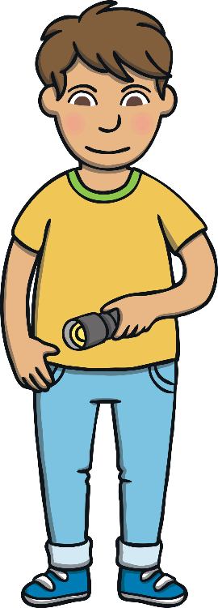
Let’s Sing!
Teach
(To the tune of ‘Black Velvet Band’)
The moths are flying around us,
They like to fly into the light.
With their wings that brush on our torches,
th - th - they fly into the night.
Play Song

Slide 19


Torchlight Words
Practise
Kit and Sam have used their torches to find some words in the campsite. Can you help to read them?

Slide 20
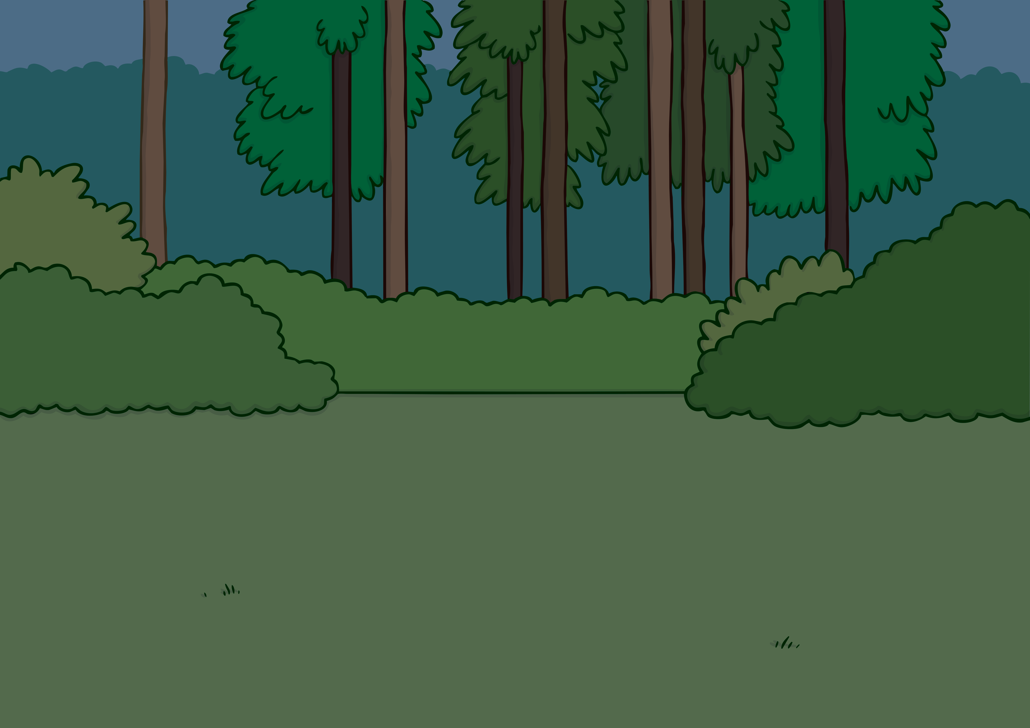


Practise
b
a
th
Sound Buttons On/Off

Slide 21

Practise
th
i
n
Sound Buttons On/Off

Slide 22
Practise
th
i
ck
Sound Buttons On/Off

Slide 23

Practise
p
a
th
Sound Buttons On/Off

Slide 24
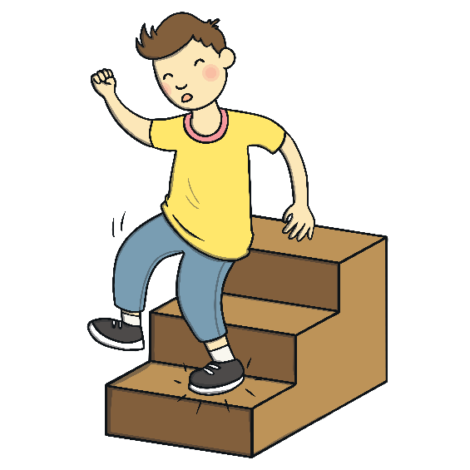
Practise
th
u
d
Sound Buttons On/Off

Slide 25
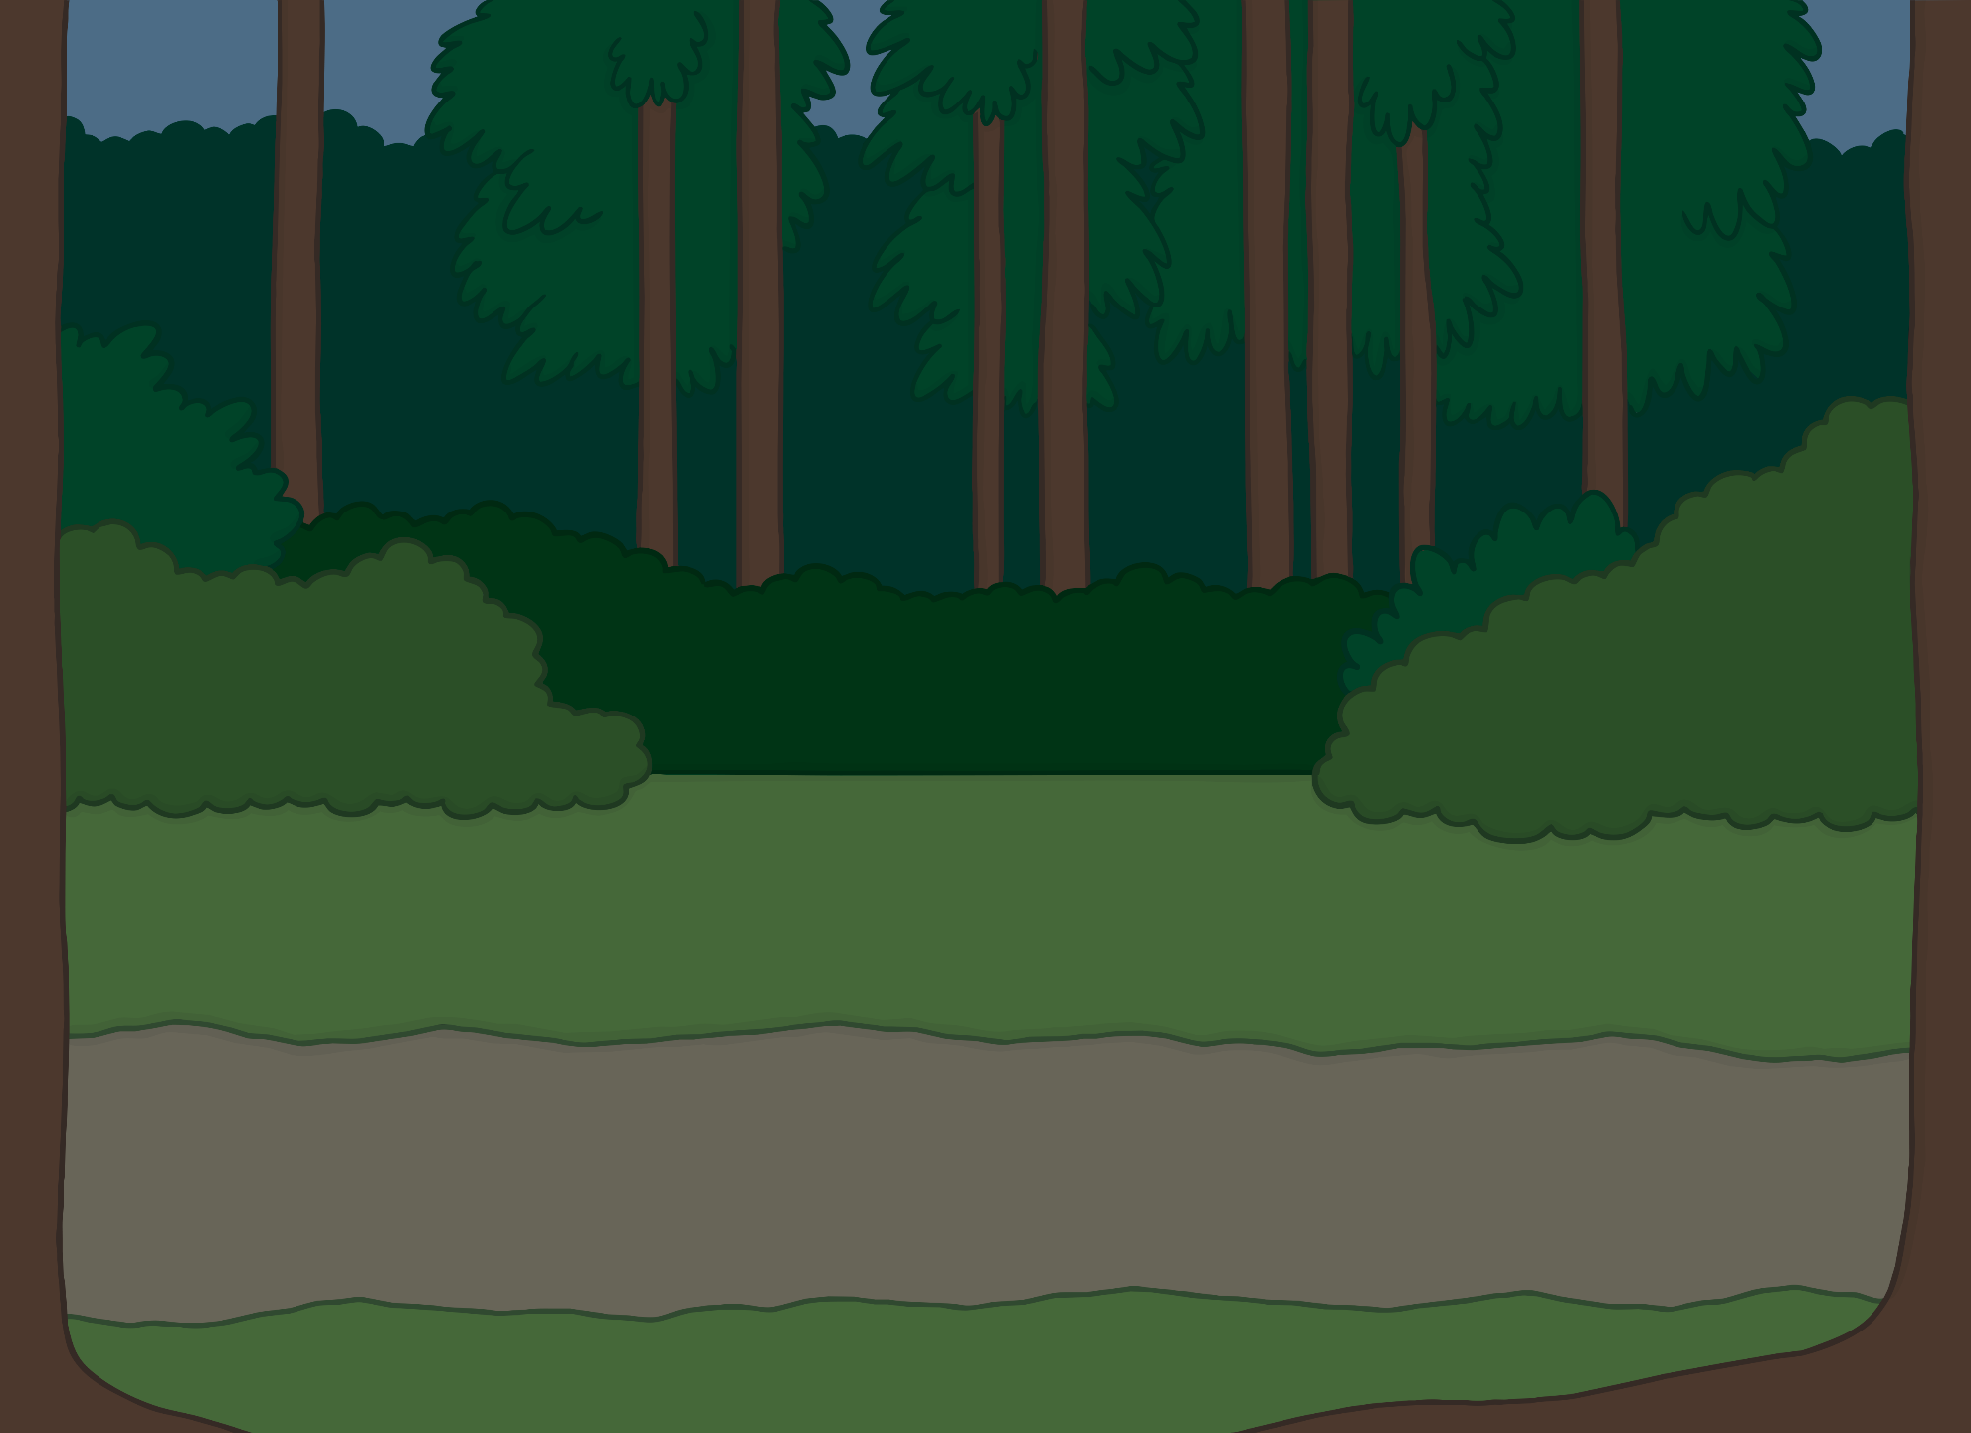


Apply
“I can see a path with my torch,” said Kit.
“We should see where it goes,” said Mum.
“Will you be following me?” said Kit.
“Of course!” said Mum. All of a sudden, there was a loud thud.

Slide 26


Sentence Time
Apply
What happened when Kit and Mum followed the path? Read the sentence to find out!
X
Click ‘Sound Buttons On/Off’ to select whether you want to show sound buttons under the caption.
Click me for Kit’s teaching tips!

Slide 27
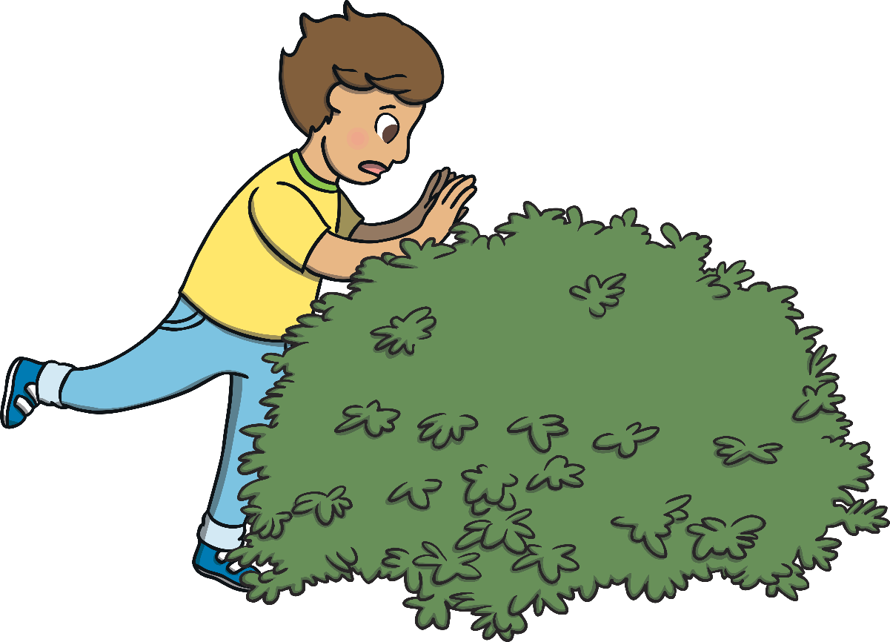
Apply
Kit fell in a thick bush.
Sound Buttons On/Off
Show

Slide 28
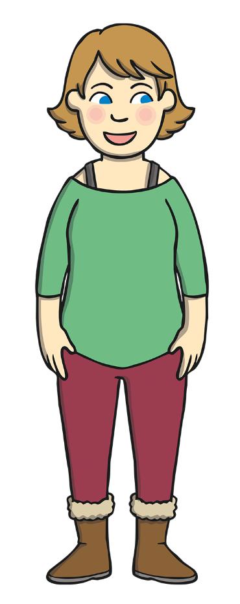
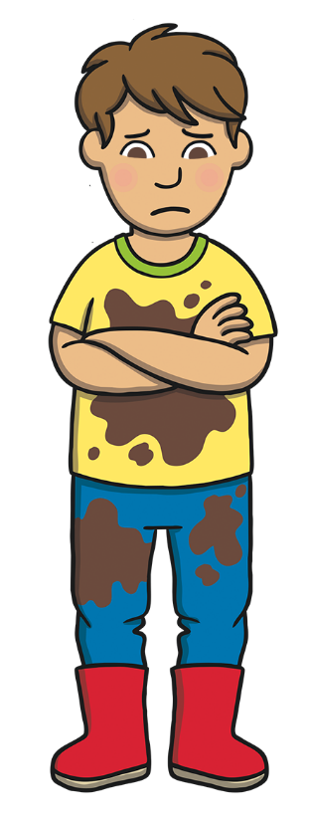
Apply
“Oh dear,” said Kit. “I am all dirty.”
“We had better go and get a cloth!” laughed Mum.
“It’s a good job the moths didn’t follow us!” said Kit.

Slide 29

Today, we have learnt…
th

