Slide 1



LIFE/work balance
We have started a #LIFEworkbalance campaign and we need your help to complete our LIFE/work balance survey.
We hope to publish the results soon, so please give 15 minutes of your time to help us get a true picture of school life.
Want to be a part of this campaign? Take the survey on our website and share it with your colleagues!
© Classroom Secrets Limited 2019

Slide 2
Year 2 – Summer Block 3 – Time – Compare Durations of Time
About This Resource:
This PowerPoint has been designed to support your teaching of this small step. It includes a starter activity and an example of each question from the Varied Fluency and Reasoning and Problem Solving resources also provided in this pack. You can choose to work through all examples provided or a selection of them depending on the needs of your class.
National Curriculum Objectives:
Mathematics Year 2: (2M4a) Tell and write the time to five minutes, including quarter past/to the hour and draw the hands on a clock face to show these times
Mathematics Year 2: (2M4b) Compare and sequence intervals of time
More Year 2 Time resources.
Did you like this resource? Don’t forget to review it on our website.
© Classroom Secrets Limited 2018

Slide 3
Year 2 – Summer Block 3 – Time – Compare Durations of Time
Step 6: Compare Durations of Time
© Classroom Secrets Limited 2018

Slide 4
Introduction
Order these activities from the
shortest length of time to the longest.
brush your teeth
a day at school
travel to school
watch a film
lunch time
a family holiday
© Classroom Secrets Limited 2018

Slide 5
Introduction
Order these activities from the
shortest length of time to the longest.
shortest
brush your teeth
travel to school
lunch time
watch a film
a day at school
longest
a family holiday
© Classroom Secrets Limited 2018

Slide 6
Varied Fluency 1
True or false?
25 minutes is less than half an hour.
50 minutes is more than an hour.
An hour and a quarter is 75 minutes.
© Classroom Secrets Limited 2018

Slide 7
Varied Fluency 1
True or false?
25 minutes is less than half an hour.
True
50 minutes is more than an hour.
False
An hour and a quarter is 75 minutes.
True
© Classroom Secrets Limited 2018

Slide 8
Varied Fluency 2
Which durations are longer than 20 minutes?
Half an hour
Quarter of an hour
Half past two to five minutes to three
© Classroom Secrets Limited 2018

Slide 9
Varied Fluency 2
Which durations are longer than 20 minutes?
Half an hour
Quarter of an hour
Half past two to five minutes to three
© Classroom Secrets Limited 2018

Slide 10
Varied Fluency 3
Use <, > or = to complete the statements.
three quarters of an hour
45 minutes
half an hour
25 minutes
© Classroom Secrets Limited 2018

Slide 11
Varied Fluency 3
Use <, > or = to complete the statements.
three quarters of an hour
=
45 minutes
half an hour
>
25 minutes
© Classroom Secrets Limited 2018

Slide 12
Varied Fluency 4
Put the durations in order from shortest to longest.
A. one o’clock to half past one
B. 35 minutes
C. three quarters of an hour
D. 40 minutes
E. 60 minutes
F. quarter to four to four o’clock
© Classroom Secrets Limited 2018

Slide 13
Varied Fluency 4
Put the durations in order from shortest to longest.
A. 30 minutes; B. 35 minutes; C. 45 minutes
D. 40 minutes; E. 60 minutes; F. 15 minutes
A. one o’clock to half past one | 2
B. 35 minutes | 3
C. three quarters of an hour | 5
D. 40 minutes | 4
E. 60 minutes | 6
F. quarter to four to four o’clock | 1
© Classroom Secrets Limited 2018

Slide 14
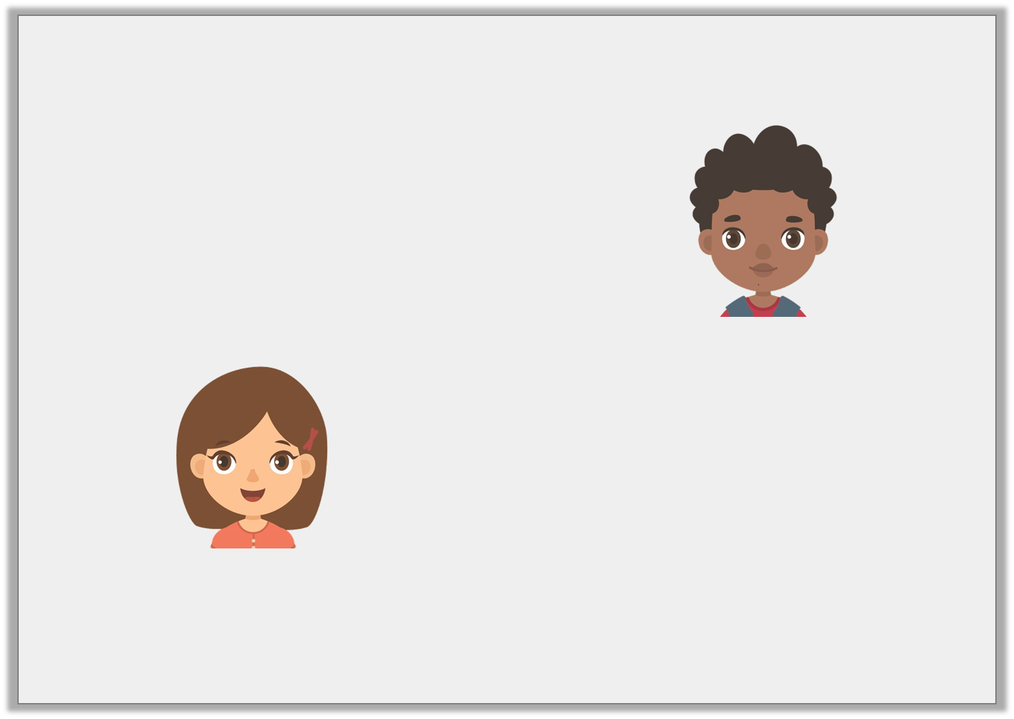
Reasoning 1
Who is correct? Explain how you know.
I left school at twenty-five minutes to four and arrived home at twenty minutes past four. It took me longer to get home.
Mo
I left school at half past three and arrived home at twenty minutes past four. It took me longer to get home.
Katie
© Classroom Secrets Limited 2018

Slide 15
Reasoning 1
Who is correct? Explain how you know.
Katie is correct because…
I left school at twenty-five minutes to four and arrived home at twenty minutes past four. It took me longer to get home.
Mo
I left school at half past three and arrived home at twenty minutes past four. It took me longer to get home.
Katie
© Classroom Secrets Limited 2018

Slide 16
Reasoning 1
Who is correct? Explain how you know.
Katie is correct because it took her 50 minutes to get home from school, while it took Mo 45 minutes.
I left school at twenty-five minutes to four and arrived home at twenty minutes past four. It took me longer to get home.
Mo
I left school at half past three and arrived home at twenty minutes past four. It took me longer to get home.
Katie
© Classroom Secrets Limited 2018

Slide 17
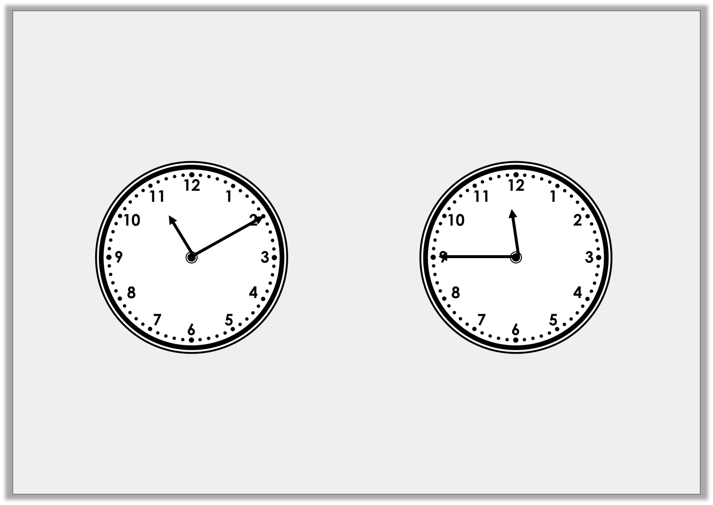
Problem Solving 1
It takes Jamie 5 minutes to complete three maths problems. How many problems can he complete in this duration of time?
© Classroom Secrets Limited 2018

Slide 18
Problem Solving 1
It takes Jamie 5 minutes to complete three maths problems. How many problems can he complete in this duration of time?
Jamie can complete 21 problems in 35 minutes.
© Classroom Secrets Limited 2018

Slide 19
Problem Solving 2
Complete the table.
Journey A is the shortest by 5 minutes.
Journey B lasts for 45 minutes.
Journey C departs at 4 o’clock and lasts for 1 hour and 5 minutes.
Journey D is longer than B by 10 minutes.
 | Depart Oxford Street | Arrive London Bridge
A | 5 minutes past 3
B | 25 minutes past 3
C
D |  | Half past 5
© Classroom Secrets Limited 2018

Slide 20
Problem Solving 2
Complete the table.
Journey A is the shortest by 5 minutes.
Journey B lasts for 45 minutes.
Journey C departs at 4 o’clock and lasts for 1 hour and 5 minutes.
Journey D is longer than B by 10 minutes.
 | Depart Oxford Street | Arrive London Bridge
A | 5 minutes past 3 | Quarter to 4
B | 25 minutes past 3 | 10 minutes past 4
C | 4 o’clock | 5 minutes past 5
D | 25 minutes to 5 | Half past 5
© Classroom Secrets Limited 2018

