Slide 1



LIFE/work balance
We have started a #LIFEworkbalance campaign and we need your help to complete our LIFE/work balance survey.
We hope to publish the results soon, so please give 15 minutes of your time to help us get a true picture of school life.
Want to be a part of this campaign? Take the survey on our website and share it with your colleagues!
R
R
PS
PS
© Classroom Secrets Limited 2019

Slide 2
Year 2 – Summer Block 3 – Time – Find Durations of Time
About This Resource:
This PowerPoint has been designed to support your teaching of this small step. It includes a starter activity and an example of each question from the Varied Fluency and Reasoning and Problem Solving resources also provided in this pack. You can choose to work through all examples provided or a selection of them depending on the needs of your class.
National Curriculum Objectives:
Mathematics Year 2: (2M4a) Tell and write the time to five minutes, including quarter past/to the hour and draw the hands on a clock face to show these times
Mathematics Year 2: (2M4b) Compare and sequence intervals of time
More Year 2 Time resources.
Did you like this resource? Don’t forget to review it on our website.
© Classroom Secrets Limited 2019

Slide 3
Year 2 – Summer Block 3 – Time
Step 5: Find Durations of Time
© Classroom Secrets Limited 2019

Slide 4
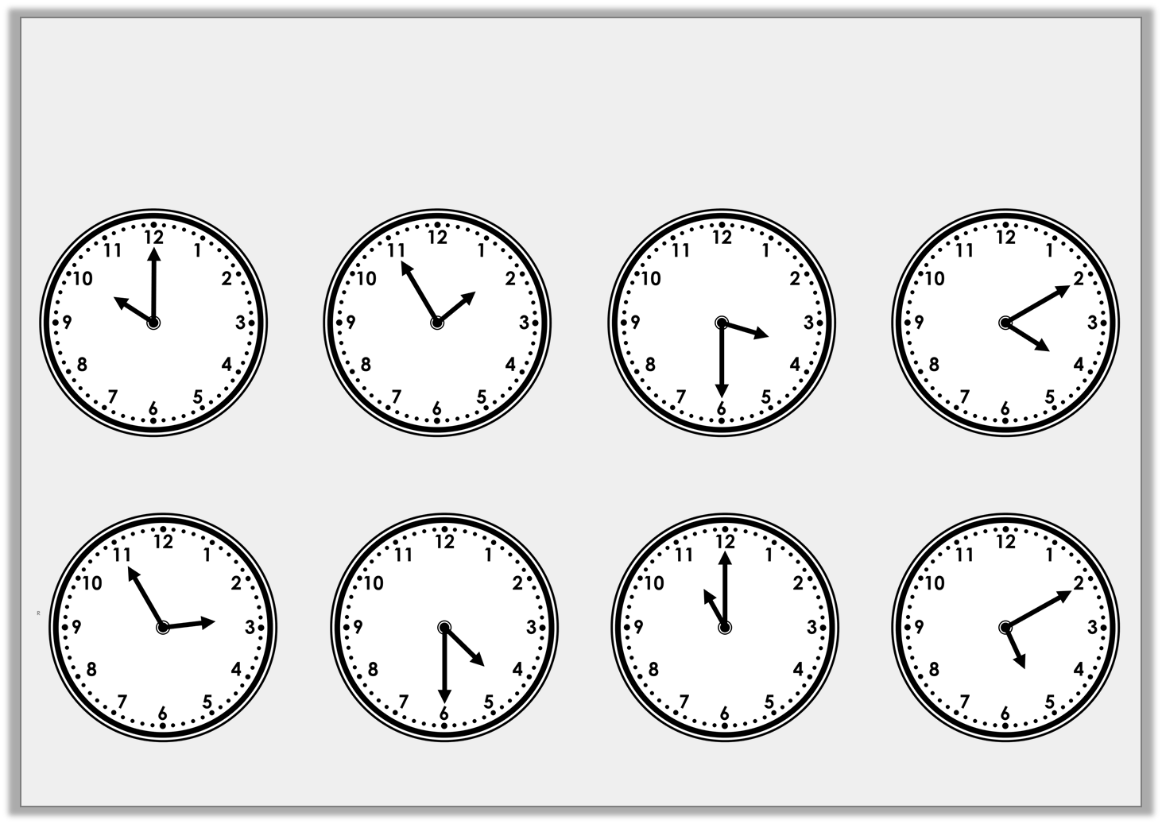
Introduction
Match each time to the time it will be one hour later.
© Classroom Secrets Limited 2019

Slide 5
Introduction
Match each time to the time it will be one hour later.
© Classroom Secrets Limited 2019

Slide 6
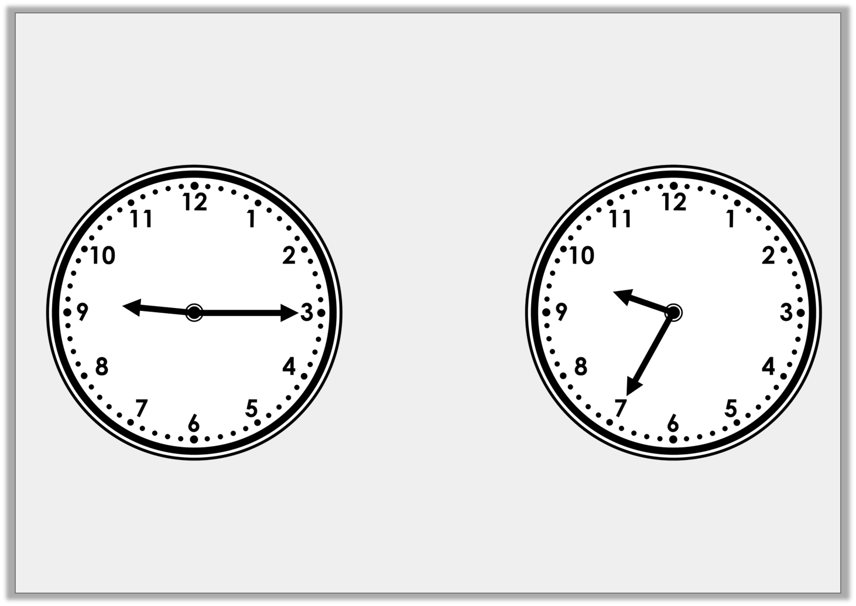
Varied Fluency 1
How much time has passed?
© Classroom Secrets Limited 2019

Slide 7
Varied Fluency 1
How much time has passed?
20 minutes
© Classroom Secrets Limited 2019

Slide 8
Varied Fluency 2
How much time has passed?
25 minutes past 3
25 minutes to 4
© Classroom Secrets Limited 2019

Slide 9
Varied Fluency 2
How much time has passed?
10 minutes
25 minutes past 3
25 minutes to 4
© Classroom Secrets Limited 2018

Slide 10
Varied Fluency 3
A cartoon starts at 25 minutes to 7 and last for 20 minutes.
Circle the time it finishes.
20 minutes to 7
5 minutes to 7
10 minutes to 7
© Classroom Secrets Limited 2019

Slide 11
Varied Fluency 3
A cartoon starts at 25 minutes to 7 and last for 20 minutes.
Circle the time it finishes.
20 minutes to 7
5 minutes to 7
10 minutes to 7
© Classroom Secrets Limited 2019

Slide 12
Varied Fluency 4
Hallie starts her dinner at 5 minutes past 12.
She finishes her dinner at 25 minutes to 1.
Circle the duration that she was eating her dinner for.
15 minutes
20 minutes
30 minutes
35 minutes
© Classroom Secrets Limited 2019

Slide 13
Varied Fluency 4
Hallie starts her dinner at 5 minutes past 12.
She finishes her dinner at 25 minutes to 1.
Circle the duration that she was eating her dinner for.
15 minutes
20 minutes
30 minutes
35 minutes
© Classroom Secrets Limited 2019

Slide 14
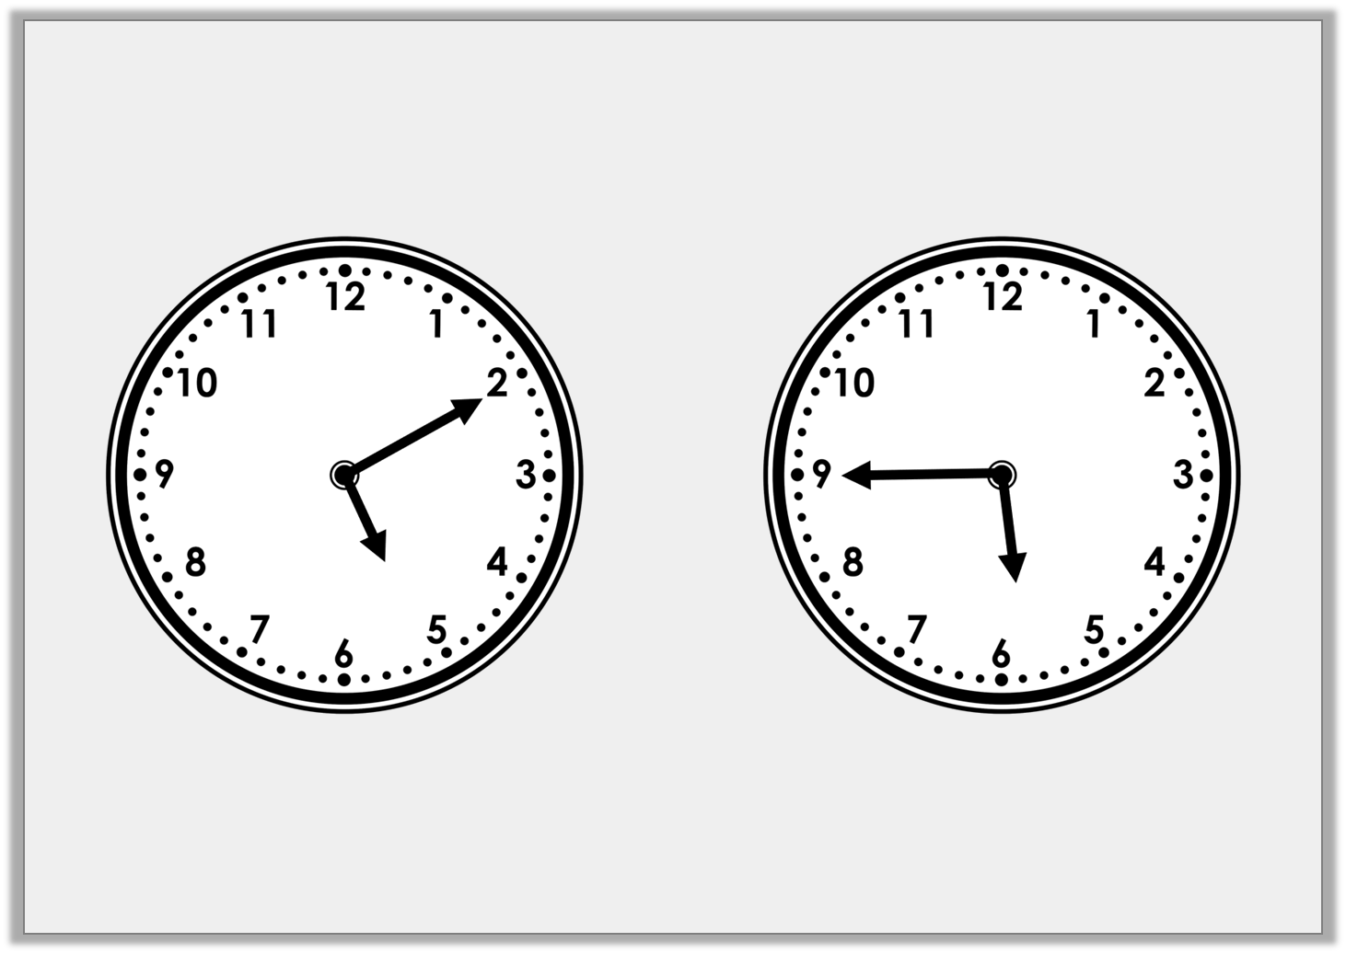
Problem Solving 1
Saffron starts swimming at 10 minutes past 5
and finishes at quarter to 6.
Saffron thinks she swam for 30 minutes.
Is she correct? Explain why.
© Classroom Secrets Limited 2019

Slide 15
Problem Solving 1
Saffron starts swimming at 10 minutes past 5
and finishes at quarter to 6.
Saffron thinks she swam for 30 minutes.
Is she correct? Explain why.
Saffron is incorrect because…
© Classroom Secrets Limited 2019

Slide 16
Problem Solving 1
Saffron starts swimming at 10 minutes past 5
and finishes at quarter to 6.
Saffron thinks she swam for 30 minutes.
Is she correct? Explain why.
Saffron is incorrect because there are 35 minutes between 10 minutes past 5 and quarter to 6.
© Classroom Secrets Limited 2019

Slide 17

Reasoning 1
Aman says,
Is he correct?
Explain why.
It takes me 30 minutes to walk to school. I need to be at school for 5 minutes to 9.
If I set off at 20 minutes past 8 I will get there at the correct time.
© Classroom Secrets Limited 2019

Slide 18
Reasoning 1
Aman says,
Is he correct?
Explain why.
Aman is incorrect because…
It takes me 30 minutes to walk to school. I need to be at school for 5 minutes to 9.
If I set off at 20 minutes past 8 I will get there at the correct time.
© Classroom Secrets Limited 2019

Slide 19
Reasoning 1
Aman says,
Is he correct?
Explain why.
Aman is incorrect because 20 minutes past 8 add 30 minutes = 10 minutes to 9.
It takes me 30 minutes to walk to school. I need to be at school for 5 minutes to 9.
If I set off at 20 minutes past 8 I will get there at the correct time.
© Classroom Secrets Limited 2019

Slide 20
Problem Solving 3
Imogen spends 2 hours at the funfair.
She goes on the funfair monorail which lasts for half an hour.
She goes on the ghost train which lasts for 20 minutes.
She plays on the stall games for 1 hour.
She spends the rest of the time on the log flume.
How long does the log flume last?
© Classroom Secrets Limited 2019

Slide 21
Problem Solving 3
Imogen spends 2 hours at the funfair.
She goes on the funfair monorail which lasts for half an hour.
She goes on the ghost train which lasts for 20 minutes.
She plays on the stall games for 1 hour.
She spends the rest of the time on the log flume.
How long does the log flume last?
1 hour + 30 minutes + 20 minutes = 1 hour and 50 minutes
2 hours – 1 hour and 50 minutes = 10 minutes
The log flume lasts 10 minutes.
© Classroom Secrets Limited 2019

