Slide 1



LIFE/work balance
We have started a #LIFEworkbalance campaign and we need your help to complete our LIFE/work balance survey.
We hope to publish the results soon, so please give 15 minutes of your time to help us get a true picture of school life.
Want to be a part of this campaign? Take the survey on our website and share it with your colleagues!
© Classroom Secrets Limited 2019

Slide 2
Year 2 – Summer Block 3 – Time – Hours and Days
About This Resource:
This PowerPoint has been designed to support your teaching of this small step. It includes a starter activity and an example of each question from the Varied Fluency and Reasoning and Problem Solving resources also provided in this pack. You can choose to work through all examples provided or a selection of them depending on the needs of your class.
National Curriculum Objectives:
Mathematics Year 2: (2M4c) Know the number of minutes in an hour and the number of hours in a day
More Year 2 Time resources.
Did you like this resource? Don’t forget to review it on our website.
© Classroom Secrets Limited 2019

Slide 3
Year 2 – Summer Block 3 – Time
Step 4: Hours and Days
© Classroom Secrets Limited 2019

Slide 4
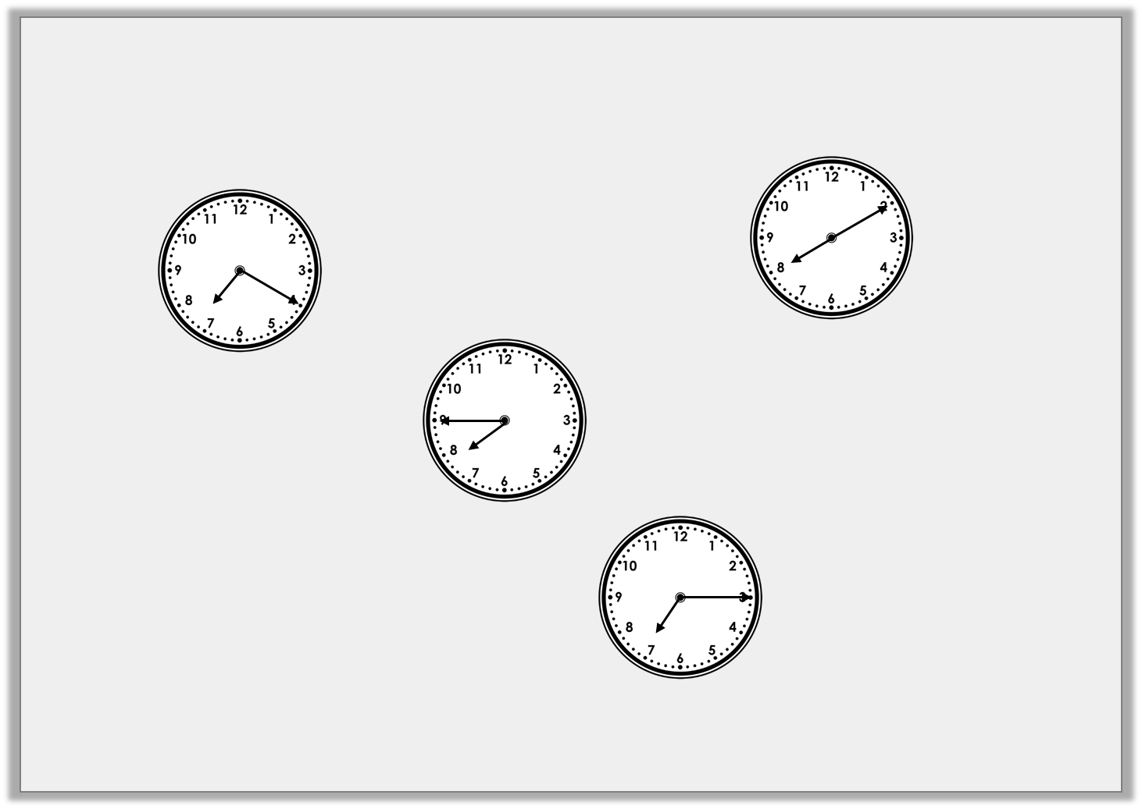
Introduction
Match the times to the clocks to find the odd one out.
Quarter
past seven
Ten to 8
Quarter
To 8
Twenty minutes past 7
Ten past
eight
© Classroom Secrets Limited 2019

Slide 5
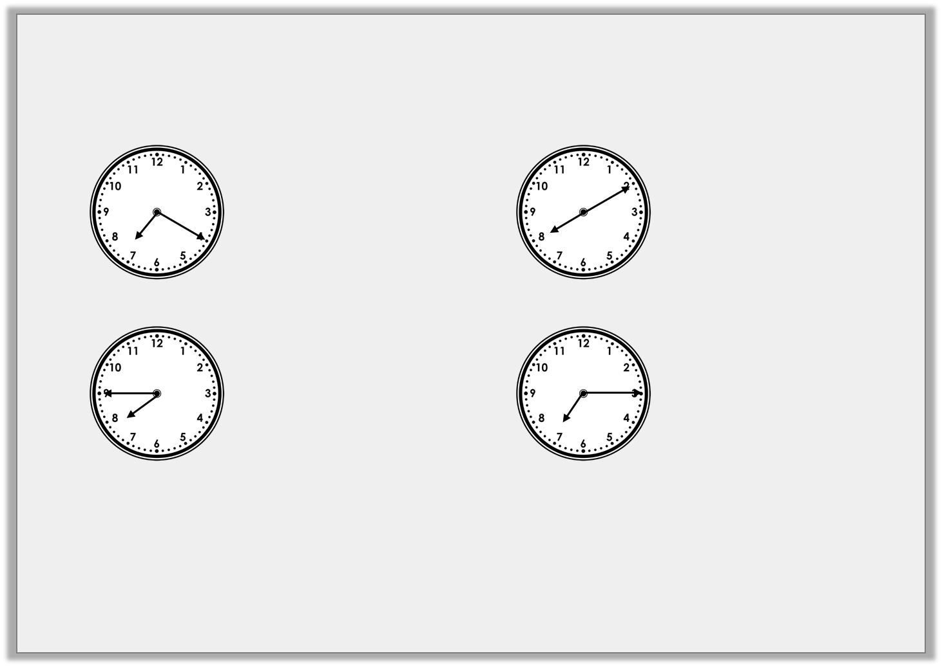
Introduction
Match the times to the clocks to find the odd one out.
Twenty minutes past 7
Ten past
eight
Quarter
To 8
Quarter
past seven
Ten to 8
© Classroom Secrets Limited 2019

Slide 6
Varied Fluency 1
Match the minutes to the correct number of hours.
1 hour
5 minutes
75
minutes
1 hour
20 minutes
65
minutes
1 hour
15 minutes
80
minutes
© Classroom Secrets Limited 2019

Slide 7
Varied Fluency 1
Match the minutes to the correct number of hours.
1 hour
5 minutes
75
minutes
1 hour
20 minutes
65
minutes
1 hour
15 minutes
80
minutes
© Classroom Secrets Limited 2019

Slide 8
Varied Fluency 2
Circle the correct number to complete the sentence.
There are ________ minutes in 1 hour.
50
24
60
© Classroom Secrets Limited 2019

Slide 9
Varied Fluency 2
Circle the correct number to complete the sentence.
There are ________ minutes in 1 hour.
50
24
60
© Classroom Secrets Limited 2019

Slide 10
Varied Fluency 3
Match the pairs to find the odd one out.
1 hour 25 minutes
85
minutes
120
minutes
125
minutes
2 hours
© Classroom Secrets Limited 2019

Slide 11
Varied Fluency 3
Match the pairs to find the odd one out.
125 minutes is the odd one out.
1 hour 25 minutes
85
minutes
120
minutes
2 hours
125
minutes
© Classroom Secrets Limited 2019

Slide 12
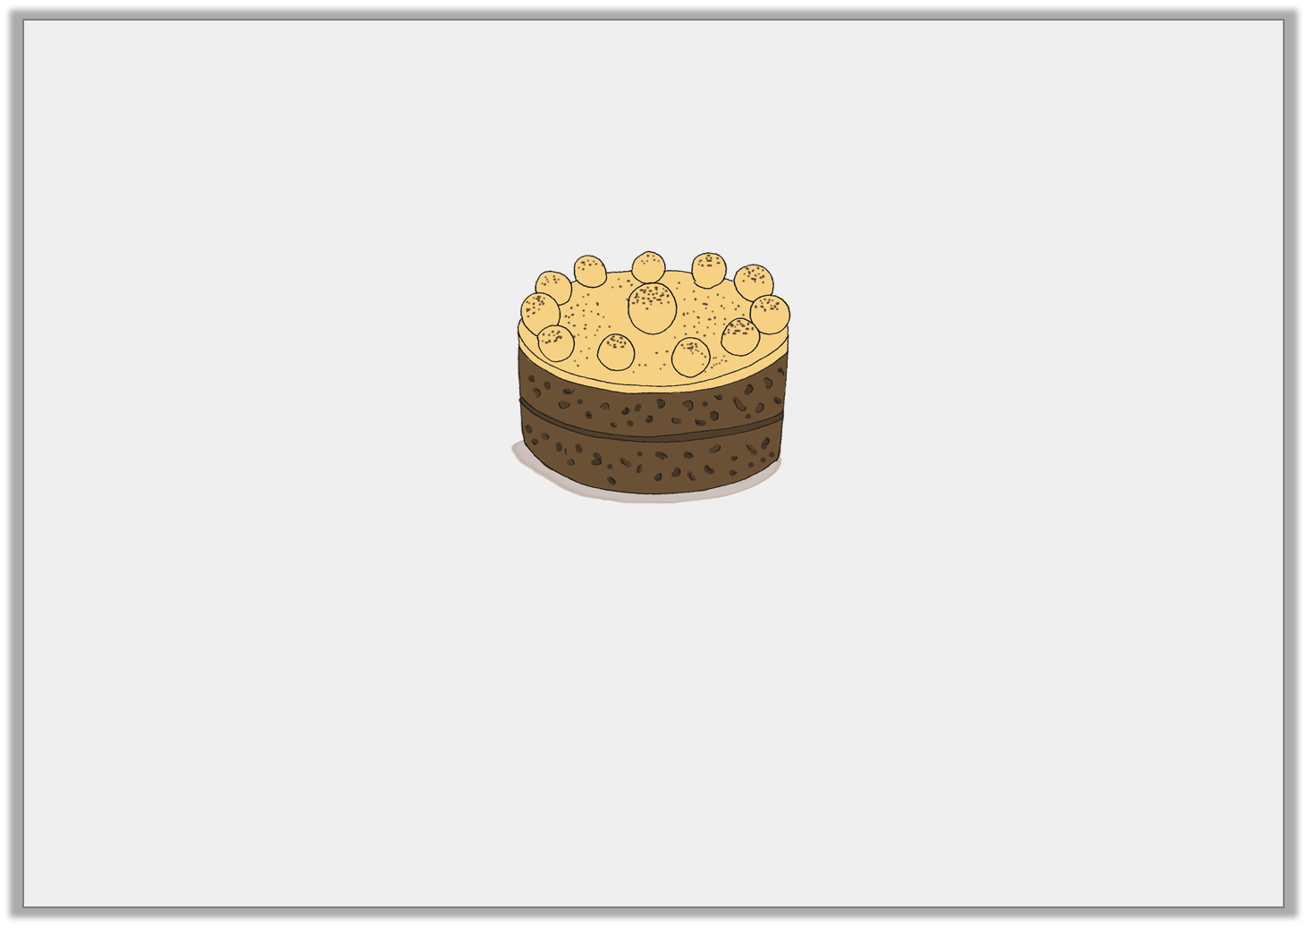
Varied Fluency 4
Charlie is baking a cake. He has to put it in the oven for 1 hour and 45 mins.
How many minutes will the cake be in the oven?
© Classroom Secrets Limited 2019

Slide 13
Varied Fluency 4
Charlie is baking a cake. He has to put it in the oven for 1 hour and 45 mins.
How many minutes will the cake be in the oven?
105 minutes
© Classroom Secrets Limited 2019

Slide 14
Problem Solving 1
Use the digit cards to make different lengths of time to make the statement correct.
4
3
1
2
 |  |  |  | hours > | 1 day
© Classroom Secrets Limited 2019

Slide 15
Problem Solving 1
Use the digit cards to make different lengths of time to make the statement correct.
Various possible answers, for example: 31, 32, 34, 41, 42, 43
4
3
1
2
 |  |  |  | hours > | 1 day
© Classroom Secrets Limited 2019

Slide 16

Reasoning 1
Jenna and Max are talking about hours and minutes.
Who do you agree with? Explain why.
1 hour and 55 minutes is 115 minutes.
Jenna
1 hour and 55 minutes is 155 minutes.
Max
© Classroom Secrets Limited 2019

Slide 17
Reasoning 1
Jenna and Max are talking about hours and minutes.
Who do you agree with? Explain why.
Jenna is correct because…
1 hour and 55 minutes is 115 minutes.
Jenna
1 hour and 55 minutes is 155 minutes.
Max
© Classroom Secrets Limited 2019

Slide 18
Reasoning 1
Jenna and Max are talking about hours and minutes.
Who do you agree with? Explain why.
Jenna is correct because there are 60 minutes in 1 hour.
60 + 55 = 115
1 hour and 55 minutes is 115 minutes.
Jenna
1 hour and 55 minutes is 155 minutes.
Max
© Classroom Secrets Limited 2019

Slide 19
Reasoning 2
Sort the times into the table below.
Which time does not fit in the table? Explain why.
Less than 70 minutes | From 70 minutes to 100 minutes
1 hour
5 minutes
1 hour
20 minutes
1 hour
15 minutes
1 hour
30 minutes
1 hour
45 minutes
© Classroom Secrets Limited 2019

Slide 20
Reasoning 2
Sort the times into the table below.
Which time does not fit in the table? Explain why.
1 hour 45 minutes does not fit because…
Less than 70 minutes | From 70 minutes to 100 minutes
1 hour
5 minutes
1 hour
20 minutes
1 hour
15 minutes
1 hour
30 minutes
1 hour
45 minutes
© Classroom Secrets Limited 2019

Slide 21
Reasoning 2
Sort the times into the table below.
Which time does not fit in the table? Explain why.
1 hour 45 minutes does not fit because this is the same as 105 minutes which is more than 100 minutes.
Less than 70 minutes | From 70 minutes to 100 minutes
1 hour
5 minutes
1 hour
20 minutes
1 hour
15 minutes
1 hour
30 minutes
1 hour
45 minutes
© Classroom Secrets Limited 2019

