Slide 1


LIFE/work balance
We have started a #LIFEworkbalance campaign and we need your help to complete our LIFE/work balance survey.
We hope to publish the results soon, so please give 15 minutes of your time to help us get a true picture of school life.
Want to be a part of this campaign? Take the survey on our website and share it with your colleagues!
© Classroom Secrets Limited 2019

Slide 2

Year 2 – Summer Block 3 – Time – Telling Time to 5 Minutes
About This Resource:
This PowerPoint has been designed to support your teaching of this small step. It includes a starter activity and an example of each question from the Varied Fluency and Reasoning and Problem Solving resources also provided in this pack. You can choose to work through all examples provided or a selection of them depending on the needs of your class.
National Curriculum Objectives:
Mathematics Year 2: (2M4a) Tell and write the time to five minutes, including quarter past/to the hour and draw the hands on a clock face to show these times
More Year 2 Time resources.
Did you like this resource? Don’t forget to review it on our website.
© Classroom Secrets Limited 2019

Slide 3
Year 2 – Summer Block 3 – Time
Step 3: Telling Time to 5 Minutes
© Classroom Secrets Limited 2019

Slide 4
Introduction
These numbers are all multiples of 5.
Identify the missing multiples.
5 |  | 15
 | 30 | 35 | 40
45 |  | 55
60 |  | 50 | 45
 | 35 |  | 25
20 |  | 10
© Classroom Secrets Limited 2019

Slide 5
Introduction
These numbers are all multiples of 5.
Identify the missing multiples.
5 | 10 | 15 | 20
25 | 30 | 35 | 40
45 | 50 | 55 | 60
60 | 55 | 50 | 45
40 | 35 | 30 | 25
20 | 15 | 10 | 5
© Classroom Secrets Limited 2019

Slide 6
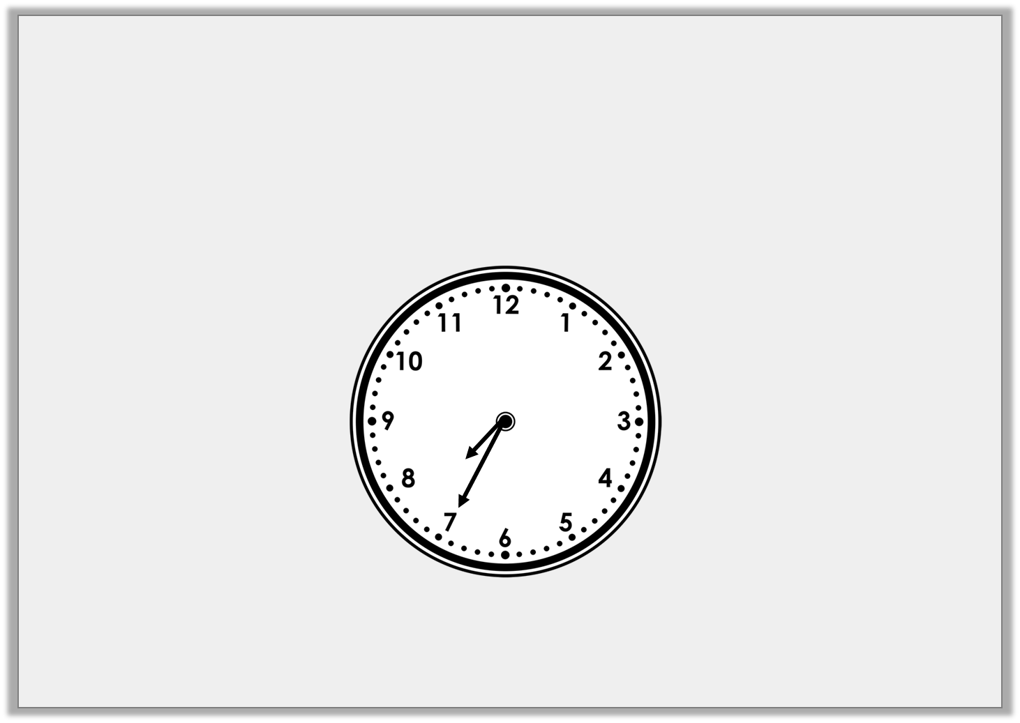
Varied Fluency 1
True or false?
The clock shows the time 25 past 8.
© Classroom Secrets Limited 2019

Slide 7
Varied Fluency 1
True or false?
The clock shows the time 25 past 8.
False, the clock shows the time 25 to 8.
© Classroom Secrets Limited 2019

Slide 8
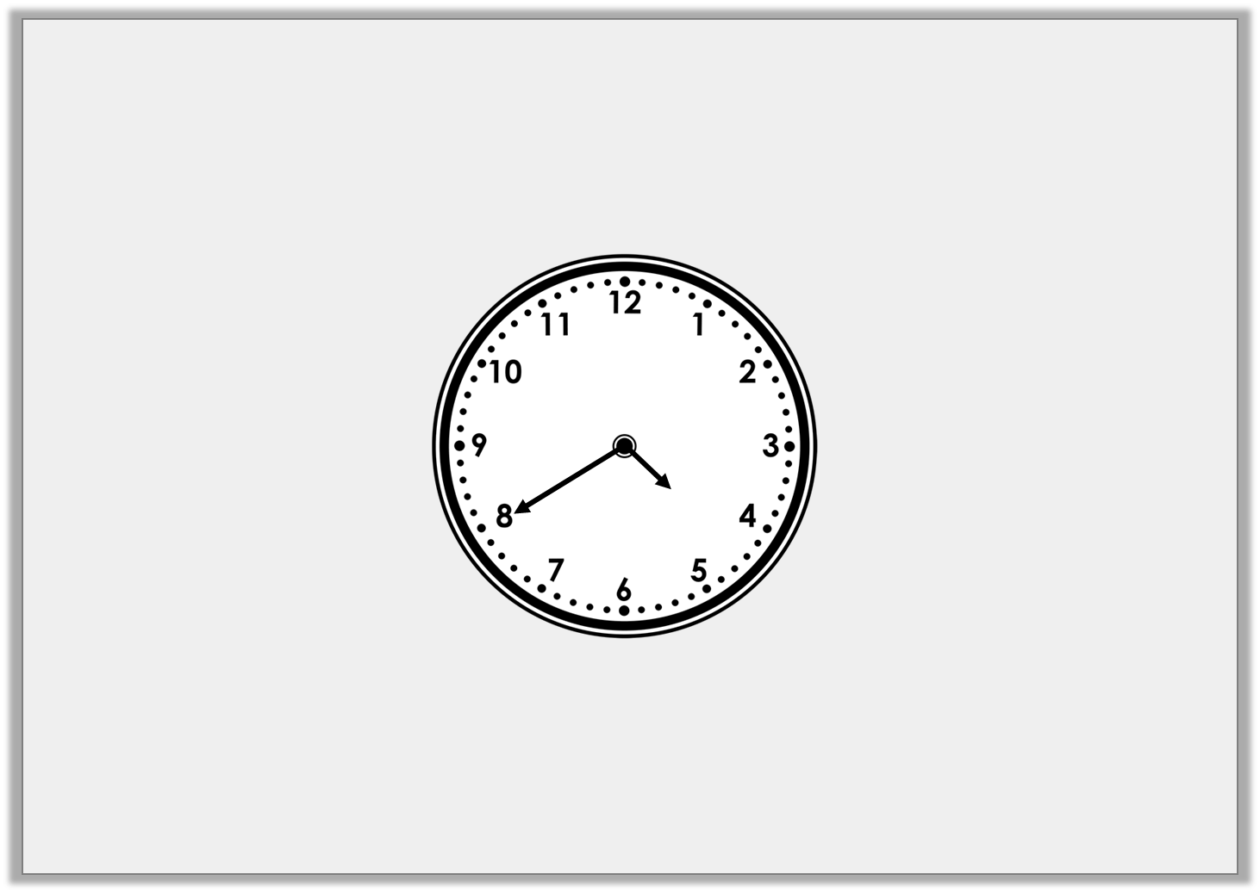
Varied Fluency 2
What is the time?
© Classroom Secrets Limited 2019

Slide 9
Varied Fluency 2
What is the time?
20 to 5
© Classroom Secrets Limited 2019

Slide 10
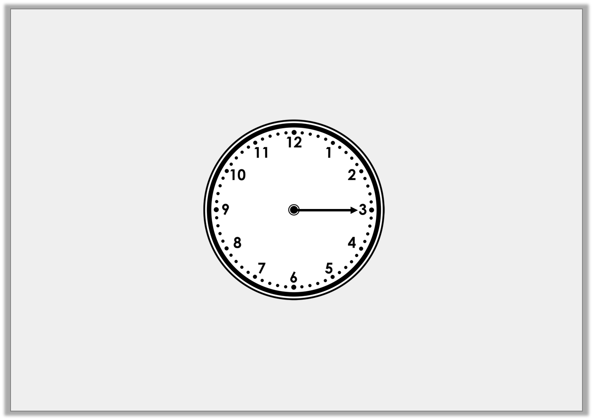
Varied Fluency 3
What is the time 20 minutes after the time shown?
© Classroom Secrets Limited 2019

Slide 11
Varied Fluency 3
What is the time 20 minutes after the time shown?
25 to 1
© Classroom Secrets Limited 2019

Slide 12
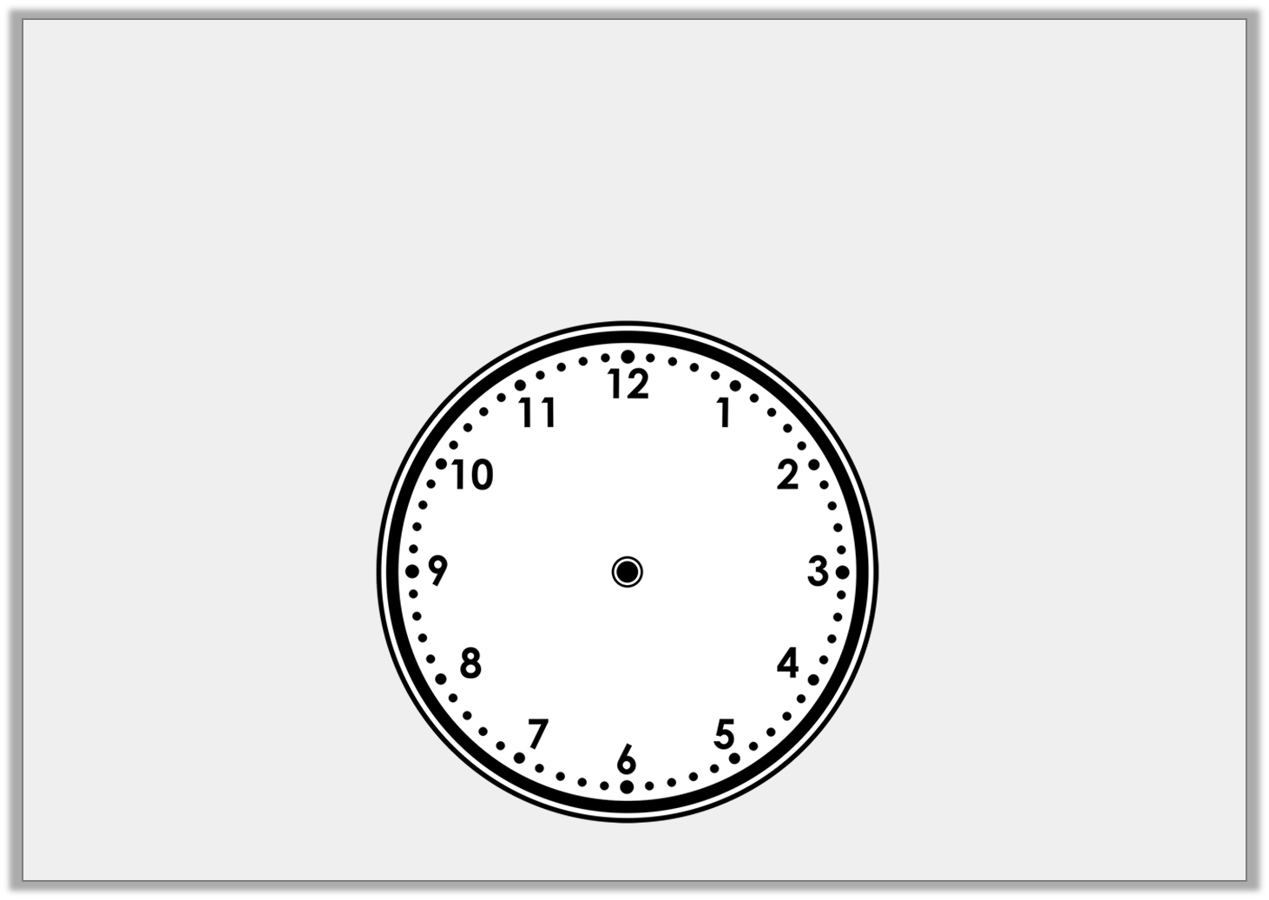
Varied Fluency 4
Draw the time below on the clock.
20 past 9
© Classroom Secrets Limited 2019

Slide 13
Varied Fluency 4
Draw the time below on the clock.
20 past 9
© Classroom Secrets Limited 2019

Slide 14
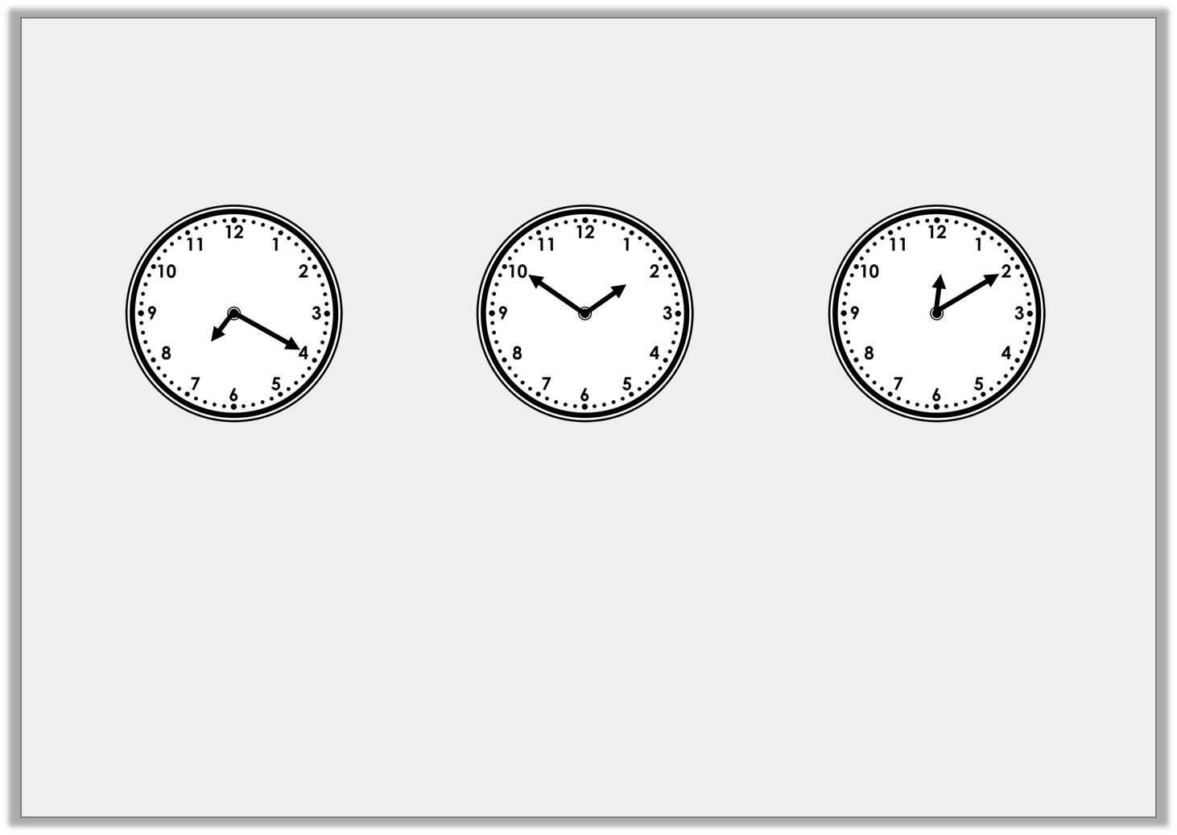
Problem Solving 1
Draw lines to match the correct times.
10 past 12
20 past 7
10 to 2
© Classroom Secrets Limited 2019

Slide 15
Problem Solving 1
Draw lines to match the correct times.
10 past 12
20 past 7
10 to 2
© Classroom Secrets Limited 2019

Slide 16

Reasoning 1
Martin says,
Is he correct?
Explain why.
I left home at 5 past 2 and arrived at the library at 10 to 3, so the minute hand was on the 9.
© Classroom Secrets Limited 2019

Slide 17
Reasoning 1
Martin says,
Is he correct?
Explain why.
Martin is not correct because…
I left home at 5 past 2 and arrived at the library at 10 to 3, so the minute hand was on the 9.
© Classroom Secrets Limited 2019

Slide 18
Reasoning 1
Martin says,
Is he correct?
Explain why.
Martin is not correct because the minute hand points to the 10 when it is 10 minutes to the hour. If the minute hand was on the 9, it would have been quarter to 3.
I left home at 5 past 2 and arrived at the library at 10 to 3, so the minute hand was on the 9.
© Classroom Secrets Limited 2019

Slide 19
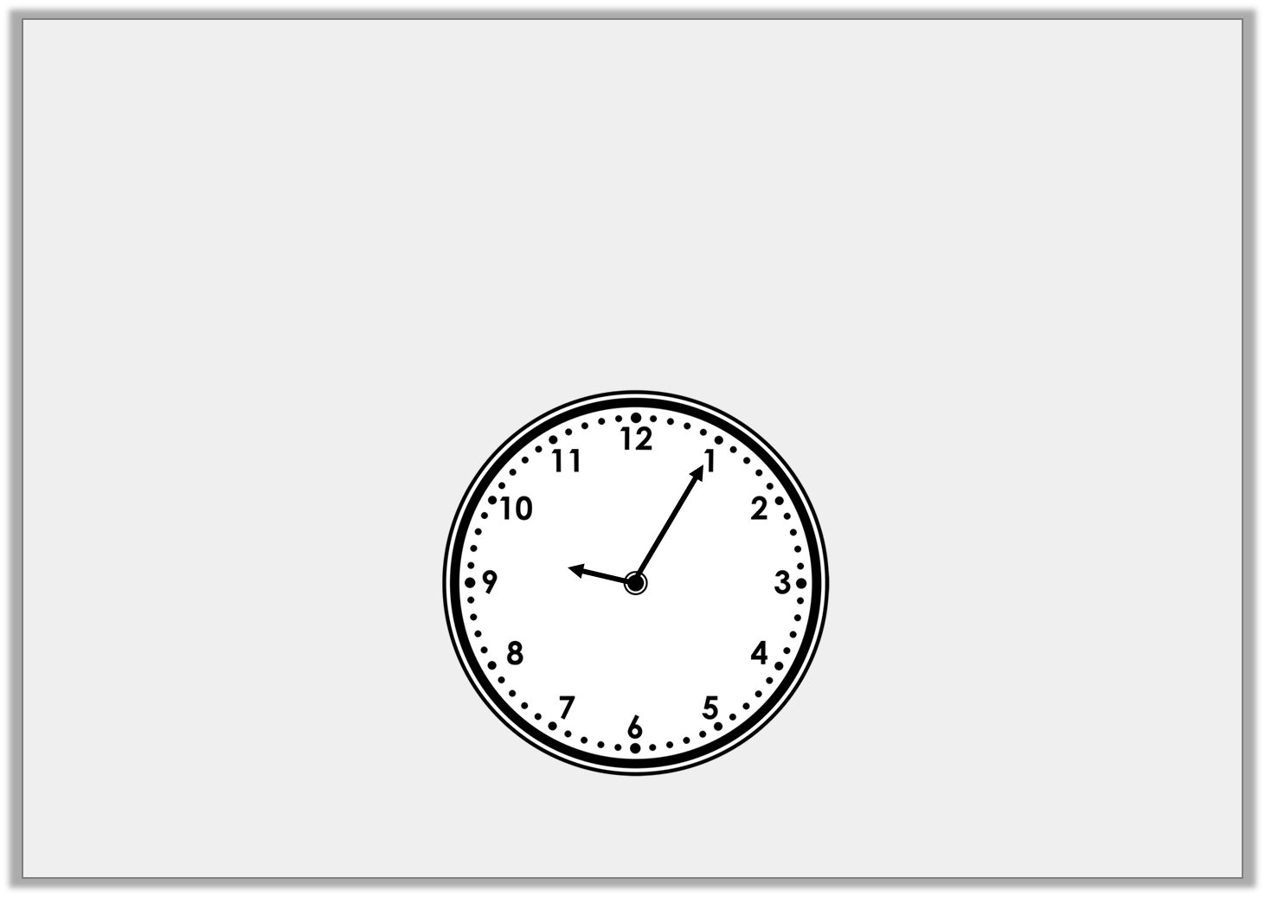
Problem Solving 2
Suzie starts skipping at 5 past 9.
She skips for 5 minutes then hops for 5 minutes.
What time does she finish hopping?
© Classroom Secrets Limited 2019

Slide 20
Problem Solving 2
Suzie starts skipping at 5 past 9.
She skips for 5 minutes then hops for 5 minutes.
What time does she finish hopping?
Quarter past 9 or 15 minutes past 9.
© Classroom Secrets Limited 2019

