Slide 1


LIFE/work balance
We have started a #LIFEworkbalance campaign and we need your help to complete our LIFE/work balance survey.
We hope to publish the results soon, so please give 15 minutes of your time to help us get a true picture of school life.
Want to be a part of this campaign? Take the survey on our website and share it with your colleagues!
© Classroom Secrets Limited 2019

Slide 2


Year 2 – Summer Block 3 – Time – Quarter Past and Quarter To
About This Resource:
This PowerPoint has been designed to support your teaching of this small step. It includes a starter activity and an example of each question from the Varied Fluency and Reasoning and Problem Solving resources also provided in this pack. You can choose to work through all examples provided or a selection of them depending on the needs of your class.
National Curriculum Objectives:
Mathematics Year 2: (2M4a) Tell and write the time to five minutes, including quarter past/to the hour and draw. the hands on a clock face to show these times
Mathematics Year 2: (2M4b) Compare and sequence intervals of time.
More Year 2 Time resources.
Did you like this resource? Don’t forget to review it on our website.
© Classroom Secrets Limited 2018

Slide 3
Year 2 – Summer Block 3 – Time
Step 2: Quarter Past and Quarter To
© Classroom Secrets Limited 2018

Slide 4
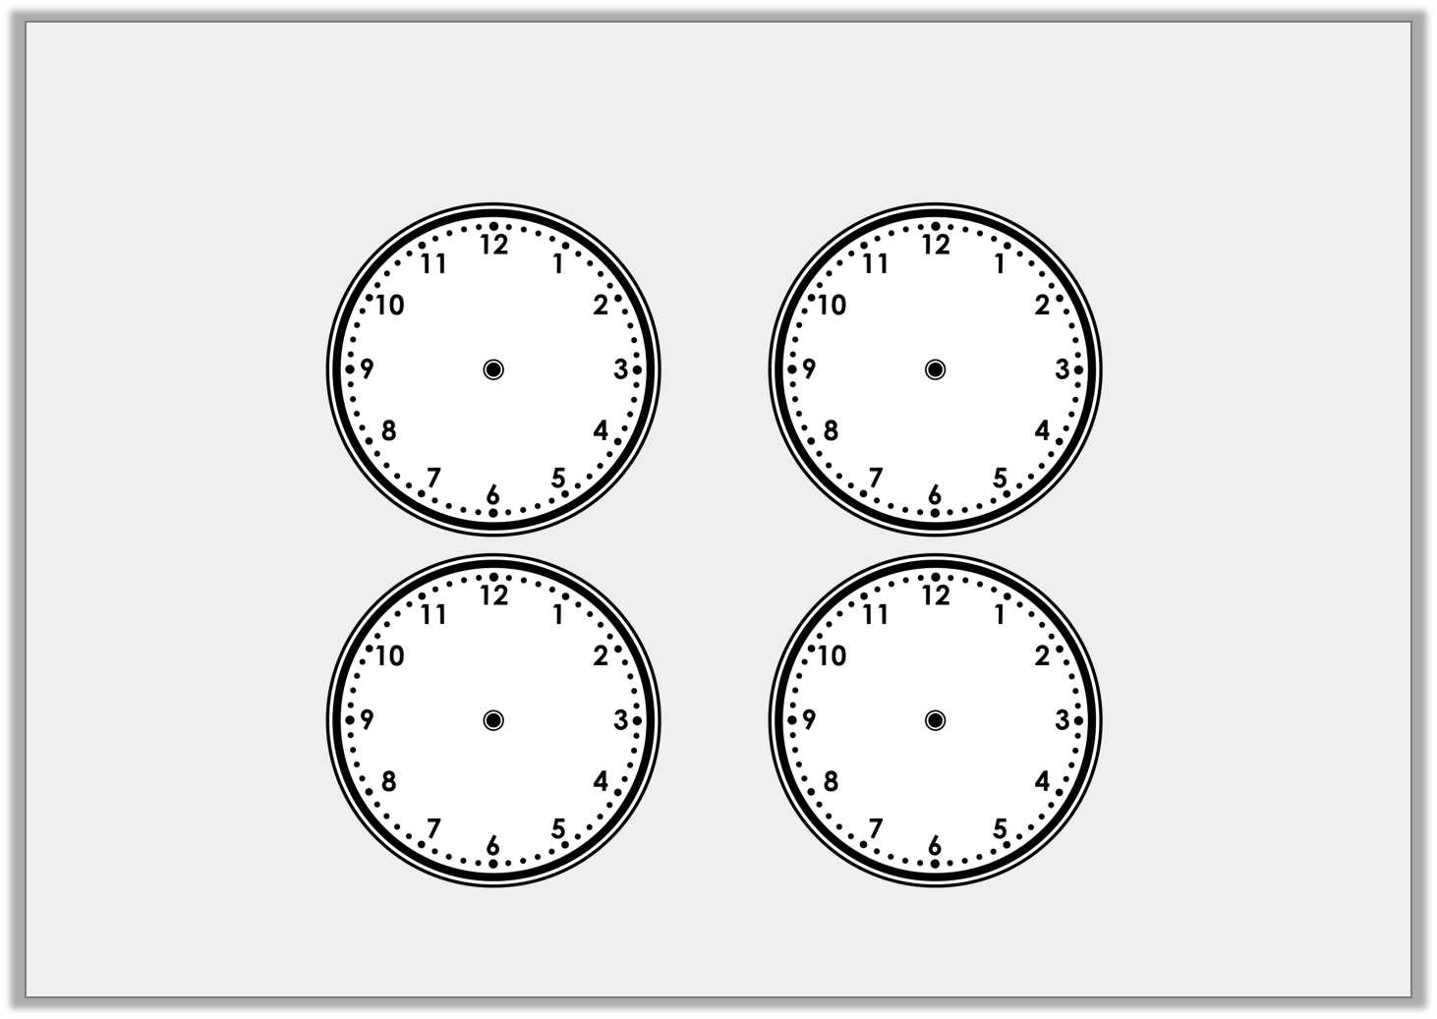
Introduction
Use the position of the minute hand to help you label each clock.
quarter past
quarter to
half past
o’clock
© Classroom Secrets Limited 2018

Slide 5
Introduction
Use the position of the minute hand to help you label each clock.
o’clock
quarter past
half past
quarter to
© Classroom Secrets Limited 2018

Slide 6
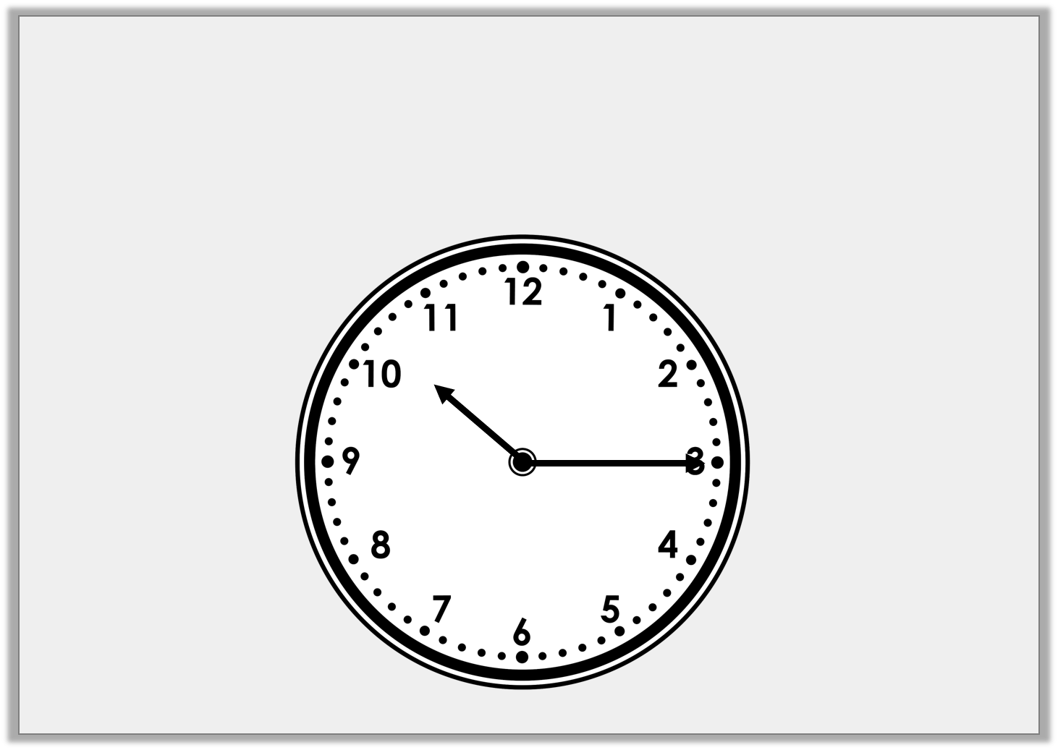
Varied Fluency 1
Write the time shown on this clock.
© Classroom Secrets Limited 2018

Slide 7
Varied Fluency 1
Write the time shown on this clock.
Quarter past 10
© Classroom Secrets Limited 2018

Slide 8
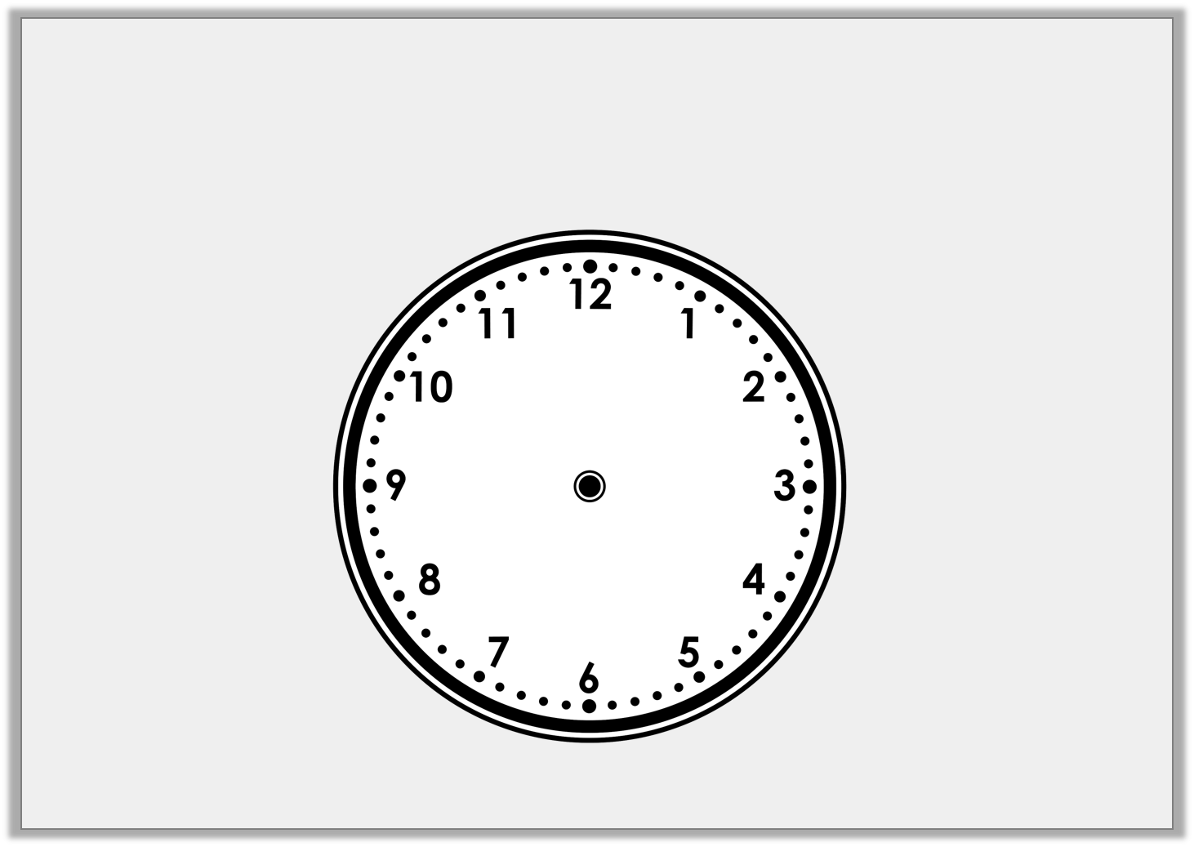
Varied Fluency 2
Draw the missing hands on the clock so that it shows the correct time written beneath it.
Quarter past 1
© Classroom Secrets Limited 2018

Slide 9
Varied Fluency 2
Draw the missing hands on the clock so that it shows the correct time written beneath it.
Quarter past 1
© Classroom Secrets Limited 2018

Slide 10
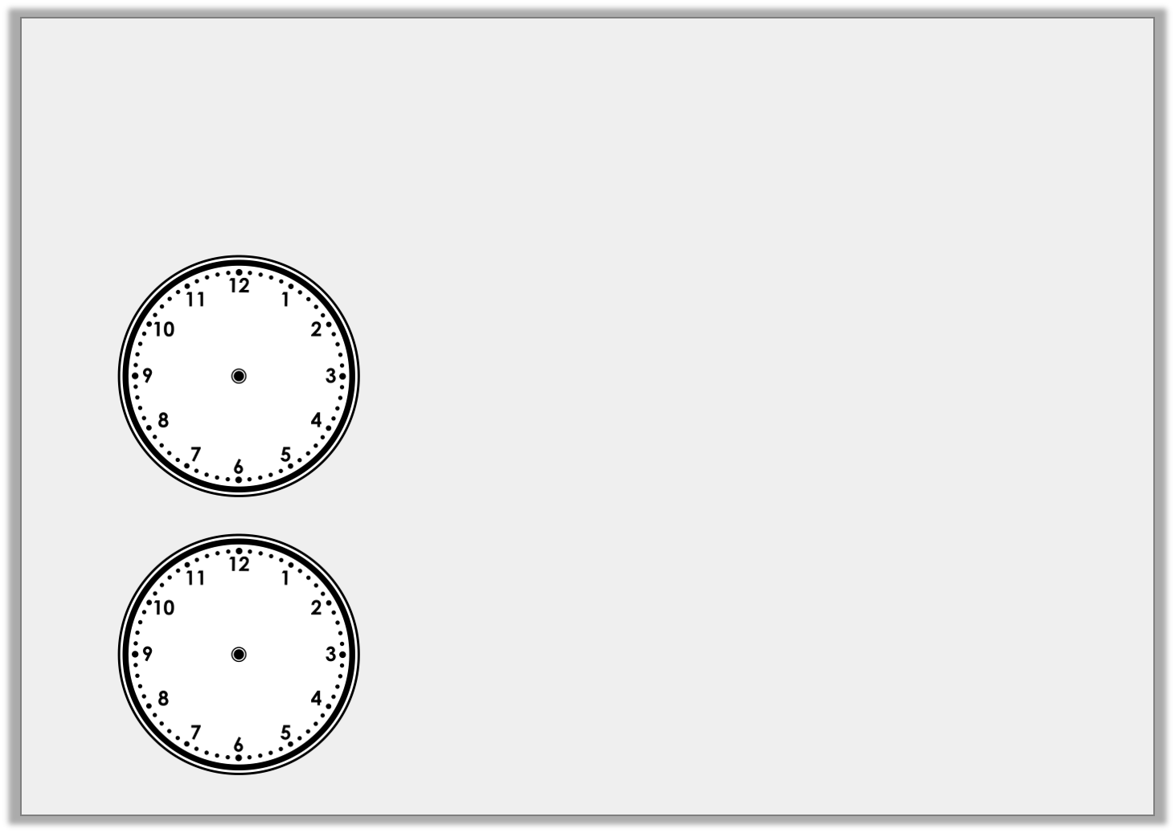
Varied Fluency 3
Draw a line to match the clocks to the correct written time.
Quarter past 3
Quarter to 7
Quarter past 12
© Classroom Secrets Limited 2018

Slide 11
Varied Fluency 3
Draw a line to match the clocks to the correct written time.
Quarter past 3
Quarter to 7
Quarter past 12
© Classroom Secrets Limited 2018

Slide 12
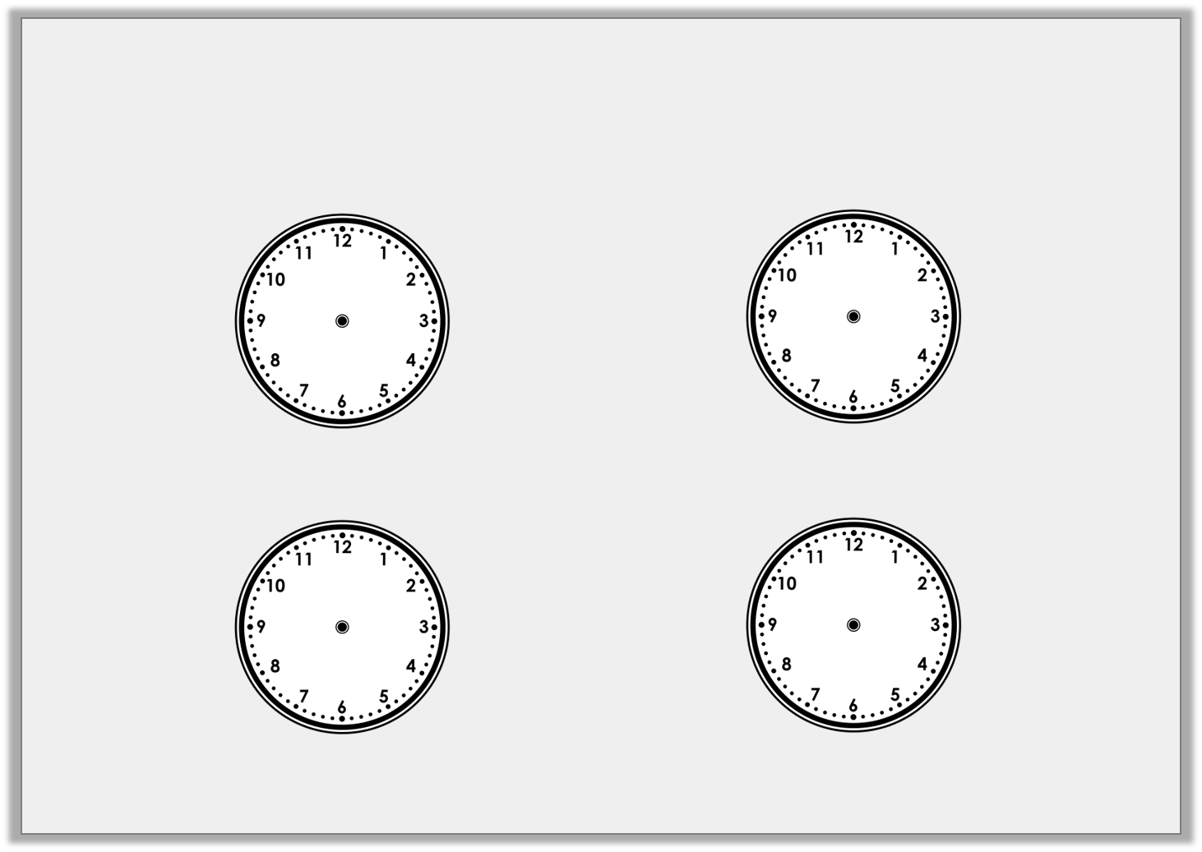
Varied Fluency 4
Draw where the minute hand will be in 15 minutes time (a quarter turn).
Half past 10 |  | Quarter to 11
8 o’clock |  | Quarter past 8
© Classroom Secrets Limited 2018

Slide 13
Varied Fluency 4
Draw where the minute hand will be in 15 minutes time (a quarter turn).
Half past 10 |  | Quarter to 11
8 o’clock |  | Quarter past 8
© Classroom Secrets Limited 2018

Slide 14
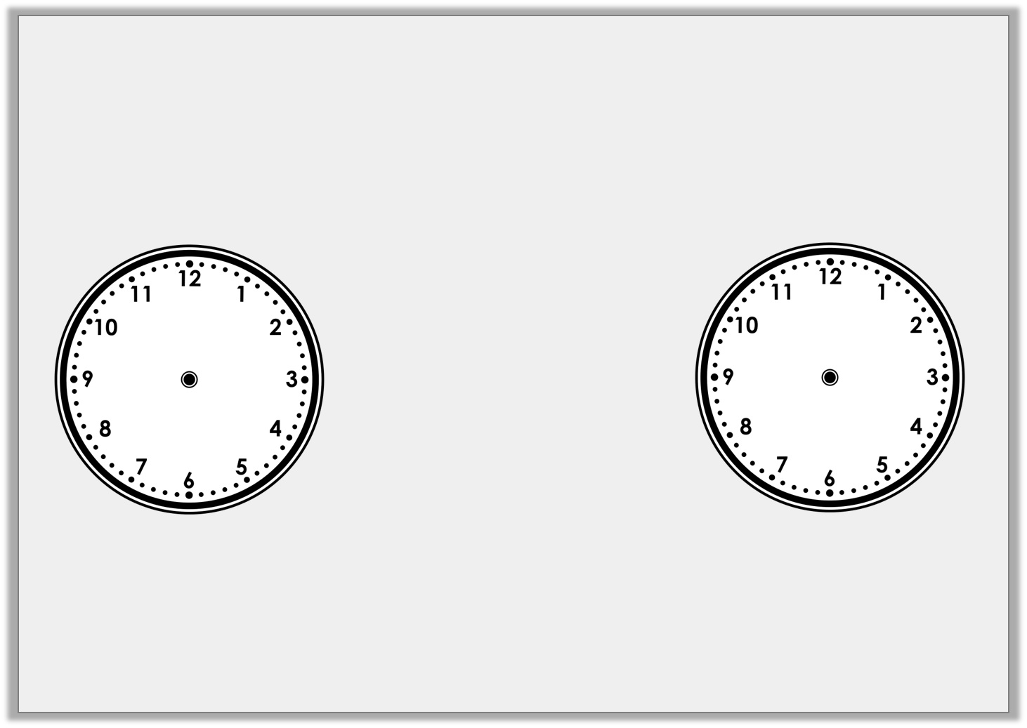
Problem Solving 1
How many quarters of an hour are between 2 o’clock and half past 4?
© Classroom Secrets Limited 2018

Slide 15
Problem Solving 1
How many quarters of an hour are between 2 o’clock and half past 4?
10 quarters of an hour
© Classroom Secrets Limited 2018

Slide 16
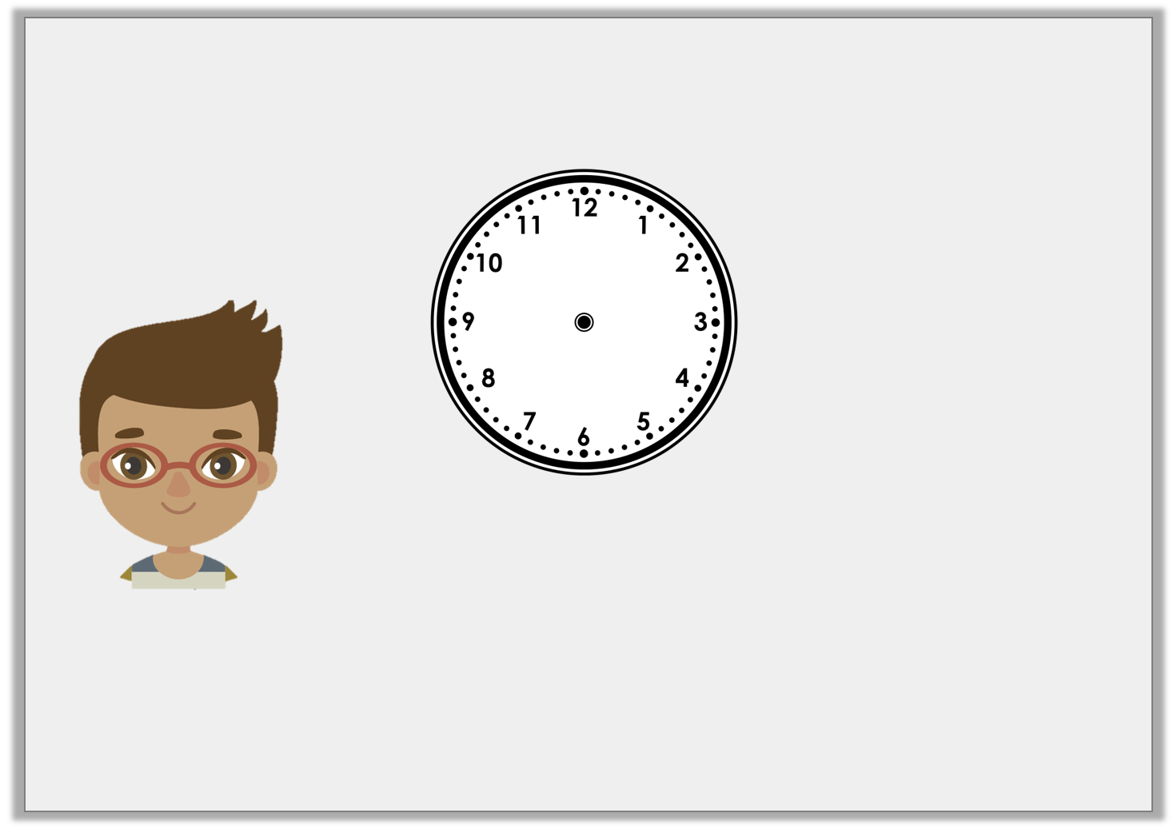
Reasoning 1
Mark is trying to tell the time.
Is Mark right? How do you know?
In quarter of an hour it will be half past 3.
© Classroom Secrets Limited 2018

Slide 17
Reasoning 1
Mark is trying to tell the time.
Is Mark right? How do you know?
Mark is right because…
In quarter of an hour it will be half past 3.
© Classroom Secrets Limited 2018

Slide 18
Reasoning 1
Mark is trying to tell the time.
Is Mark right? How do you know?
Mark is right because the time shown on the clock is quarter past 3.
In quarter of an hour it will be half past 3.
© Classroom Secrets Limited 2018

Slide 19
Problem Solving 2
Playtime is 15 minutes long. What time would it finish if it started at the time shown on the clock?
Draw the hands and write the answer.
© Classroom Secrets Limited 2018

Slide 20
Problem Solving 2
Playtime is 15 minutes long. What time would it finish if it started at the time shown on the clock?
Draw the hands and write the answer.
Half past 10
© Classroom Secrets Limited 2018

