Slide 1

Year 2 – Spring Block 2 – Apostrophes – Introducing Possession
About This Resource:
This PowerPoint has been designed to support your teaching of this small step. It includes a starter activity and an example of each question from the Varied Fluency and Application and Reasoning resources also provided in this pack. You can choose to work through all examples provided or a selection of them depending on the needs of your class.
National Curriculum Objectives:
English Year 2: (2G5.8) Apostrophes to mark where letters are missing in spelling and to mark singular possession in nouns [for example, the girl’s name]
Terminology for pupils:
  English Year 2: (2G5.8) apostrophe
More resources from our Grammar, Punctuation and Spelling scheme of work.
Did you like this resource? Don’t forget to review it on our website.
© Classroom Secrets Limited 2019

Slide 2
Year 2 – Spring Block 2 – Apostrophes – Introducing Possession
Notes and Guidance:
Please note: this step focuses specifically on apostrophes to show possession in singular nouns only. Possession using plural nouns will be covered in Year 4 Spring Block 1.
Children need to understand the term possession and that it shows that something belongs to something else, for example, the car belongs to the man so it is the man’s car.
Children need to know that the apostrophe is always placed before the -s to show singular possession, for example: the dog’s toy; the boy’s father.
There is a variety of guidance on apostrophes for possession when the singular noun ends in -s. It is grammatically correct to use both James’ bag and James’s bag to show possession. The main rule is that the use of apostrophes are consistent across the piece of writing. We suggest using the following guidance to ensure consistency.
For a singular noun or proper noun ending in -s, add ’s to show possession, for example Thomas’s book. This then allows the use of just an apostrophe for any plural nouns ending in -s (which is covered in Year 4).
Focused Questions
Which word is missing an apostrophe to show possession?
Who does the dog belong to in this sentence? (For example, the man’s dog was old.)
What type of apostrophe has been used in this sentence? Words with apostrophes for possession and those for simple contractions.
© Classroom Secrets Limited 2019

Slide 3
Year 2 – Spring Block 2 – Apostrophes
Step 3: Introducing Possession
© Classroom Secrets Limited 2019

Slide 4
Introduction
Circle all the apostrophes in this sentence.
Explain what the apostrophes are being used for.
The rabbit’s ears twitched because he’d heard a noise in the bushes.
© Classroom Secrets Limited 2019

Slide 5
Introduction
Circle all the apostrophes in this sentence.
Explain what the apostrophes are being used for.
The apostrophe in rabbit’s shows that the ears belong to the rabbit.
The apostrophe in he’d shows where letters are missing in the contraction.
The rabbit’s ears twitched because he’d heard a noise in the bushes.
© Classroom Secrets Limited 2019

Slide 6
Varied Fluency 1
Circle all the apostrophes.
Match the phrases to the possessive form.
my uncle’s car |  | the car’s tyres
the car’s wheels |  | the car belonging to my uncle
the tyres of the car |  | the wheels of the car
© Classroom Secrets Limited 2019

Slide 7
Varied Fluency 1
Circle all the apostrophes.
Match the phrases to the possessive form.
my uncle’s car |  | the car’s tyres
the car’s wheels |  | the car belonging to my uncle
the tyres of the car |  | the wheels of the car
© Classroom Secrets Limited 2019

Slide 8
Varied Fluency 2
Tick the sentence that uses an apostrophe for possession correctly.
A. The tree’s leaves were golden.
B. The trees leave’s were changing colour.
© Classroom Secrets Limited 2019

Slide 9
Varied Fluency 2
Tick the sentence that uses an apostrophe for possession correctly.
A. The tree’s leaves were golden. |  | ✓
B. The trees leave’s were changing colour.
© Classroom Secrets Limited 2019

Slide 10
Varied Fluency 3
Rewrite the sentence using an apostrophe for possession.
The hair belonging to Tess was very long.
© Classroom Secrets Limited 2019

Slide 11
Varied Fluency 3
Rewrite the sentence using an apostrophe for possession.
The hair belonging to Tess was very long.
Tess’s hair was very long.
© Classroom Secrets Limited 2019

Slide 12
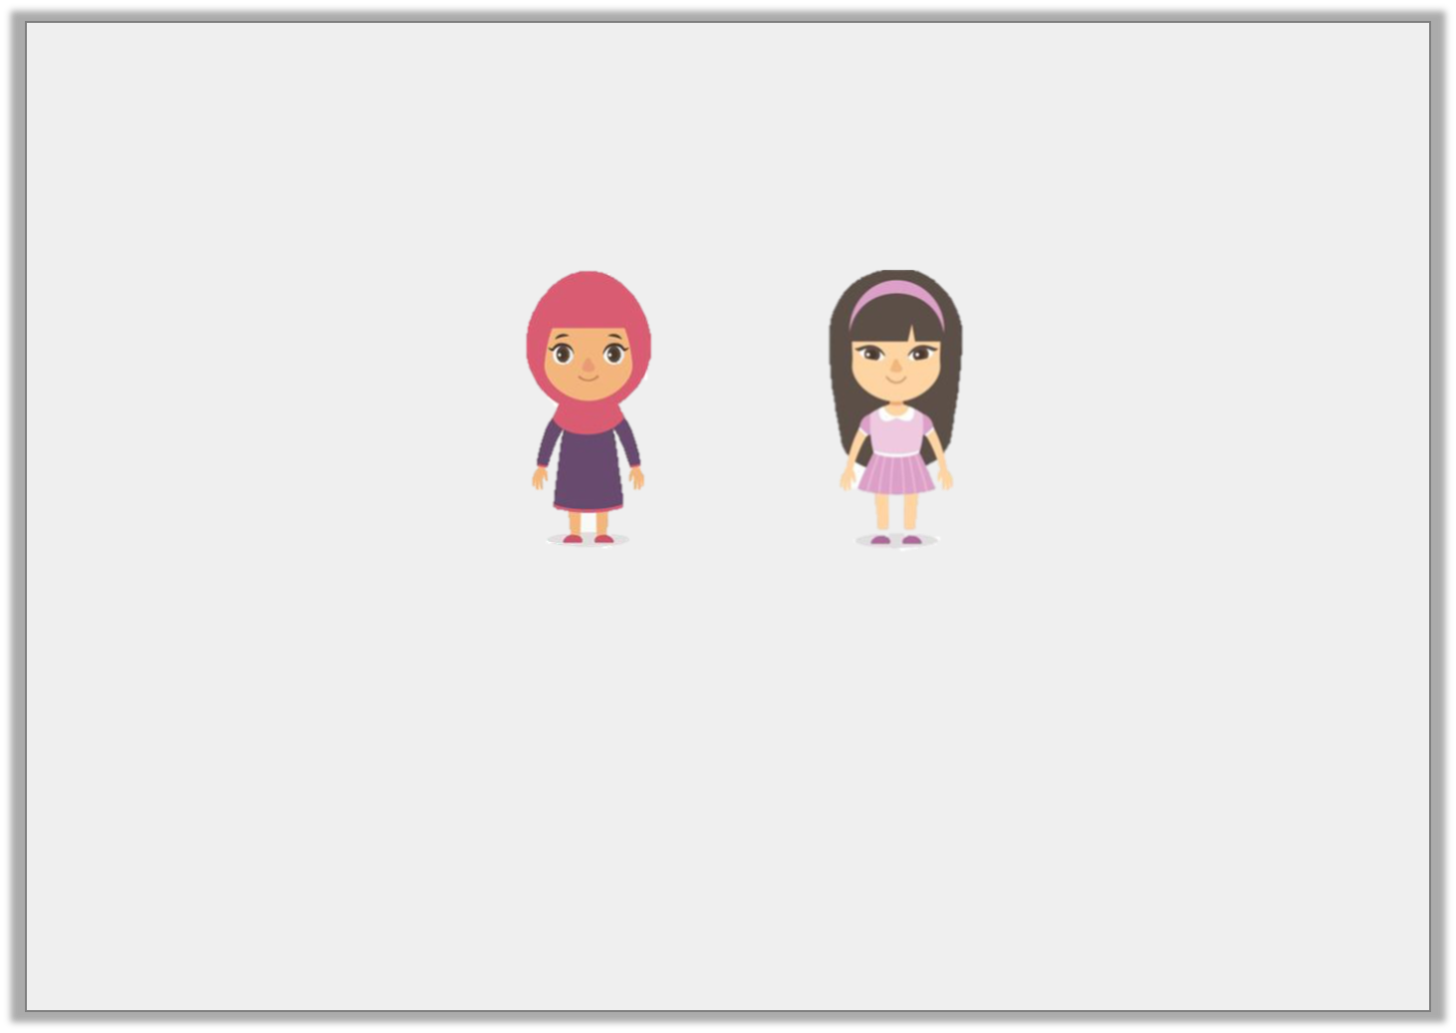
Varied Fluency 4
Use the pictures to complete the sentences.
____________________ dress has long sleeves.
____________________ dress has short sleeves.
Maya
Iris
© Classroom Secrets Limited 2019

Slide 13
Varied Fluency 4
Use the pictures to complete the sentences.
Maya’s dress has long sleeves.
Iris’s dress has short sleeves.
Maya
Iris
© Classroom Secrets Limited 2019

Slide 14
Application 1
Choose the correct words from the word bank to complete the sentences below.
____________________ pet is a rabbit.
The ____________________ fur is white.
rabbits | Ross
Ross’s | rabbit’s
© Classroom Secrets Limited 2019

Slide 15
Application 1
Choose the correct words from the word bank to complete the sentences below.
Ross’s pet is a rabbit.
The rabbit’s fur is white.
rabbits | Ross
Ross’s | rabbit’s
© Classroom Secrets Limited 2019

Slide 16
Application 2
Punctuate the sentence below by adding an apostrophe in the correct place.
Dad picked up the babys toys.
© Classroom Secrets Limited 2019

Slide 17
Application 2
Punctuate the sentence below by adding an apostrophe in the correct place.
Dad picked up the baby’s toys.
© Classroom Secrets Limited 2019

Slide 18
Reasoning 1
True or false? The apostrophe has been used correctly in the sentence below.
Ben and Sam are Jacob’s friends.
Explain your answer
© Classroom Secrets Limited 2019

Slide 19
Reasoning 1
True or false? The apostrophe has been used correctly in the sentence below.
Ben and Sam are Jacob’s friends.
Explain your answer
This is true because…
© Classroom Secrets Limited 2019

Slide 20
Reasoning 1
True or false? The apostrophe has been used correctly in the sentence below.
Ben and Sam are Jacob’s friends.
Explain your answer
This is true because the apostrophe has been used to show that the friends belong to Jacob.
© Classroom Secrets Limited 2019

