Slide 1

Year 2 – Spring Block 2 – Apostrophes – Using Simple Contractions
About This Resource:
This PowerPoint has been designed to support your teaching of this small step. It includes a starter activity and an example of each question from the Varied Fluency and Application and Reasoning resources also provided in this pack. You can choose to work through all examples provided or a selection of them depending on the needs of your class.
National Curriculum Objectives:
English Year 2: (2G5.8) Apostrophes to mark where letters are missing in spelling and to mark singular possession in nouns [for example, the girl’s name]
Terminology for pupils:
  English Year 2: (2G5.8) apostrophe
More resources from our Grammar, Punctuation and Spelling scheme of work.
Did you like this resource? Don’t forget to review it on our website.
© Classroom Secrets Limited 2019

Slide 2
Year 2 – Spring Block 2 – Apostrophes – Using Simple Contractions
Notes and Guidance
Now that children can recognise apostrophes in simple contractions, they need to move on to using them.
This step focuses specifically on using apostrophes in simple contractions to mark where letters are missing.
Children need to know that the apostrophe is always placed where the letter or letters have been removed. For example: can’t (can not), didn’t (did not), hasn’t (has not), couldn’t (could not), it’s (it is), I’ll (I will).
Children should be able to identify missing apostrophes and correctly insert them, for example didnt should be corrected to didn’t.
Children should be able to use apostrophes in simple contractions and explain which letters it replaces.
Focused Questions
Which words can be put together? Which letter needs to be removed? Where does the apostrophe go?
Has this apostrophe been put in the correct place? How do you know?
What are the missing letters in this contraction?
© Classroom Secrets Limited 2019

Slide 3
Year 2 – Spring Block 2 – Apostrophes
Step 2: Using Simple Contractions
© Classroom Secrets Limited 2019

Slide 4
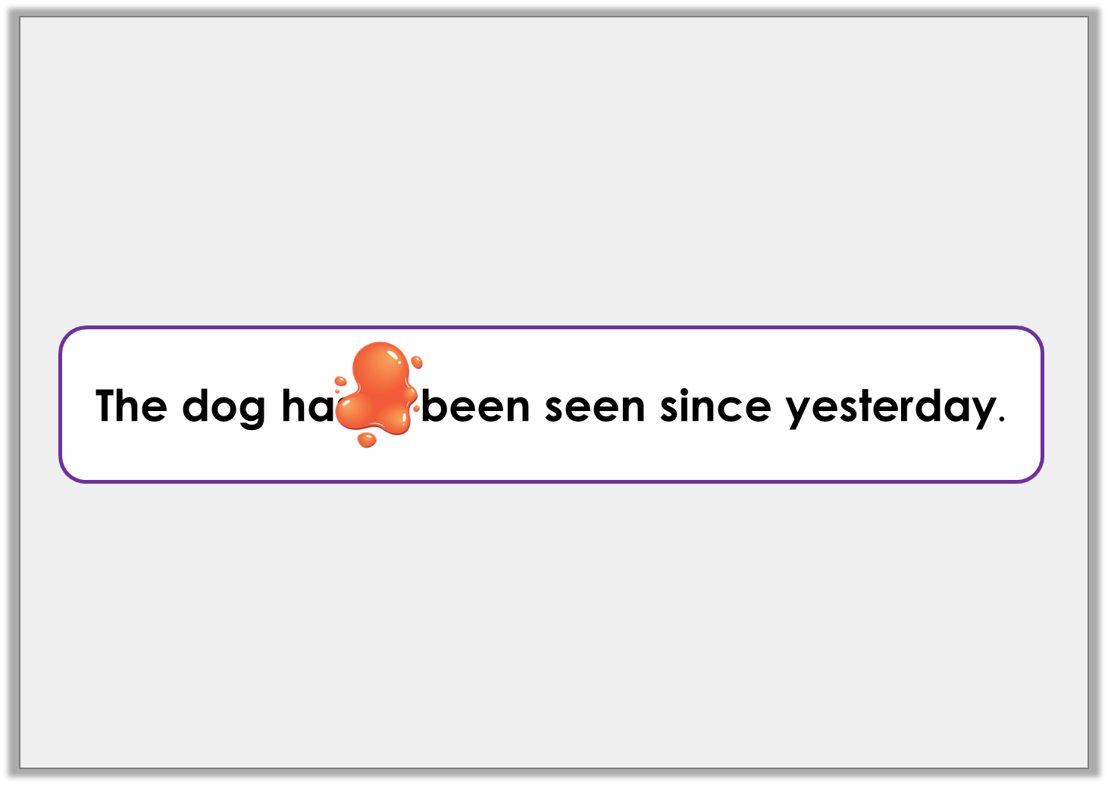
Introduction
The following sentence contains a contraction that has been covered by spilt paint.
Which letters have been covered?
© Classroom Secrets Limited 2019

Slide 5
Introduction
The following sentence contains a contraction that has been covered by spilt paint.
Which letters have been covered?
The dog hasn’t been seen since yesterday.
The dog hadn’t been seen since yesterday.
© Classroom Secrets Limited 2019

Slide 6
Varied Fluency 1
Add apostrophes to show the missing letters in the following contractions:
here is = heres
they had = theyd
© Classroom Secrets Limited 2019

Slide 7
Varied Fluency 1
Add apostrophes to show the missing letters in the following contractions:
here is = here’s
they had = they’d
© Classroom Secrets Limited 2019

Slide 8
Varied Fluency 2
Which contraction will complete the following sentence?
I think ______________ win the ballet show.
wouldn’t
she’ll
© Classroom Secrets Limited 2019

Slide 9
Varied Fluency 2
Which contraction will complete the following sentence?
I think ______________ win the ballet show.
she’ll
wouldn’t
she’ll
© Classroom Secrets Limited 2019

Slide 10
Varied Fluency 3
Tick the sentence that has used the contraction correctly.
I don’t believe that pigs can fly.
The girl don’t see the cows in the field.
© Classroom Secrets Limited 2019

Slide 11
Varied Fluency 3
Tick the sentence that has used the contraction correctly.
I don’t believe that pigs can fly.
The girl don’t see the cows in the field.
P
© Classroom Secrets Limited 2019

Slide 12
Varied Fluency 4
Write the contraction for the word pairs below.
you are
he will
had not
© Classroom Secrets Limited 2019

Slide 13
Varied Fluency 4
Write the contraction for the word pairs below.
you are
you’re
he will
he’ll
had not
hadn’t
© Classroom Secrets Limited 2019

Slide 14
Application 1
Rewrite the following sentence so that the new sentence uses contractions.
It does not look like it will snow.
© Classroom Secrets Limited 2019

Slide 15
Application 1
Rewrite the following sentence so that the new sentence uses simple contractions.
It does not look like it will snow.
It doesn’t look like it’ll snow.
© Classroom Secrets Limited 2019

Slide 16
Application 2
Use the word bank to build two contractions and use them to complete the sentences correctly.
_________________ these flowers beautiful?
Do you think ______________ like dogs?
she | not | is
what | are | will
© Classroom Secrets Limited 2019

Slide 17
Application 2
Use the word bank to build two contractions and use them to complete the sentences correctly.
Aren’t these flowers beautiful?
Do you think ______________ like dogs?
she | not | is
what | are | will
© Classroom Secrets Limited 2019

Slide 18
Application 2
Use the word bank to build two contractions and use them to complete the sentences correctly.
_________________ these flowers beautiful?
Do you think she’ll like dogs?
she | not | is
what | are | will
© Classroom Secrets Limited 2019

Slide 19
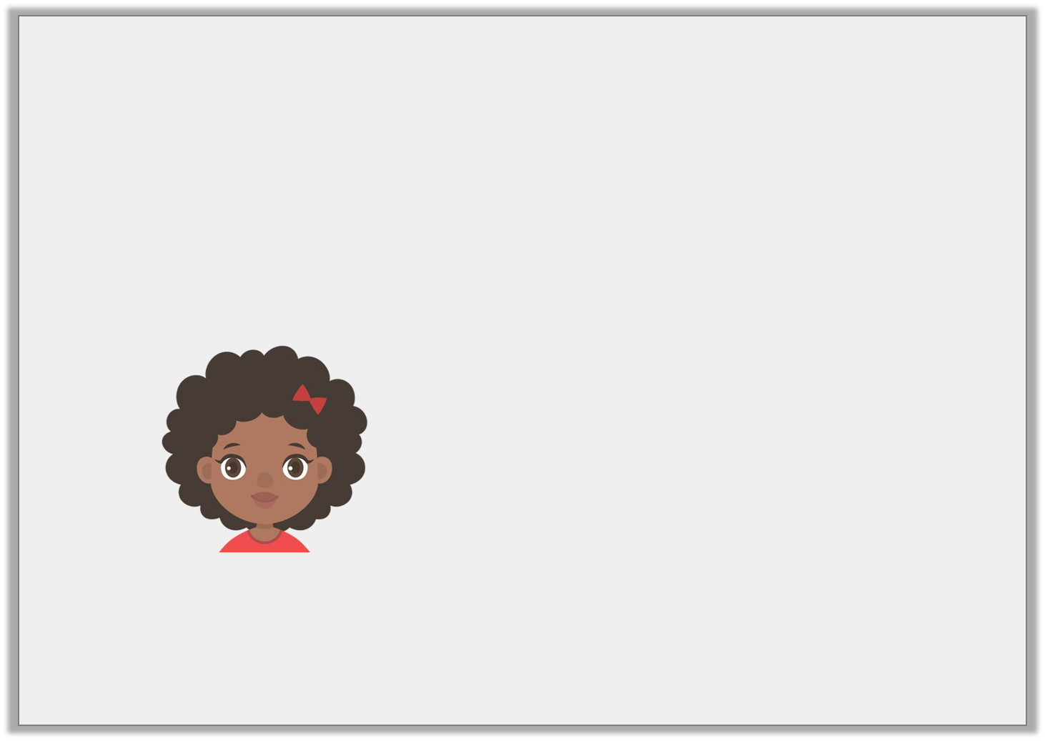
Reasoning 1
Patti is writing a sentence.
Is she correct? Prove it.
I must not forget to brush my teeth.
I cannot use a contraction in this sentence.
© Classroom Secrets Limited 2019

Slide 20
Reasoning 1
Patti is writing a sentence.
Is she correct? Prove it.
Patti is incorrect because…
I must not forget to brush my teeth.
I cannot use a contraction in this sentence.
© Classroom Secrets Limited 2019

Slide 21
Reasoning 1
Patti is writing a sentence.
Is she correct? Prove it.
Patti is incorrect because she can contract must not.
I mustn’t forget to brush my teeth.
I must not forget to brush my teeth.
I cannot use a contraction in this sentence.
© Classroom Secrets Limited 2019

