Slide 2
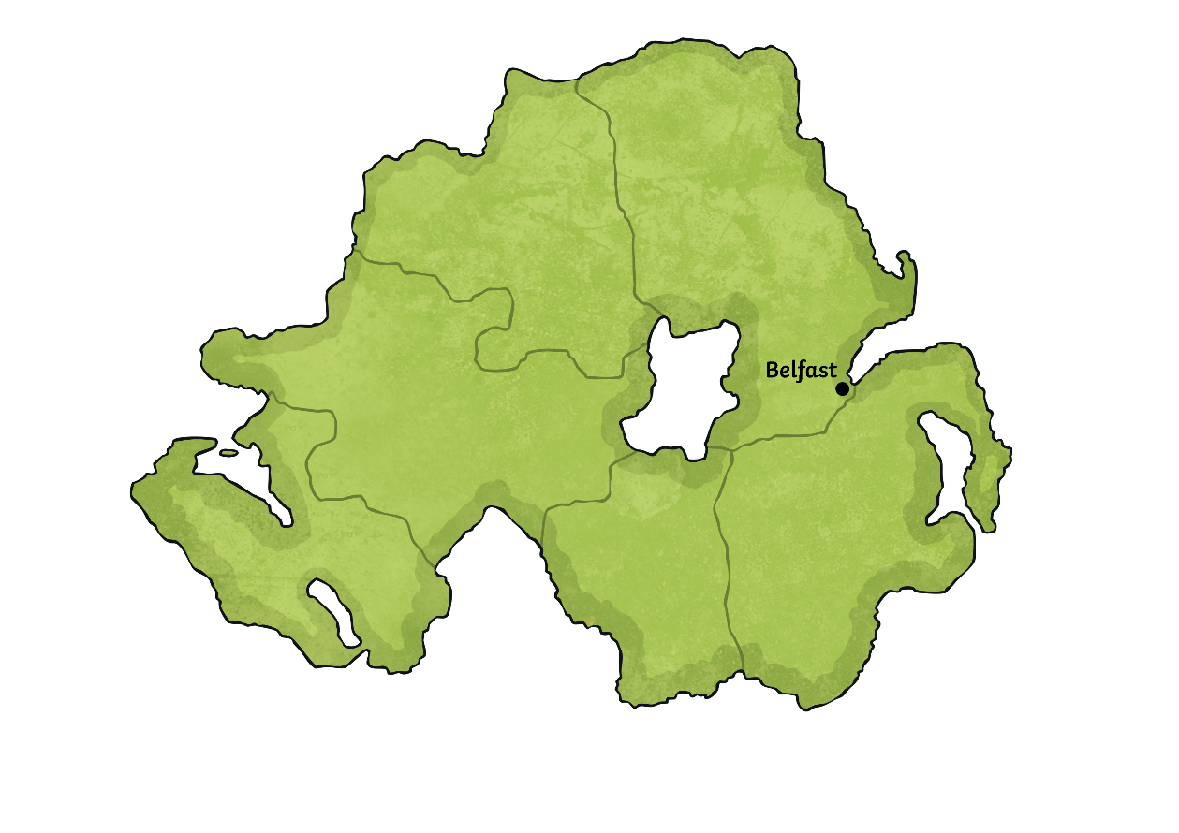
Oliver Jeffers
Early Years
Oliver Jeffers was born on 1st July 1977.
Although he was born in Western Australia, Oliver grew up in Belfast, in Northern Ireland.
He was the second of four brothers.
He has previously said that he came
from both a creative family and a
creative city.

Slide 3
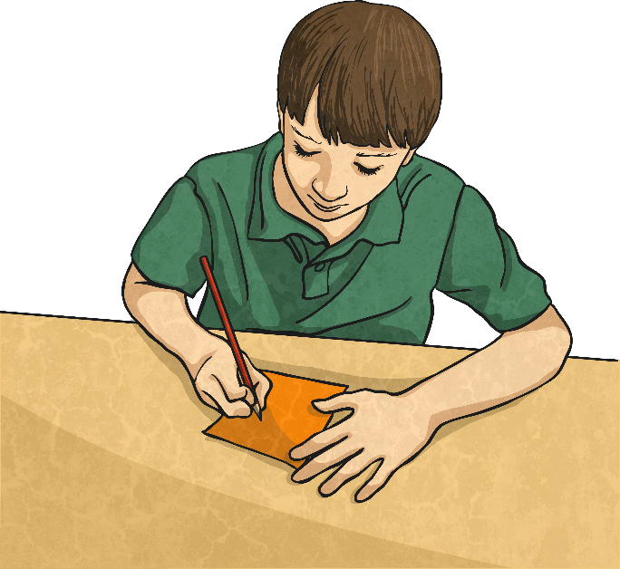
A Love for Art
Oliver Jeffers realised that he may have artistic talent when he was asked to help with the set for the school play when he was just six!
As a teenager, other pupils at Oliver’s school, Hazelwood Integrated College, would ask him to draw on their schoolbags and skateboards!
He always loved drawing pictures and, in 1995, he was runner up in an amateur
art competition.

Slide 4

Becoming an Illustrator and Author
Oliver went to the University of Ulster, graduating with a First Class Honours degree in Illustration and Visual Communication.
His first picture book, ‘How to Catch a Star’, was published in 2004.
As well as writing and illustrating his own books, Jeffers has also illustrated for other authors.
His books have been translated into more than 35 different languages.

Slide 5

Career
Oliver Jeffers’ artwork has been exhibited at the Brooklyn Museum, the National Portrait Gallery in London and the Ulster Museum in Belfast.
He has won many awards including a New York Times Best Illustrated Children’s Books Award, Irish Book Award ‘Children’s Book of the Year’, Blue Peter Book Award and British Book Design Award. He was also a recipient of the Hay Medal for ‘Outstanding Body of Work’.
An animated version of Jeffers’ book ‘Lost and Found’ won a BAFTA in 2009.

Slide 6

Illustration
Many of Oliver Jeffers’ book illustrations are painted using watercolours but he has also used acrylics and oil paints in his work.
In 2007, Oliver was chosen as the official illustrator for World Book Day.

Slide 7

Family
Oliver Jeffers now lives in Brooklyn, New York, with his wife Suzanne and their children.
The family make regular trips back to Northern Ireland to see relatives and friends and to ensure that the children get to know the place where both Oliver and Suzanne grew up.
Jeffers believes that his upbringing
and background contributed to
his love of storytelling.
He has said, “…everything
revolved around stories.”

