Slide 1


Slide 3


1) How many pencils?
2) How many spots?
3) Here is an array.
How many groups of 4 are there?

Slide 4
1) How many pencils?
2) How many spots?
3) Here is an array.
How many groups of 4 are there?
20
16
3

Slide 6







What do you see?
3
4
There are ____ equal groups of ____
$+ + =$
4
4
4
12
$× =$
3
4
12
$× =$
4
3
12

Slide 7

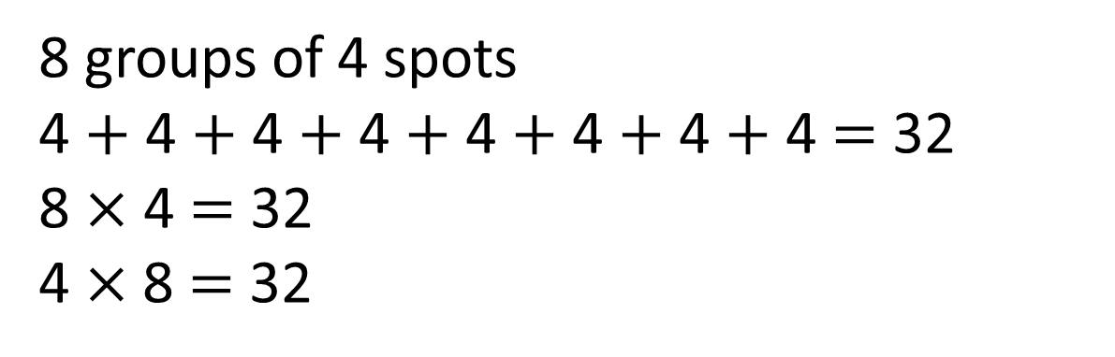
What do you see?
Have a think
8 groups of 4 spots
4 $+$ 4 $+$ 4 $+$ 4 $+$ 4 $+$ 4 $+$ 4 $+$ 4 $=$ 32
8 $×$ 4 $=$ 32
4 $×$8 $=$ 32

Slide 8
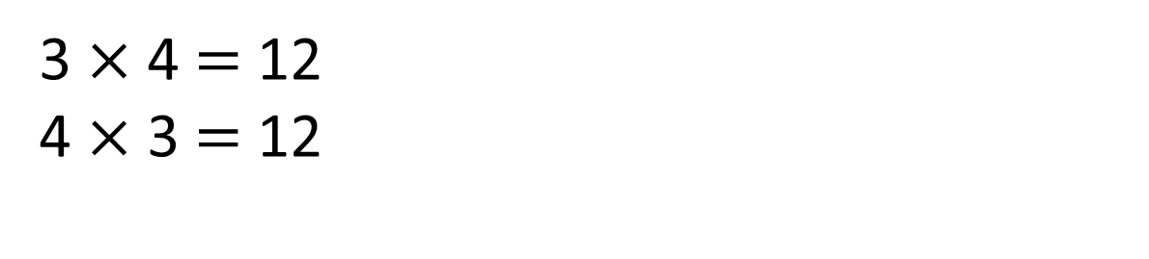
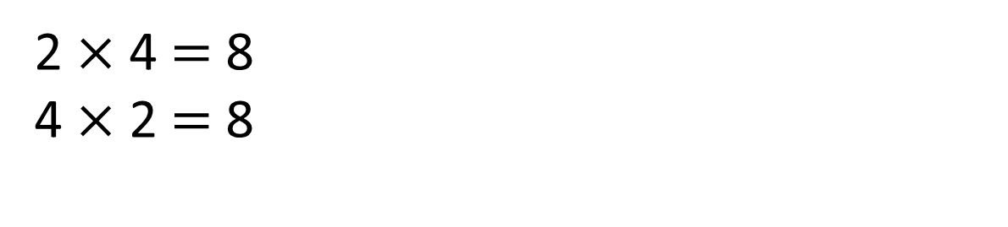
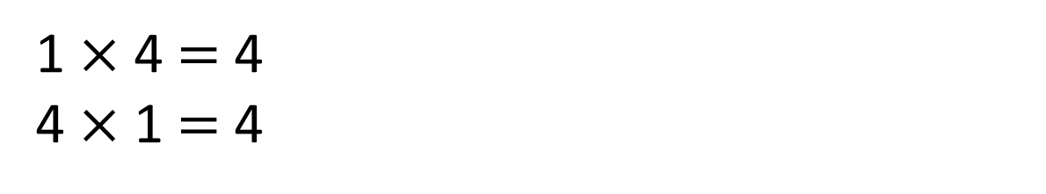
4
1 $×$ 4 $=$ 4
4 $×$ 1 $=$ 4
0
4
4
4
2 $×$ 4 $=$ 8
4 $×$ 2 $=$ 8
0
4
8
4
4
4
3 $×$ 4 $=$ 12
4 $×$ 3 $=$ 12
0
4
8
12

Slide 9
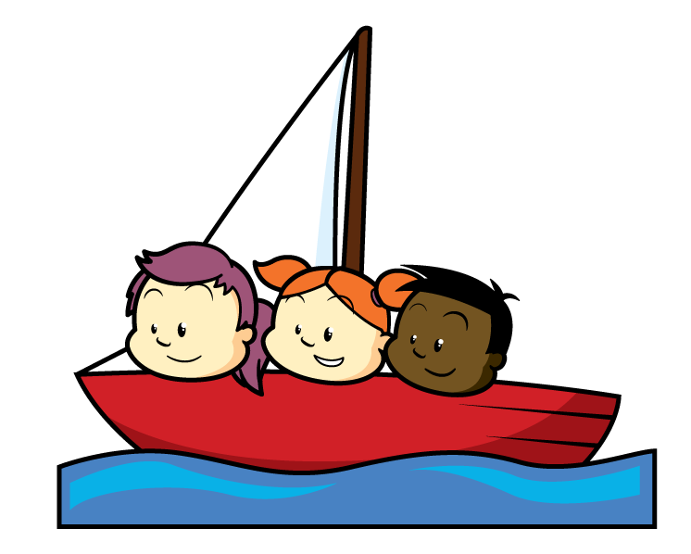
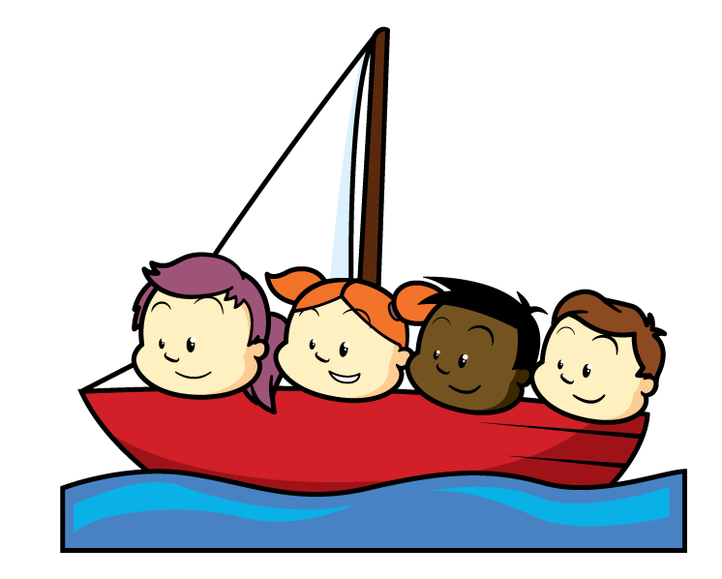
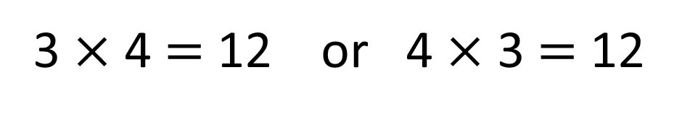
Which number story matches the picture?
3 $×$ 4 $=$ 12 or 4 $×$ 3 $=$ 12
Have a think
There are 3 boats.
Each boat has 4 children.
There are 12 children altogether.
There are 4 boats.
Each boat has 3 children.
There are 12 children altogether.

Slide 10


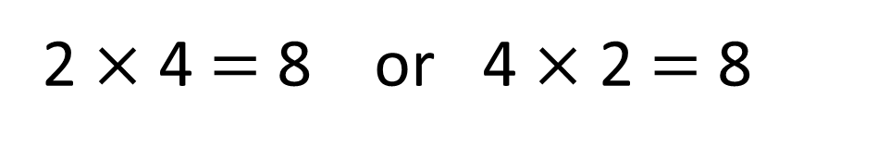
Draw a picture to represent each number story.
2 $×$ 4 $=$ 8 or 4 $×$ 2 $=$ 8
Have a think
Amir has 2 plates of cakes. Each plate
has 4 cakes.
Amir has 4 plates of cakes. Each plate has 2 cakes.

Slide 11
Have a go at all of the questions on the worksheet

Slide 12
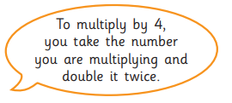






4 $×$ 1
double
double
1
1
1
1
1
1
1
4 $×$ 2
double
double
2
2
2
2
2
2
2
4 $×$
double
double

Slide 13







4 $×$ 9 is the same as 4 $×$ 3 $×$ 3
Have a think
4 $×$ 9
4 $×$ 9
4 $×$ 3
4 $×$ 3
4 $×$ 3

