Slide 1
Lesson 2: Using shapes and lines
Save a copy
Year 1 – Creating Media – Digital Painting
Notes:
Last updated: 01-07-20
This resource is available online at ncce.io/cm1p-2-s. Resources are updated regularly — please check that you are using the latest version.
This resource is licensed under the Open Government Licence, version 3. For more information on this licence, see ncce.io/ogl.

Slide 2
Lesson 2: Using shapes and lines
Objectives
To use the shape tool and the line tool
I can make marks with the square and line tools
I can use the shape and line tools effectively
I can use the shape and line tools to recreate the work of an artist

Slide 3
Lesson 2: To use shape and line tools
Keywords
Piet Mondrian
Shape tools
Line tool
Fill tool
Undo tool
Primary colours

Slide 4
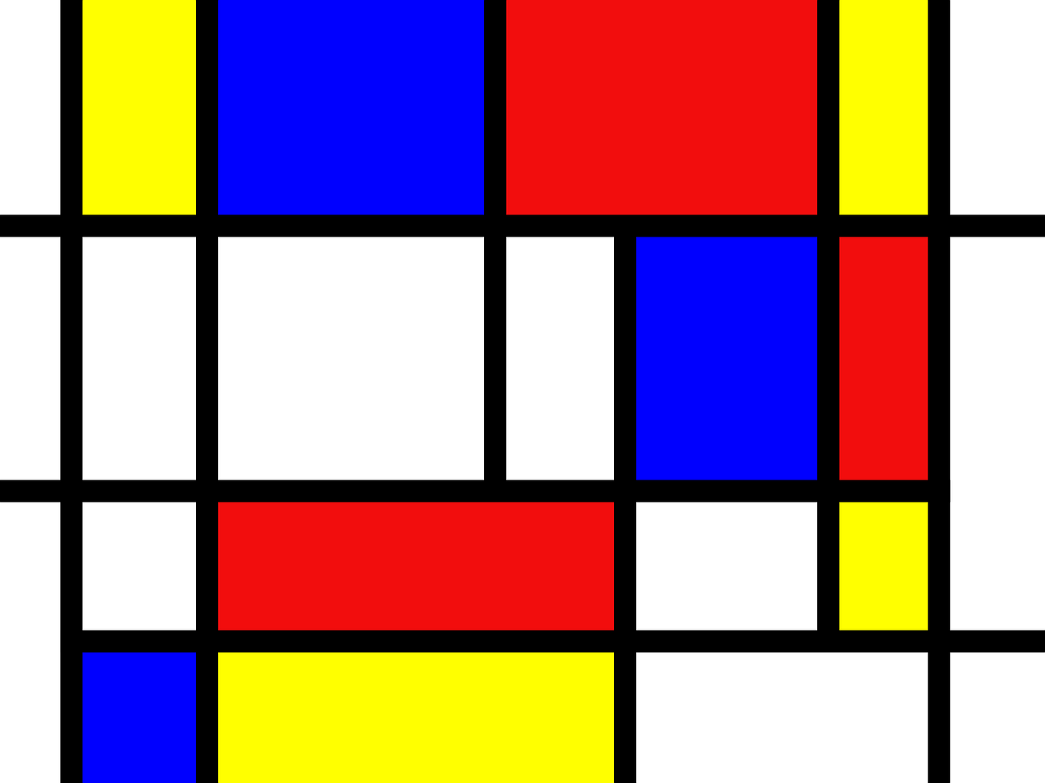
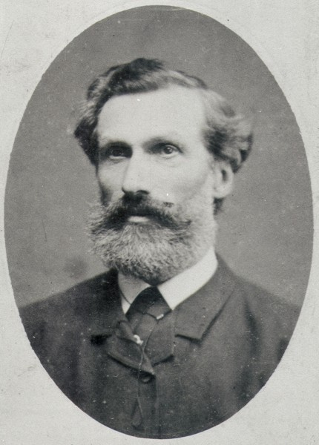
Piet Mondrian
Introduction
Artist
Lived 1872–1944
Created abstract art
Notes:
Piet Mondrian Image https://commons.wikimedia.org/wiki/File:Portrait_of_Pieter_Cornelis_Mondriaan_sr._001.jpg
Mondrian art image: https://pixabay.com/illustrations/mondrian-red-blue-yellow-1504681/

Slide 5

Mondrian’s work
Activity 1
What shapes can you see?
What colours can you see?
How do you think these shapes were made?
Notes:
Mondrian image: https://pixabay.com/illustrations/mondrian-red-blue-yellow-1504681/
Inspector image: https://pixabay.com/vectors/inspector-man-detective-male-160143/

Slide 6


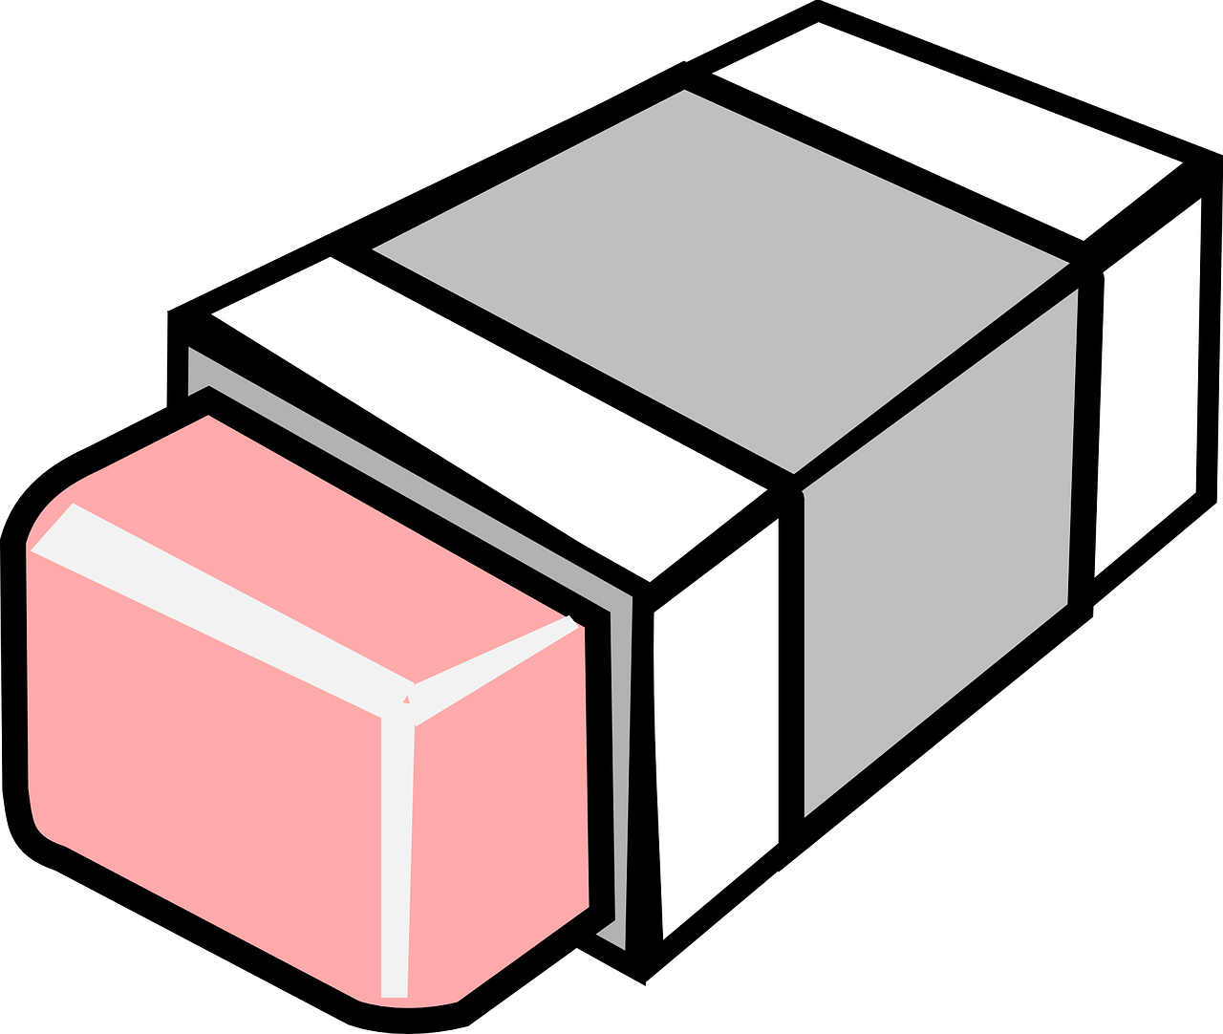

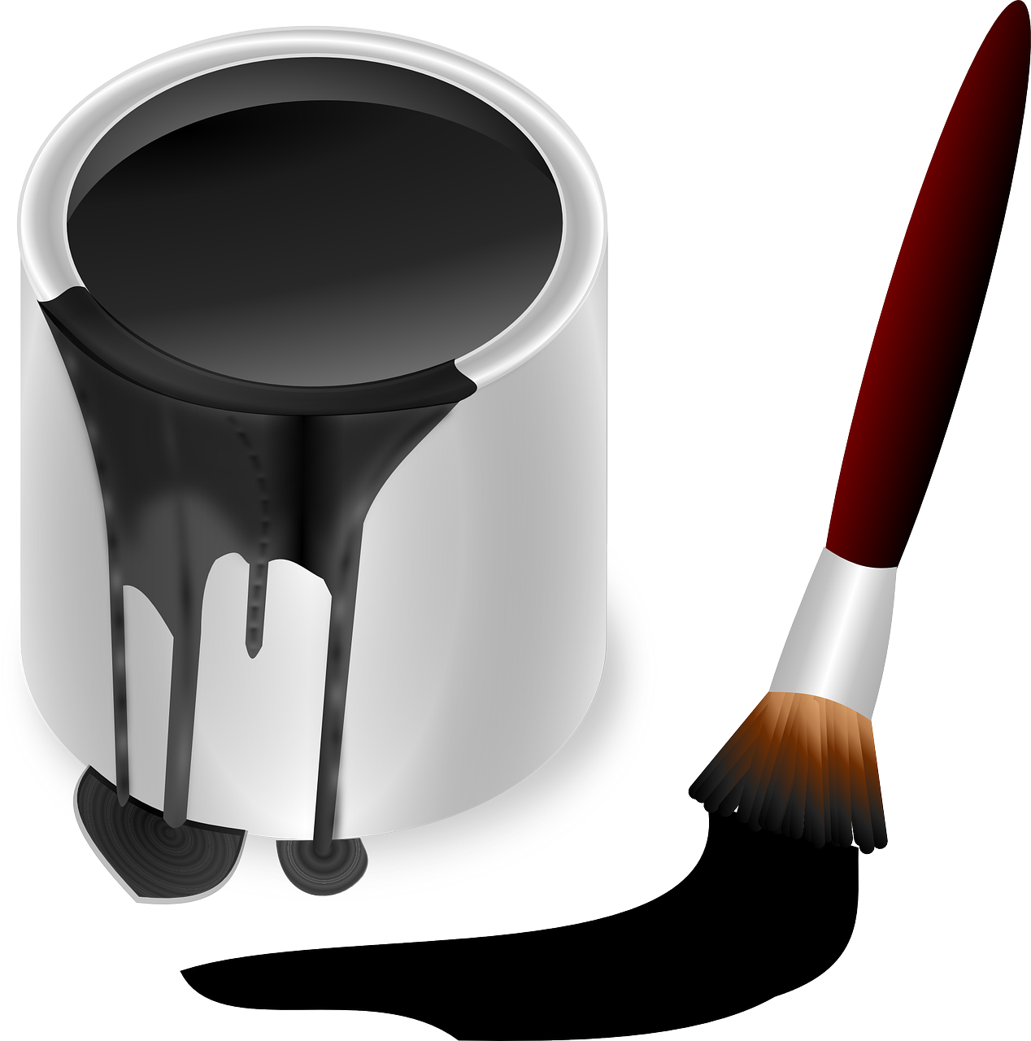
Which of these tools would be helpful?
Activity 1
Notes:
[Ideally, show the icons in the painting program learners use in this lesson here.]
Paintbrush icon: https://pixabay.com/vectors/paint-brush-silhouette-black-paint-4127172/
Inspector image: https://pixabay.com/vectors/inspector-man-detective-male-160143/
Spray can icon: https://pixabay.com/illustrations/graffiti-deo-spray-can-doodle-1435214/
Pencil icon: https://pixabay.com/vectors/grey-icon-pencil-1293127/
Paint pot icon: https://pixabay.com/vectors/paint-pot-pot-color-bucket-157813/
Eraser icon: https://pixabay.com/vectors/eraser-rubber-pink-remove-erase-309830/
(Arrow drawn from shape tools)

Slide 7
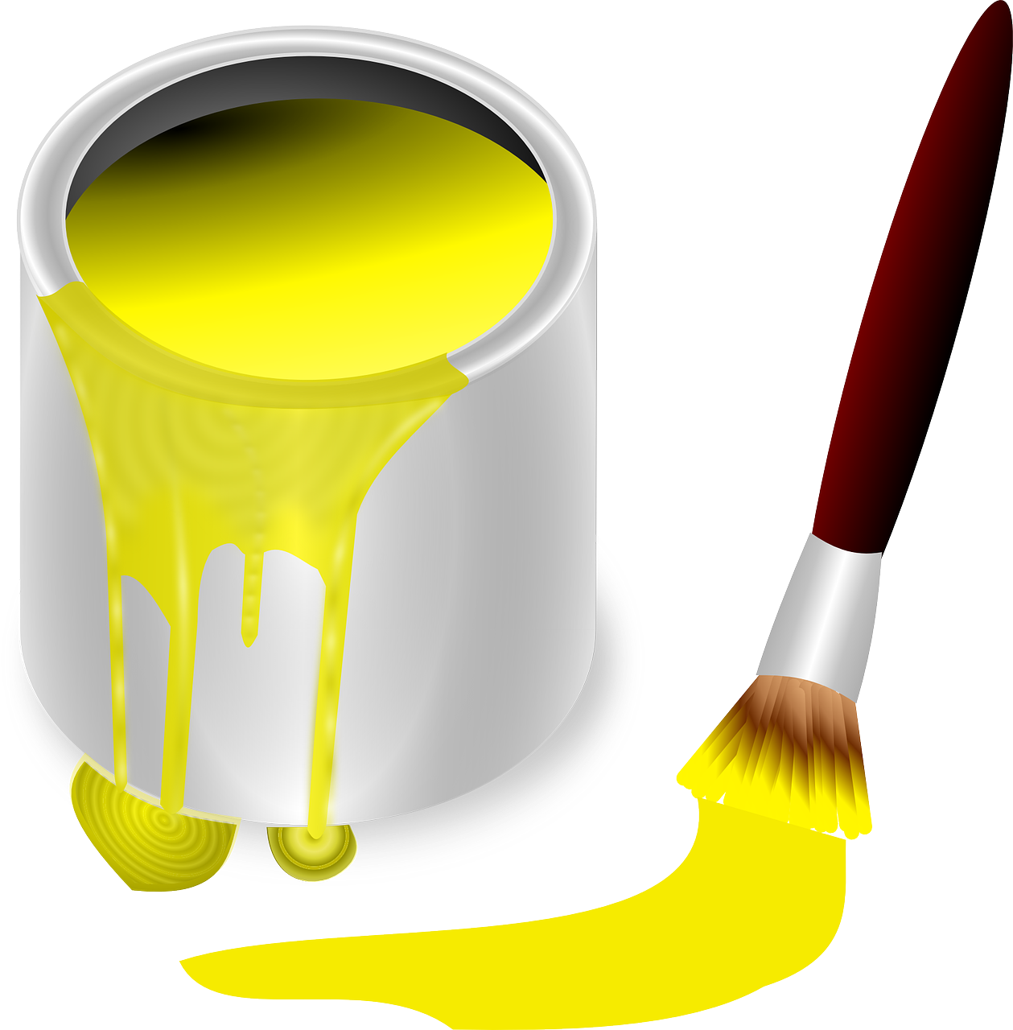

Can you think of any other tools you would need to use to make this picture?
Activity 1
How would you make the main shape?
How would you make the smaller shapes?
Which tools would you use?
Fill
Undo
Notes:
Paint pot icon: https://pixabay.com/vectors/paint-pot-pot-color-bucket-157811/
Mondrian image: https://pixabay.com/illustrations/mondrian-red-blue-yellow-1504681/
(Arrow drawn from shape tools)

Slide 8

Primary colours
Activity 1
There are three primary colours:
Red
Yellow
Blue
These colours cannot be made by mixing other colours of paint.
These colours can be mixed together to make many other colours.
Notes:
Balloon image: https://pixabay.com/vectors/balloons-red-blue-yellow-shiny-25737/

Slide 9
Steps to success
Activity 2
3. Fill in some of the blocks using primary colours
2. Add some horizontal and vertical lines
Draw a square
Notes:
Balloon image: https://pixabay.com/vectors/balloons-red-blue-yellow-shiny-25737/

Slide 10

Time to save
Activity 2
Notes:
Floppy disk image: https://pixabay.com/vectors/floppy-disk-disk-storage-data-save-98413/

Slide 11
Share your picture and tell someone which tools you used to make it.
Plenary
Share

Slide 12
Steps to success
Plenary
3. Fill in some of the blocks using primary colours
2. Add some horizontal and vertical lines
Draw a square
Notes:
Balloon image: https://pixabay.com/vectors/balloons-red-blue-yellow-shiny-25737/

Slide 13

How confident are you? (from 1 to 3)
Assessment
I can make marks with the square and line tools
I can use the shape and line tools effectively
I can use the shape and line tools to recreate the work of an artist
3 = very confident
2 = unsure
1 = not confident
Notes:
https://pixabay.com/vectors/thumb-up-hand-like-confirm-go-top-307176/

Slide 14
To use shape and line tools
Summary
In this lesson, you...
Picked the best painting tools to use to create a picture like that of Piet Mondrian.
Next lesson you will…
Look at another artist’s work and create your own picture using different shapes.

