Slide 1
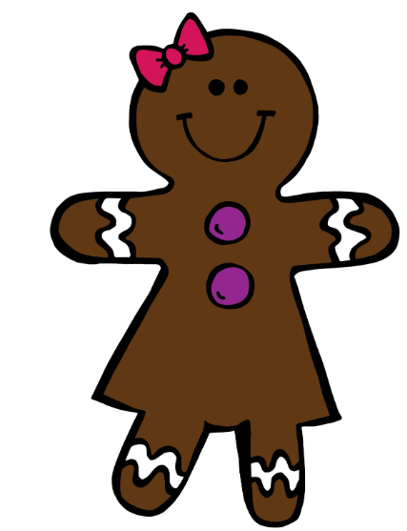
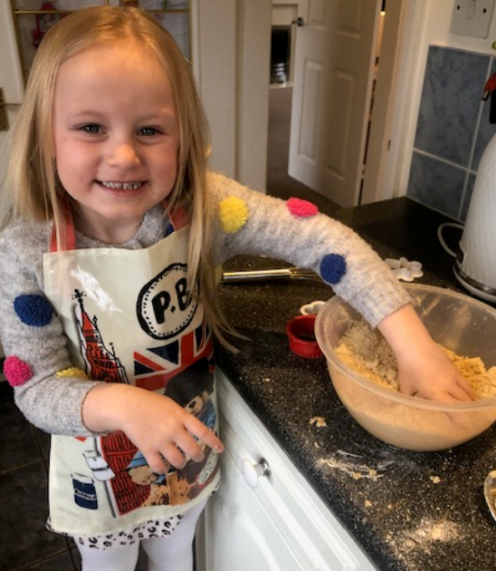
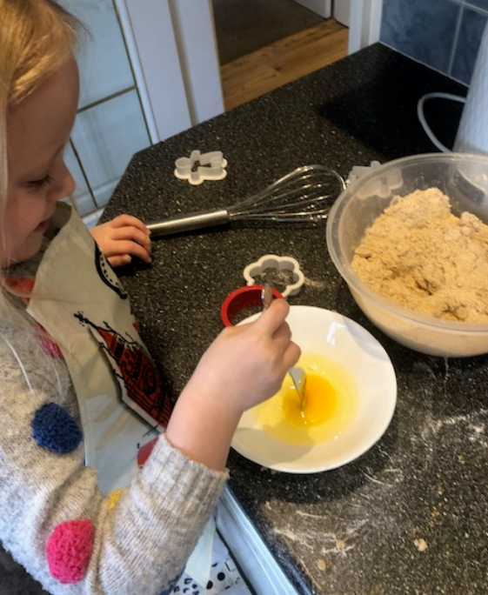
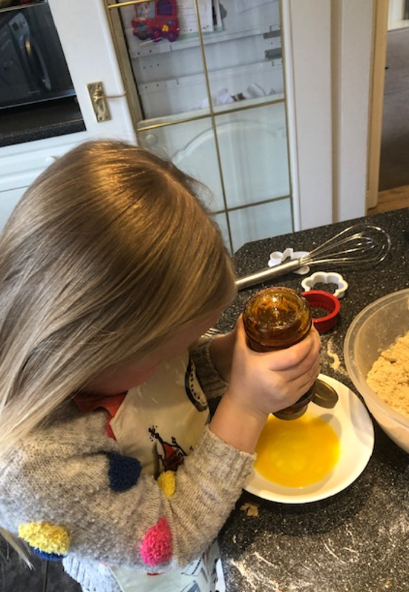
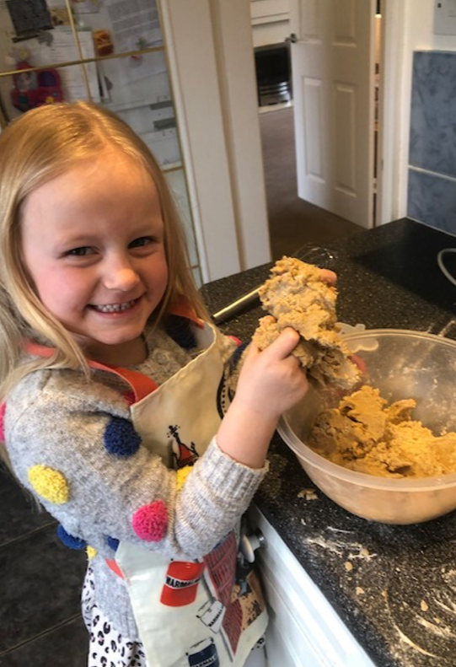
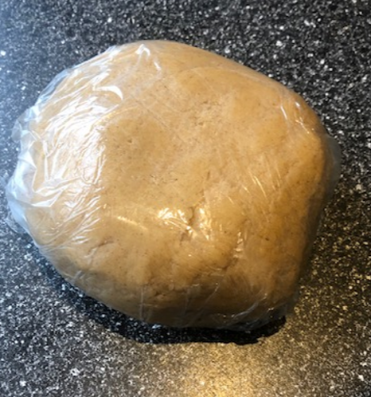
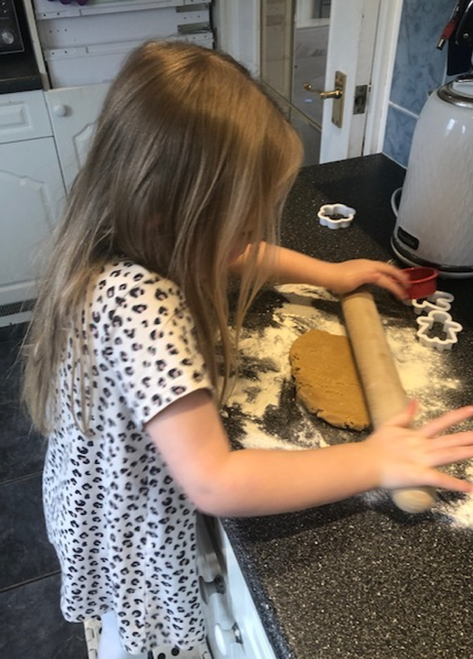
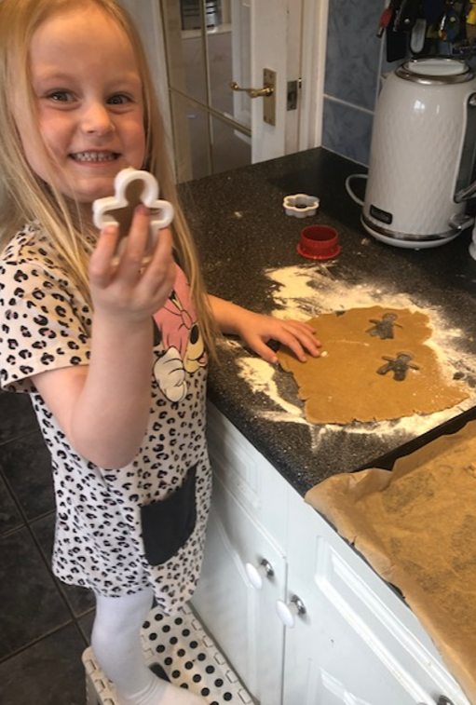
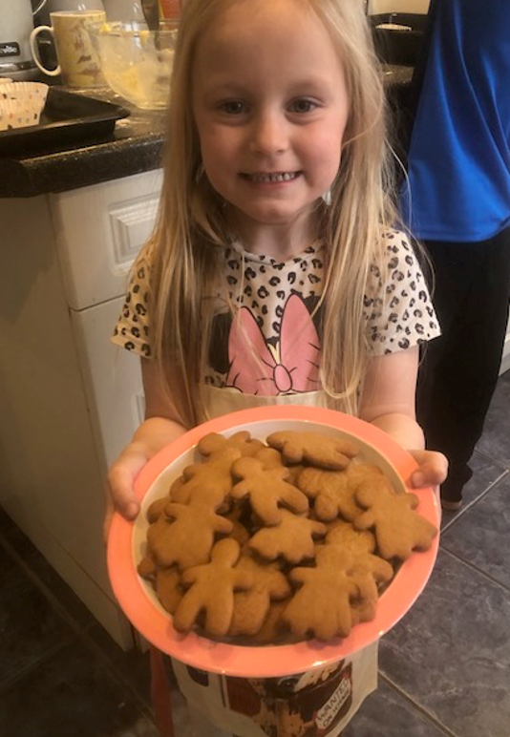
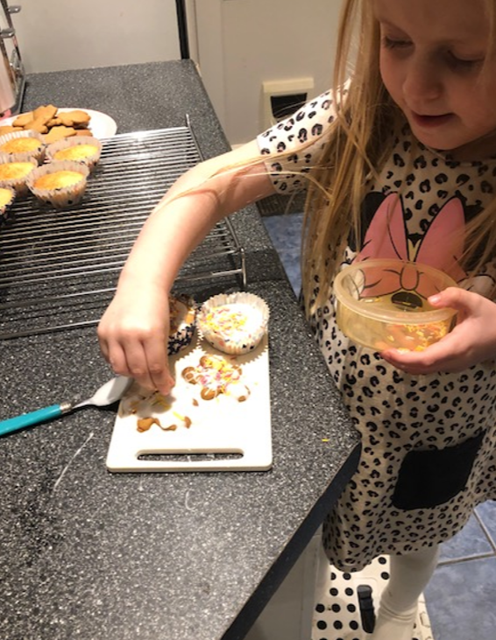
Mini Gingerbread biscuits recipe
By Ava Roberts
Reception
Step 1
Mix 350g flour, 1tsp Bicarb soda, 175g sugar, 1tsp cinnamon and 2tsp ground ginger in a bowl
Step 2 Mix 1 free range egg in a bowl
Step 3
Add 4 BIG squeezes of golden syrup to the egg and mix
Step 4
Mix all together in a bowl until you get a ball of dough. Wrap in cling film and chill in the fridge for 20 mins
Step 5
roll out the dough with a rolling pin to about 0.5cm thick
Step 6
Using your cutters, cut out the shapes of your gingerbread biscuits – I have made men and women shapes!
Step 7
Put them on a lined baking tray and get a grown up to put them in the oven at about 160 degrees for 8-10 minutes if they are small like mine or longer if they are big.
Step 8
As an extra option you can put icing and sprinkles on like me!

