Slide 1
Lesson 1: How can we paint using computers?
Save a copy
Year 1 – Creating media – Digital Painting
Notes:
Last updated: 01-07-20
This resource is available online at ncce.io/cm1p-1-s. Resources are updated regularly — please check that you are using the latest version.
This resource is licensed under the Open Government Licence, version 3. For more information on this licence, see ncce.io/ogl.

Slide 2
Lesson 1: How can we paint using computers?
Objectives
To describe what different freehand tools do
I can make marks on a screen and explain which tools I used
I can draw lines on a screen and explain which tools I used
I can use the paint tools to draw a picture

Slide 3

Lesson 1: To describe what different tools do
Keywords
Paint program
Tool
Paintbrush
Erase
Fill
Undo
Drag
Notes:
https://pixabay.com/vectors/owl-book-animal-literature-297413/

Slide 4



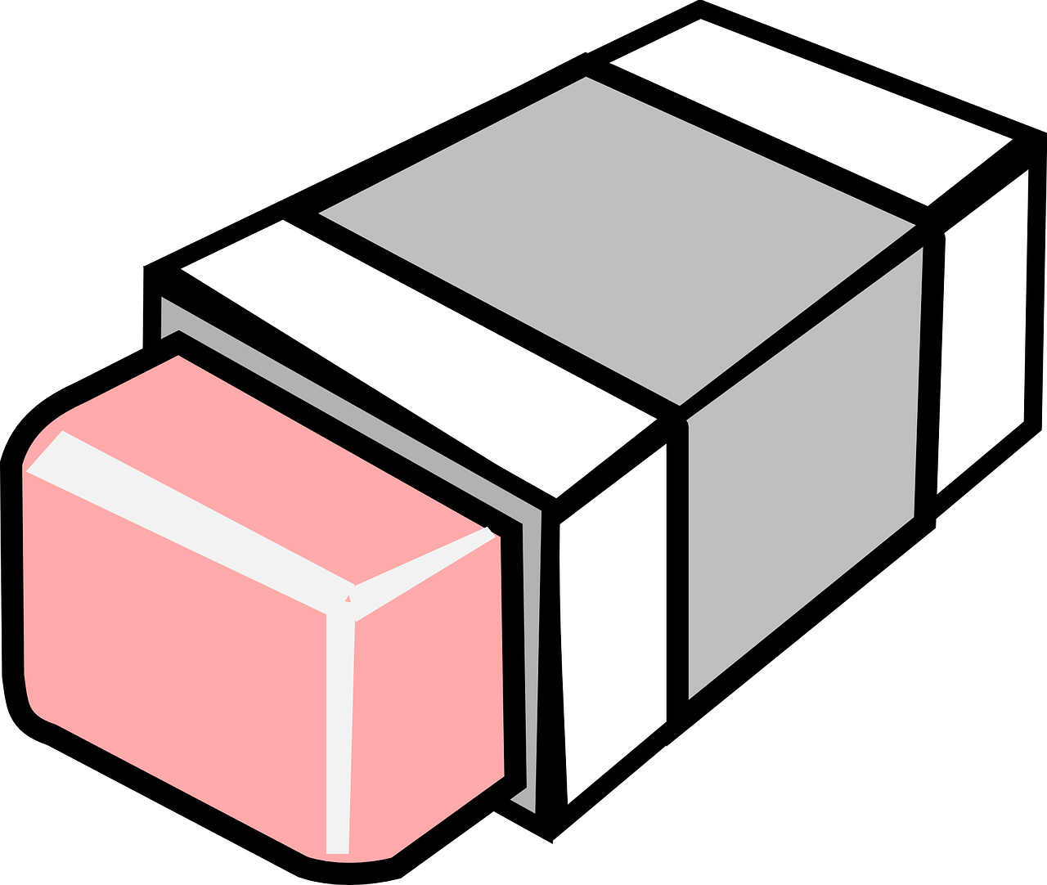


What do you think these tools do?
Introduction
Notes:
[Ideally, show the icons in the painting program learners use in this lesson here.]
Paintbrush icon: https://pixabay.com/vectors/paint-brush-silhouette-black-paint-4127172/
Inspector image: https://pixabay.com/vectors/inspector-man-detective-male-160143/
Spray can icon: https://pixabay.com/illustrations/graffiti-deo-spray-can-doodle-1435214/
Pencil icon: https://pixabay.com/vectors/grey-icon-pencil-1293127/
Paint pot icon: https://pixabay.com/vectors/paint-pot-pot-color-bucket-157813/
Eraser icon: https://pixabay.com/vectors/eraser-rubber-pink-remove-erase-309830/
(Arrow drawn from shape tools)

Slide 5


What did you find out?
Activity 2
Notes:
Inspector image: https://pixabay.com/vectors/inspector-man-detective-male-160143/
Technology image: https://pixabay.com/illustrations/technology-equipment-responsive-web-2468063/
Question mark image: https://pixabay.com/illustrations/question-mark-note-duplicate-460864/

Slide 6


Create a picture of yourself
Activity 3
Notes:
Whiteboard image: https://pixabay.com/vectors/whiteboard-white-board-blank-303145/
Child face image: https://pixabay.com/illustrations/drawing-face-child-blond-girl-2307780/

Slide 7

Time to save
Activity 3
Notes:
Floppy disk image: https://pixabay.com/vectors/floppy-disk-disk-storage-data-save-98413/

