Slide 1



LIFE/work balance
We have started a #LIFEworkbalance campaign and we need your help to complete our LIFE/work balance survey.
We hope to publish the results soon, so please give 15 minutes of your time to help us get a true picture of school life.
Want to be a part of this campaign? Take the survey on our website and share it with your colleagues!
R
R
PS
PS
© Classroom Secrets Limited 2019

Slide 2
Year 1 – Summer Block 3 – Time – Describe Position 2
About This Resource:
This PowerPoint has been designed to support your teaching of this small step. It includes a starter activity and an example of each question from the Varied Fluency and Reasoning and Problem Solving resources also provided in this pack. You can choose to work through all examples provided or a selection of them depending on the needs of your class.
National Curriculum Objectives:
Mathematics Year 1: (1P2) Describe position, direction and movement, including whole, half, quarter and three-quarter turns
More Year 1 Position and Direction resources.
Did you like this resource? Don’t forget to review it on our website.
© Classroom Secrets Limited 2019

Slide 3
Year 1 – Summer Block 3 – Time
Step 3: Describe Position 2
© Classroom Secrets Limited 2019

Slide 4
Introduction
What colour should each shape be?
The shape down from the heart is red.
The shape to the right of the heart is green.
The shape down from the triangle is orange.
The shape down from the circle is yellow.
The shape to the left of the heart is pink.
The shape up from the cross is blue.
© Classroom Secrets Limited 2019

Slide 5
Introduction
What colour should each shape be?
The shape down from the heart is red.
The shape to the right of the heart is green.
The shape down from the triangle is orange.
The shape down from the circle is yellow.
The shape to the left of the heart is pink.
The shape up from the cross is blue.
© Classroom Secrets Limited 2019

Slide 6
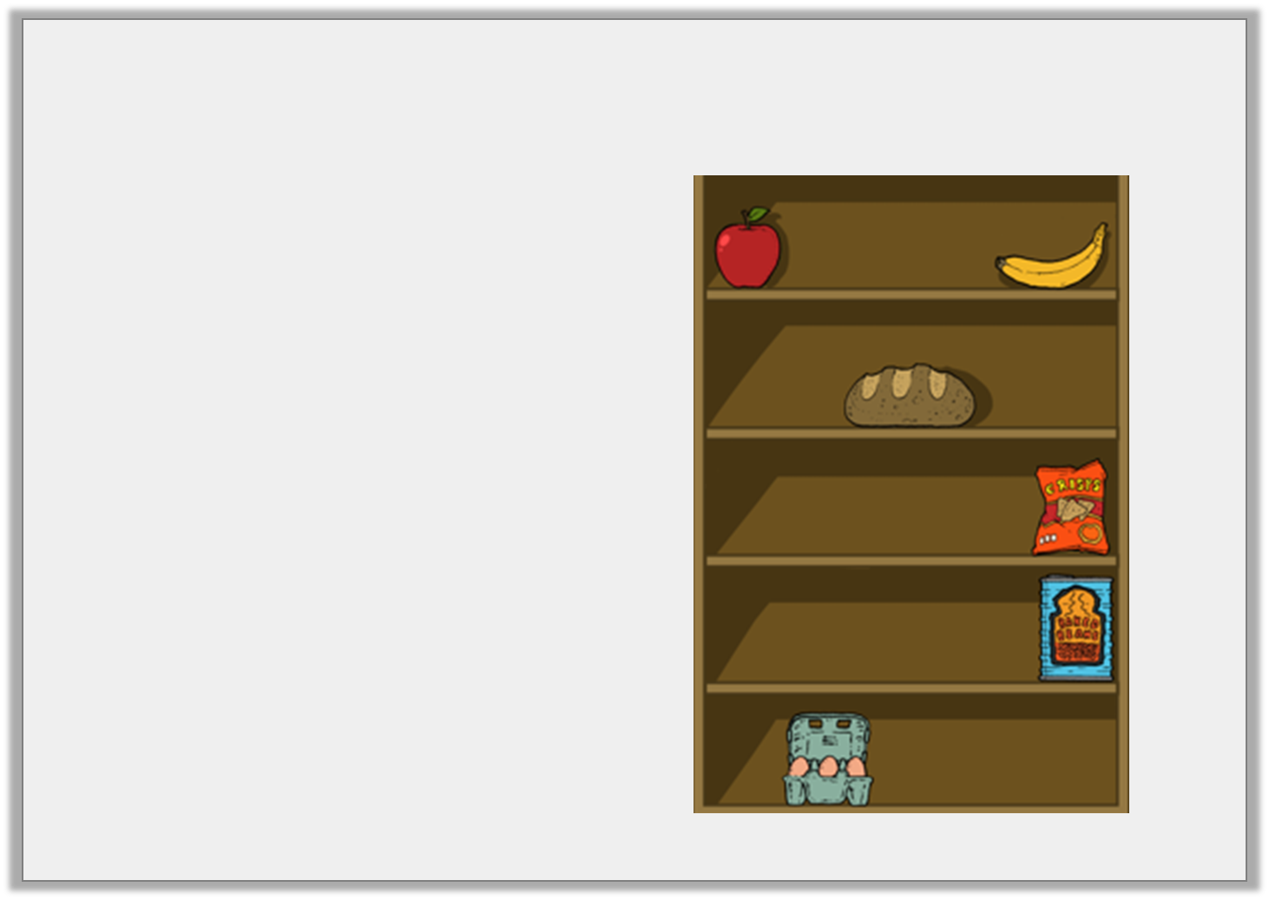
Varied Fluency 1
Complete the sentences.
The eggs are on the
______________ shelf.
The apple is on the
______________ shelf.
______________ the beans are the crisps.
top | middle | bottom
above below
© Classroom Secrets Limited 2019

Slide 7
Varied Fluency 1
Complete the sentences.
The eggs are on the
bottom shelf.
The apple is on the top
shelf.
Above the beans are the crisps.
top | middle | bottom
above below
© Classroom Secrets Limited 2019

Slide 8
Varied Fluency 2
Answer the questions below.
A) Which colour is above the blue block?
B) Which colour is below the purple block?
C) Which three colours are at the top?
green | orange | purple
yellow | blue | red
© Classroom Secrets Limited 2019

Slide 9
Varied Fluency 2
Answer the questions below.
A) Which colour is above the blue block? Orange
B) Which colour is below the purple block? Red
C) Which three colours are at the top? Green, orange and purple
green | orange | purple
yellow | blue | red
© Classroom Secrets Limited 2019

Slide 10
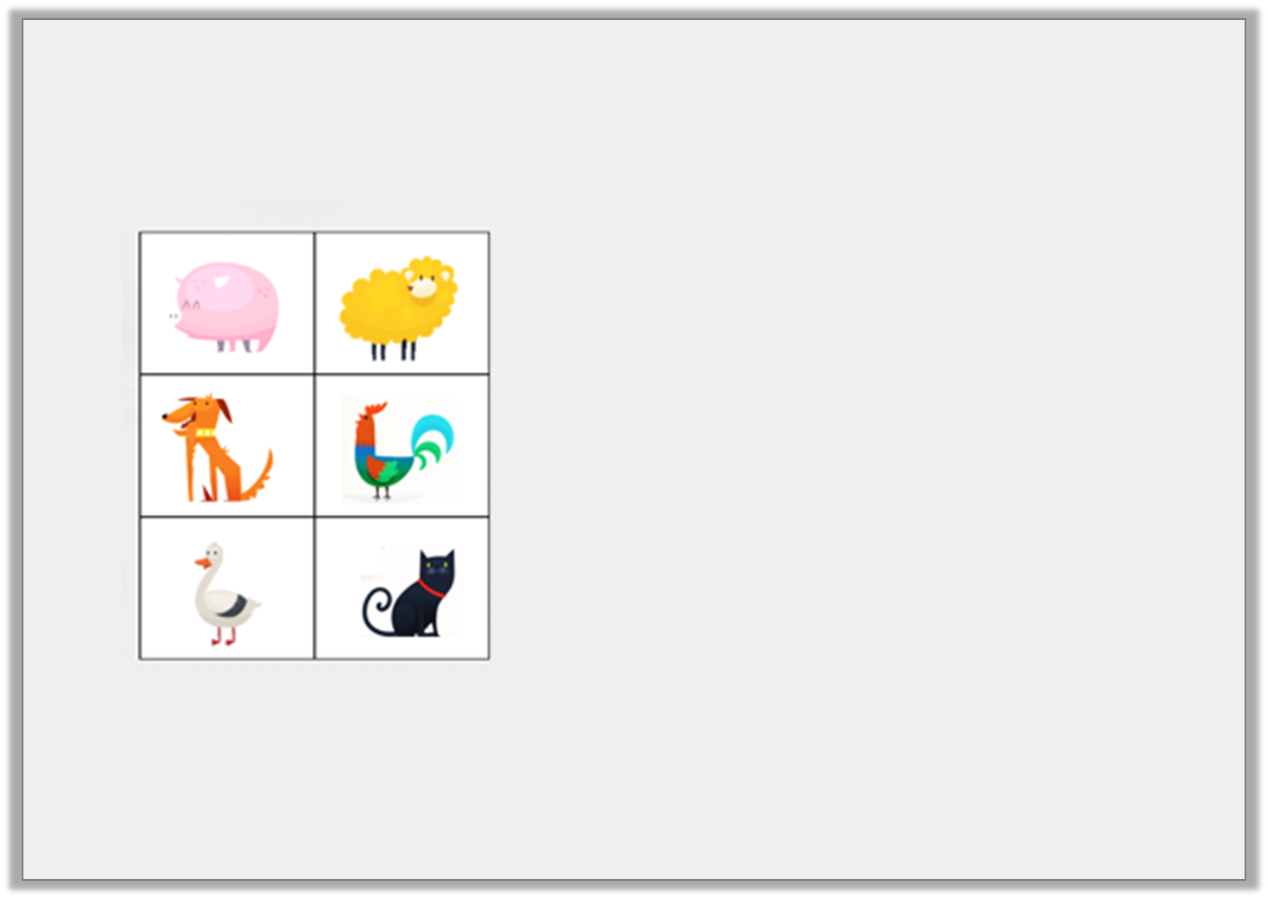
Varied Fluency 3
Describe the positions of the animals below.
Where is the:
a) hen?
b) duck?
c) pig?
top | middle | bottom
above below
© Classroom Secrets Limited 2019

Slide 11
Varied Fluency 3
Describe the positions of the animals below.
Where is the:
a) hen? The hen is above the cat. The hen is in the middle. The hen is below the sheep.
b) duck? The duck is at the bottom. The duck is below the dog.
c) pig? The pig is at the top. The pig is above the dog.
top | middle | bottom
above below
© Classroom Secrets Limited 2019

Slide 12
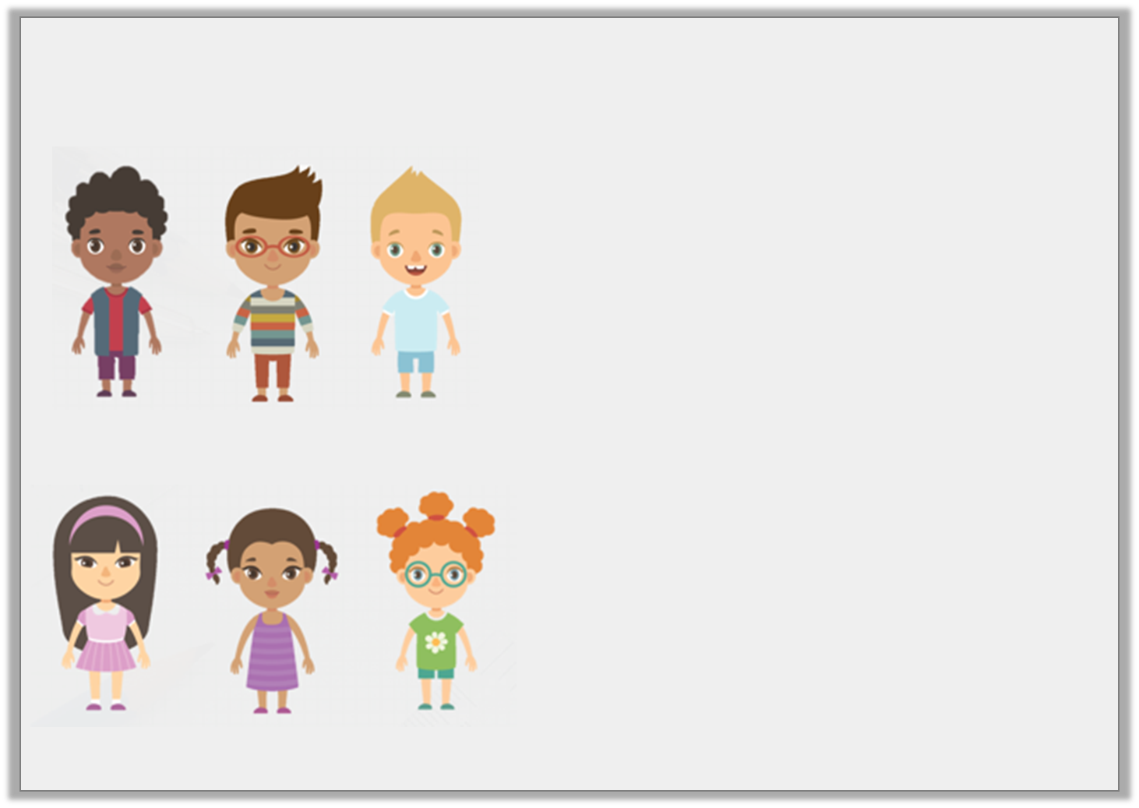
Reasoning 1
True or false? Explain why.
Danny is above Faizah.
B) All the girls are on top.
C) Below Mel is Jibrail.
Jibrail | Danny | Tom
Mel | Faizah | Zion
© Classroom Secrets Limited 2019

Slide 13
Reasoning 1
True or false? Explain why.
Danny is above Faizah.
True because…
B) All the girls are on top.
False because…
C) Below Mel is Jibrail.
False because…
Jibrail | Danny | Tom
Mel | Faizah | Zion
© Classroom Secrets Limited 2019

Slide 14
Reasoning 1
True or false? Explain why.
Danny is above Faizah.
True because Danny is on the top row and Faizah is on the bottom so Danny must be above Faizah.
B) All the girls are on top.
False because the girls are on the bottom and the boys are on the top.
C) Below Mel is Jibrail.
False because Mel is on the bottom and Jibrail is on the top row.
Jibrail | Danny | Tom
Mel | Faizah | Zion
© Classroom Secrets Limited 2019

Slide 15
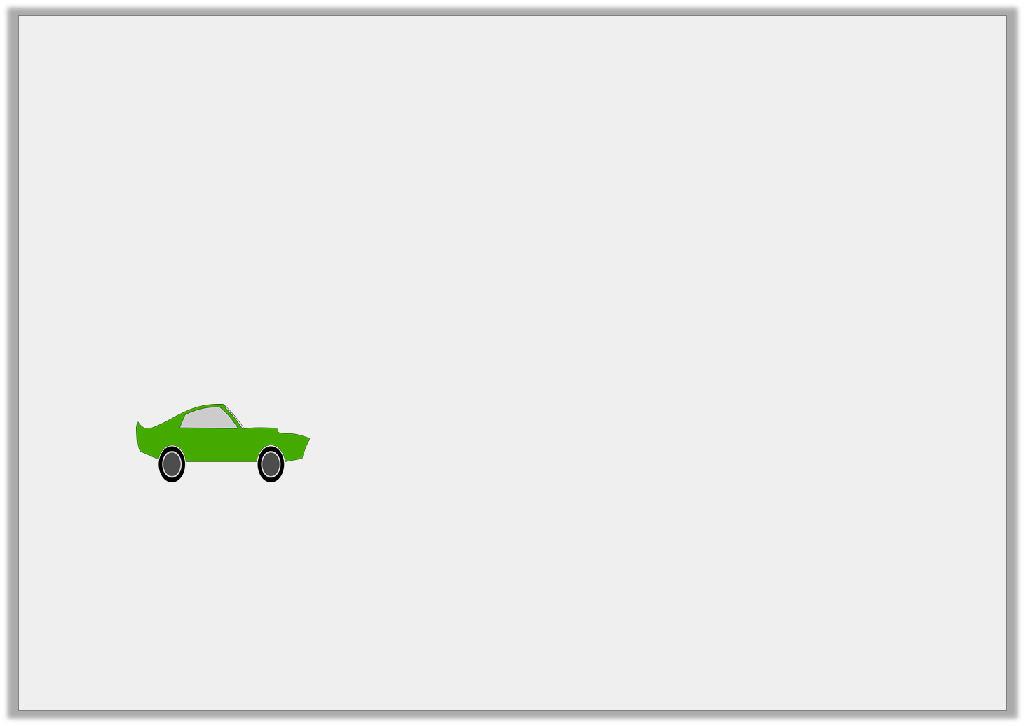
Problem Solving 1
Draw a line from the car to the box it should be in using the clue.
The car is in the top row in the middle box.
© Classroom Secrets Limited 2019

Slide 16
Problem Solving 1
Draw a line from the car to the box it should be in using the clue.
The car is in the top row in the middle box.
© Classroom Secrets Limited 2019

Slide 17
Reasoning 2
Explain who is correct.
The star is below the square.
Maria
The star is above the square.
Nico
© Classroom Secrets Limited 2019

Slide 18
Reasoning 2
Explain who is correct.
Maria is correct. Nico is incorrect because…
The star is below the square.
Maria
The star is above the square.
Nico
© Classroom Secrets Limited 2019

Slide 19
Reasoning 2
Explain who is correct.
Maria is correct. Nico is incorrect because the square is at the top so the star cannot be above it.
The star is below the square.
Maria
The star is above the square.
Nico
© Classroom Secrets Limited 2019

