Slide 1


Year 1 – Summer Block 3 – Position and Direction – Describe Position 1
About This Resource:
This PowerPoint has been designed to support your teaching of this small step. It includes a starter activity and an example of each question from the Varied Fluency and Reasoning and Problem Solving resources also provided in this pack. You can choose to work through all examples provided or a selection of them depending on the needs of your class.
National Curriculum Objectives:
Mathematics Year 1: (1P2) Describe position, direction and movement, including whole, half, quarter and three quarter turns
More Year 1 Position and Direction resources.
Did you like this resource? Don’t forget to review it on our website.
© Classroom Secrets Limited 2018

Slide 2
Year 1 – Summer Block 3 – Position and Direction
Step 2: Describe Position 1
© Classroom Secrets Limited 2018

Slide 3
Introduction
Match the labels to the direction of the arrows.
up
left
down
right
© Classroom Secrets Limited 2018

Slide 4
Introduction
Match the labels to the direction of the arrows.
up
left
down
right
© Classroom Secrets Limited 2018

Slide 5
Varied Fluency 1
Colour the shape one place to the left and
one place down from the circle.
© Classroom Secrets Limited 2018

Slide 6
Varied Fluency 1
Colour the shape one place to the left and
one place down from the circle.
© Classroom Secrets Limited 2018

Slide 7
Varied Fluency 2
Circle the shape that is one place right and
one place up from the square.
© Classroom Secrets Limited 2018

Slide 8
Varied Fluency 2
Circle the shape that is one place right and
one place up from the square.
© Classroom Secrets Limited 2018

Slide 9
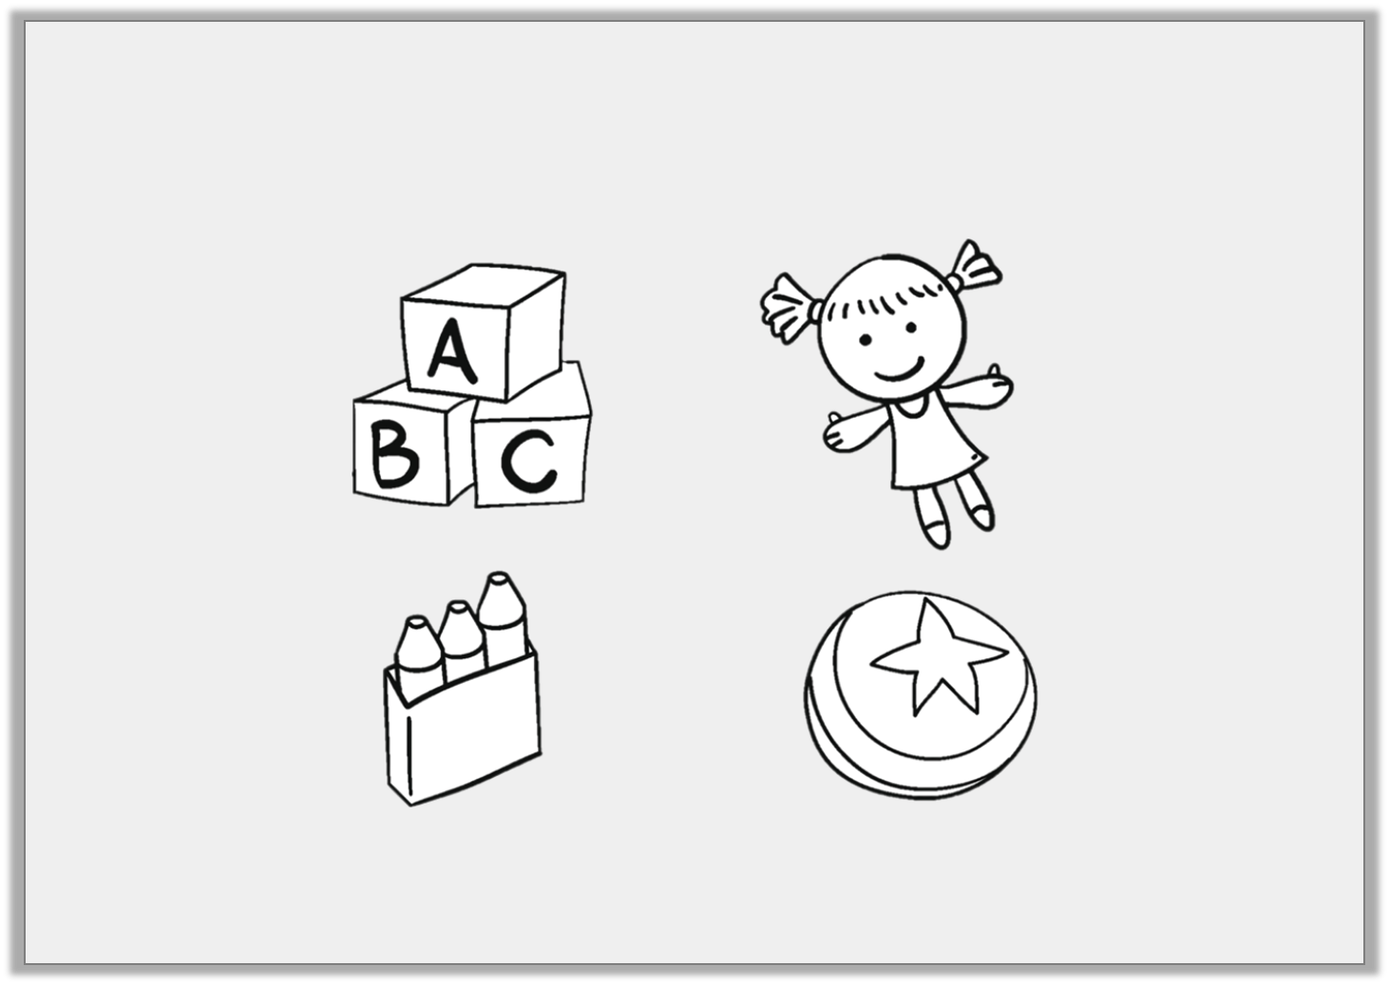
Varied Fluency 3
True or false?
The doll is up from the ball and to the left of the blocks.
© Classroom Secrets Limited 2018

Slide 10
Varied Fluency 3
True or false?
The doll is up from the ball and to the left of the blocks.
False, the doll is up from the ball and to the right of the blocks.
© Classroom Secrets Limited 2018

Slide 11
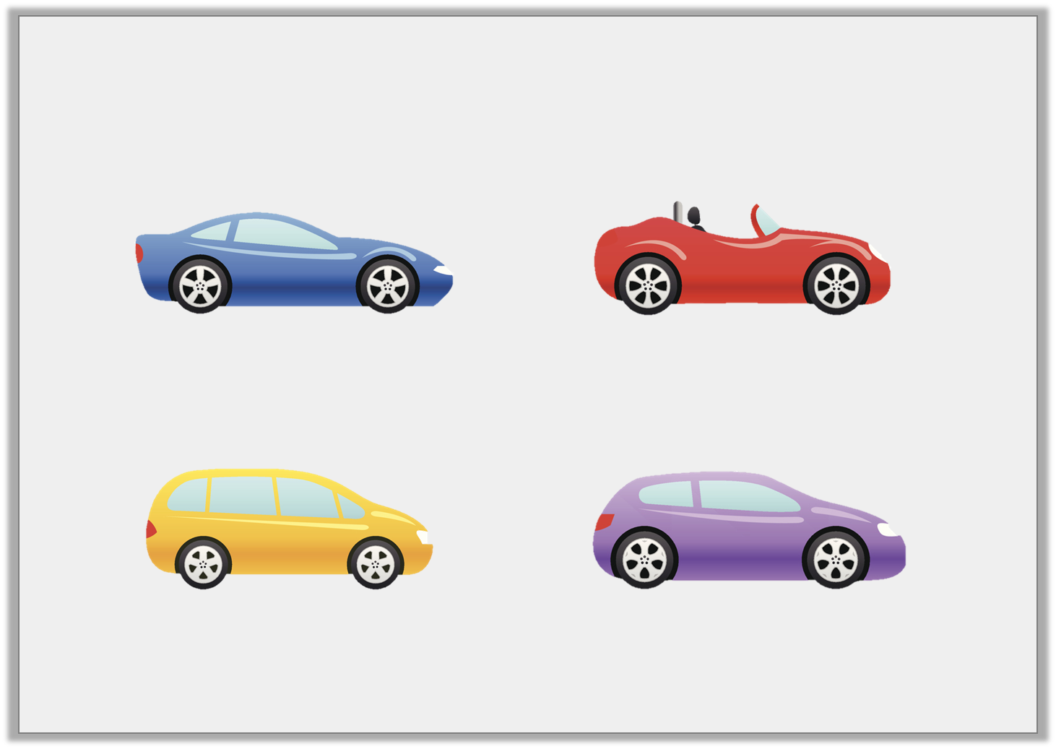
Varied Fluency 4
Which colour car is right of the blue car and down from the red?
blue
red
yellow
purple
© Classroom Secrets Limited 2018

Slide 12
Varied Fluency 4
Which colour car is right of the blue car and down from the red?
blue
red
yellow
purple
© Classroom Secrets Limited 2018

Slide 13
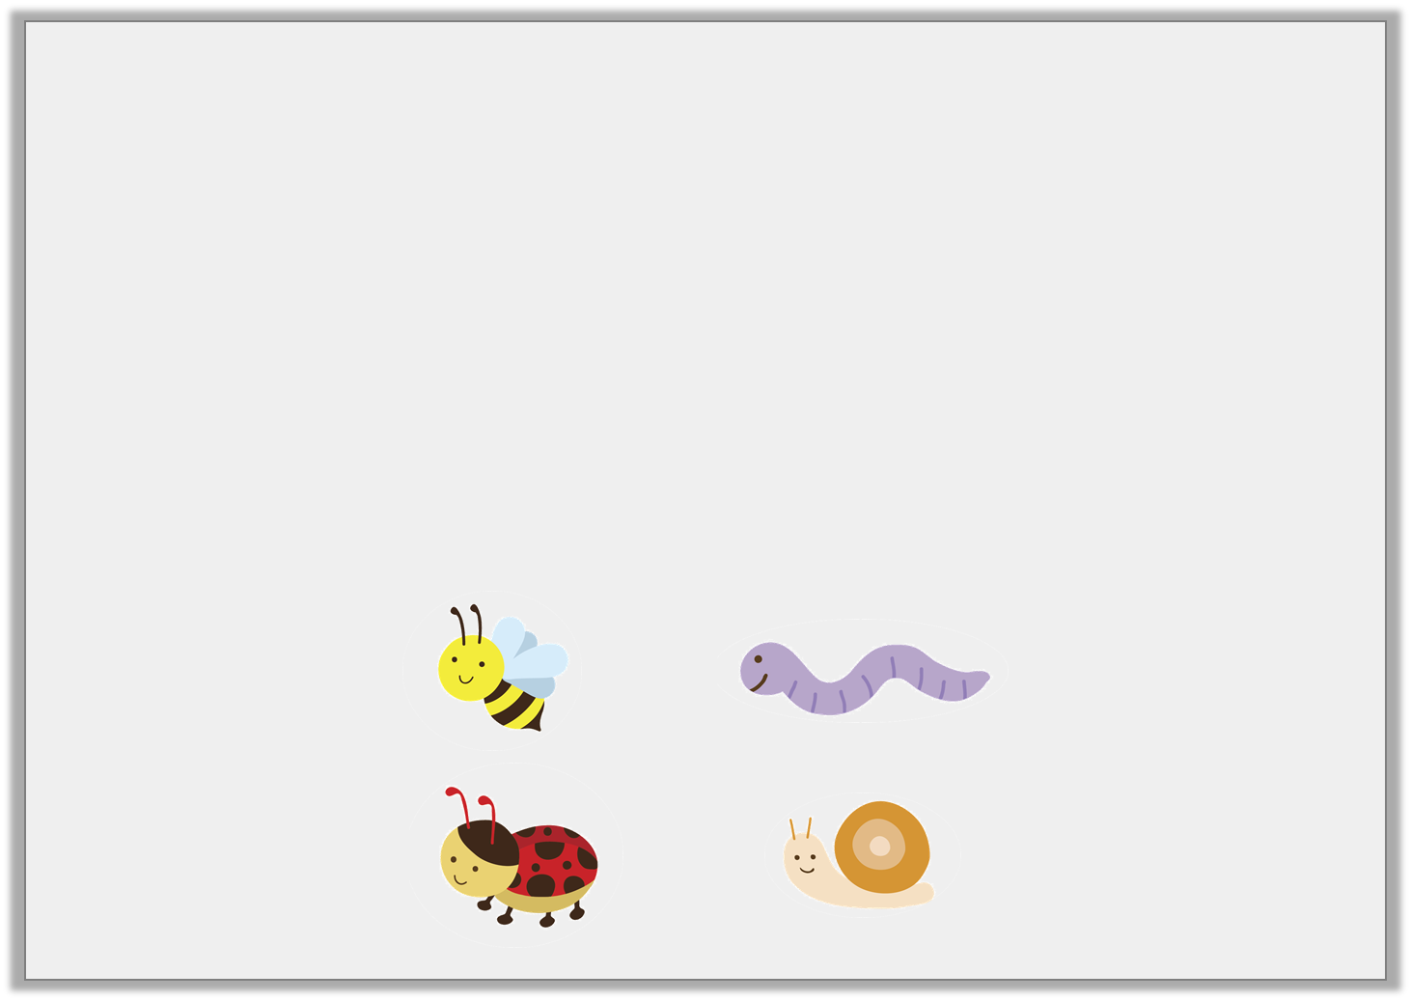
Problem Solving 1
Fill in the gaps using the word bank.
The worm is _______________ of the bee and _______________ from the snail.
The ladybird is _______________ from the bee and _______________ of the snail.
up
down
left
right
© Classroom Secrets Limited 2018

Slide 14
Problem Solving 1
Fill in the gaps using the word bank.
The worm is right of the bee and up from the snail.
The ladybird is down from the bee and left of the snail.
up
down
left
right
© Classroom Secrets Limited 2018

Slide 15

Problem Solving 2
I am one place left and one place down from Beth.
Who am I?
Penny
Beth
Carlos
Jake
© Classroom Secrets Limited 2018

Slide 16
Problem Solving 2
I am one place left and one place down from Beth.
Who am I?
Penny
Beth
Carlos
Jake
© Classroom Secrets Limited 2018

Slide 17
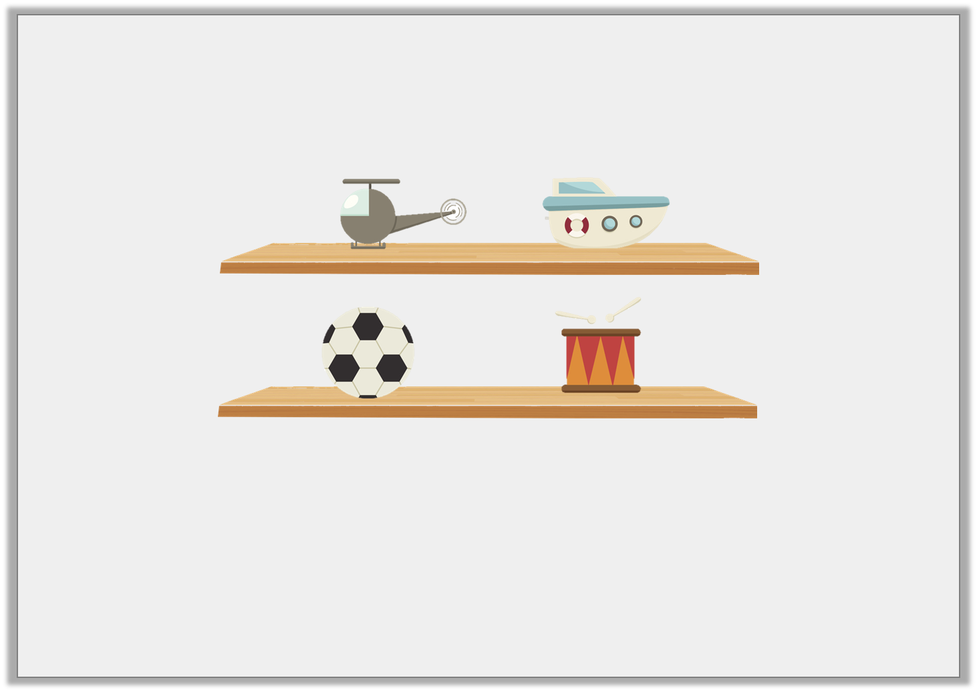
Reasoning 1
Tim says he put his football on the
right of the drum and down from the boat.
Is he correct?
Explain how you know.
© Classroom Secrets Limited 2018

Slide 18
Reasoning 1
Tim says he put his football on the
right of the drum and down from the boat.
Is he correct?
Explain how you know.
Tim is not correct because…
© Classroom Secrets Limited 2018

Slide 19
Reasoning 1
Tim says he put his football on the
right of the drum and down from the boat.
Is he correct?
Explain how you know.
Tim is not correct because the football is on the left of the drum.
© Classroom Secrets Limited 2018

