Slide 1


LIFE/work balance
We have started a #LIFEworkbalance campaign and we need your help to complete our LIFE/work balance survey.
We hope to publish the results soon, so please give 15 minutes of your time to help us get a true picture of school life.
Want to be a part of this campaign? Take the survey on our website and share it with your colleagues!
© Classroom Secrets Limited 2019

Slide 2
Year 1 – Summer Block 1 – Singular and Plural – Adding ‘s’ or ‘es’
About This Resource:
This PowerPoint has been designed to support your teaching of this small step. It includes a starter activity and an example of each question from the Varied Fluency and Application and Reasoning resources also provided in this pack. You can choose to work through all examples provided or a selection of them depending on the needs of your class.
National Curriculum Objectives:
English Year 1: (1G6.3) Regular plural noun suffixes –s or –es [for example, dog, dogs; wish, wishes], including the effects of these suffixes on the meaning of the noun​
Terminology for pupils:​
(1G6.3) singular​
(1G6.3) plural
More resources from our Grammar, Punctuation and Spelling scheme of work.
Did you like this resource? Don’t forget to review it on our website.
© Classroom Secrets Limited 2019

Slide 3
Year 1 – Summer Block 2 – Singular and Plural – Adding ‘s’ or ‘es’
Notes and Guidance:
Children should now have an understanding of the difference between singular and plural nouns, and that most plural nouns are formed by adding ‘s’. They should also now be familiar that all singular nouns ending in –s, -x, -z, -sh, -ch, or –ss must add ‘es’ to the end of the word to form the plural, instead of ‘s’.
In this step children will practice using the two plural forms in their writing.
Children will be able to select the correct plural form of nouns according to the rules and exceptions they have learnt.
They will be able to complete sentences writing the correct plural form of nouns.
By the end of this block, children should be able to identify between singular and plural nouns as well as correct and incorrect plural nouns.
Focused Questions
Select the correct ending for the noun to make it plural.
Is this plural noun correct? Explain your answer.
Complete the sentence using a singular or plural noun and/or a correctly formed plural noun.
© Classroom Secrets Limited 2019

Slide 4
Year 2 – Summer Block 2 – Singular and Plural
Step 5: Adding ‘s’ or ‘es’
© Classroom Secrets Limited 2019

Slide 5
Introduction
Sort the words into the table.
singular | plural
watch
dish
kiss
face
kisses
boot
faces
watches
dishes
boots
© Classroom Secrets Limited 2019

Slide 6
Introduction
Sort the words into the table.
singular | plural
watch
watches
boot
boots
dish
dishes
face
faces
kiss
kisses
© Classroom Secrets Limited 2019

Slide 7
Varied Fluency 1
Sort the words into the table.
add ‘s’ | add ‘es’
lake
gas
bunch
dress
hand
sweet
© Classroom Secrets Limited 2019

Slide 8
Varied Fluency 1
Sort the words into the table.
add ‘s’ | add ‘es’
lake
dress
hand
gas
sweet
bunch
© Classroom Secrets Limited 2019

Slide 9

Varied Fluency 2
Match the pictures to the correct words.
chips
churchs
churches
chip
© Classroom Secrets Limited 2019

Slide 10
Varied Fluency 2
Match the pictures to the correct words.
chips
churchs
churches
chip
© Classroom Secrets Limited 2019

Slide 11
Varied Fluency 3
Match the nouns to the correct plural spelling.
watchs
watch
watches
tiles
tile
tilees
paints
paint
paintes
© Classroom Secrets Limited 2019

Slide 12
Varied Fluency 3
Match the nouns to the correct plural spelling.
watchs
watch
watches
tiles
tile
tilees
paints
paint
paintes
© Classroom Secrets Limited 2019

Slide 13
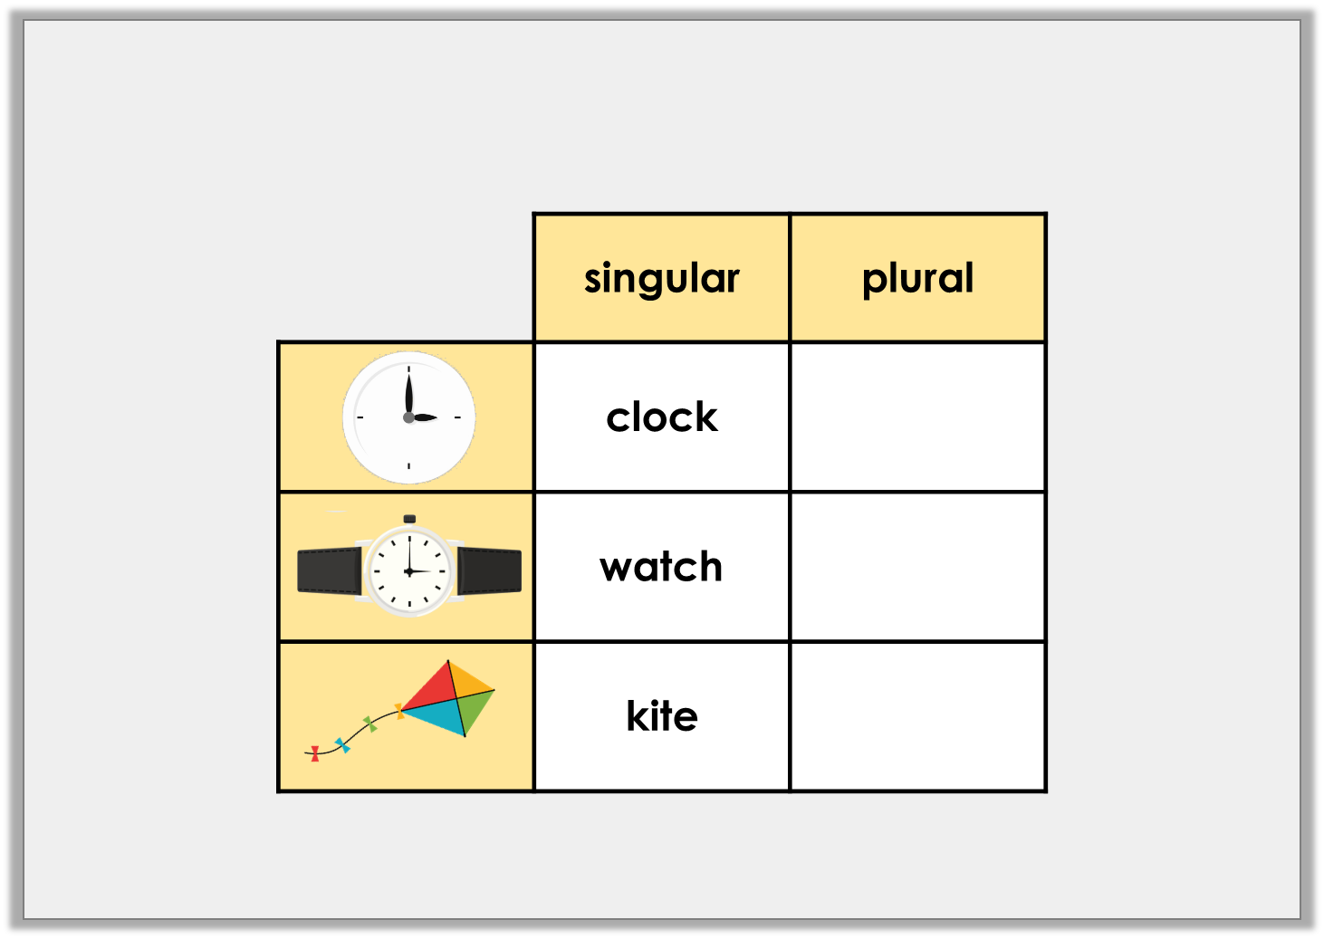
Application 1
Complete the table.
© Classroom Secrets Limited 2019

Slide 14

Application 1
Complete the table.
© Classroom Secrets Limited 2019

Slide 15
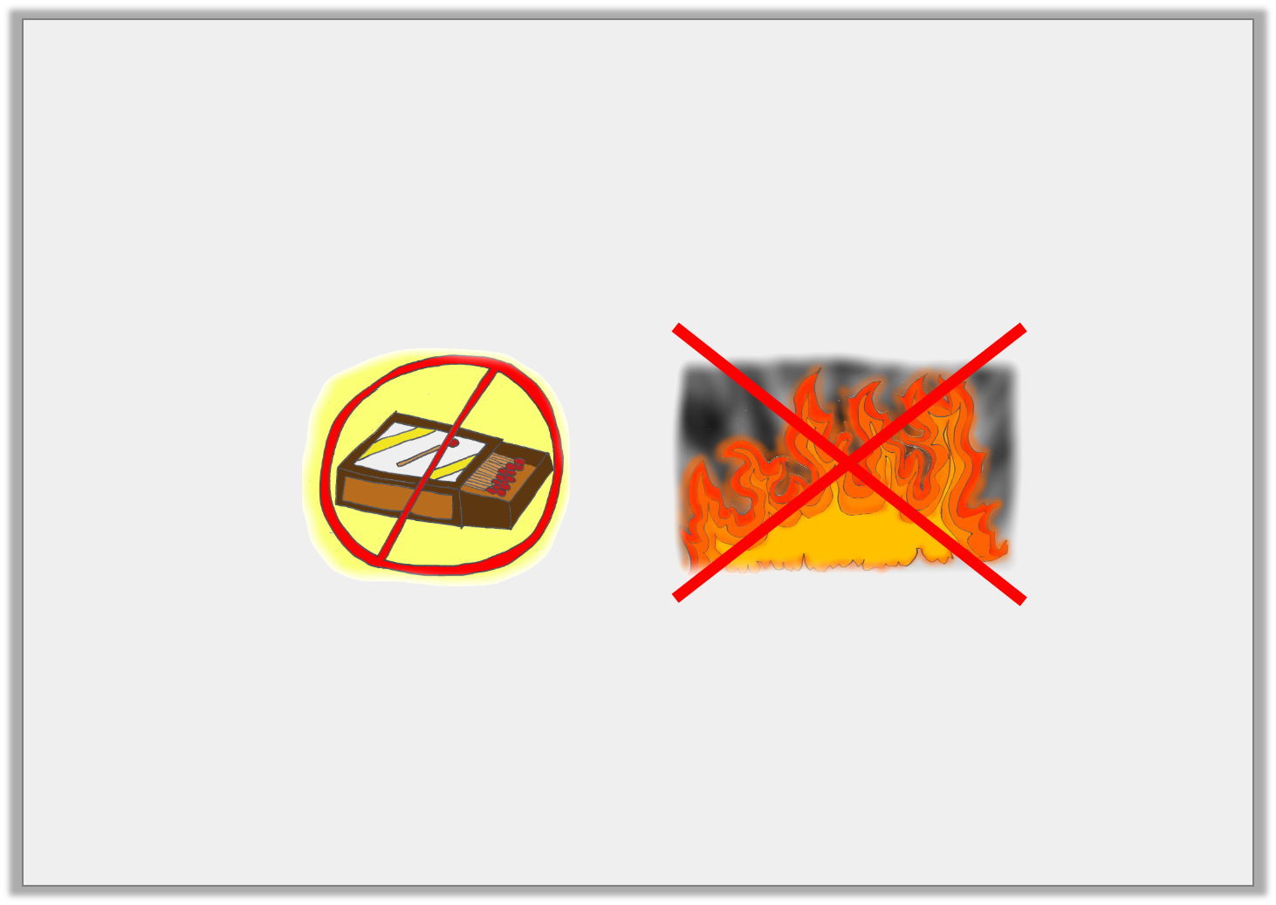
Application 2
Use the word bank to complete the sentence.
Do not touch _______________________ or __________________________ !
match |  | flame
© Classroom Secrets Limited 2019

Slide 16
Application 2
Use the word bank to complete the sentence.
Do not touch _______________________ or __________________________ !
match |  | flame
matches
flames
© Classroom Secrets Limited 2019

Slide 17
Reasoning 1
This is Arjun’s spelling test. Is he correct?
Explain your answer.
1. houses
2. torchs
3. doors
4. glasses
© Classroom Secrets Limited 2019

Slide 18
Reasoning 1
This is Arjun’s spelling test. Is he correct?
Explain your answer.
Arjun is not correct because
1. houses
2. torchs
3. doors
4. glasses
© Classroom Secrets Limited 2019

Slide 19
Reasoning 1
This is Arjun’s spelling test. Is he correct?
Explain your answer.
Arjun is not correct because he should have added ‘es’ to torch because it ends with ‘ch’
1. houses
2. torchs
3. doors
4. glasses
✓
x
✓
✓
© Classroom Secrets Limited 2019

