Slide 1

Year 1 – Summer Block 2 – Singular and Plural – Adding ‘-es’
About This Resource:
This PowerPoint has been designed to support your teaching of this small step. It includes a starter activity and an example of each question from the Varied Fluency and Application and Reasoning resources also provided in this pack. You can choose to work through all examples provided or a selection of them depending on the needs of your class.
National Curriculum Objectives:
English Year 1: (1G6.3) Regular plural noun suffixes –s or –es [for example, dog, dogs; wish, wishes], including the effects of these suffixes on the meaning of the noun
Terminology for pupils:
  (1G6.3) singular
  (1G6.3) plural
More resources from our Grammar, Punctuation and Spelling scheme of work.
Did you like this resource? Don’t forget to review it on our website.
© Classroom Secrets Limited 2019

Slide 2
Year 1 – Summer Block 2 – Singular and Plural – Adding ‘-es’
Notes and Guidance:
Children should now have an understanding of the difference between singular and plural nouns, knowing that singular nouns are used to describe one person, place or object; plural nouns are used to describe more than one person, place or object.
Children should now be familiar that most plural nouns are formed by adding ‘s’ and be able to correctly use these in their writing.
In this step children will learn that not all plural nouns are formed by adding ‘s’, and that some add ‘es’ instead.
All singular nouns ending in –s, -x, -z, -sh, -ch, or –ss must add ‘es’ to the end of the word to form the plural, instead of ‘s’.
Children will see examples of words which add ‘es’ to form the plural and will practise changing words from singular to plural following the same patterns.
They will be able to complete sentences using the plural form of nouns ending in –s, -x, -z, -sh, -ch, or –ss.
Focused Questions
Write the plural noun to match the picture.
Complete the sentence adding the correct plural noun, using pictorial support.
© Classroom Secrets Limited 2019

Slide 3
Year 1 – Summer Block 2 – Singular and Plural
Step 4: Adding ‘-es’
© Classroom Secrets Limited 2019

Slide 4
Introduction
Sort these singular and plural nouns under the correct headings.
Singular
Plural
roads
car
light
boats
wheel
chairs
pens
house
© Classroom Secrets Limited 2019

Slide 5
Introduction
Sort these singular and plural nouns under the correct headings.
Singular
Plural
car
roads
light
boats
wheel
chairs
house
pens
© Classroom Secrets Limited 2019

Slide 6

Varied Fluency 1
Add ‘-es’ to the words and then match them to the pictures.
dress______
brush______
church______
© Classroom Secrets Limited 2019

Slide 7
Varied Fluency 1
Add ‘-es’ to the words and then match them to the pictures.
dresses
brushes
churches
© Classroom Secrets Limited 2019

Slide 8
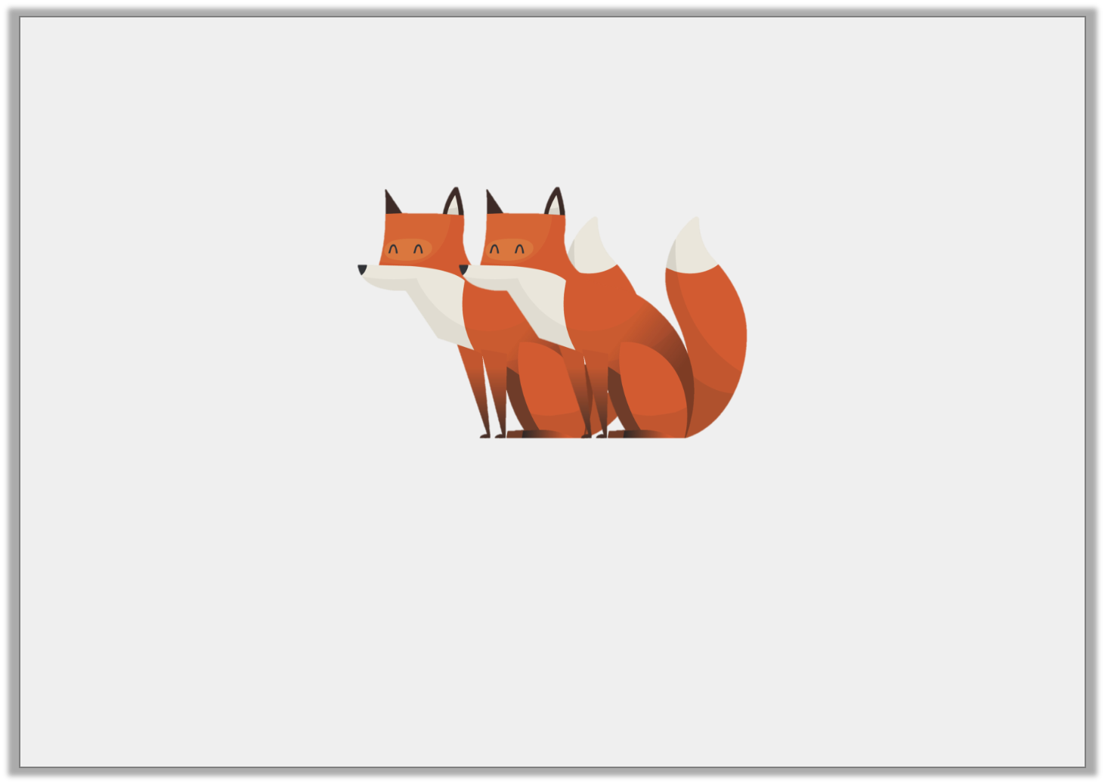
Varied Fluency 2
Circle the correct spelling to match the picture.
foxess | fox
foxs | foxes
© Classroom Secrets Limited 2019

Slide 9
Varied Fluency 2
Circle the correct spelling to match the picture.
foxess | fox
foxs | foxes
© Classroom Secrets Limited 2019

Slide 10
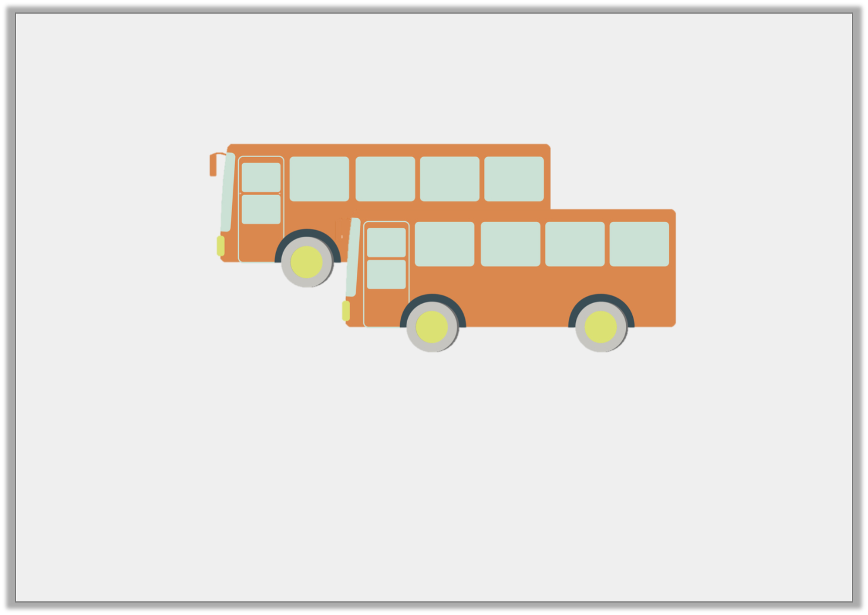
Varied Fluency 3
True or false? The word below is spelt correctly.
busss
© Classroom Secrets Limited 2019

Slide 11
Varied Fluency 3
True or false? The word below is spelt correctly.
False, it should be ‘buses’.
busss
© Classroom Secrets Limited 2019

Slide 12
Application 1
Sort these words into the table.
correct use of -es
incorrect use of -es
pitches | pilles | bookes
toyes | sixes | classes
© Classroom Secrets Limited 2019

Slide 13
Application 1
Sort these words into the table.
correct use of -es
incorrect use of -es
classes
pilles
sixes
bookes
pitches
toyes
© Classroom Secrets Limited 2019

Slide 14
Application 2
Use the first sentence to complete the second sentence.
My gran gives me a kiss on the top of my head.
My gran gives me lots of ______________ on the top of my head.
© Classroom Secrets Limited 2019

Slide 15
Application 2
Use the first sentence to complete the second sentence.
My gran gives me a kiss on the top of my head.
My gran gives me lots of ______________ on the top of my head.
kisses
© Classroom Secrets Limited 2019

Slide 16

Reasoning 1
Kiran has written a word to match the picture below, but she has made a mistake.
peachs
Explain what Kiran has done wrong and what she should have written.
© Classroom Secrets Limited 2019

Slide 17
Reasoning 1
Kiran has written a word to match the picture below, but she has made a mistake.
peachs
Explain what Kiran has done wrong and what she should have written.
Kiran has only added an ‘-s’, but…
© Classroom Secrets Limited 2019

Slide 18
Reasoning 1
Kiran has written a word to match the picture below, but she has made a mistake.
peachs
Explain what Kiran has done wrong and what she should have written.
Kiran has only added an ‘-s’, but she should have added ‘-es’.
© Classroom Secrets Limited 2019

