Slide 1


LIFE/work balance
We have started a #LIFEworkbalance campaign and we need your help to complete our LIFE/work balance survey.
We hope to publish the results soon, so please give 15 minutes of your time to help us get a true picture of school life.
Want to be a part of this campaign? Take the survey on our website and share it with your colleagues!
© Classroom Secrets Limited 2019

Slide 2
Year 1 – Summer Block 2 – Singular and Plural – Adding ‘-s’
About This Resource:
This PowerPoint has been designed to support your teaching of this small step. It includes a starter activity and an example of each question from the Varied Fluency and Application and Reasoning resources also provided in this pack. You can choose to work through all examples provided or a selection of them depending on the needs of your class.
National Curriculum Objectives:
English Year 1: (1G6.3) Regular plural noun suffixes –s or –es [for example, dog, dogs; wish, wishes], including the effects of these suffixes on the meaning of the noun
Terminology for pupils:
  (1G6.3) singular
  (1G6.3) plural
More resources from our Grammar, Punctuation and Spelling scheme of work.
Did you like this resource? Don’t forget to review it on our website.
© Classroom Secrets Limited 2019

Slide 3
Year 1 – Summer Block 2 – Singular and Plural – Adding ‘-s’
Notes and Guidance:
Children should now have an understanding of the difference between singular and plural nouns, knowing that singular nouns are used to describe one person, place or object; plural nouns are used to describe more than one person, place or object.
Children should now be familiar that most plural nouns are formed by adding ‘s’ and be able to correctly identify these in written form.
Children will practise changing nouns from singular to plural by adding ‘s’, and use these in their writing to describe pictures or to complete sentences.
Focused Questions
Write the correct word to describe the picture.
Choose the correct word to complete the sentence, choosing between singular and plural nouns formed with ‘s’.
© Classroom Secrets Limited 2019

Slide 4
Year 1 – Summer Block 2 – Singular and Plural
Step 3: Adding ‘-s’
© Classroom Secrets Limited 2019

Slide 5
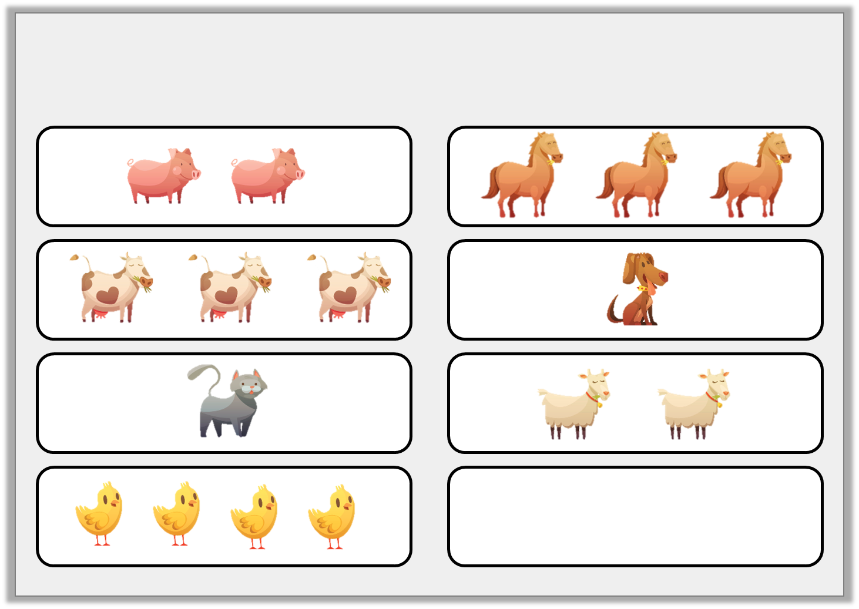
Introduction
Circle the groups of animals that have more than one.
© Classroom Secrets Limited 2019

Slide 6
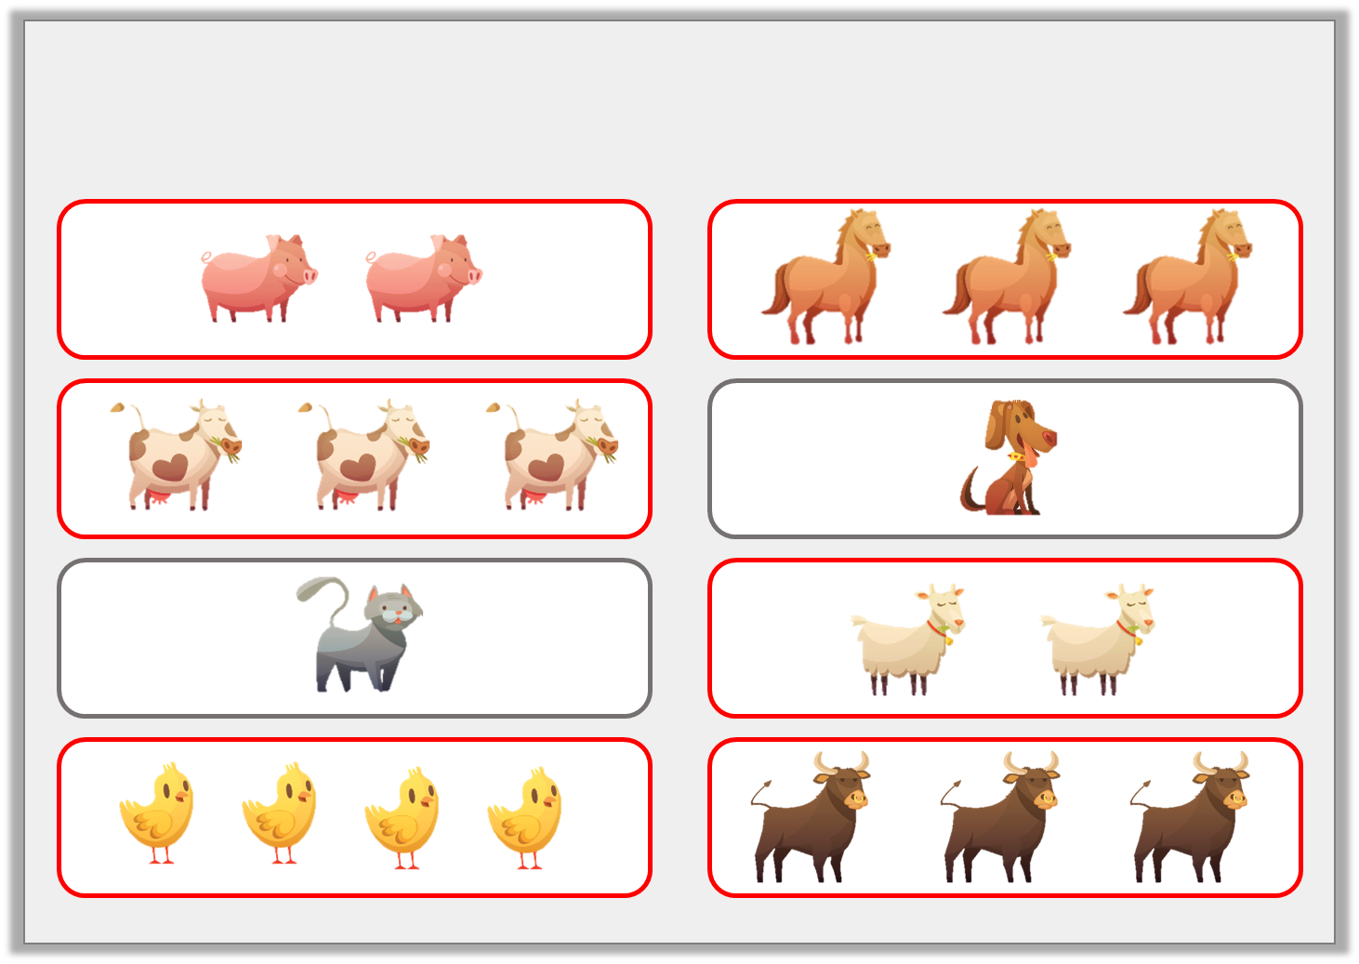
Introduction
Circle the groups of animals that have more than one.
© Classroom Secrets Limited 2019

Slide 7

Varied Fluency 1
Add an ‘-s’ to the word below to match the picture.
sweet
© Classroom Secrets Limited 2019

Slide 8
Varied Fluency 1
Add an ‘-s’ to the word below to match the picture.
sweets
© Classroom Secrets Limited 2019

Slide 9
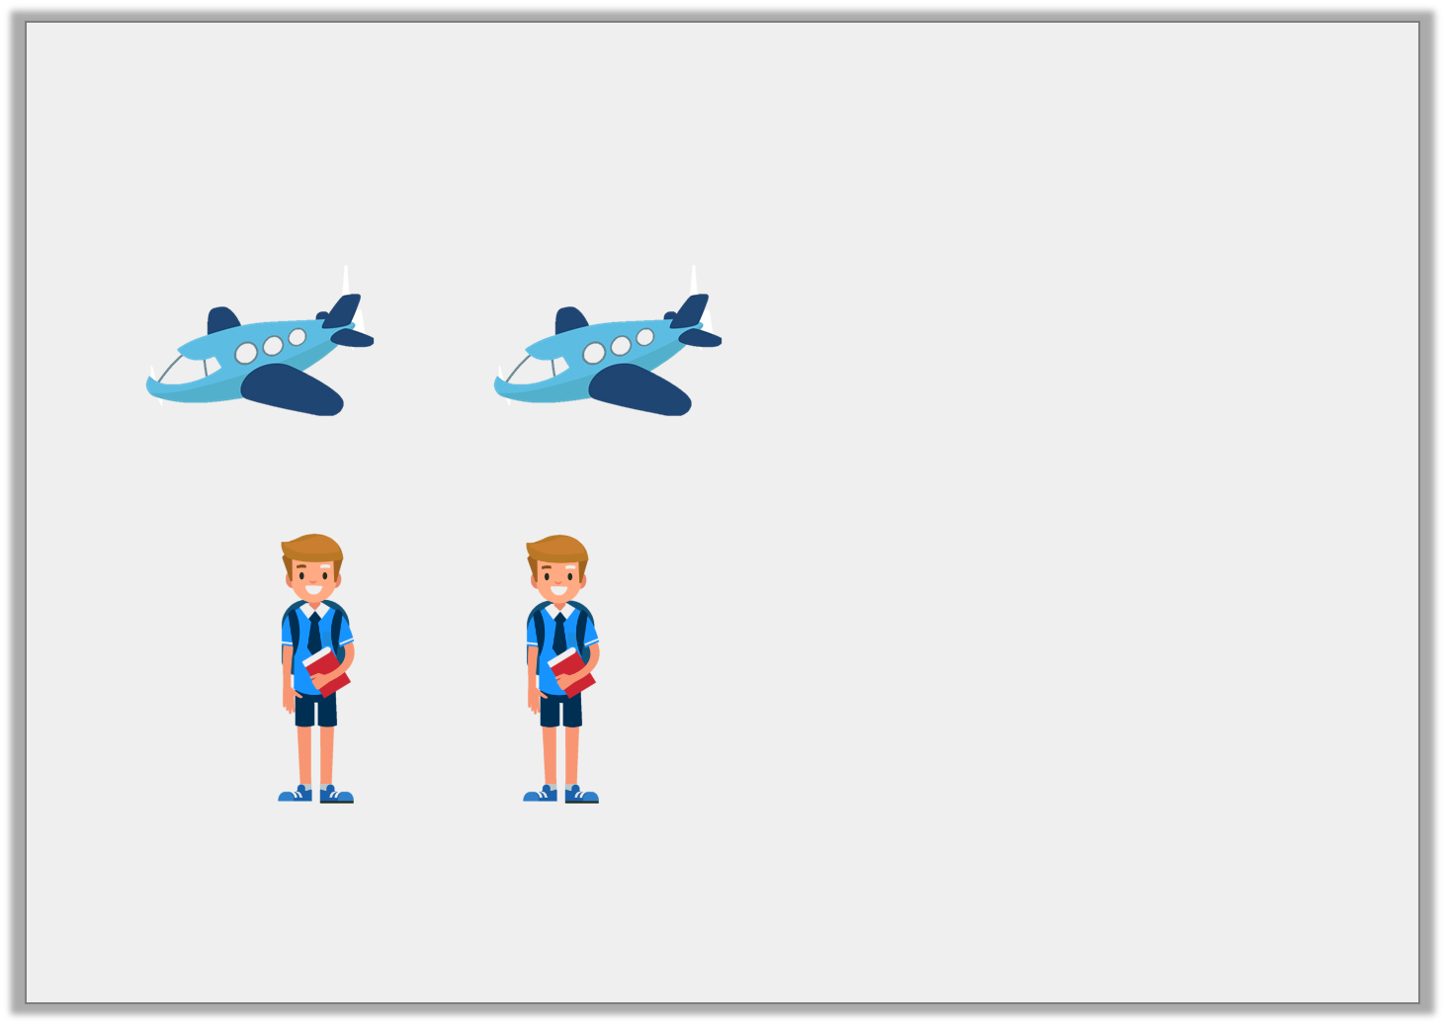
Varied Fluency 2
Match the pictures to the words.
boys
grapes
planes
© Classroom Secrets Limited 2019

Slide 10
Varied Fluency 2
Match the pictures to the words.
boys
grapes
planes
© Classroom Secrets Limited 2019

Slide 11

Varied Fluency 3
Circle the nouns that match the pictures.
whale |  | ropes
whales |  | rope
© Classroom Secrets Limited 2019

Slide 12
Varied Fluency 3
Circle the nouns that match the pictures.
whale |  | ropes
whales |  | rope
© Classroom Secrets Limited 2019

Slide 13

Reasoning 1
Tom has written a noun under the picture.
Is he correct?
Explain your answer.
© Classroom Secrets Limited 2019

Slide 14
Reasoning 1
Tom has written a noun under the picture.
Is he correct?
Explain your answer.
Tom is incorrect because…
© Classroom Secrets Limited 2019

Slide 15
Reasoning 1
Tom has written a noun under the picture.
Is he correct?
Explain your answer.
Tom is incorrect because there is more than one globe so his noun should say ‘globes’.
© Classroom Secrets Limited 2019

Slide 16
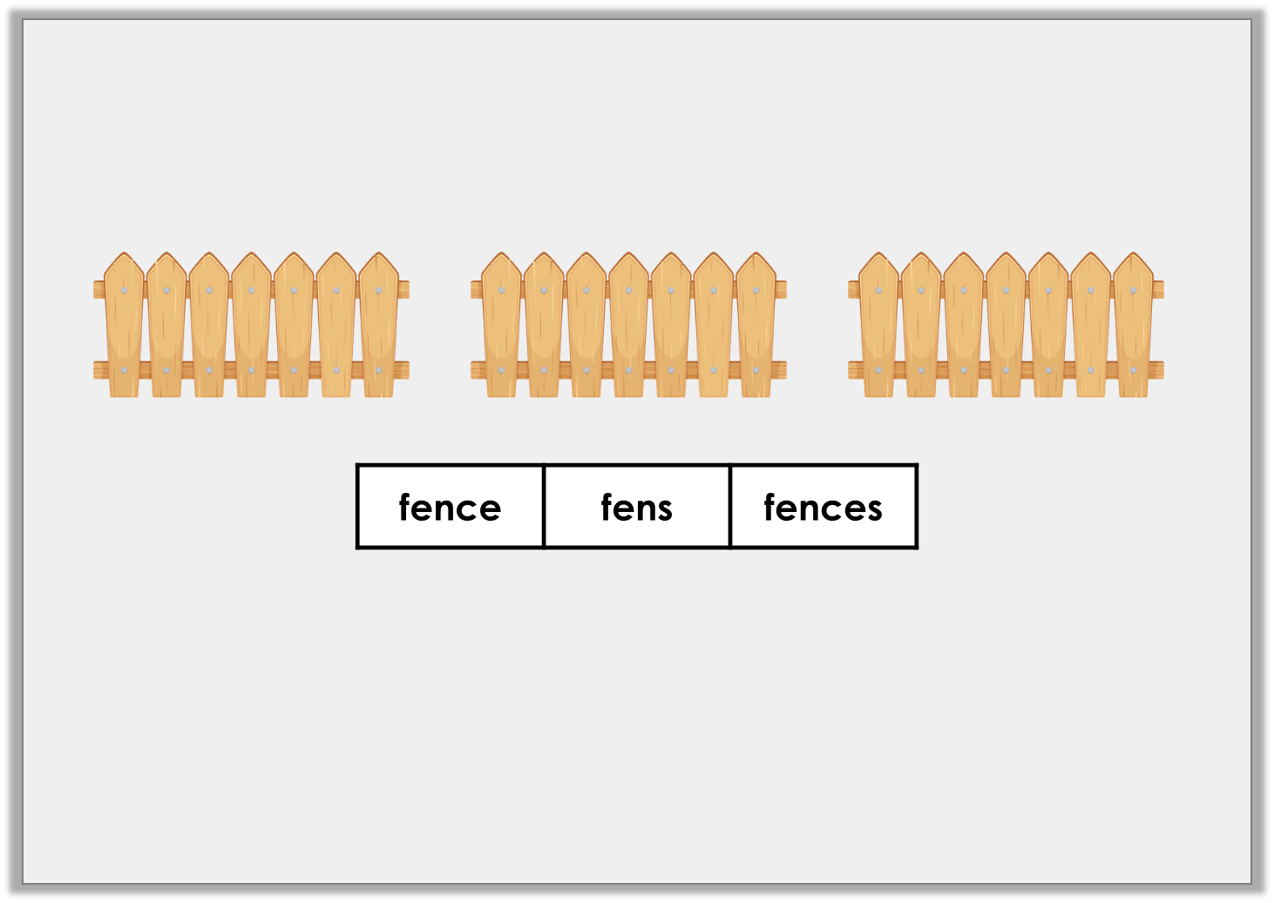
Application 1
Complete the sentence to match the picture. Use the word bank.
© Classroom Secrets Limited 2019

Slide 17
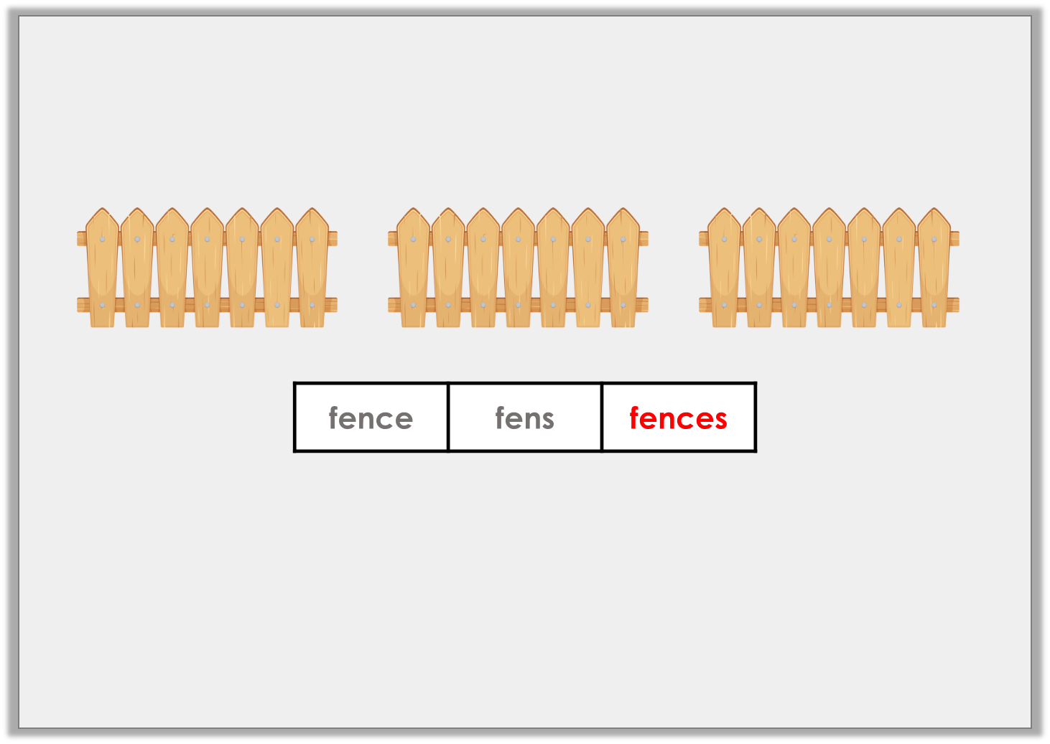
Application 1
Complete the sentence to match the picture. Use the word bank.
There are three fences.
© Classroom Secrets Limited 2019

Slide 18
Application 2
Sort the words into the table.
tie | slides
bones | dress
Singular | Plural
© Classroom Secrets Limited 2019

Slide 19
Application 2
Sort the words into the table.
tie | slides
bones | dress
Singular | Plural
tie dress | slides bones
© Classroom Secrets Limited 2019

