Slide 1


LIFE/work balance
We have started a #LIFEworkbalance campaign and we need your help to complete our LIFE/work balance survey.
We hope to publish the results soon, so please give 15 minutes of your time to help us get a true picture of school life.
Want to be a part of this campaign? Take the survey on our website and share it with your colleagues!
© Classroom Secrets Limited 2019

Slide 2
Year 1 – Summer Block 2 – Singular and Plural – Plural Nouns
About This Resource:
This PowerPoint has been designed to support your teaching of this small step. It includes a starter activity and an example of each question from the Varied Fluency and Application and Reasoning resources also provided in this pack. You can choose to work through all examples provided or a selection of them depending on the needs of your class.
National Curriculum Objectives:
English Year 1: (1G6.3) Regular plural noun suffixes –s or –es [for example, dog, dogs; wish, wishes], including the effects of these suffixes on the meaning of the noun
More resources from our Grammar, Punctuation and Spelling scheme of work.
Did you like this resource? Don’t forget to review it on our website.
© Classroom Secrets Limited 2019

Slide 3
Year 1 – Summer Block 2 – Singular and Plural – Plural Nouns
Notes and Guidance:
Children should have an understanding of nouns from work done in previous blocks using capital letters for names, people, places and days and months.
Children should now be familiar with singular nouns. In this step they will go on to learn that a plural noun is a word that refers to more than one person, place or object, for example: chairs.
Discuss that the most common way to make a noun plural is to add ‘s’ to the end of a singular noun. Children will be able to match plural nouns using some pictorial support and by comparison with singular nouns. They should be able to identify that plural nouns have extra letters at the end of the word, usually ‘s’.
Focused Questions
Match the singular noun to its plural form.
Circle the plural noun in the sentence.
Match the word to the correct image.
© Classroom Secrets Limited 2019

Slide 4
Year 1 – Summer Block 2 – Singular and Plural
Step 2: Plural Nouns
© Classroom Secrets Limited 2019

Slide 5
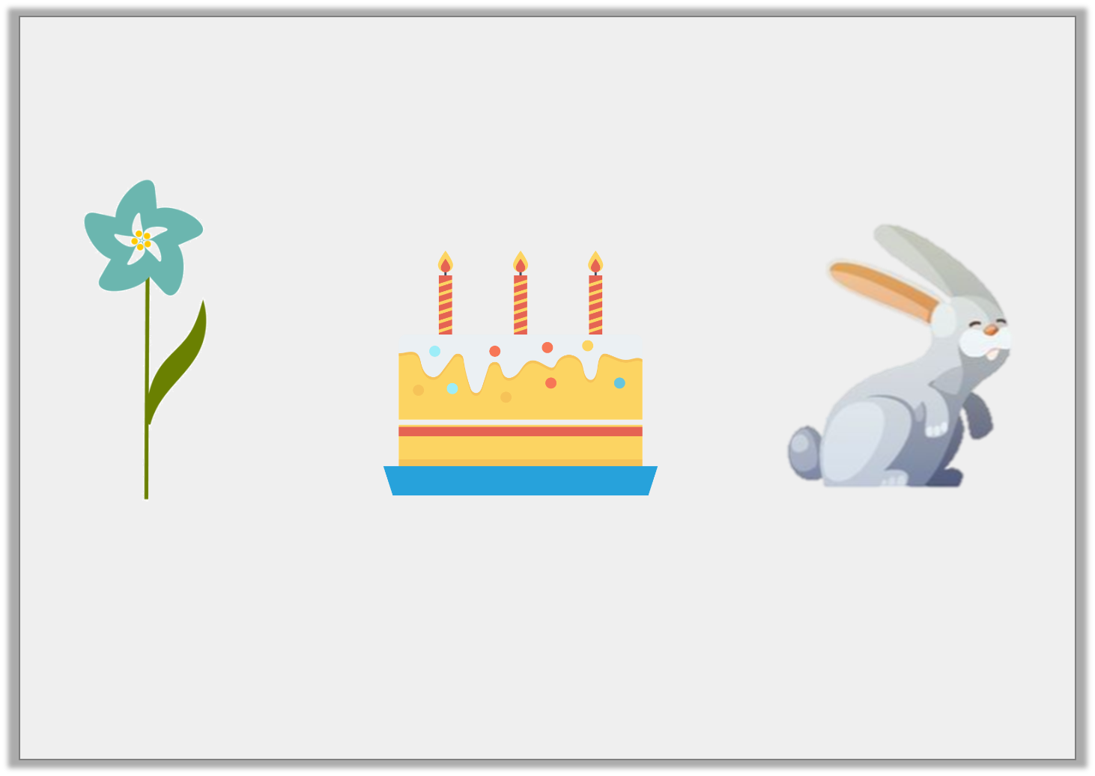
Introduction
Match the images to the correct words.
rabbit |  | flower |  | cake
© Classroom Secrets Limited 2019

Slide 6
Introduction
Match the images to the correct words.
rabbit |  | flower |  | cake
© Classroom Secrets Limited 2019

Slide 7
Varied Fluency 1
Underline the nouns in the sentence below.
My friends like to sing songs.
© Classroom Secrets Limited 2019

Slide 8
Varied Fluency 1
Underline the nouns in the sentence below.
My friends like to sing songs.
© Classroom Secrets Limited 2019

Slide 9

Varied Fluency 2
Match the picture to the word.
A.
B.
kite
chocolates
kites
© Classroom Secrets Limited 2019

Slide 10
Varied Fluency 2
Match the picture to the word.
A.
B.
kite
chocolates
kites
© Classroom Secrets Limited 2019

Slide 11
Varied Fluency 3
Put the nouns in the correct column in the table.
one object | more than one object
cube | eyes | cubes
paths | path | eye
© Classroom Secrets Limited 2019

Slide 12
Varied Fluency 3
Put the nouns in the correct column in the table.
one object | more than one object
cube path eye | cubes paths eyes
cube | eyes | cubes
paths | path | eye
© Classroom Secrets Limited 2019

Slide 13
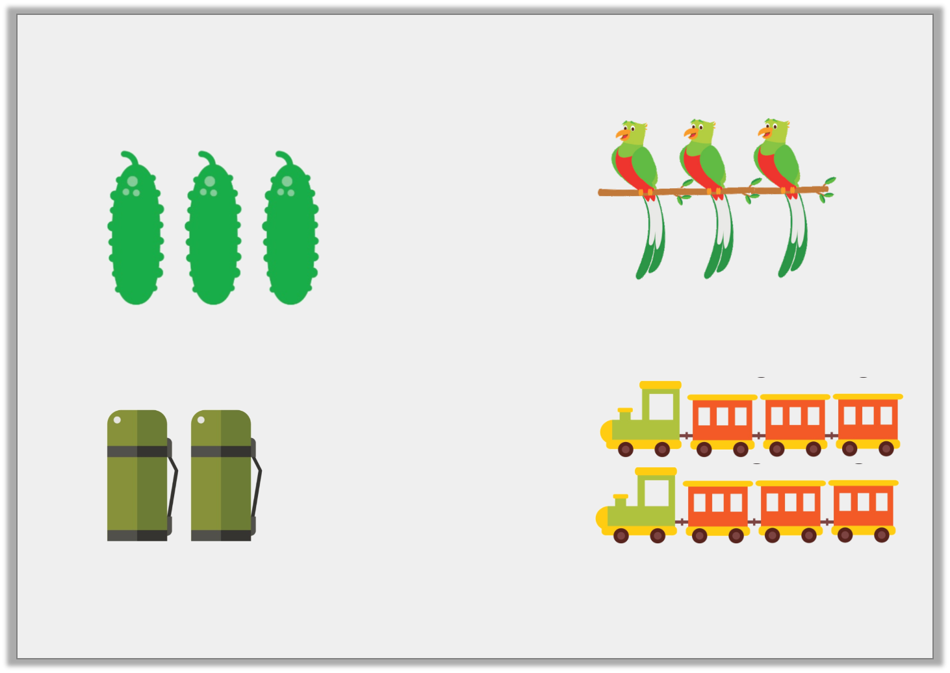
Application 1
Write three nouns that you can see below.
A.
C.
B.
D.
© Classroom Secrets Limited 2019

Slide 14
Application 1
Write three nouns that you can see below.
pickles, parrots, flasks or trains
A.
C.
B.
D.
© Classroom Secrets Limited 2019

Slide 15
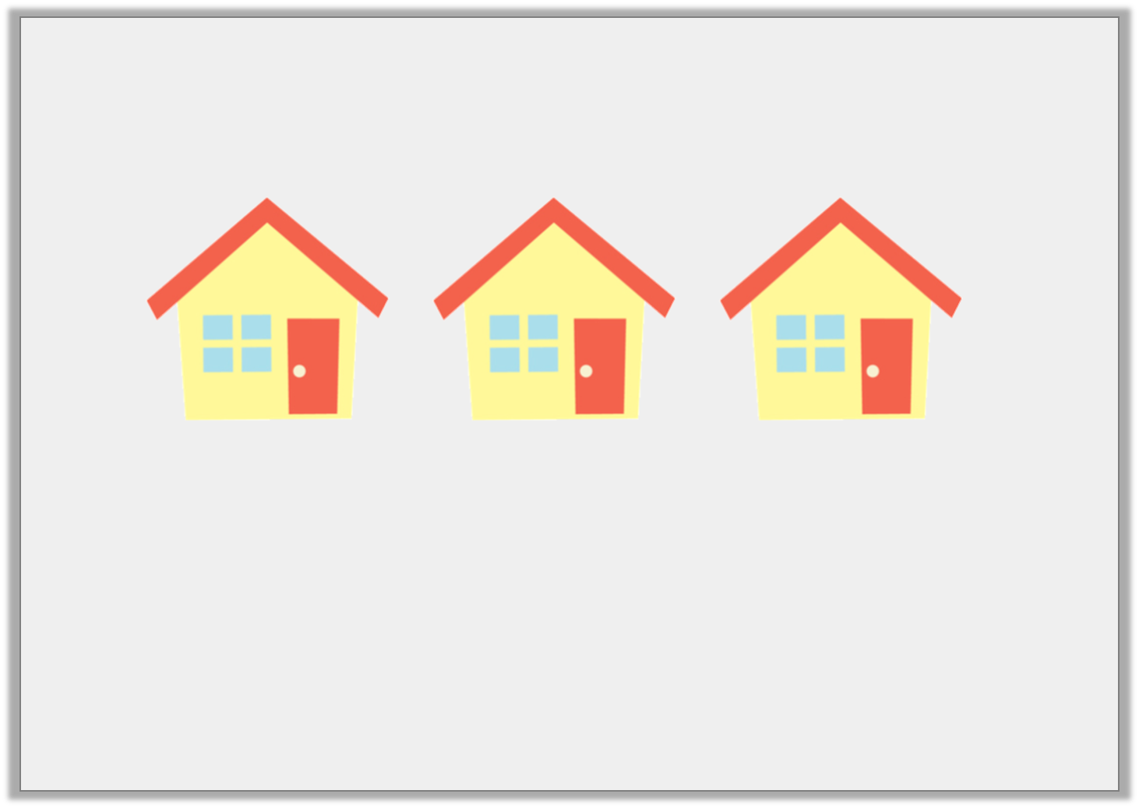
Application 2
Correct the mistake in the sentence below.
These house are very pretty.
© Classroom Secrets Limited 2019

Slide 16
Application 2
Correct the mistake in the sentence below.
These houses are very pretty.
© Classroom Secrets Limited 2019

Slide 17
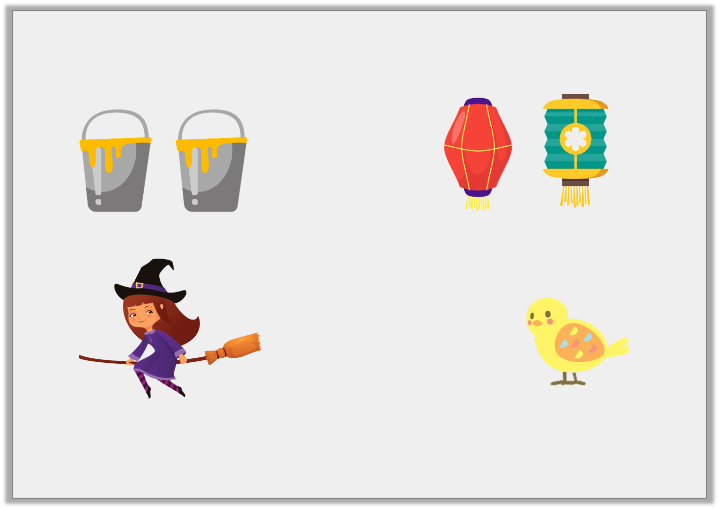
Reasoning 1
Tick the pictures you think would end with an ‘s’.
A.
C.
B.
D.
© Classroom Secrets Limited 2019

Slide 18
Reasoning 1
Tick the pictures you think would end with an ‘s’.
A and C because…
A.
C.
B.
D.
© Classroom Secrets Limited 2019

Slide 19
Reasoning 1
Tick the pictures you think would end with an ‘s’.
A and C because there is more than one object in each picture.
✓
A.
✓
C.
B.
D.
© Classroom Secrets Limited 2019

