Slide 1
Structure of Plants

Slide 2
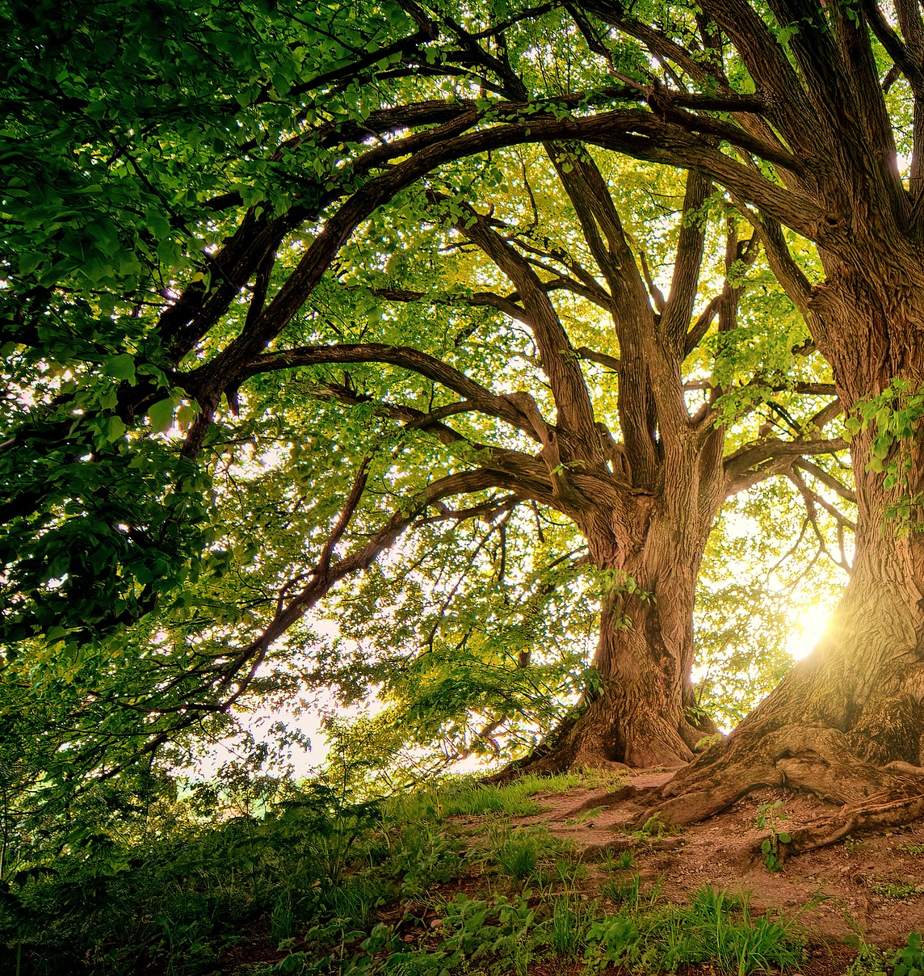
Trees

Slide 3
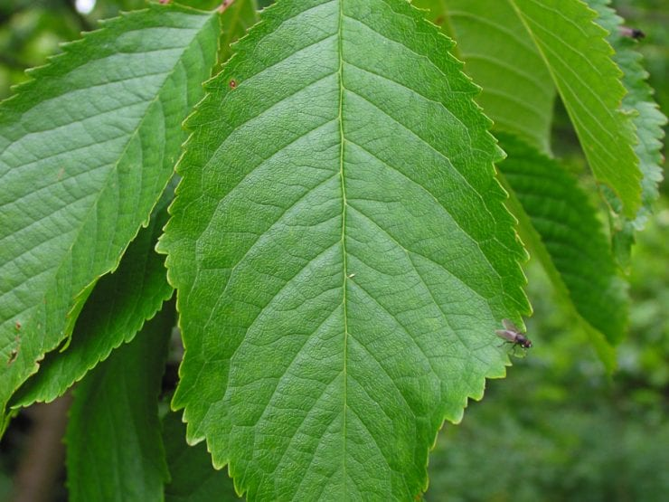
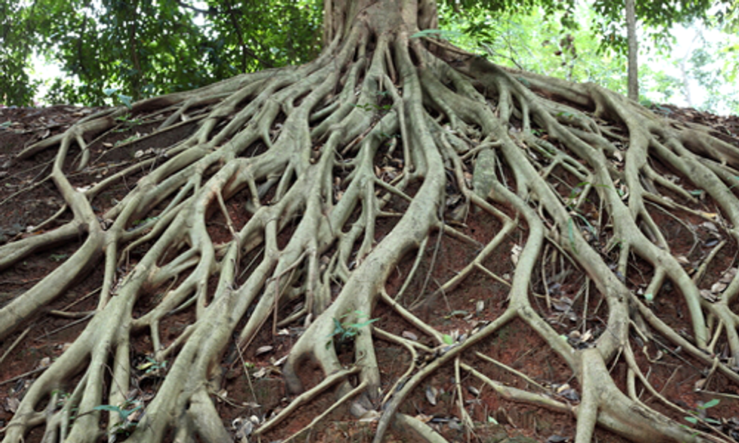
Structure of Trees
Leaves: Leaves are green and make the food for the tree and also evaporate water which helps to keep the surface of the leaf cool.
Roots: The roots hold the tree in the ground so that the wind cannot blow over it. A tree gets water through its roots.

Slide 4
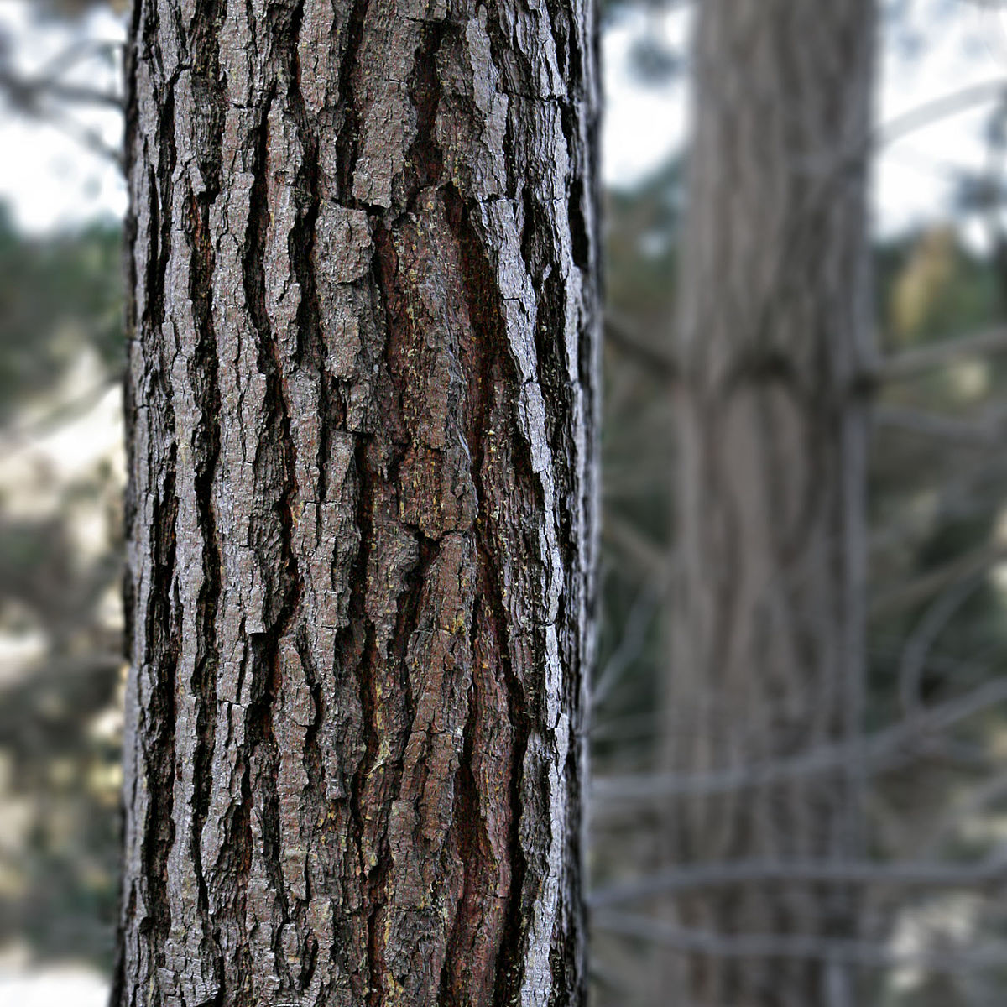
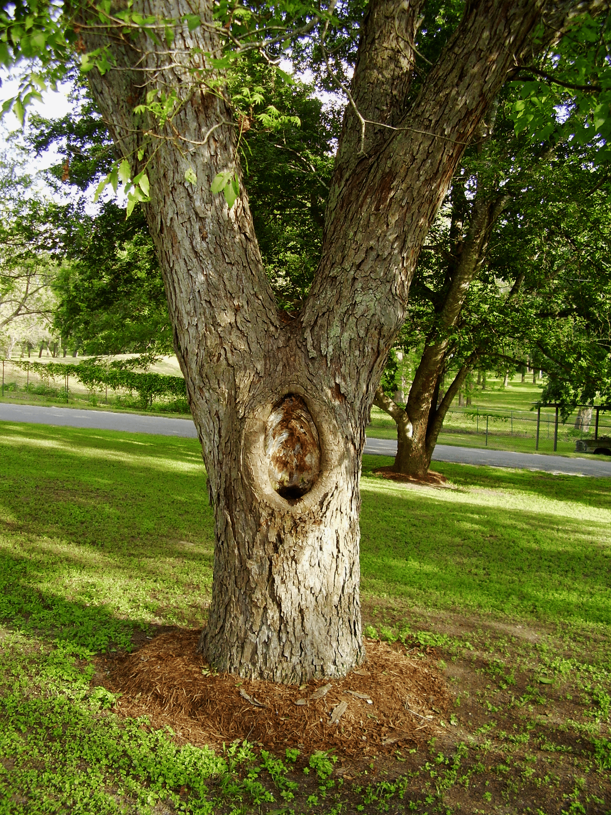
Structure of Trees
Bark: The bark is the skin of a tree and covers the whole of the trunk.
Trunk: The trunk is the strongest part of the tree and holds up the branches. The water from the roots goes up the trunk to the leaves.

Slide 5
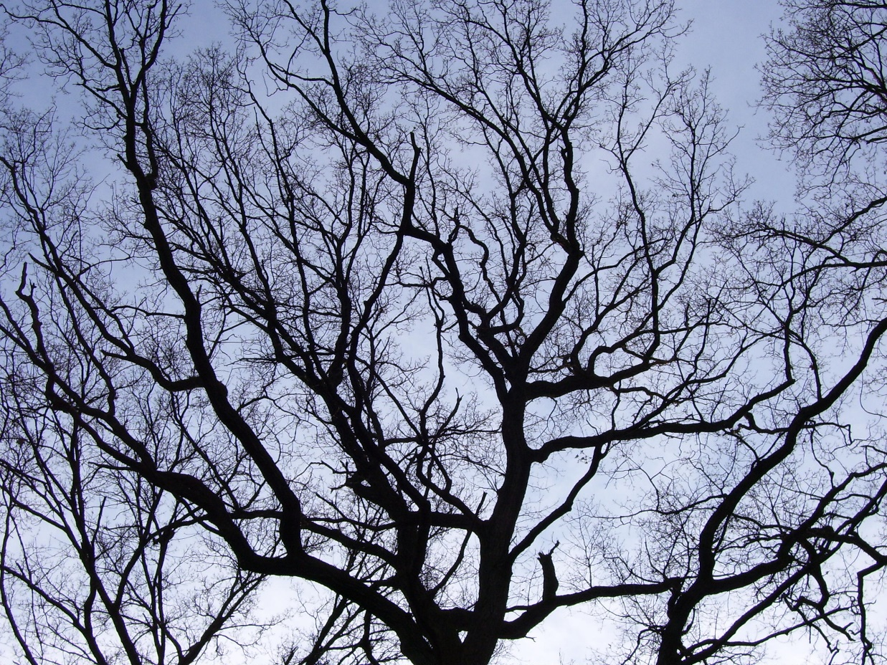
Structure of Trees
Branches: A part of a tree that grows out of its trunk with leaves, flowers, or fruit growing on it. A very small branch is called a twig

Slide 6
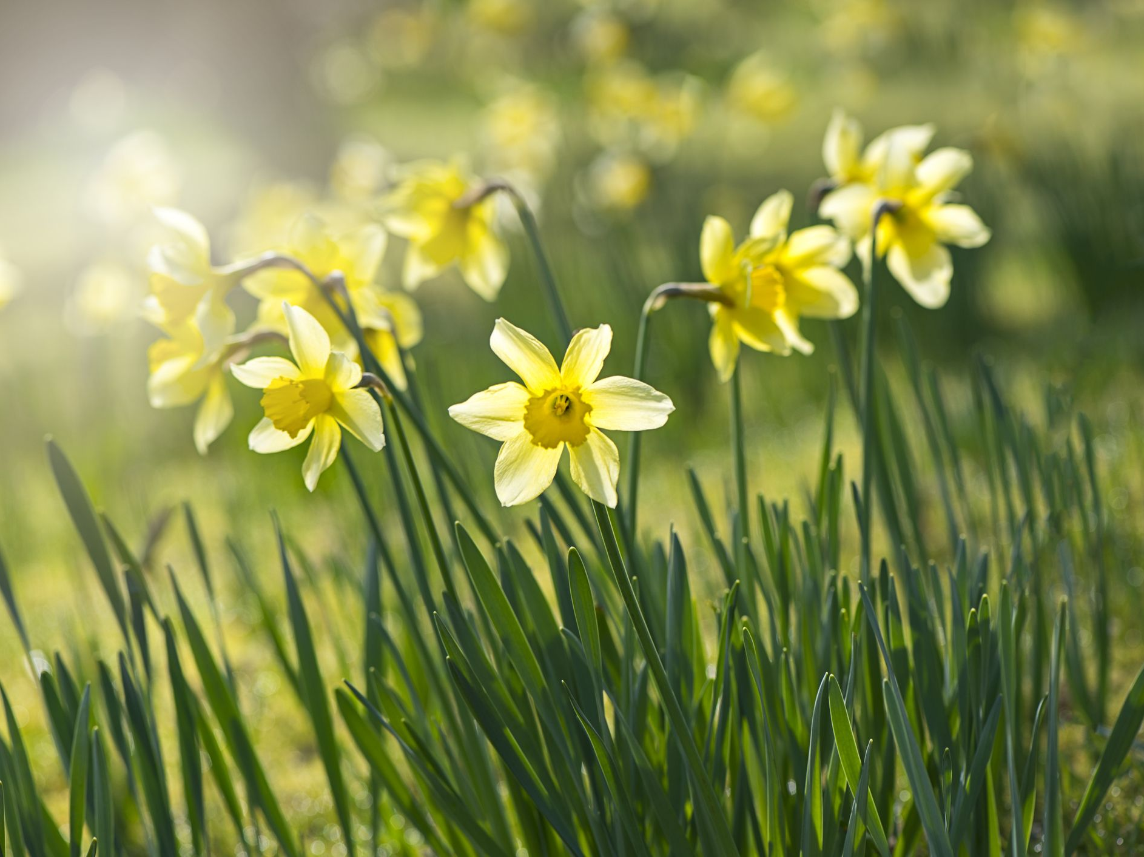
Flowers

Slide 7
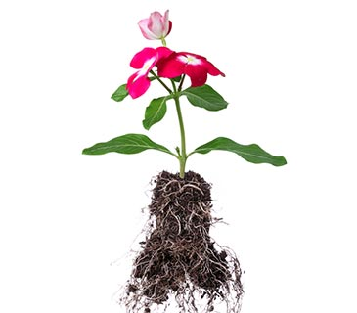
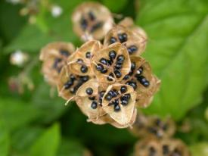
Structure of Flowers
Seeds: The small parts produced by plants from which new plants grow.
Roots: It is part of a plant that is usually hidden underground. They hold the plant in the ground and keep it upright. They take water and food from the soil.

Slide 8

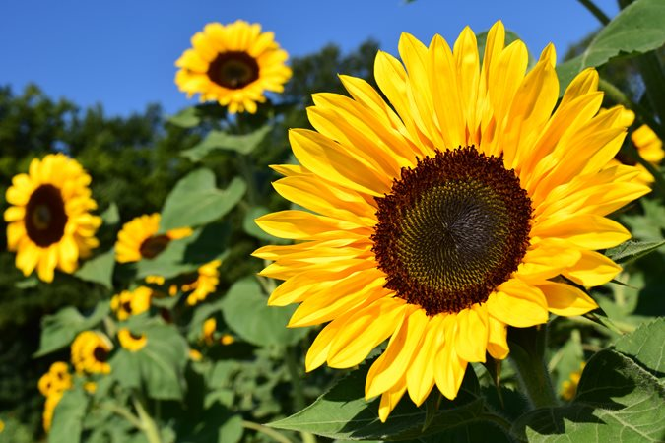
Structure of Flowers
Flower: It is part of a plant that blossoms. Flowers produce the seeds that can become new plants.
Leaves: They provide food and air to help a plant stay healthy and grow.

Slide 9


Structure of Flowers
Petal: They are the coloured part of a flower. With bright colours and scent, they often bring insects and birds to pollinate the flowers.
Stem: It is the main structure that supports leaves and flowers. Stems move food and water around the plant to help it grow. Plants often store food in their stems.

