Slide 1



LIFE/work balance
We have started a #LIFEworkbalance campaign and we need your help to complete our LIFE/work balance survey.
We hope to publish the results soon, so please give 15 minutes of your time to help us get a true picture of school life.
Want to be a part of this campaign? Take the survey on our website and share it with your colleagues!
© Classroom Secrets Limited 2018

Slide 2
Year 1 – Summer Block 4 – Place Value – One More One Less
About This Resource:
This PowerPoint has been designed to support your teaching of this small step. It includes a starter activity and an example of each question from the Varied Fluency and Reasoning and Problem Solving resources also provided in this pack. You can choose to work through all examples provided or a selection of them depending on the needs of your class.
National Curriculum Objectives:
Mathematics Year 1: (1N1a) Count to and across 100, forwards and backwards, beginning with 0 or 1, or from any given number
Mathematics Year 1: (1N2b) Given a number, identify one more and one less
Mathematics Year 1: (1N4) Identify and represent numbers using objects and pictorial representations including the number line, and use the language of: equal to, more than, less than (fewer), most, least
Mathematics Year 1: (1N2c) Read and write numbers from 1 to 20 in numerals and words
More Year 1 Place Value resources.
Did you like this resource? Don’t forget to review it on our website.
© Classroom Secrets Limited 2019

Slide 3
Year 1 – Summer Block 4 – Place Value
Step 6: One More One Less
© Classroom Secrets Limited 2019

Slide 4
Introduction
Identify the hidden numbers.
1 | 2 | 3 | 4 | 5 | 6 | 7 | 8 | 9 | 10
11 | 12 | 13 | 14 | 15 | 16 | 17 | 18 | 19 | 20
21 | 22 | 23 | 24 | 25 | 26 | 27 | 28 | 29 | 30
31 | 32 | 33 | 34 | 35 | 36 | 37 | 38 | 39 | 40
41 | 42 | 43 | 44 | 45 | 46 | 47 | 48 | 49 | 50
51 | 52 | 53 | 54 | 55 | 56 | 57 | 58 | 59 | 60
61 | 62 | 63 | 64 | 65 | 66 | 67 | 68 | 69 | 70
71 | 72 | 73 | 74 | 75 | 76 | 77 | 78 | 79 | 80
81 | 82 | 83 | 84 | 85 | 86 | 87 | 88 | 89 | 90
91 | 92 | 93 | 94 | 95 | 96 | 97 | 98 | 99 | 100
© Classroom Secrets Limited 2019

Slide 5
Introduction
Identify the hidden numbers.
1 | 2 | 3 | 4 | 5 | 6 | 7 | 8 | 9 | 10
11 | 12 | 13 | 14 | 15 | 16 | 17 | 18 | 19 | 20
21 | 22 | 23 | 24 | 25 | 26 | 27 | 28 | 29 | 30
31 | 32 | 33 | 34 | 35 | 36 | 37 | 38 | 39 | 40
41 | 42 | 43 | 44 | 45 | 46 | 47 | 48 | 49 | 50
51 | 52 | 53 | 54 | 55 | 56 | 57 | 58 | 59 | 60
61 | 62 | 63 | 64 | 65 | 66 | 67 | 68 | 69 | 70
71 | 72 | 73 | 74 | 75 | 76 | 77 | 78 | 79 | 80
81 | 82 | 83 | 84 | 85 | 86 | 87 | 88 | 89 | 90
91 | 92 | 93 | 94 | 95 | 96 | 97 | 98 | 99 | 100
© Classroom Secrets Limited 2019

Slide 6
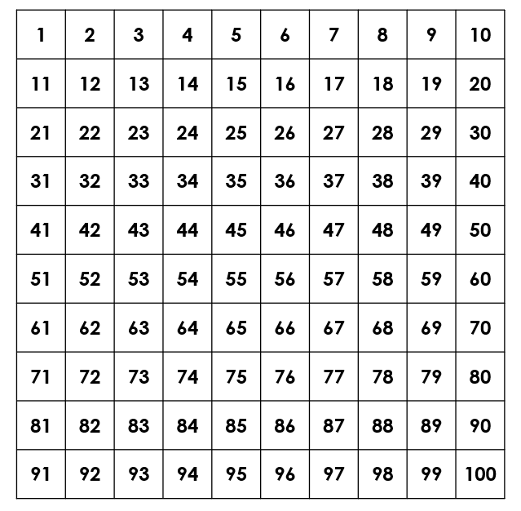
Varied Fluency 1
True or false? One more than 36 is 35.
© Classroom Secrets Limited 2019

Slide 7
Varied Fluency 1
True or false? One more than 36 is 35.
False. One more than 36 is 37.
© Classroom Secrets Limited 2019

Slide 8
Varied Fluency 2
Write one more and one less than this number.
Tens | Ones
10
10
10
10
1
1
1
1
1
1
1
1
1
© Classroom Secrets Limited 2019

Slide 9
Varied Fluency 2
Write one more and one less than this number.
One more is 50.
One less is 48.
Tens | Ones
10
10
10
10
1
1
1
1
1
1
1
1
1
© Classroom Secrets Limited 2019

Slide 10
Varied Fluency 3
Complete the number line.
 |  |  | 77
© Classroom Secrets Limited 2019

Slide 11
Varied Fluency 3
Complete the number line.
74 | 75 | 76 | 77
© Classroom Secrets Limited 2019

Slide 12
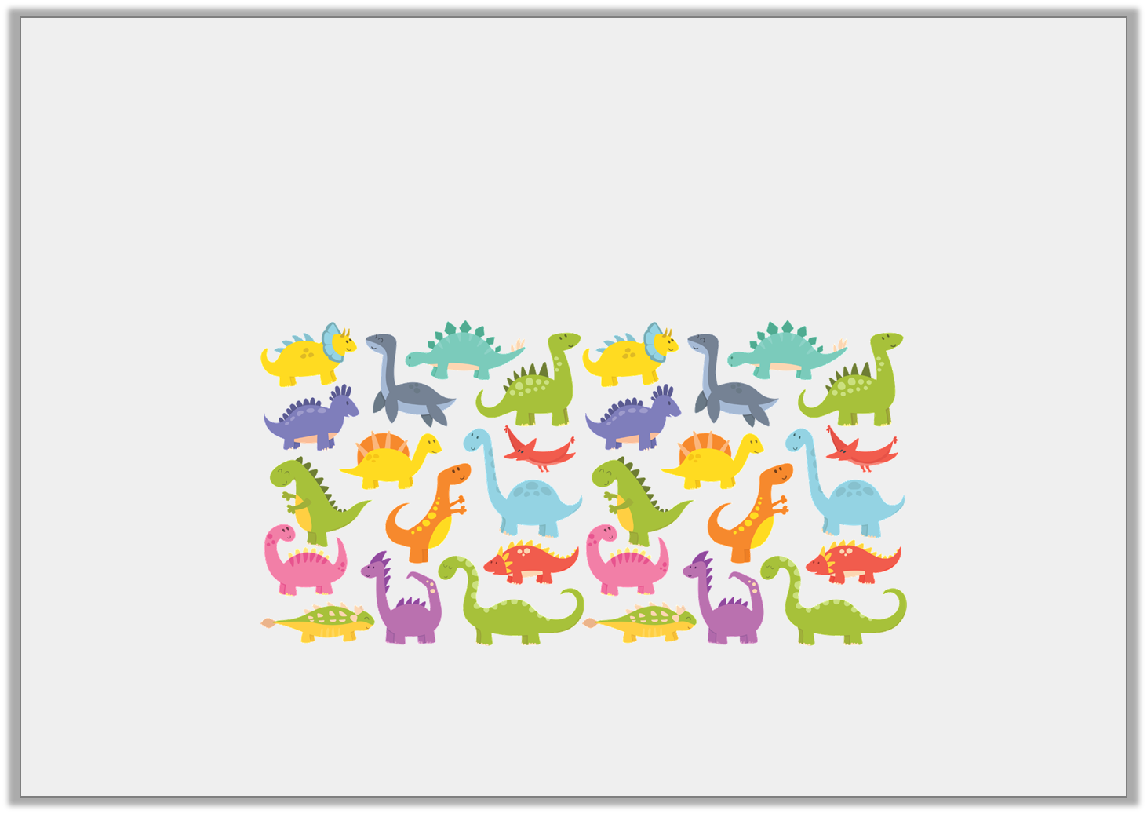
Varied Fluency 4
Amy has 32 toy dinosaurs.
Her mum buys her one more one.
How many does she have now?
© Classroom Secrets Limited 2019

Slide 13
Varied Fluency 4
Amy has 32 toy dinosaurs.
Her mum buys her one more one.
How many does she have now?
One more than 32 = 33
© Classroom Secrets Limited 2019

Slide 14
Problem Solving 1
Use the digit cards to create three 2-digit numbers you find beside each other on a number line.
4
4
9
5
8
0
© Classroom Secrets Limited 2019

Slide 15
Problem Solving 1
Use the digit cards to create three 2-digit numbers you find beside each other on a number line.
4
8
4
9
5
0
© Classroom Secrets Limited 2019

Slide 16
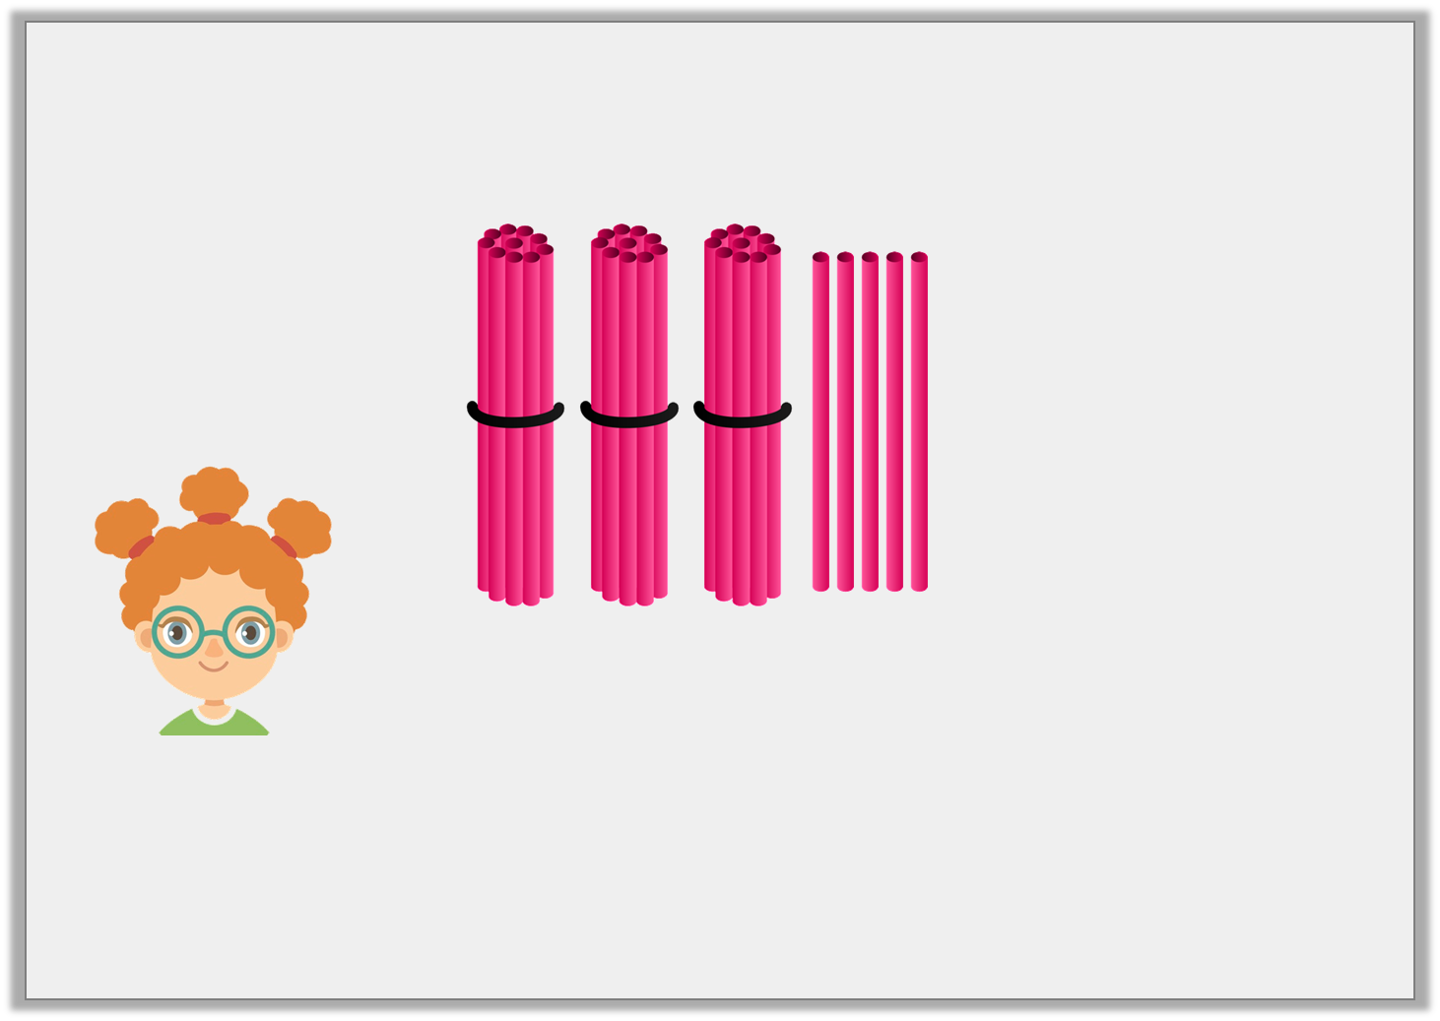
Reasoning 1
Look at the straws.
Explain Martha’s mistake.
One less than this would be 25.
© Classroom Secrets Limited 2019

Slide 17
Reasoning 1
Look at the straws.
Explain Martha’s mistake.
Martha has taken away ________________________________.
She needs to take away _____________ . One less than 35 is _____ .
One less than this would be 25.
© Classroom Secrets Limited 2019

Slide 18
Reasoning 1
Look at the straws.
Explain Martha’s mistake.
Martha has taken away ________________________________.
She needs to take away _____________ . One less than 35 is _____ .
One less than this would be 25.
one bundle of 10 straws
one straw
34
© Classroom Secrets Limited 2019

Slide 19
Reasoning 2
Check Orla’s test.
Correct any mistakes you find.
 | 1 | 4 | + | 1 | = | 2 | 5
 | 2 | 1 | – | 1 | = | 1 | 9
1
1
10
1
1
10
10
1
© Classroom Secrets Limited 2019

Slide 20
Reasoning 2
Check Orla’s test.
Correct any mistakes you find.
 | 1 | 4 | + | 1 | = | 2 | 5 |  | 1 | 5
 | 2 | 1 | – | 1 | = | 1 | 9 |  | 2 | 0
1
1
10
1
1
10
10
1
© Classroom Secrets Limited 2019

