Slide 1



LIFE/work balance
We have started a #LIFEworkbalance campaign and we need your help to complete our LIFE/work balance survey.
We hope to publish the results soon, so please give 15 minutes of your time to help us get a true picture of school life.
Want to be a part of this campaign? Take the survey on our website and share it with your colleagues!
© Classroom Secrets Limited 2020

Slide 2
Year 1 – Spring Block 3 – Length and Height – Measure Length 2
About This Resource:
This PowerPoint has been designed to support your teaching of this small step. It includes a starter activity and an example of each question from the Varied Fluency and Reasoning and Problem Solving resources also provided in this pack. You can choose to work through all examples provided or a selection of them depending on the needs of your class.
National Curriculum Objectives:
Mathematics Year 1 (1M1): Compare, describe and solve practical problems for: lengths and heights [for example, long/short, longer/shorter, tall/short, double/half] mass/weight [for example, heavy/light, heavier than, lighter than]capacity and volume [for example, full/empty, more than, less than, half, half full, quarter] Time [for example, quicker, slower, earlier, later]
Mathematics Year 1 (1M2): Measure and begin to record: lengths and heights, mass/weight , capacity and volume, time (hours, minutes, seconds)
More Year 1 Length and Height resources.
Did you like this resource? Don’t forget to review it on our website.
© Classroom Secrets Limited 2019

Slide 3
Year 1 – Spring Block 3 – Length and Height
Step 3: Measure Length 2
© Classroom Secrets Limited 2019

Slide 4

Introduction
Circle the item you would use to measure the book.
cubes
hands
© Classroom Secrets Limited 2019

Slide 5
Introduction
Circle the item you would use to measure the book.
cubes
hands
© Classroom Secrets Limited 2019

Slide 6
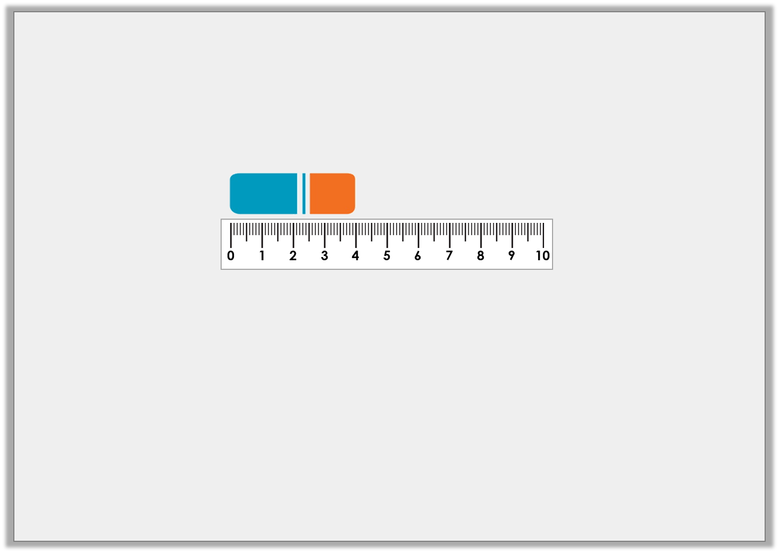
Varied Fluency 1
Circle the correct length of the rubber.
5cm | 4cm | 6cm
© Classroom Secrets Limited 2019

Slide 7
Varied Fluency 1
Circle the correct length of the rubber.
5cm | 4cm | 6cm
© Classroom Secrets Limited 2019

Slide 8
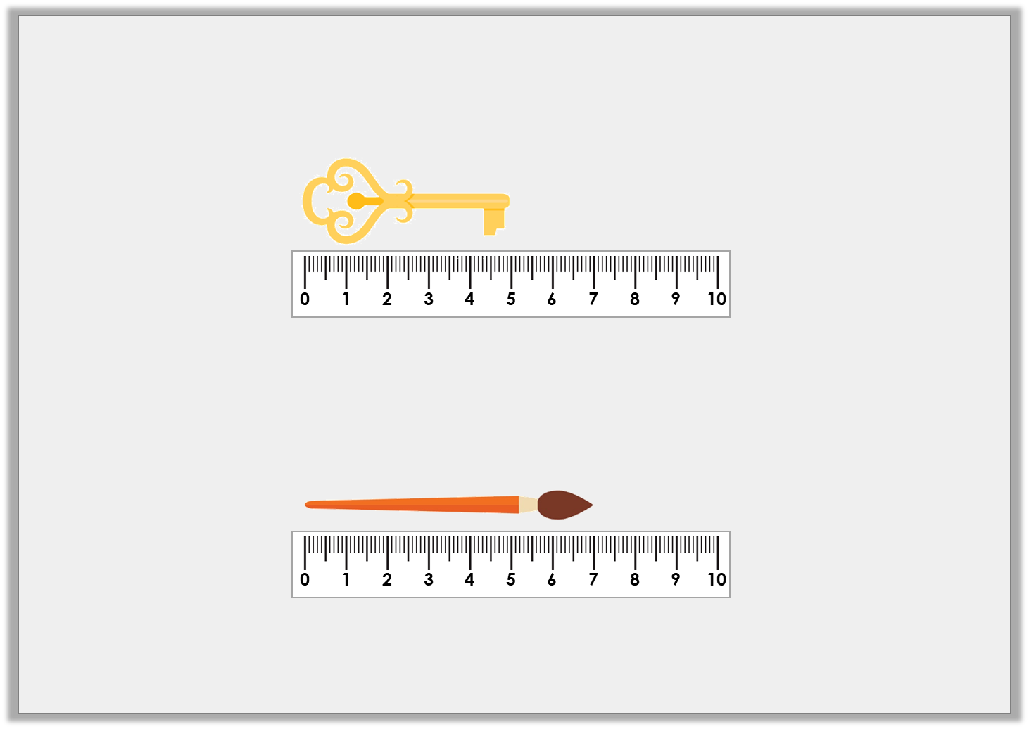
Varied Fluency 2
Measure the items to complete the sentences.
The key is _______ cm.
The paintbrush is _______ cm.
© Classroom Secrets Limited 2019

Slide 9
Varied Fluency 2
Measure the items to complete the sentences.
The key is _______ cm.
The paintbrush is _______ cm.
5
7
© Classroom Secrets Limited 2019

Slide 10
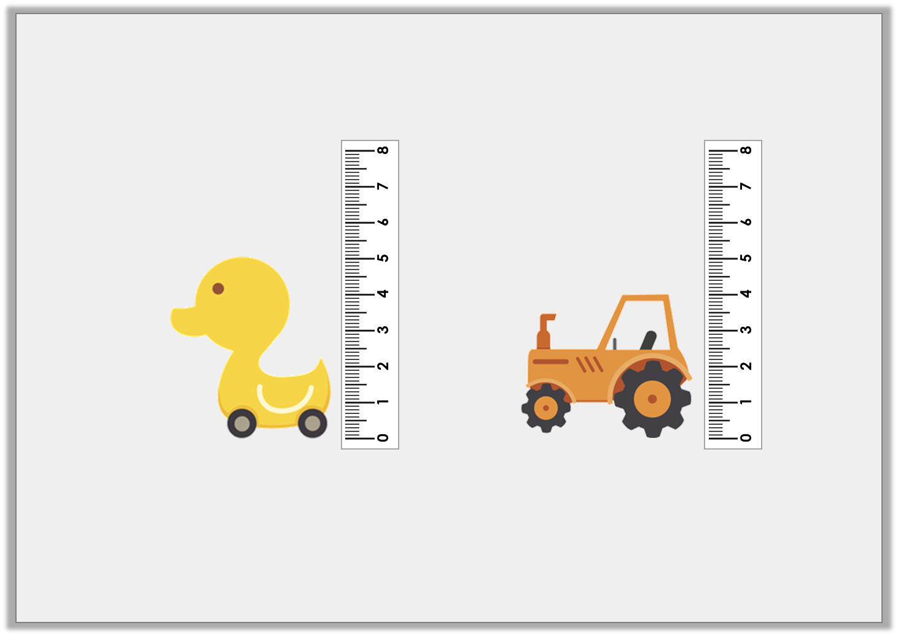
Varied Fluency 3
Measure the items and compare their height.
cm | is less than | cm
© Classroom Secrets Limited 2019

Slide 11
Varied Fluency 3
Measure the items and compare their height.
4cm | is less than | 5cm
© Classroom Secrets Limited 2019

Slide 12
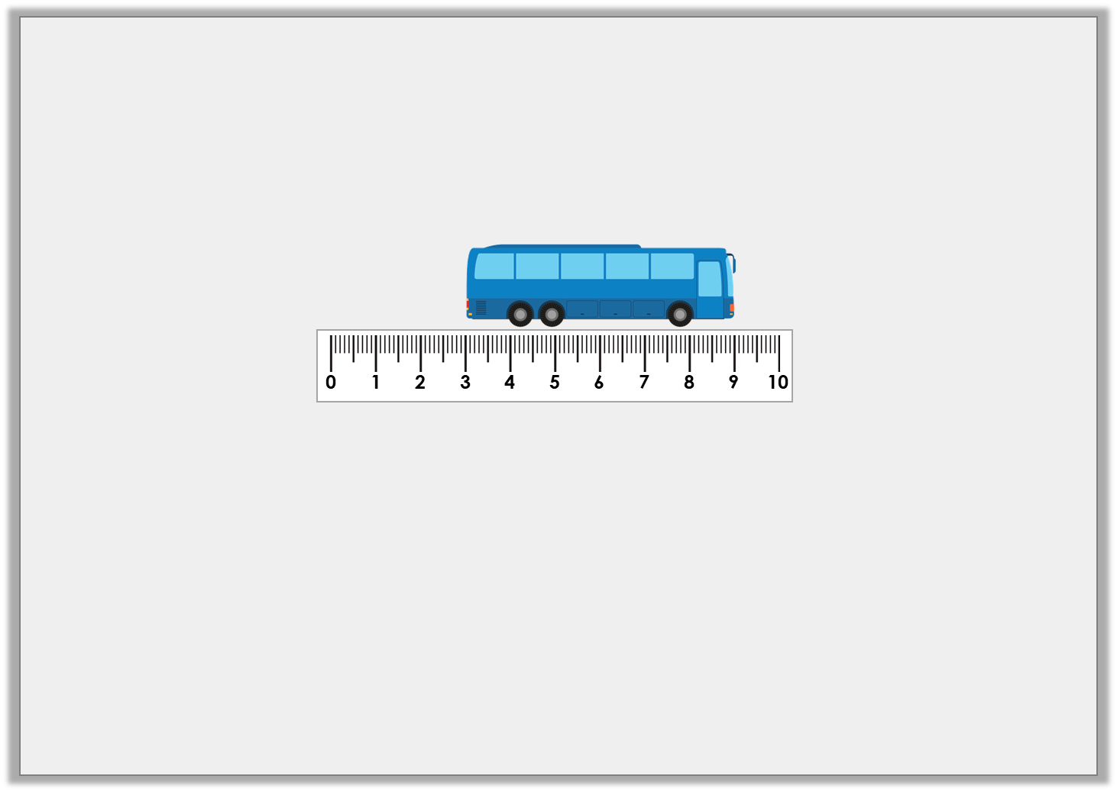
Reasoning 1
Lee thinks his toy bus measures 9cm.
Explain the mistake he has made.
© Classroom Secrets Limited 2019

Slide 13
Reasoning 1
Lee thinks his toy bus measures 9cm.
Explain the mistake he has made.
Lee is incorrect because…
© Classroom Secrets Limited 2019

Slide 14
Reasoning 1
Lee thinks his toy bus measures 9cm.
Explain the mistake he has made.
Lee is incorrect because he has not started to measure the bus from 0cm. The bus measures 6cm.
© Classroom Secrets Limited 2019

Slide 15
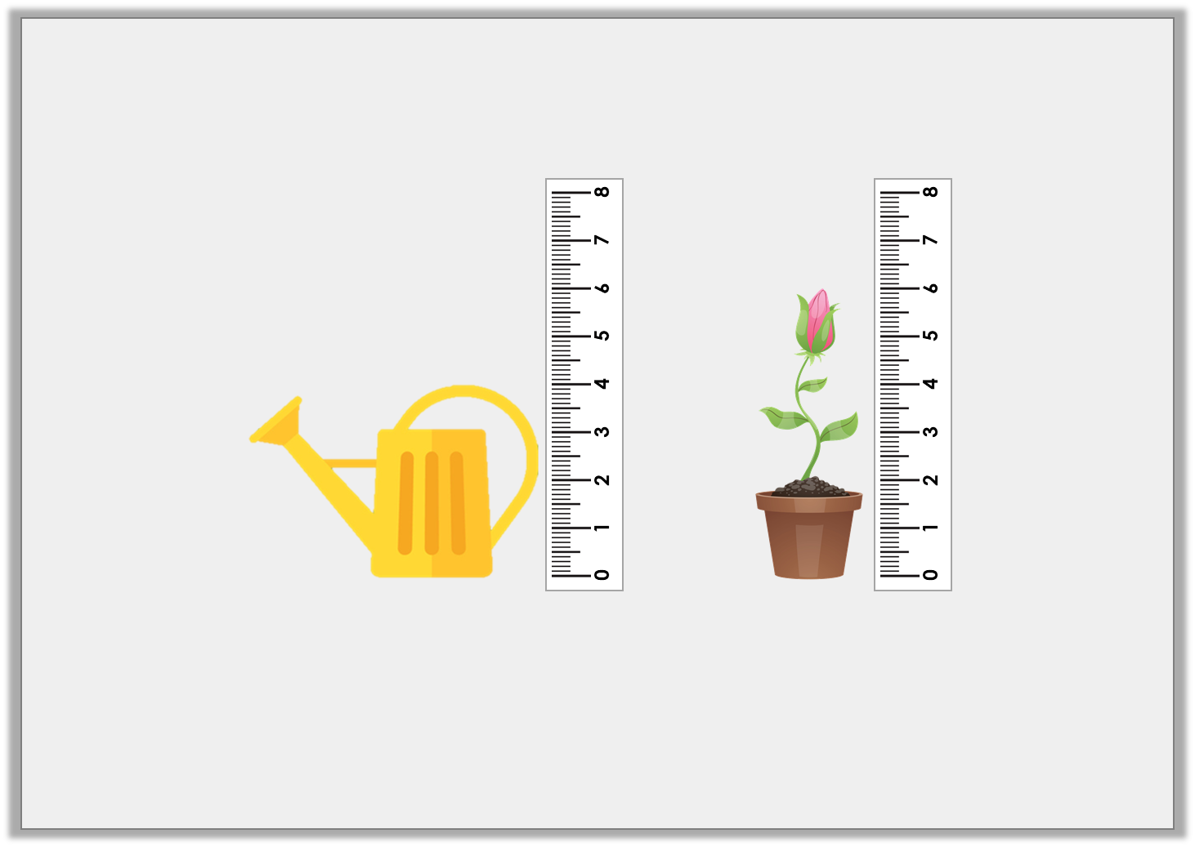
Reasoning 2
Eve thinks the plant is taller than the watering can.
Is she correct? Explain your answer.
© Classroom Secrets Limited 2019

Slide 16
Reasoning 2
Eve thinks the plant is taller than the watering can.
Is she correct? Explain your answer.
Eve is correct because…
© Classroom Secrets Limited 2019

Slide 17
Reasoning 2
Eve thinks the plant is taller than the watering can.
Is she correct? Explain your answer.
Eve is correct because the plant is 6cm tall and the watering can is 4cm tall. 6cm is greater than 4cm.
© Classroom Secrets Limited 2019

Slide 18
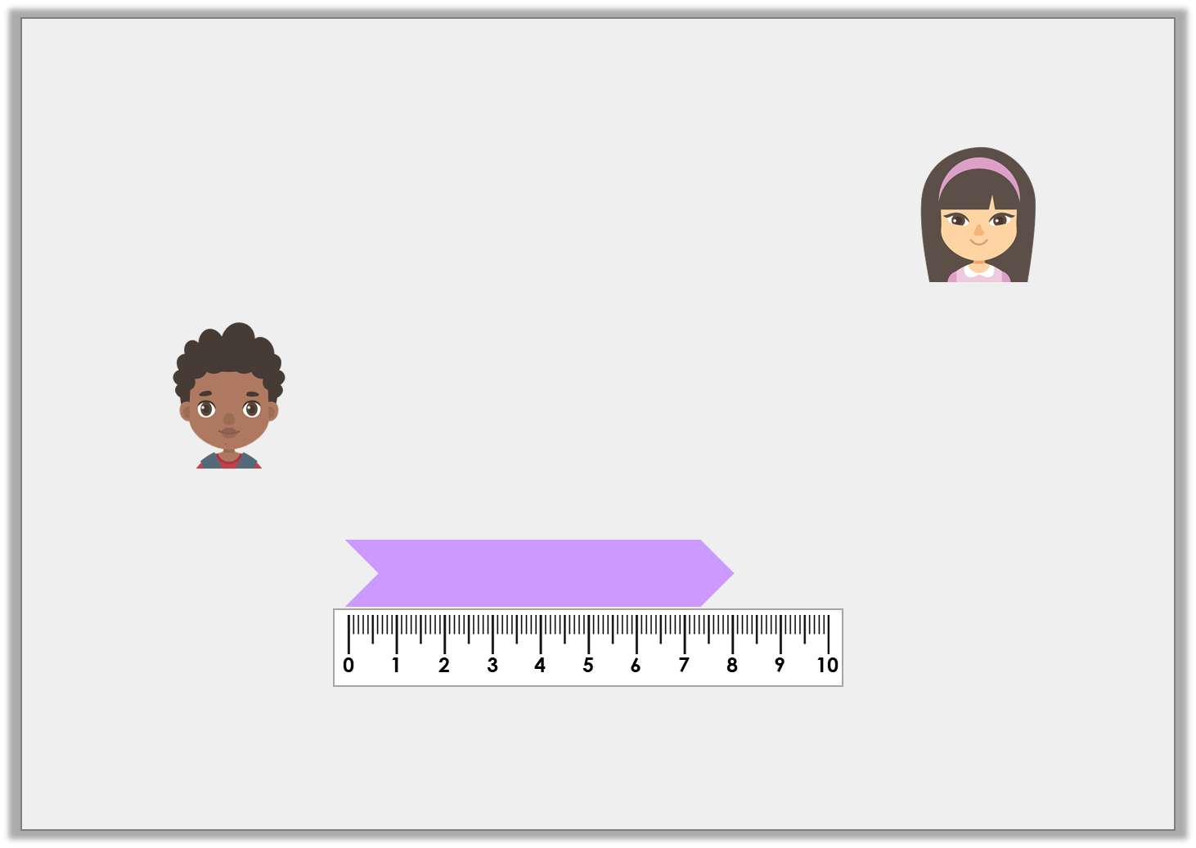
Problem Solving 1
Whose ribbon is being measured?
My ribbon is greater than 5cm long.
Nala
My ribbon is less than 7cm long.
Ralph
© Classroom Secrets Limited 2019

Slide 19
Problem Solving 1
Whose ribbon is being measured?
Nala
My ribbon is greater than 5cm long.
Nala
My ribbon is less than 7cm long.
Ralph
© Classroom Secrets Limited 2019

