Slide 1



LIFE/work balance
We have started a #LIFEworkbalance campaign and we need your help to complete our LIFE/work balance survey.
We hope to publish the results soon, so please give 15 minutes of your time to help us get a true picture of school life.
Want to be a part of this campaign? Take the survey on our website and share it with your colleagues!
© Classroom Secrets Limited 2020

Slide 2
Year 1 – Spring Block 3 – Length and Height – Compare Lengths and Heights
About This Resource:
This PowerPoint has been designed to support your teaching of this small step. It includes a starter activity and an example of each question from the Varied Fluency and Reasoning and Problem Solving resources also provided in this pack. You can choose to work through all examples provided or a selection of them depending on the needs of your class.
National Curriculum Objectives:
Mathematics Year 1:(1M1) Compare, describe and solve practical problems for: lengths and heights [for example, long/short, longer/shorter, tall/short, double/half]
More Year 1 Length and Height resources.
Did you like this resource? Don’t forget to review it on our website.
© Classroom Secrets Limited 2019

Slide 3
Year 1 – Spring Block 3 – Length and Height
Step 1: Compare Lengths and Heights
© Classroom Secrets Limited 2019

Slide 4
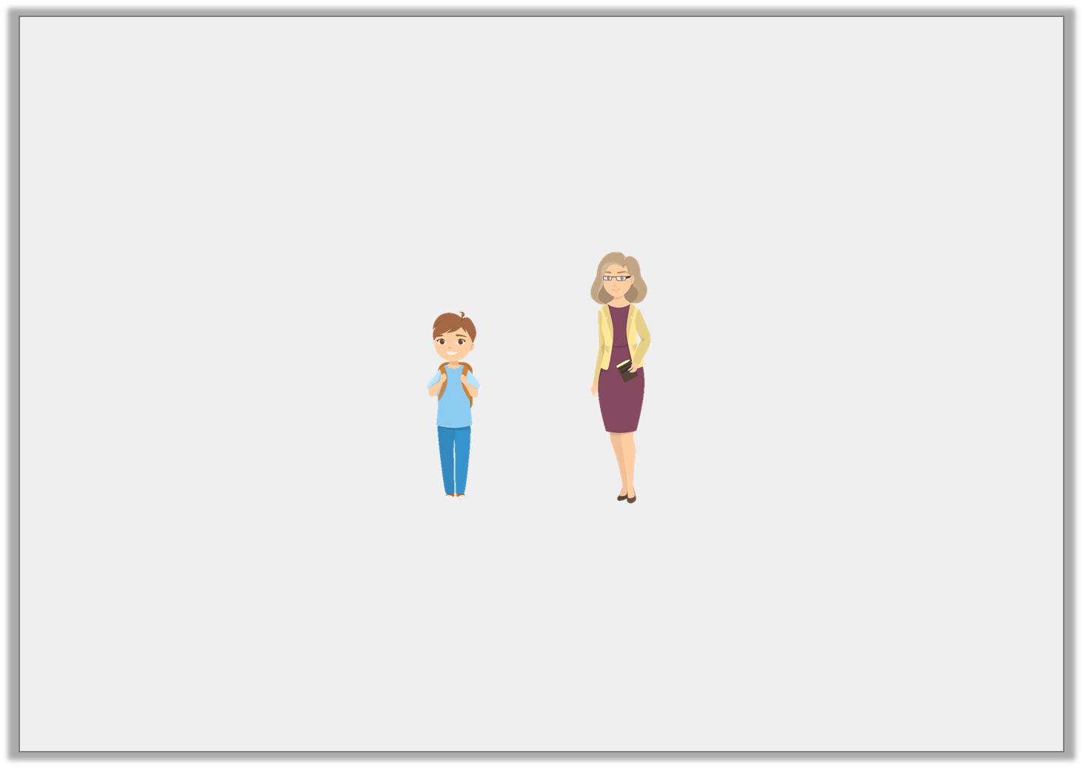
Introduction
Circle the person that is the shortest.
© Classroom Secrets Limited 2019

Slide 5
Introduction
Circle the person that is the shortest.
© Classroom Secrets Limited 2019

Slide 6
Varied Fluency 1
Tick the tallest tower.
A.
B.
C.
© Classroom Secrets Limited 2019

Slide 7
Varied Fluency 1
Tick the tallest tower.
A. | 
B.
C.
© Classroom Secrets Limited 2019

Slide 8
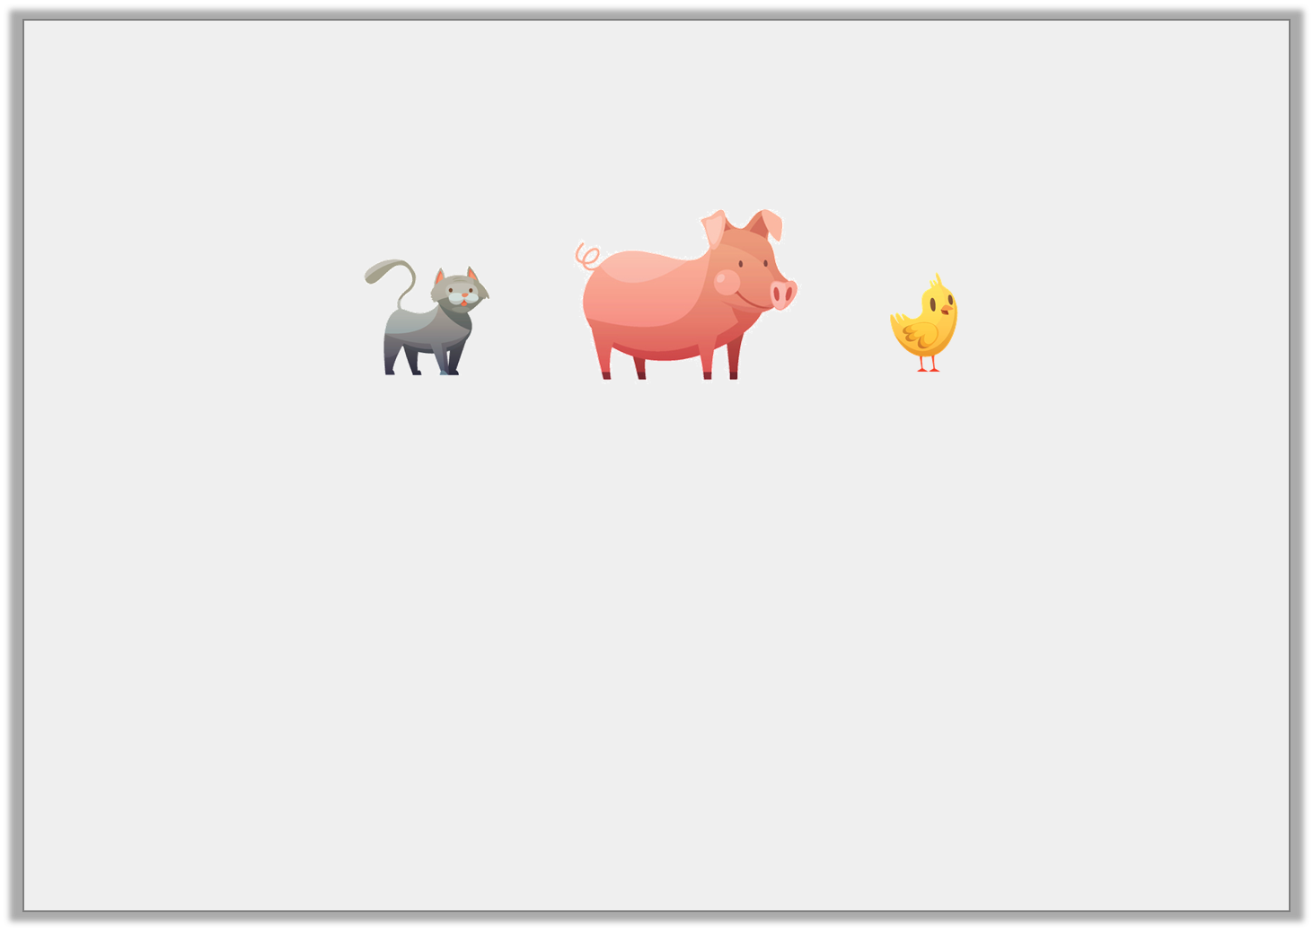
Varied Fluency 2
Choose a word to complete the sentences.
The pig is ________________ than the chick.
The cat is ________________ than the pig.
taller | shorter
© Classroom Secrets Limited 2019

Slide 9
Varied Fluency 2
Choose a word to complete the sentences.
The pig is ________________ than the chick.
The cat is ________________ than the pig.
taller
shorter
© Classroom Secrets Limited 2019

Slide 10
Varied Fluency 3
Tick the sentence that is correct.
A.
B.
C.
C is longer than A.
B is shorter than C.
© Classroom Secrets Limited 2019

Slide 11
Varied Fluency 3
Tick the sentence that is correct.
A.
B.
C.
C is longer than A. | 
B is shorter than C.
© Classroom Secrets Limited 2019

Slide 12

Varied Fluency 4
Order the pencils from longest to shortest.
A.
B.
C.
© Classroom Secrets Limited 2019

Slide 13
Varied Fluency 4
Order the pencils from longest to shortest.
A, C, B
A.
B.
C.
© Classroom Secrets Limited 2019

Slide 14
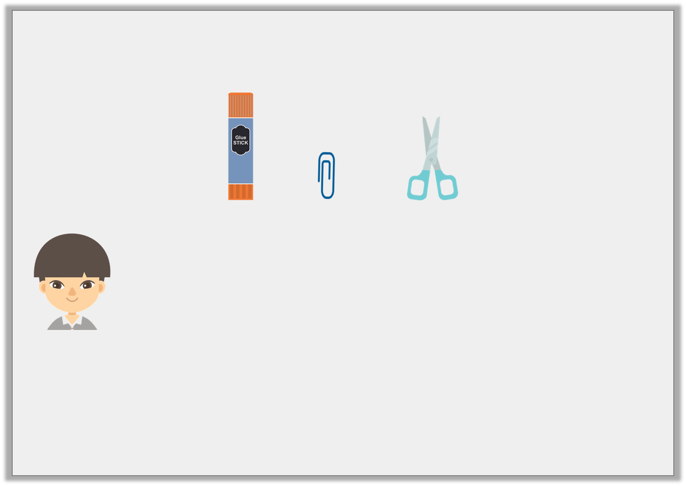
Reasoning 1
Reece is comparing items at school.
He says,
Do you agree? Explain your answer.
The scissors are the shortest.
The glue stick is the tallest.
© Classroom Secrets Limited 2019

Slide 15
Reasoning 1
Reece is comparing items at school.
He says,
Do you agree? Explain your answer.
Reece is incorrect because…
The scissors are the shortest.
The glue stick is the tallest.
© Classroom Secrets Limited 2019

Slide 16
Reasoning 1
Reece is comparing items at school.
He says,
Do you agree? Explain your answer.
Reece is incorrect because the paperclip is the shortest and the glue stick is the tallest.
The scissors are the shortest.
The glue stick is the tallest.
© Classroom Secrets Limited 2019

Slide 17
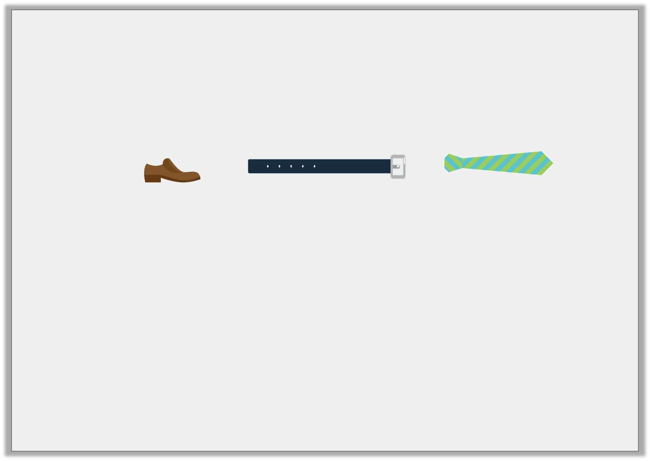
Problem Solving 1
Use the items below to make comparison statements.
Find 3 possibilities.
tie
belt
shoe
is longer than
is shorter than
© Classroom Secrets Limited 2019

Slide 18
Problem Solving 1
Use the items below to make comparison statements.
Find 3 possibilities.
Various answers, for example: The shoe is shorter than the tie; The belt is longer than the shoe; The tie is shorter than the belt.
tie
belt
shoe
is longer than
is shorter than
© Classroom Secrets Limited 2019

Slide 19
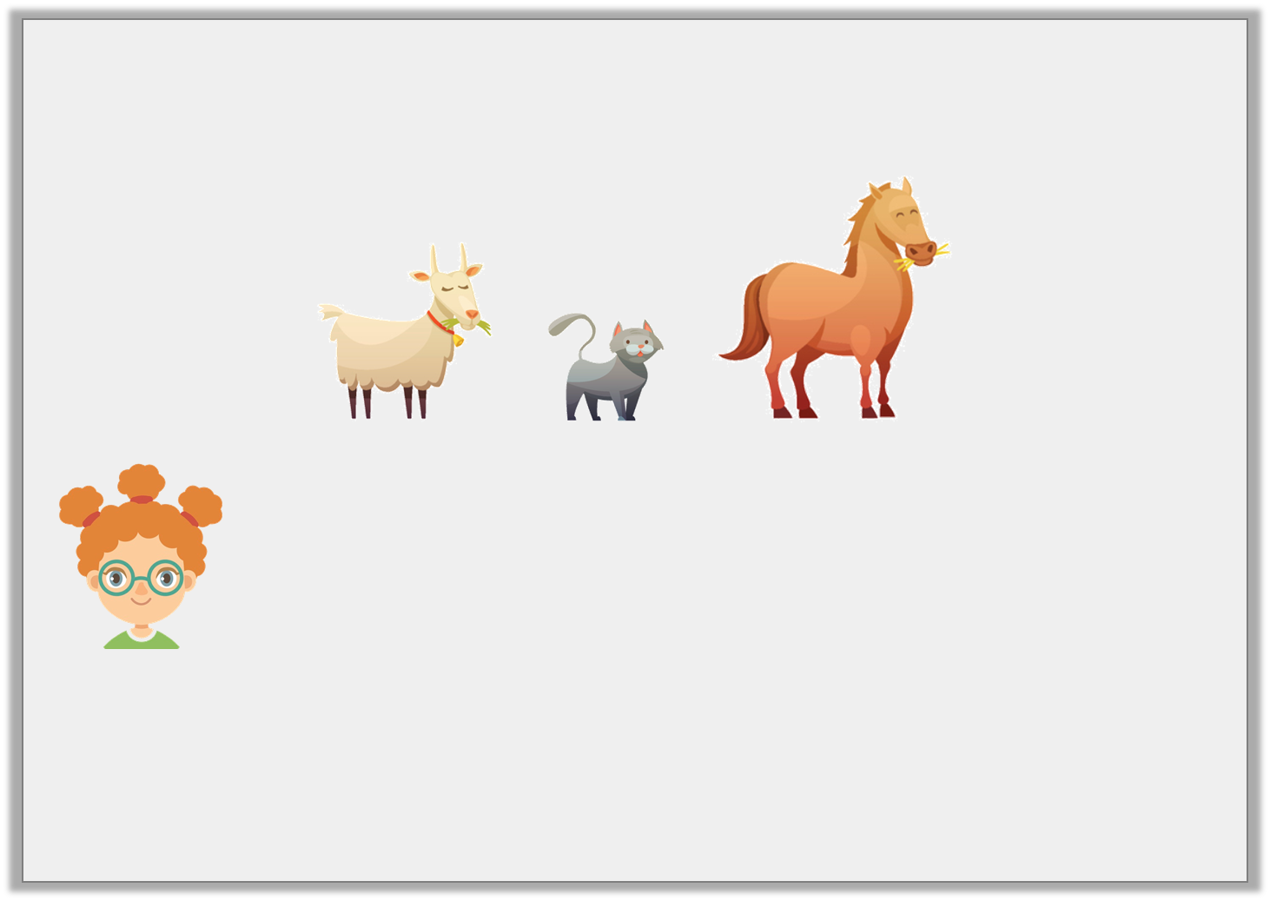
Problem Solving 2
Daisy is thinking of an animal.
She says,
What animal is Daisy thinking of?
My animal is taller than the cat and shorter than the horse.
© Classroom Secrets Limited 2019

Slide 20
Problem Solving 2
Daisy is thinking of an animal.
She says,
What animal is Daisy thinking of?
The goat
My animal is taller than the cat and shorter than the horse.
© Classroom Secrets Limited 2019

