Slide 1
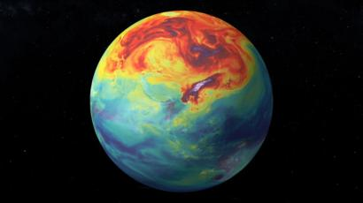
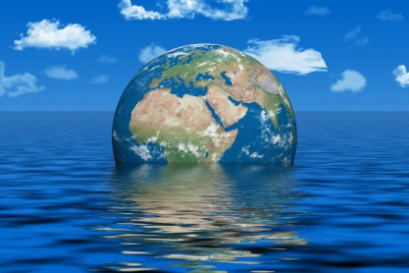
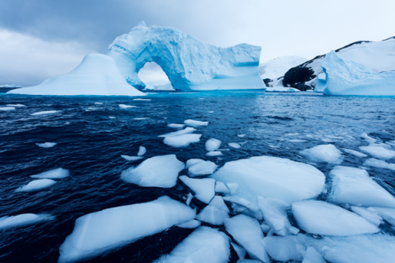
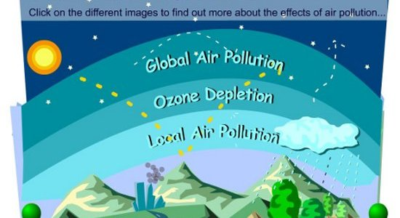
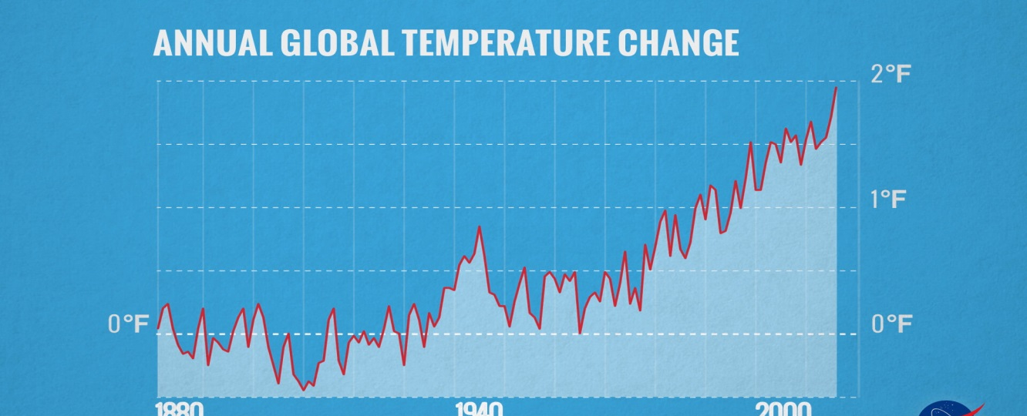
How Can YOU Change the World?
Key Terms
As temperatures rise:
Glaciers melt
Ocean levels rise
Extreme weather
Migration of animals
Change in eco-systems
Global Warming | The steady rise in global average temperature in recent decades, which experts believe is largely caused by man-made greenhouse gas emissions.
Pollution | When the environment is contaminated or dirtied by waste, chemicals or other harmful substances.
Climate Change | A pattern of change affecting global or regional climate, such as average temperature and rainfall, or an alteration in frequency of extreme weather conditions. This variation may be caused by both natural processes and human activity.
Recycling | Making rubbish into something new.
Consequence | Something produced by a cause or action.
Protest | A complaint or objection against an idea, an act or a way of doing things.
Activist | Someone who’s actively involved in a protest or political cause.
Campaign | A series of planned actions carried out in order to reach a particular goal.
In the past 100 years the global average temperature has risen by 0.74 degrees celsius.
The sea level has risen 21-24 cm since 1880.
All over the world glaciers are melting at a very fast rate. On average, glaciers have thinned by 10 metres since 1980.

Slide 2
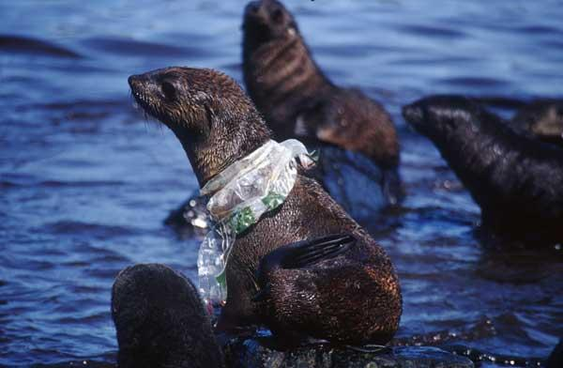
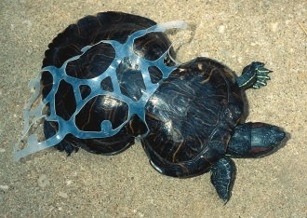
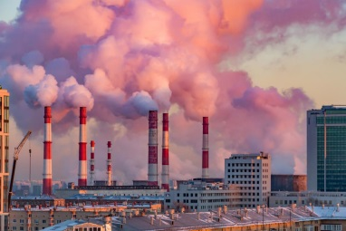
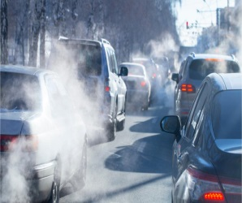
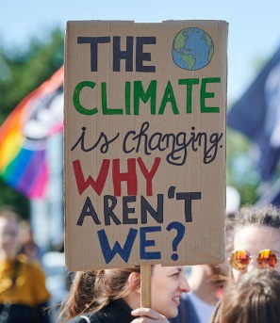
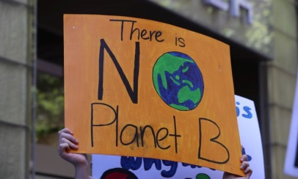
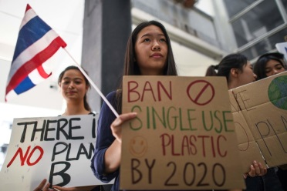
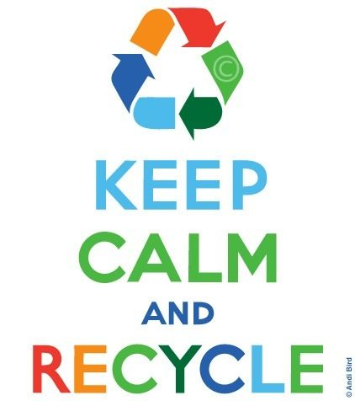
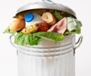
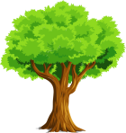
How Can YOU Change the World
Key Terms
Adaptation | Action that helps cope with the effects of climate change - for example construction of barriers to protect against rising sea levels, or conversion to crops capable of surviving high temperatures and drought.
Fossil Fuels | Petroleum (oil), coal and natural gas.
Ozone Layer | A layer of the Earth’s upper atmosphere which blocks most of the Sun’s radiation.
Greenhouse Gases | Natural and industrial gases that trap heat from the Earth and warm the surface.
Renewable Energy | Renewable energy is energy created from sources that can be replenished in a short period of time.
Carbon Footprint | The amount of carbon emitted by an individual or organisation in a given period of time, or the amount of carbon emitted during the manufacture of a product.
Sustainability | Using natural resources in a way which enables us to could keep going for a long period of time.
Glacier | A large area of thick ice that remains frozen from one year to the next.
12.7 million tons of plastic ends up in our oceans each year.
Burning fossil fuels releases carbon dioxide and other greenhouses gases into the atmosphere.
21.5 million tonnes of food is wasted each year.
The average family uses 6 trees worth of paper each year.
If we practiced composting that amount of food, it would have the same effect to our environment as removing 2 million cars from the road.
1 tonne of paper can save 17 trees!

