Slide 1
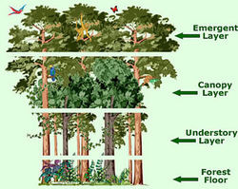
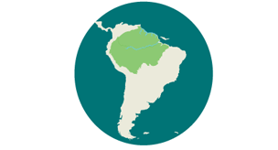
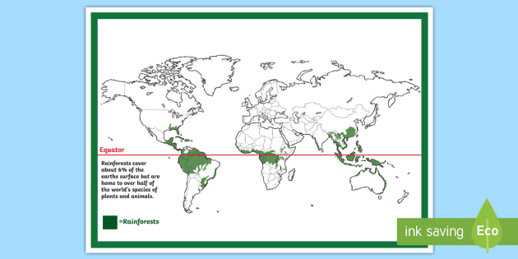
Key Terms
Emergent layer | Highest layer of the rainforest that receives the most sunlight.
Canopy layer | Under the emergent layer. This layer provides food and shelter to the layers below.
Understory layer | Under the canopy layer. Dense and dark providing camouflage for its inhabitants.
Forest Floor | Under the understory layer and the ground floor of the forest. Dark and poor soil quality resulting in limited plant growth.
Deforestation | The destruction of trees over large areas.
Climate | The weather and temperature usually found in an area over a long period of time.
Botanist | Someone who studies plants.
Carbon Dioxide | A gas (also called C0²) that is released when fuel burns and animals breathe. Plants also absorb it.
Due to the thickness of the canopy, the Amazon floor is in permanent darkness.
When it rains, its takes around 10 minutes for the water to reach the ground.
The Amazon Rainforest is located in South America.
It spans across 9 countries: Brazil has 60%, Peru has 13%, and Colombia has 10% while other countries have small parts of the rainforest in their borders.
The Amazon Rainforest covers 2.1 million square miles. If it was a country, it would rank ninth in size.
The Amazon Rainforest is close to the equator, where the climate is very hot and wet all through the year.

Slide 2
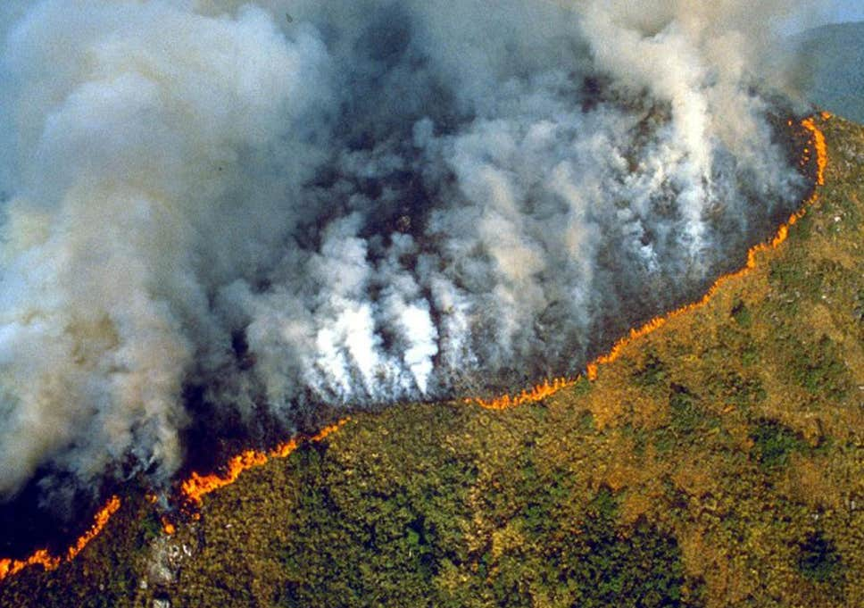
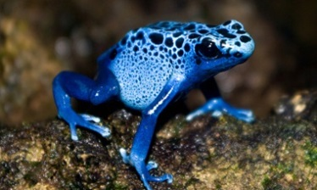
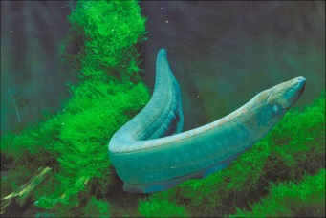
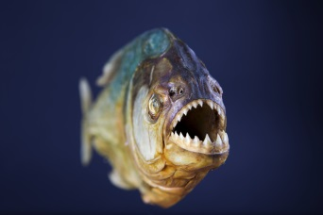
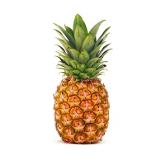
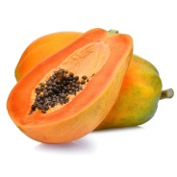
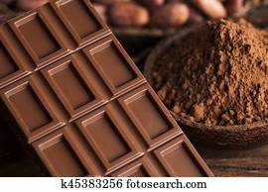
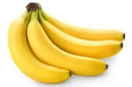
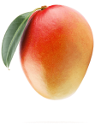

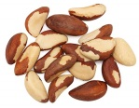
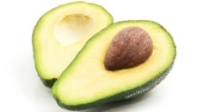
Key Terms
What an incredibly rich ecosystem!
Humid | Having a high level of moisture in the air.
Colony | A group of the same kind of animals that live and work closely together.
Indigenous | A living thing that belongs naturally to an area.
Drip Tip | Pointed tips on leaves that help water to run off them.
Biomes | A large naturally occurring community of flora and fauna occupying a major habitat e.g. the forest.
Ecosystem | All living (plants and animals) and non-living things (water, rocks, soil and sand) in one area e.g.
Biodiversity | The wide variety of living things on Earth.
Basin | A dip in the Earth’s surface.
Fires in the Amazon are common in the dry months (July to October).
It is estimated that over 3,500 square miles of forest within the Amazon biome has been lost to fires in 2019.
40,000 plant species
1,300 bird species
3,000 types of fish
430 mammals
2.5 million different insects
The Amazon’s DEADLY CREATURES
Poison dart frog
Electric eel
Flesh-eating piranha
What do we get from the Amazon Rainforest?

