Slide 1
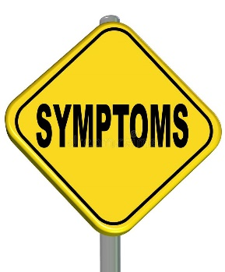
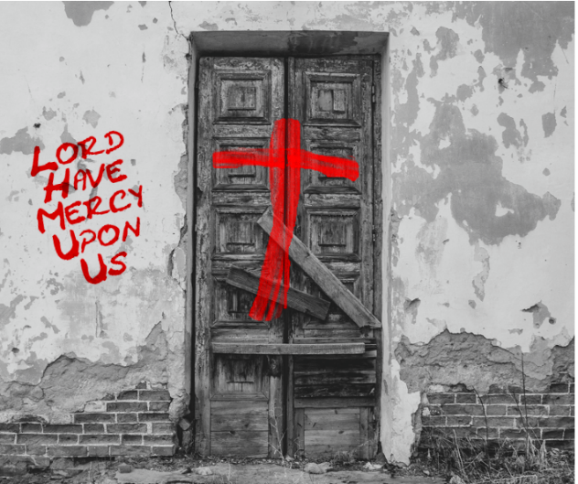
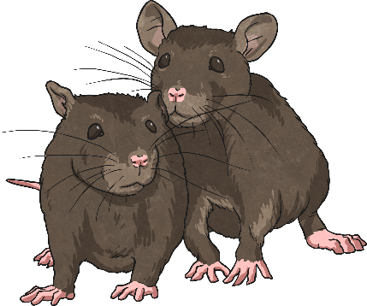
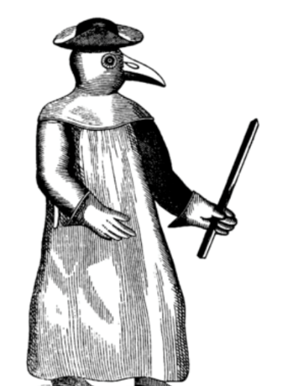
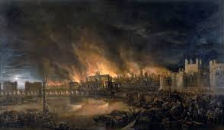
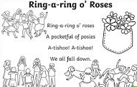
Key Terms
1500
1600
1700
1800
1900
2000
2100
Epidemic | An outbreak of a disease that quickly infects a large number of people
Remedy | To provide or serve as a cure or solution
Symptoms | A noticeable change in the body or its functions that indicates disease.
Antibiotics | Medicines that attack bacteria that make you sick
Cure | To become healthy or sound again
Quarantine | The keeping of a person, animal, or thing away from others to stop a disease from spreading
Black Death | Another term used to refer to the plague.
Coronavirus | A group of viruses that present in humans and sometimes animals
Immunology | Immunology is the study of the immune system
Experimentation | Carefully planned tests used to discover something unknown
The Plague
1665
Now
The most common symptoms of the plague included headaches, fever, vomiting, painful swellings on the neck, blisters and bruises and coughing up blood.
There was still no cure for the plague – people just had to try and stop it from spreading.
People suffering or showing symptoms of the plague were banished to their homes. Even healthy family members could not leave the house. A large red cross was nailed to the front door to warn others that those inside were infected. 'God have mercy upon us' was written on the door.
The plague was spread by rats.
Doctors wore masks, gowns and gloves to protect themselves from the plague.
By the end of 1665, 100 000 people had died in London.
The Great Fire of London, which took place in 1666 destroyed a lot of the old, rat-infested buildings, but a very cold winter had already stopped the spread of the disease as the rats and fleas were affected by the bad weather.
The rhyme ‘Ring-a-ring o’ roses’ is about the plague.

Slide 2
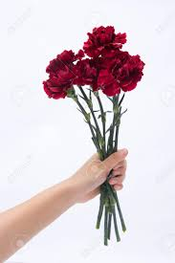
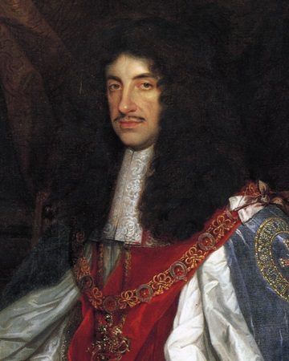
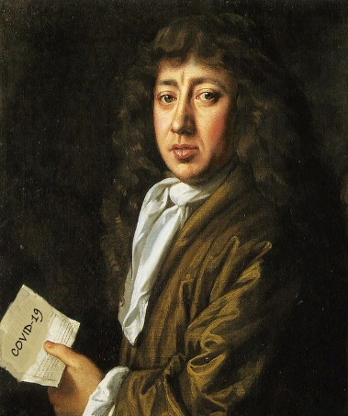
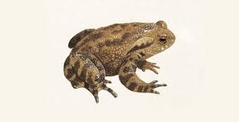
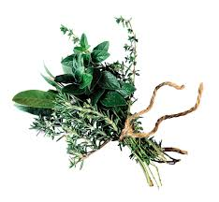
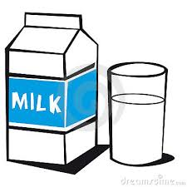

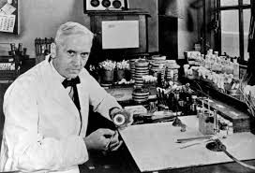
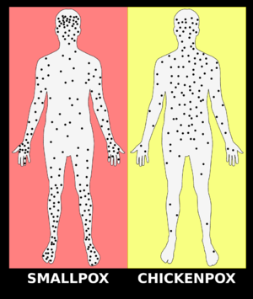
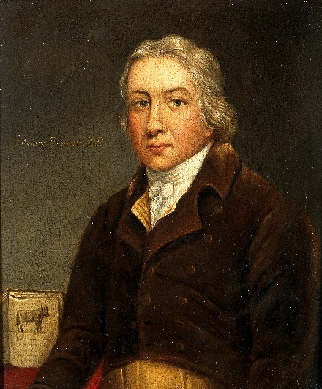
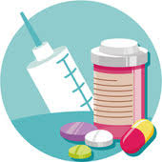
Holding a small bunch of flowers to their nose
Some ate toads
Key Terms
How did people try to avoid the plague?
Pox | A disease that produces a rash or pimples
Disease | a condition that causes harm to the health of a person, animal, or plant; illness; sickness
Antibiotics | A substance used to destroy or prevent the growth of bacteria or other disease-causing organisms
Death toll | The number of deaths resulting from a particular cause
Victims | A person harmed, injured or killed as a result of something
Fumigate | disinfect or purify (an area) with the fumes of certain chemicals
Druggist | Someone who studies and sells medicines
Pharmacist | a person who is professionally qualified to prepare and dispense medicinal drugs
King Charles II fled London
Samuel Pepys kept a diary throughout the plague.
King Charles II fled London
Holding a small bunch of herbs to their nose
Some bathed in milk
Some drank fine wine
The Great Plague in London lasted until the Autumn of 1666. A very cold spell of weather killed off the fleas and bacteria.
Smallpox is highly contagious infectious disease.
Alexander Fleming invented antibiotics in 1928.
Edward Jenner created a vaccine to protect people from smallpox.
Antibiotics kills bacteria.
Smallpox is believed to have originated in Africa from a rodent that lived along the south Nile River in the crescent green forests.

