Slide 1
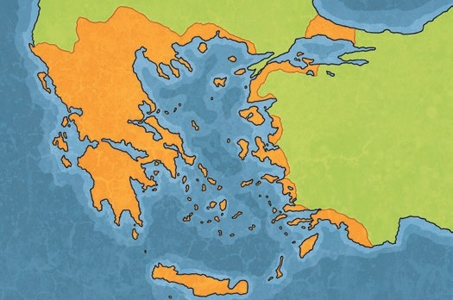
Who Let the Gods Out?
Key Vocabulary
ancient | Something from a very long time ago.
civilisation | A human society with well- developed rules and government, often where technology and the arts are considered important.
city states | Small areas that ancient Greece was divided into, each with their own governments, laws and army.
empire | A group of countries or states that are ruled by one ruler or country.
legacies | Things that exist after someone dies or after a civilisation or event ends.
democracy | A system where the citizens of a country or state are involved in the way it is run.
myth | A story from ancient times about something that happened long ago that some people believed to be true.
Timeline
3500 BC
AD 1500
Ancient Egypt
Ancient Rome
Maya Civilisation
Ancient Greece
Stone Age
Bronze Age
AD 1
Anglo- Saxon Britain
Iron Age
Roman Britain
Ancient Greek City States
Ancient Greece was not a country. It was made up of city states. There were often battles between these city states but sometimes they would join together to defend themselves from a common enemy. Important city states of ancient Greece included Athens, Corinth and Sparta.
Alexander the Great’s Empire
Enslaved People in
Ancient Greece
Independent city states existed for most of the ancient Greek period. However, towards the end of this period, King Philip II of Macedonia ruled over all of ancient Greece. Following his death, his son, Alexander the Great, took over the empire along with other lands that he conquered. After Alexander the Great died, the Romans slowly took over parts of the empire.
There were many enslaved people in ancient Greece. They made many objects and goods to be sold.
Many ancient Greek pots that survive today would have been made by enslaved people.

Slide 2
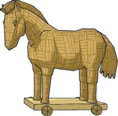
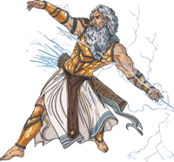
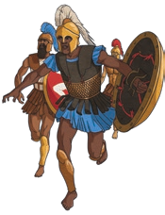
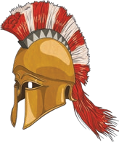
Who Let the Gods Out?
Historical Skills Vocabulary
primary source | Information and objects that come from the time being studied.
secondary source | Interpretations of information and objects which are produced after the time being studied.
Ancient Greek Gods and Goddesses
Myths
The ancient Greeks believed in many different gods and goddesses. Each god/goddess represented a certain aspect of humanity
and each was responsible for certain parts of life too.
Festivals were held to celebrate the gods and goddesses.
It is believed that the 12 most powerful
gods lived on Mount Olympus.
Zeus was the most powerful of all the gods. He was god of the sky and the king of Mount Olympus.
The Trojan War is a very famous
ancient Greek myth.
Many people believe that it is a myth but that there is some historical truth behind it.
The Trojan War was between the Greek and the Trojan Armies.
In the story, the Greeks pretended to surrender, leaving a gift of a giant horse for the Trojans. The gift was brought inside the city walls. During the night, Greek soldiers hiding inside the horse let the Greek army inside Troy’s walls and the city was destroyed.
The Olympics
The Olympics were first held in ancient Greece in 776 BC. This is one of the legacies of ancient Greece.
Events included boxing, wrestling, running and chariot racing.
Women were not allowed to compete in the Olympics. This was because ancient Greek women were not treated as equals to men and had fewer freedoms.
The idea for the marathon also originates from this time.
The Spartans and the Athenians
Democracy
Much of what we see of the Spartans on television and in films is based on myth and does not present the
Spartans accurately. The Spartans were known for their strong army and ability to fight. In childhood, boys were trained to be warriors. Girls were taught academic subjects and how to fight.
The Athenians were known for their cultural developments and learning. Girls did not go to school but many were taught how to look after the home and family.
Ancient Athens is where democracy began in around 508 BC. Listening to the opinions of other people and debating issues was an important part of this system. After debating issues, the ancient Athenians would vote. At that time, the only people allowed to take part in democracy were adult males who were citizens of Athens. The legacy of democracy still exists today in many parts of the world.

