Slide 1
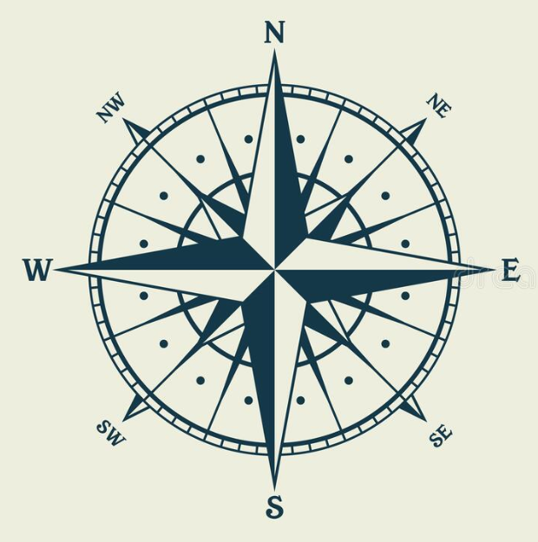
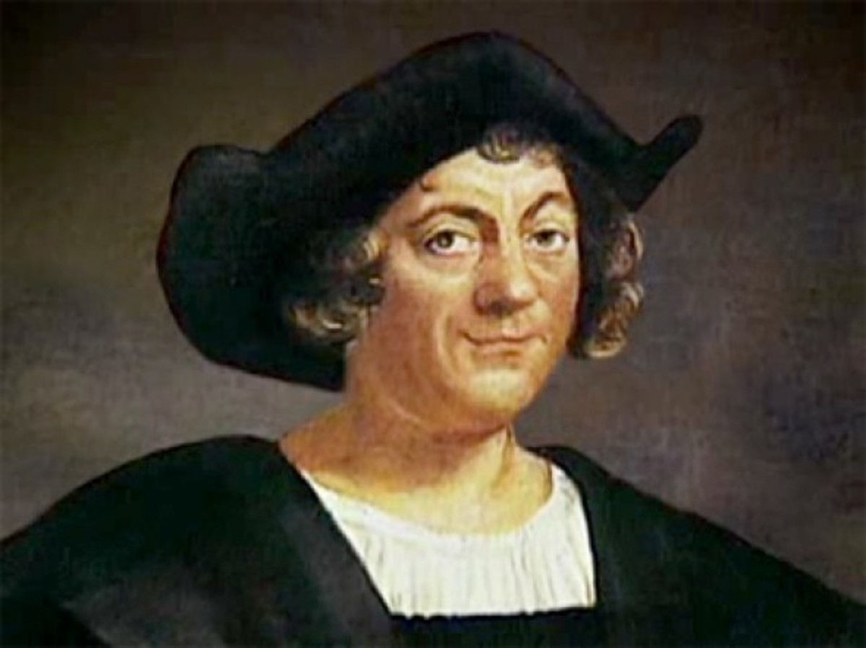
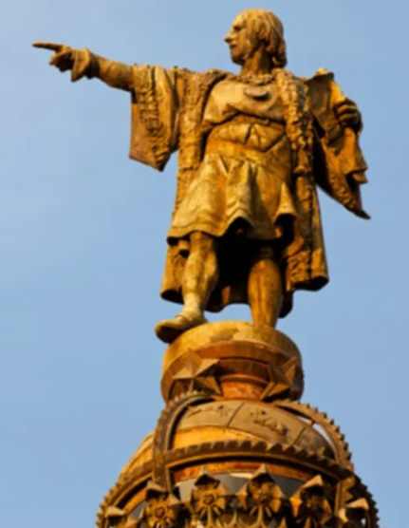
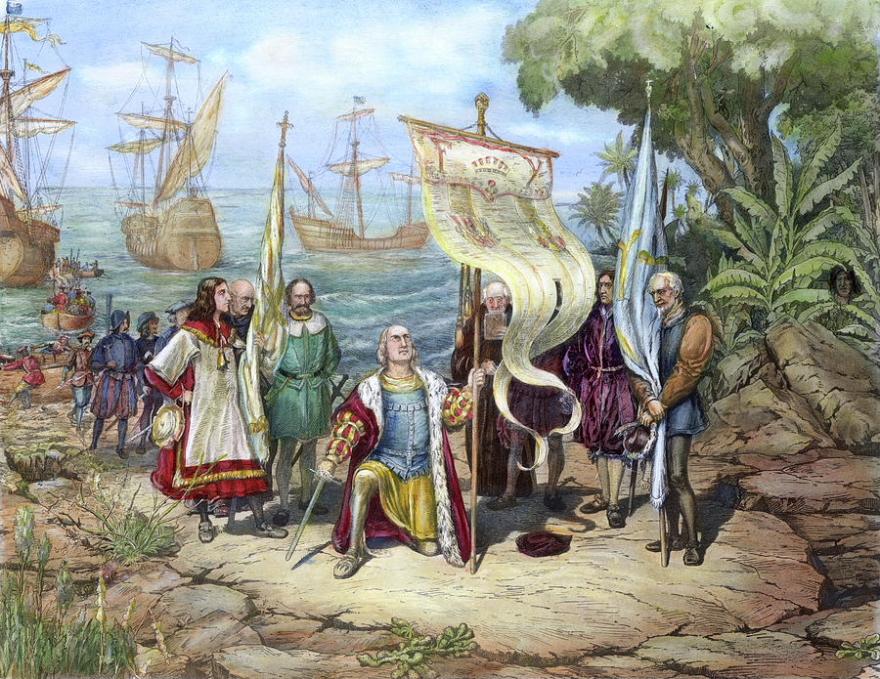
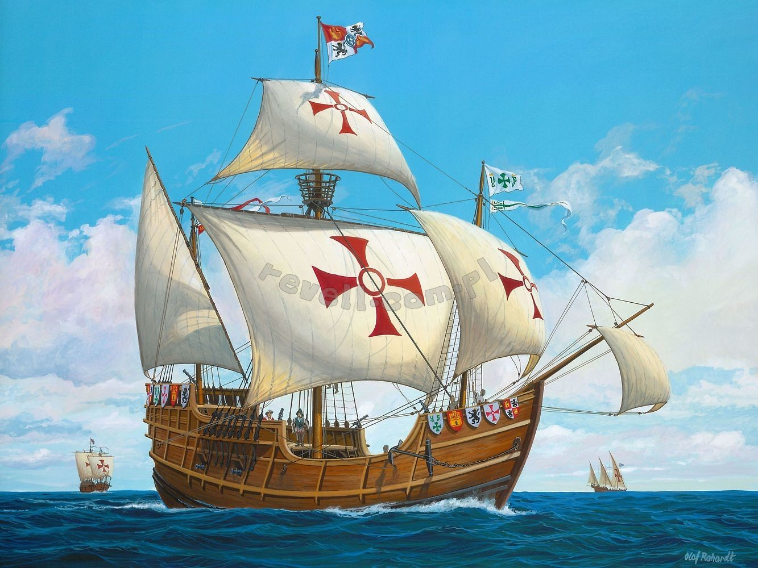
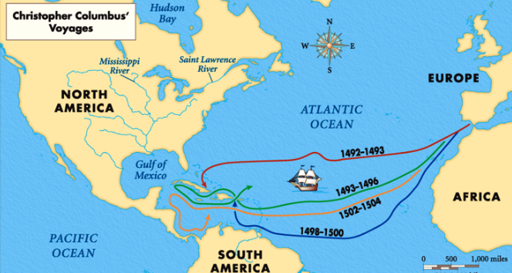
Should we be afraid of the unknown?
Key Terms
Christopher Columbus
Continent | A very large area of land, such as Africa or Asia, that is made up of several countries
Equator | An imaginary line around the middle of the Earth
Coordinates | A grid method used to plot a location or a journey
Explorer | Someone who travels to places, where very little is known, in order to discover what is there
Sailor | Someone who works, lives or sails on a ship.
Merchant | A person who buys and sells goods.
Compass | An item used to show directions. This can be north, west, south, east. It can also be north-west, north-east, south-west or south-east.
Voyage | A long journey.
Christopher Columbus was an explorer born in 1451 in Genoa, Italy.
Columbus believed the Earth was round and tried to sail West from Europe to reach Asia.
August 3rd 1492, three ships sailed West (Santa Maria, Nina & Pinta)
12th October 1492: Columbus finds an island and calls it San Salvador
Columbus goes on 4 voyages across the Atlantic Ocean.
Columbus never realised in his lifetime that he had discovered a new continent, called North America.
Columbus visited many islands and countries on his voyage, including Cuba, Haiti, Dominican Republic, Grenada, Dominica, Costa Rica, Jamaica, Trinidad & Tobago and Venezuela

Slide 2
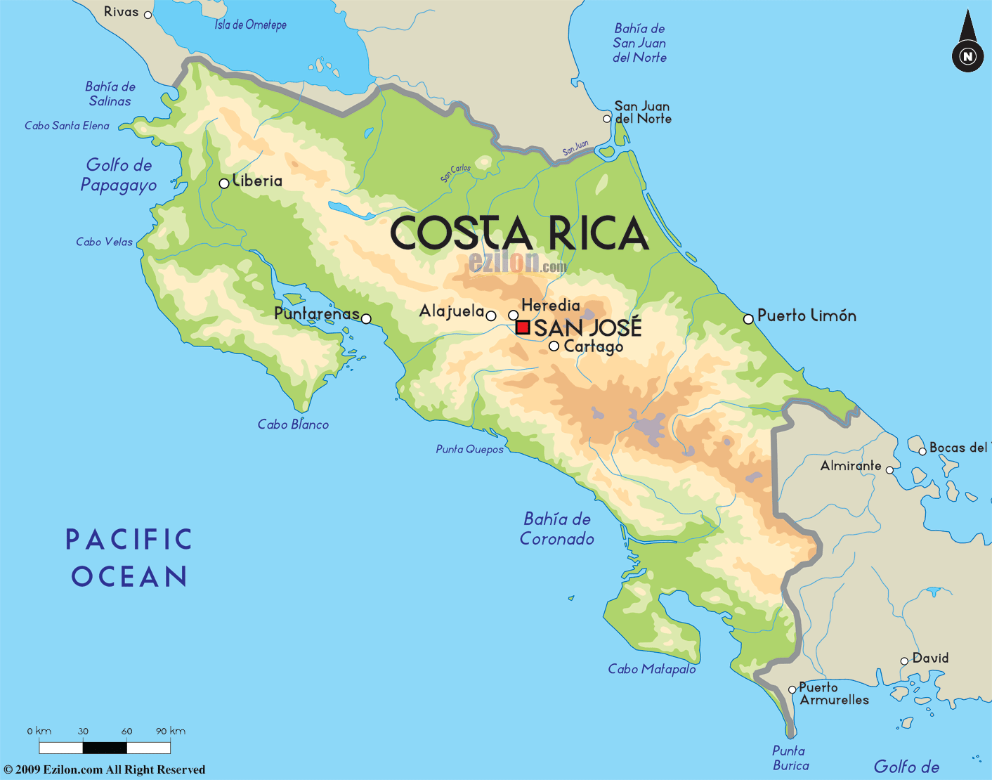
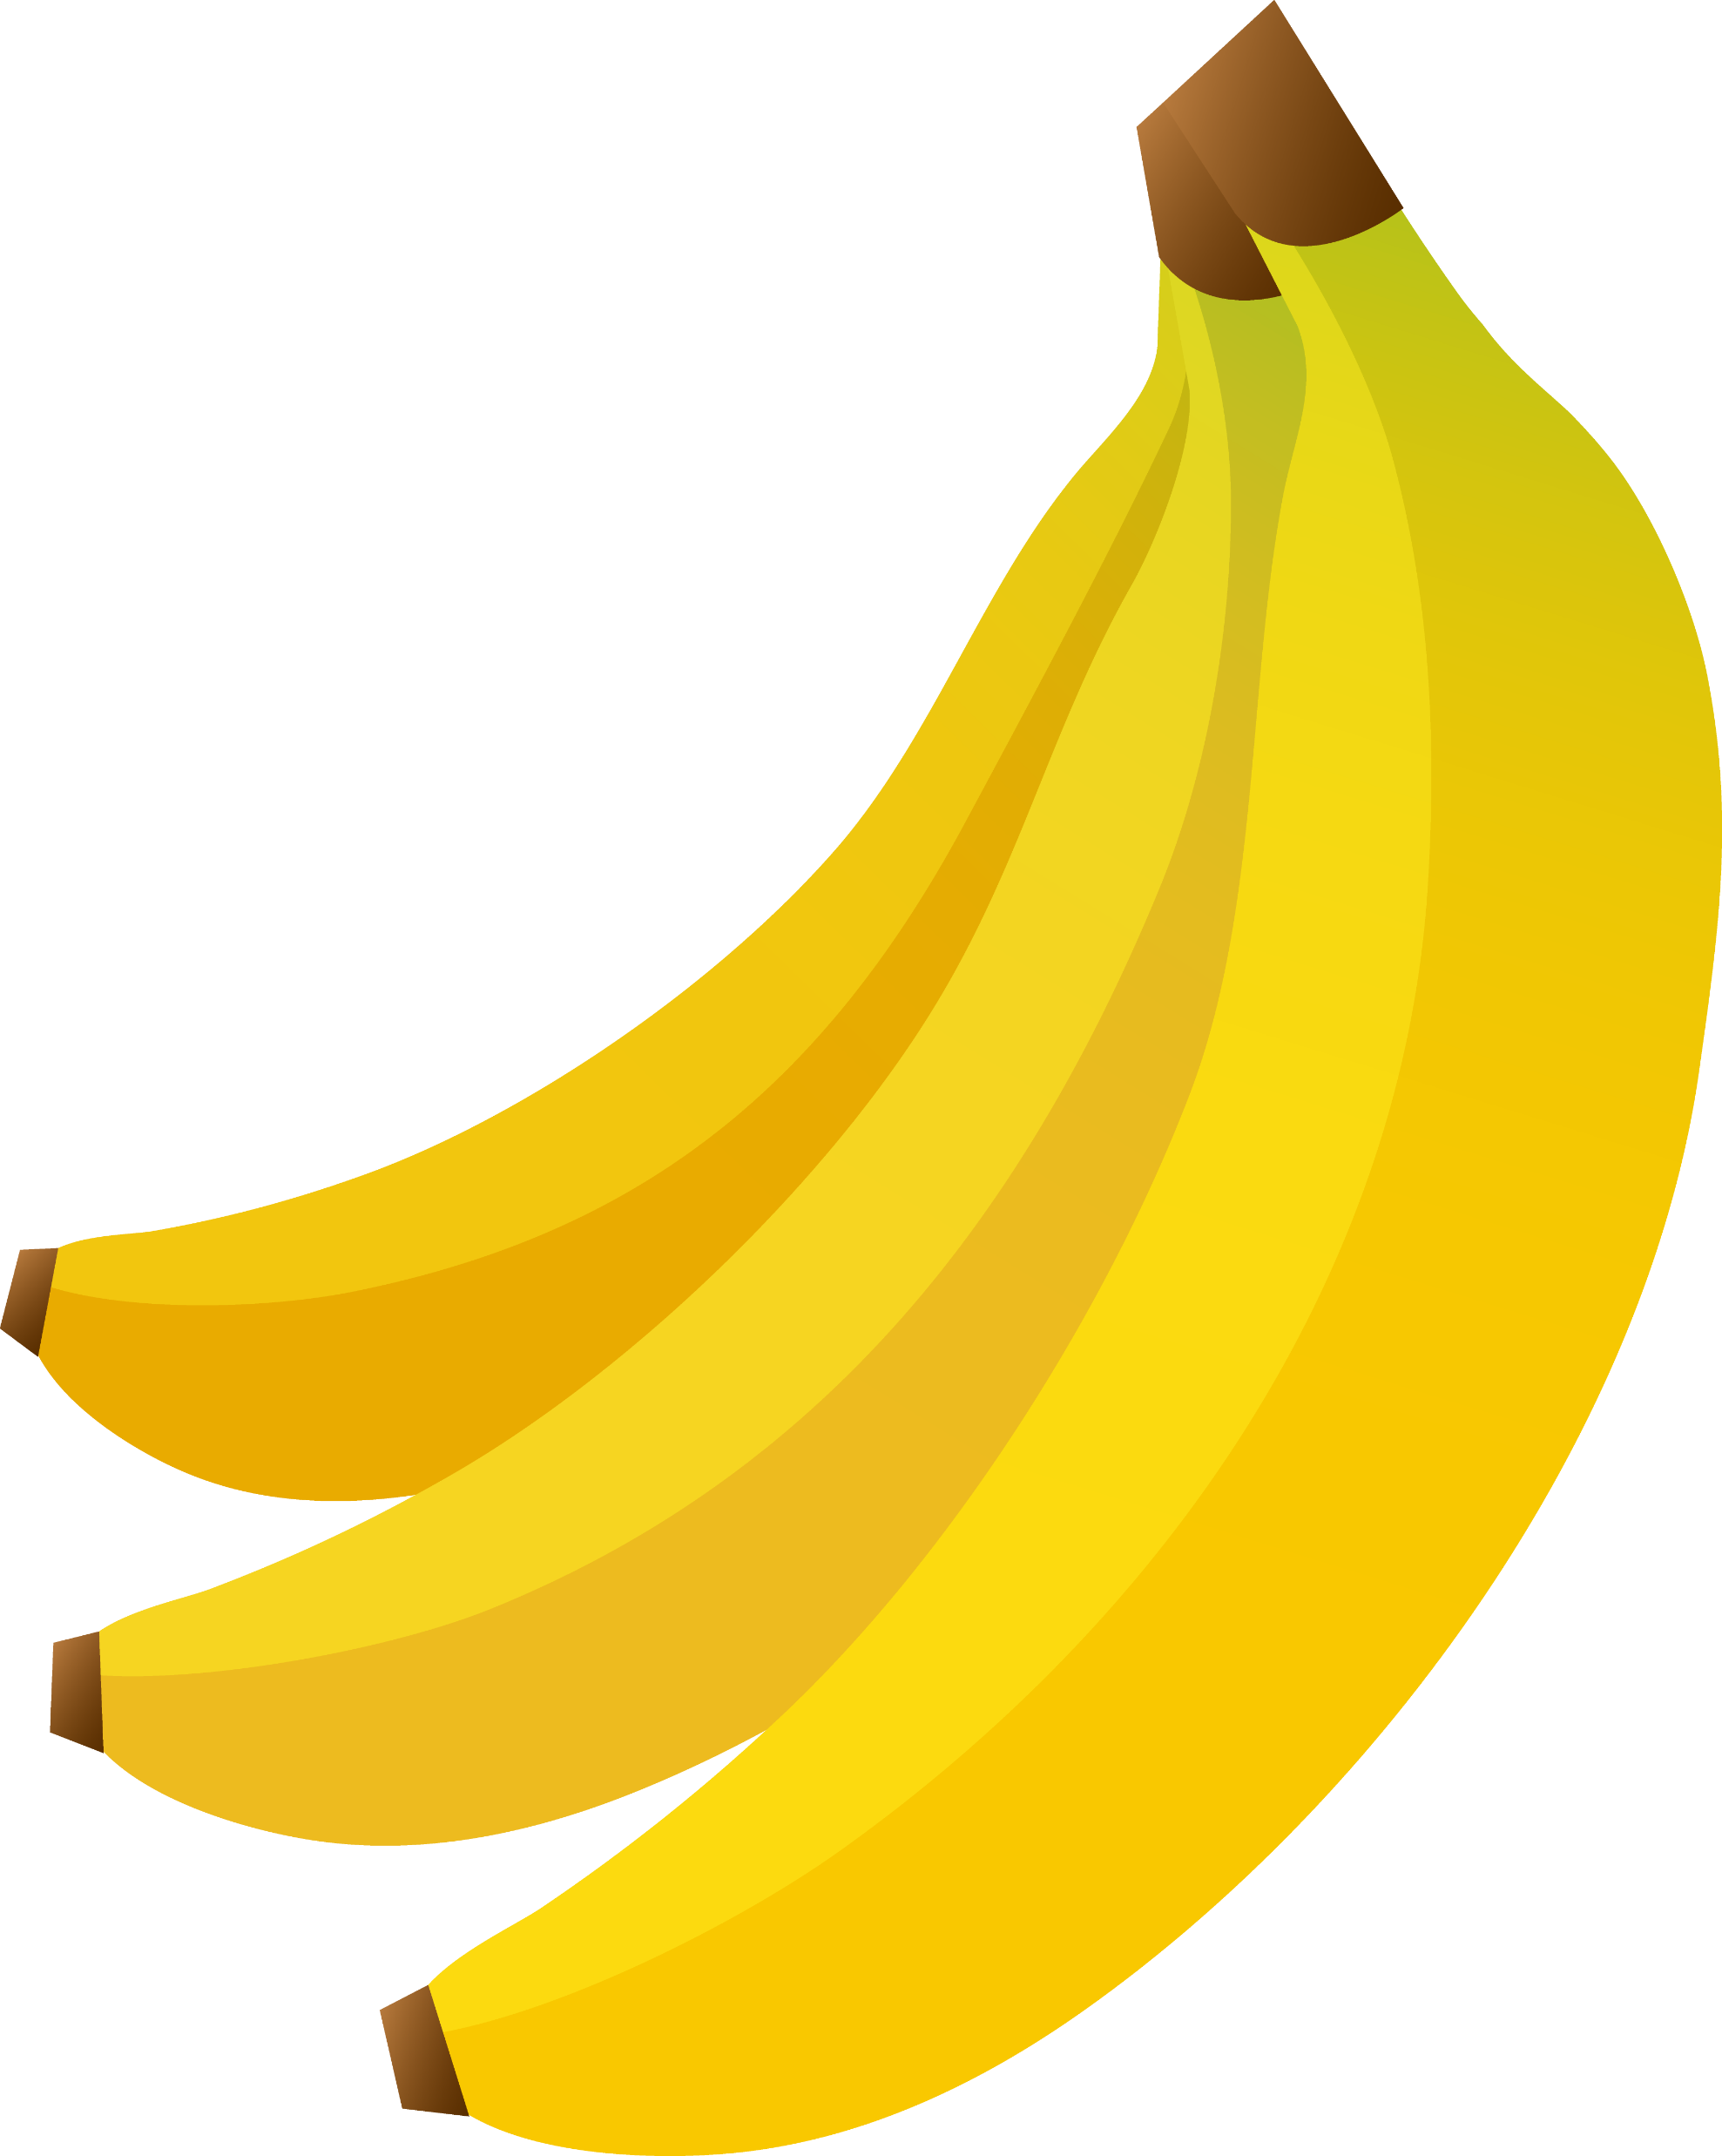
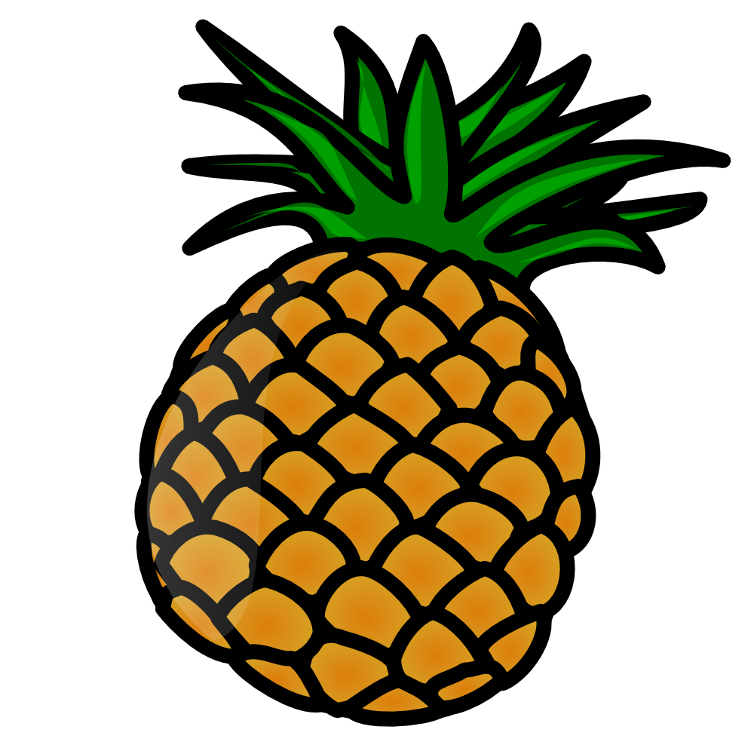
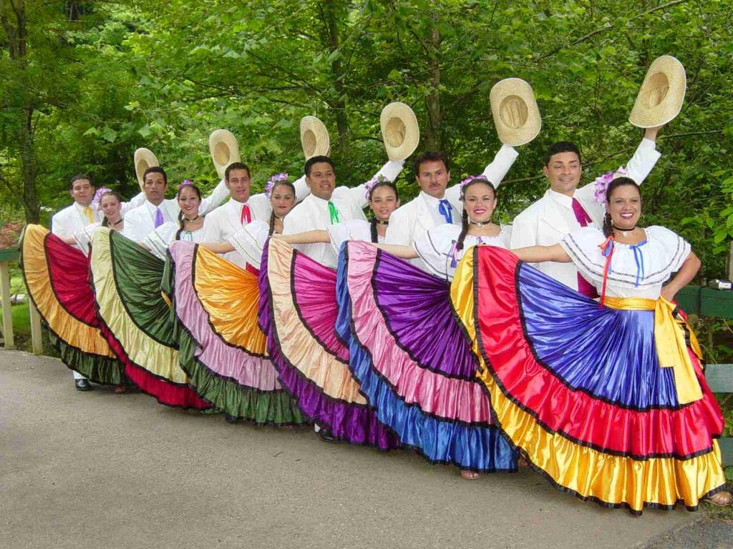
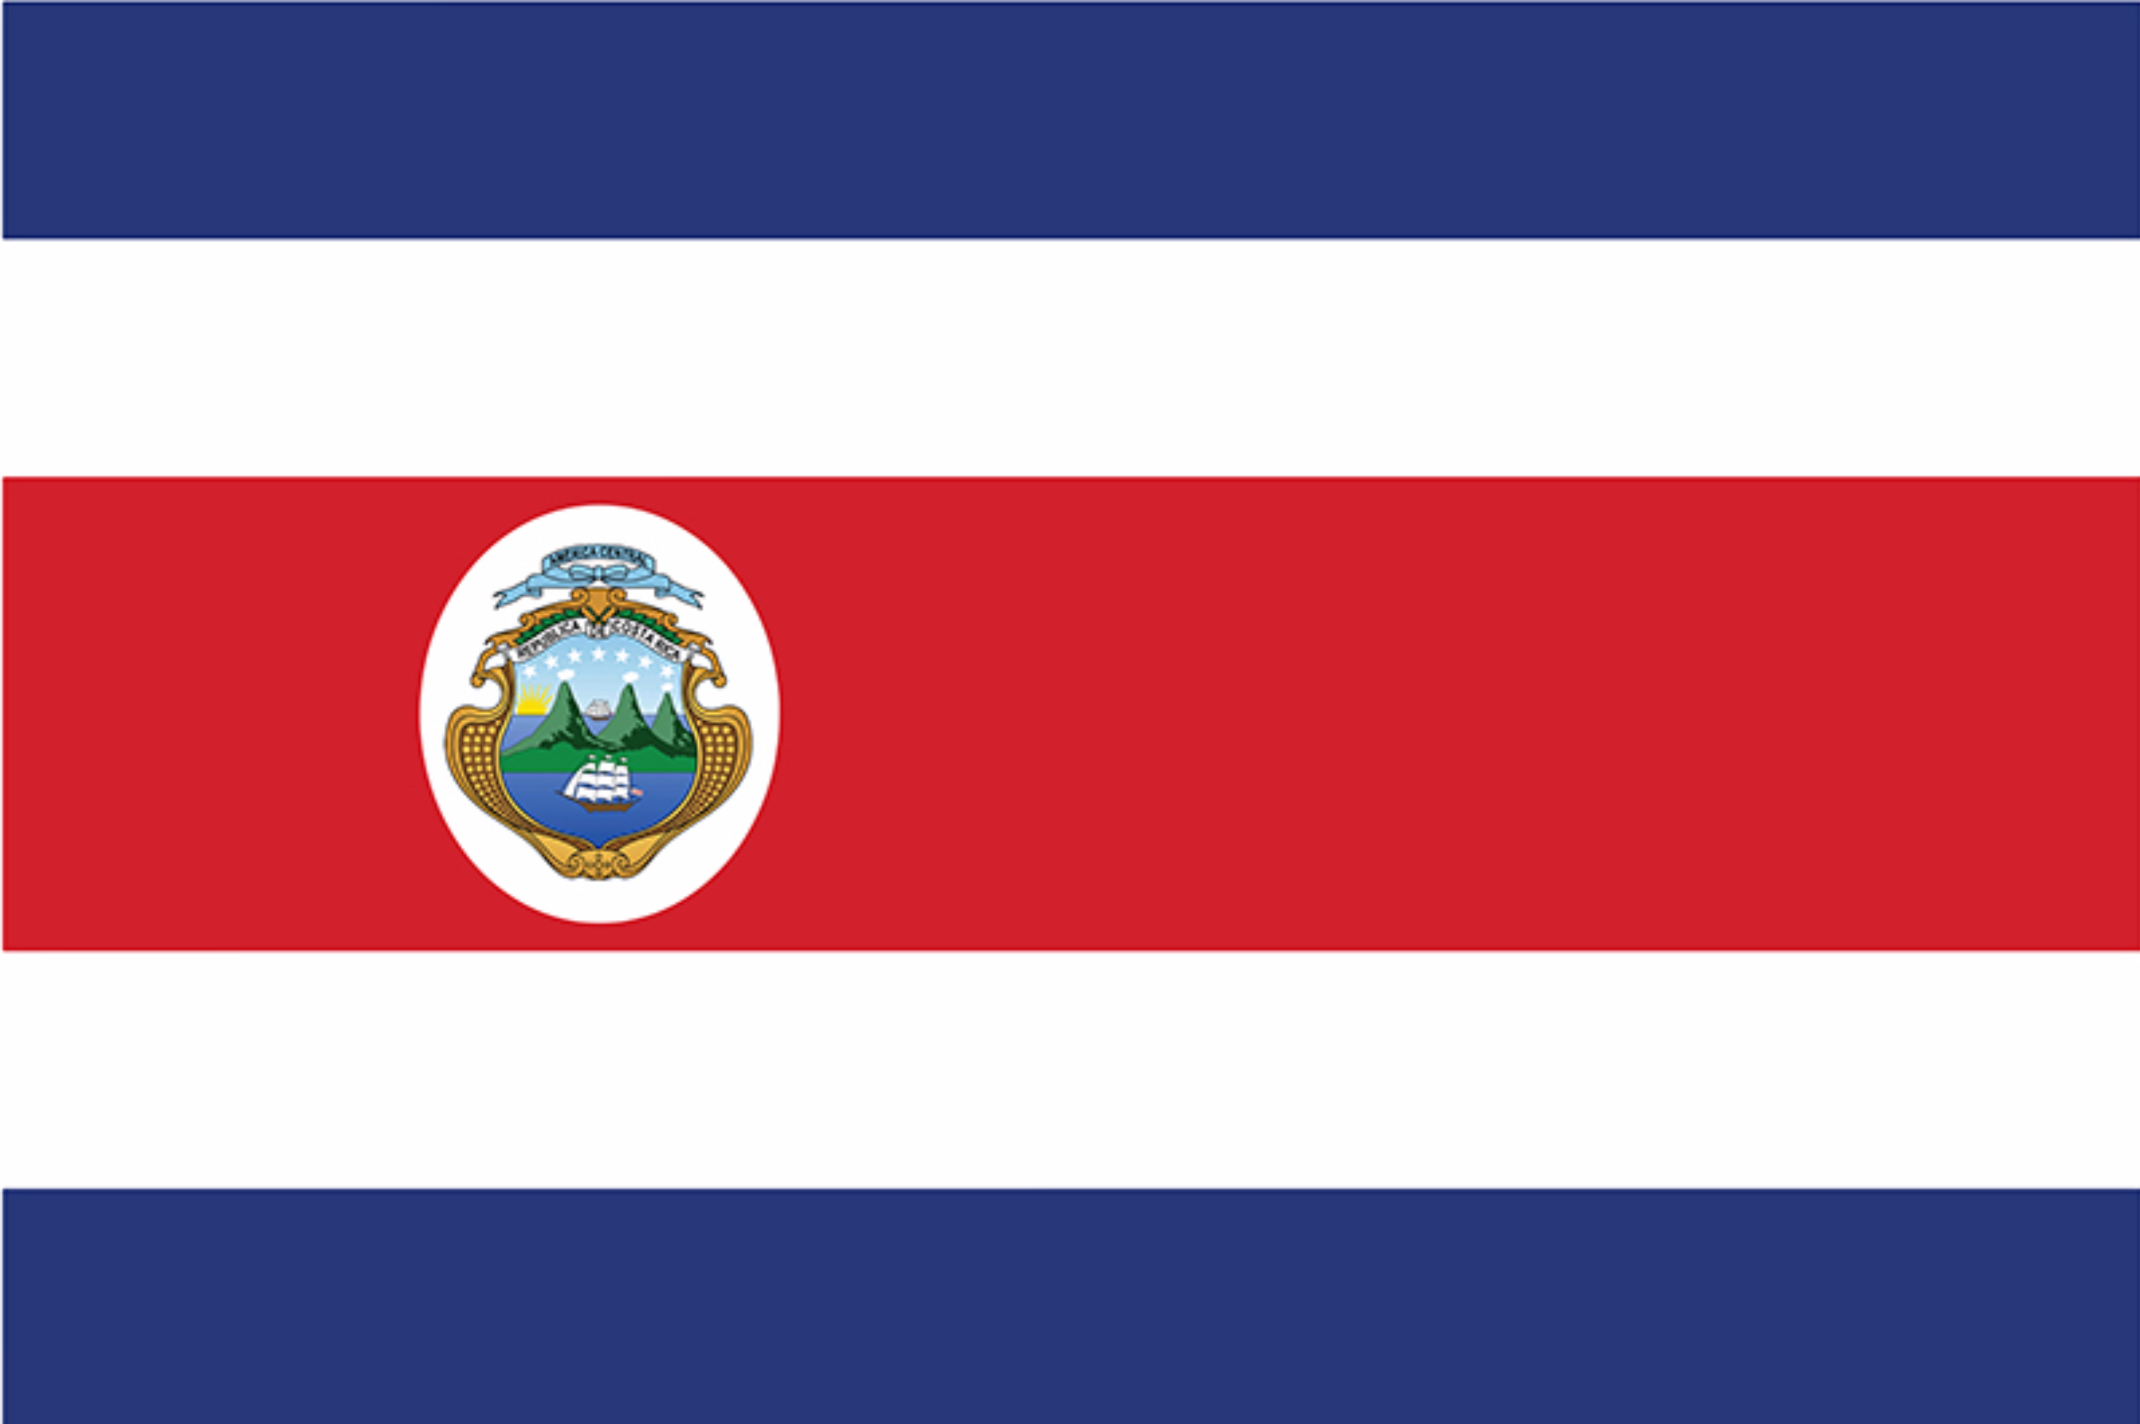
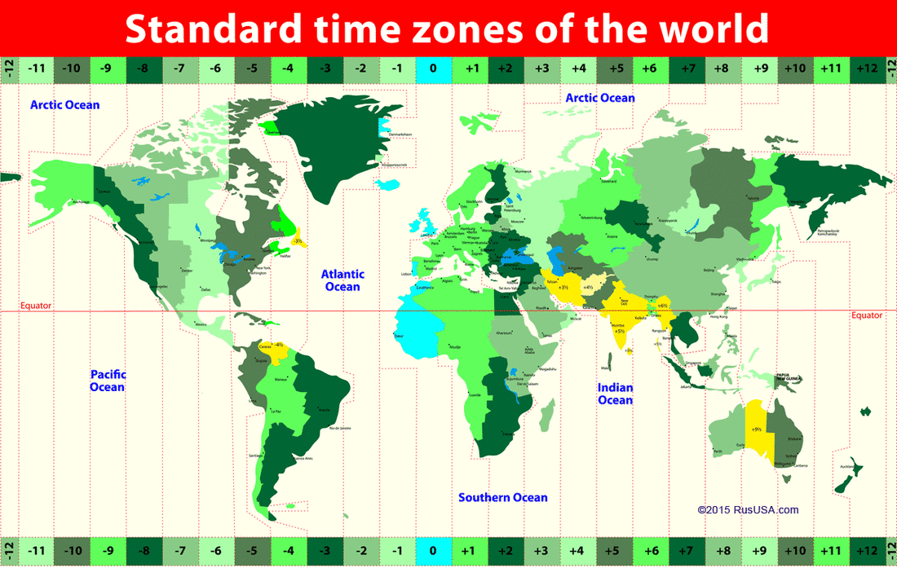
Key Terms | Definition
Population | The whole number of people or inhabitants in a country or region.
Satellite | An artificial body placed in orbit round the earth to collect information or for communication.
Land use | The term used to describe the human use of land.
Climate Zones | Climate zones are areas with distinct climates
Grid reference | A map reference indicating a location in terms of a series of vertical and horizontal grid lines identified by numbers or letters.
Tourism | The commercial organization and operation of holidays and visits to places of interest.
The country of Costa Rica is found in the subcontinent of Central America. This part of the world is covered by rainforests and you may find lots of natural resources such as coffee, rice, banana, pineapples and sugar. Central America is covered with volcanoes, which means the soil is perfect for growing crops.
Irazu Volcano similarly makes up its tallest volcano.
Lake Arenal makes up the country’s biggest lake.
Costa Rica has a rich biodiversity.
Pre-Columbian Costa Rica had a complex society of its own.

