Slide 1
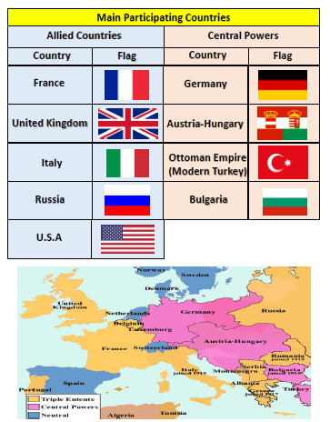
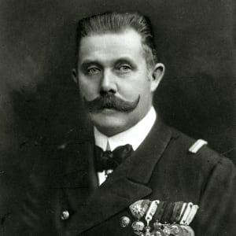
Does Conflict Always Result in Sacrifice?
Key Terms
Background Information
World War I began in 1914, after the assassination of Archduke Franz Ferdinand, and lasted until 1918. During the conflict, Germany, Austria-Hungary, Bulgaria and the Ottoman Empire fought against Great Britain, France, Russia, Italy, Romania, Japan and the United States. Thanks to new military technologies and the horrors of trench warfare, World War I saw unprecedented levels of carnage and destruction. By the time the war was over, more than 16 million people (soldiers and civilians) were dead.
Word | Definition
Trench | A long, narrow ditch.
Warfare | Engagement in or the activities involved in war or conflict.
No Man’s Land | Ground between the front lines or trenches of two opposing armies.
Armistice | An agreement made by opposing sides in a war to stop fighting for a certain time; a truce
Propaganda | Biased or misleading information used to promote a political cause or point of view.
Triple entente | Great Britain, France and Russia.
Who?
Winston Churchill | Prime Minister of the United Kingdom from 1940 to 1945. Advocated that the UK adopt a strong stance against Germany.
Woodrow Wilson | President of the United States during the war.
Archduke Franz Ferdinand

Slide 2
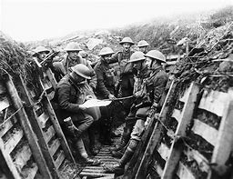
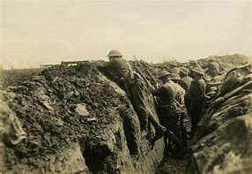
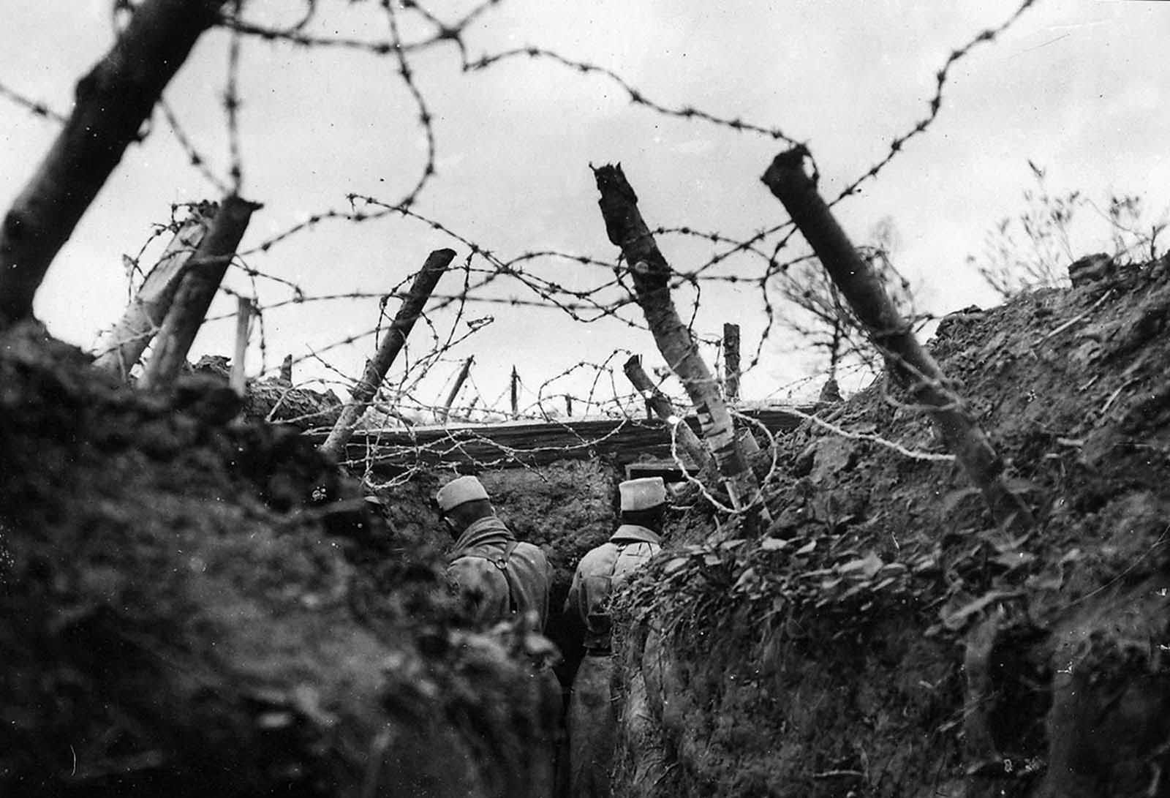
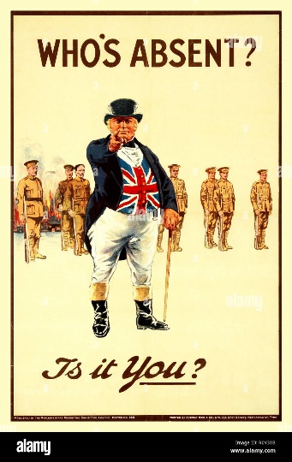
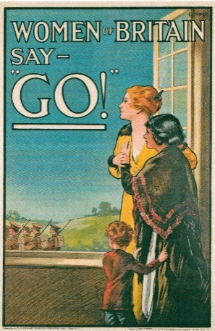
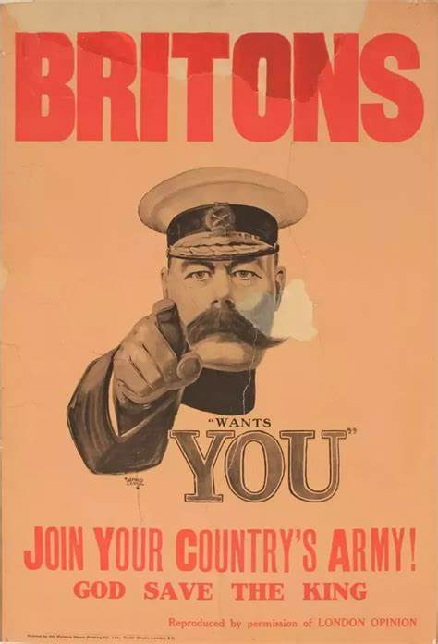
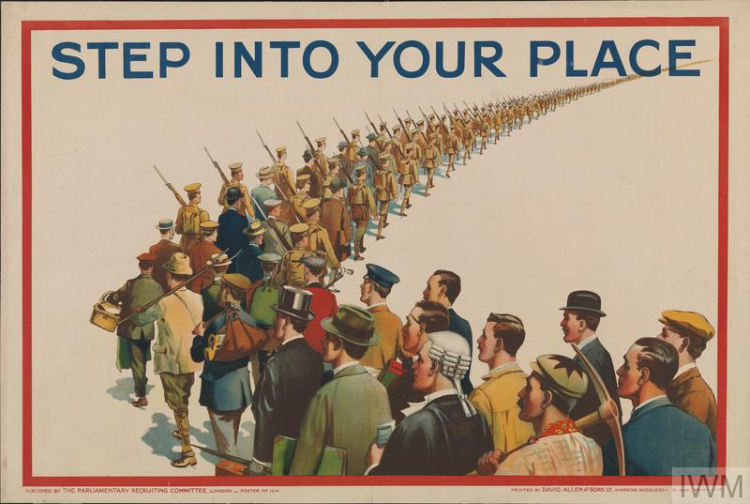
Does Conflict Always Result in Sacrifice?
Key Terms
When? (Key Knowledge)
June 1914 | Archduke Franz Ferdinand of Austria is assassinated by a Serbian terrorist.
 | Following a number of threats, Austria-Hungary declares war on Serbia.
August 1914 | Germany declares war on Russia in support of Austria-Hungary before declaring war on France. Following a German invasion of Belgium, Britain declares war on Germany.
September 1914 | The German army is stopped short of Paris by British and French soldiers. Trench warfare begins.
April 1917 | America declares war on Germany.
November 1918 | Armistice agrees that sees Germany admit defeat. Guns fall silent at 11am.
Word | Definition
Front line | The military line or part of an army that is closest to the enemy
Victoria Cross | An award given for bravery
Remembrance | the action of remembering something.
Flanders Field | a phrase used to refer to the areas of north-east France and Belgium where many soldiers died and were buried in the First World War.
Alliance | a relationship based on similarity of interests, nature, or qualities.
Trench Warfare | A type of combat in which opposing troops fight from trenches facing each other.
Triple Alliance | Germany, Austria-Hungary and their allies.
Trench Life

