Slide 1
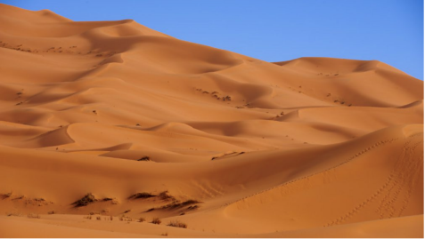
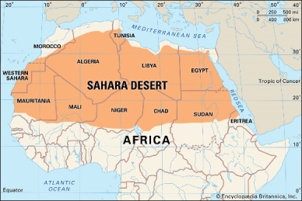
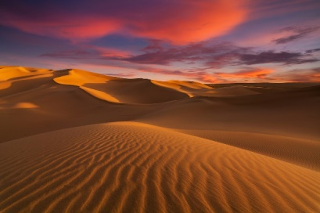
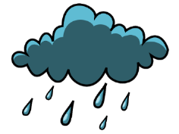

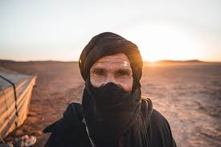
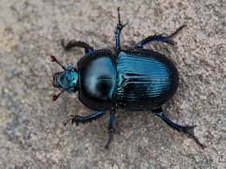
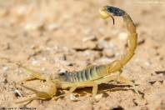
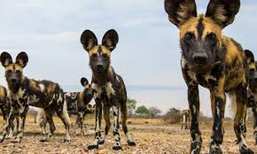
How Does Diversity Shape Our World?
Key Terms
Biome | A biome is a large area characterized by its vegetation, soil, climate, and wildlife e.g. forest or desert.
Desert | A desert is any large region that gets very little rain each year. Very few plants or animals live in desert areas.
Arid | An adjective to describe a place with little access to water.
Oasis | A spot in a desert where water and plants can be found (often around a natural spring).
Biotic | Living components e.g. plants
Abiotic | Non living components e.g. sand
Desertification | The process in which land turns into desert land.
Sand dune | A hill or. ridge of sand piled up by the wind.
The Sahara desert (Africa)
The Sahara desert is very hot. It can be over 40 degrees during the day but can drop to below 0 degrees at night.
The Sahara desert is the largest hot desert in the world. It spans 9.2 million km and covers 8% of the world’s surface.
There is less than 2.5 cm of rain in the Sahara desert each year.
Deathstalker Scorpion
African wild dogs
The population of the Sahara is just two million. People who live in the Sahara are known as nomads, who move from place to place depending on the seasons. Whilst others live in permanent communities near water sources.
Dung beetles
In the Sahara, there are -
70 species of mammals
90 species of resident birds
100 species of reptile
The Sahara used to be home to a variety of plants and animals. The change came approximately 5000 years ago, due to a gradual change in the tilt of the earth. It is thought that the Sahara Desert will become green again at some point in the future.

Slide 2
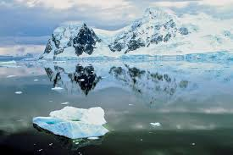
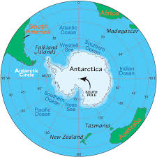
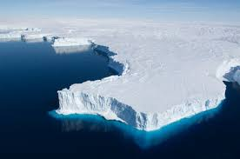
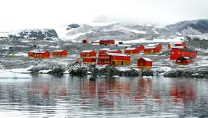
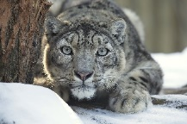
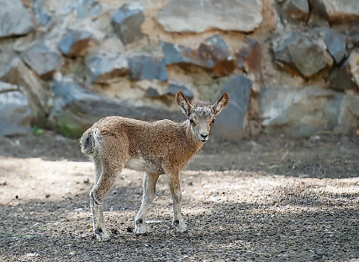
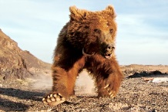
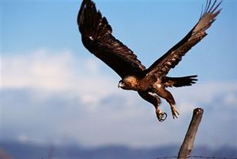

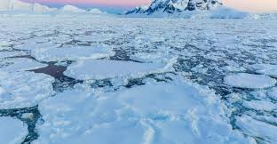
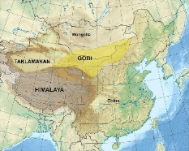
How Does Diversity Shape Our World?
Key Terms
Climate | Weather over a long period of time.
Ecosystem | An ecosystem is made up of all of the living and non-living things in an area.
Tundra | Treeless regions, where the climate is cold and windy.
Adaptation | When a plant or animal becomes better suited to its habitat.
Species | A group of animals, plants or other living things that all share common characteristics and that are all classified as alike in some manner.
Glacier | A slowly moving mass or river of ice formed by the accumulation and compaction of snow on mountains or near the poles.
Ice cap | A covering of ice over a large area, especially on the polar region of a planet.
Cold deserts get very little snow or rain.
The Gobi Desert is the largest and coldest desert in Asia.
Cold deserts are covered with snow and ice.
The coldest temperature ever recorded on Earth was −89.2 °C.
The Gobi Desert experiences snow in the winter, due to being 910-1520 m above sea level.
Approximately 57,000 people live on and the Gobi Desert. Most of these people were born in Mongolia.
Animals from the Gobi Desert
Snow Leopards
Ibex
Gobi Bear
Golden Eagle
The Gobi Desert borders Mongolia to the north and China. to the south.
The Gobi Desert is over four times the size of the U.K.
The Gobi Desert reaches
-38°C at its coldest and +42°C at its warmest.

