Slide 1
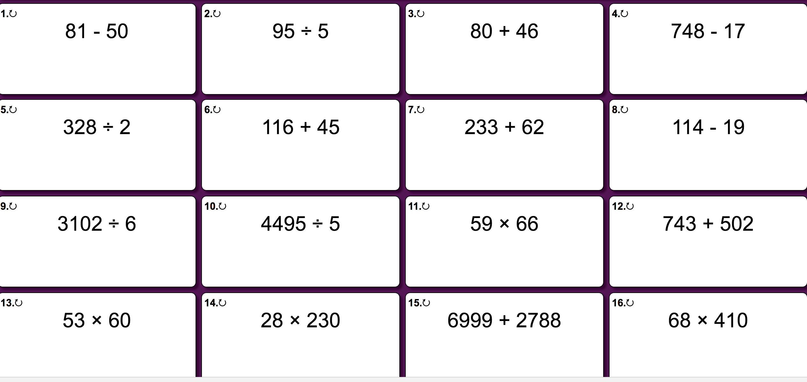
Monday - Questions

Slide 2
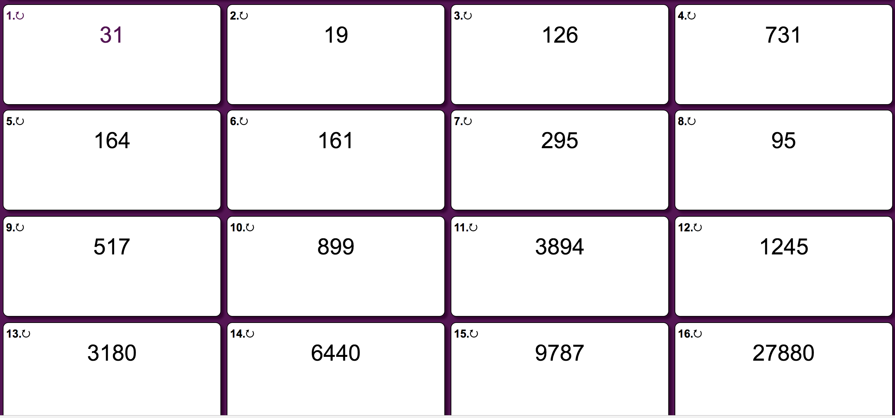
Monday - Answers

Slide 3
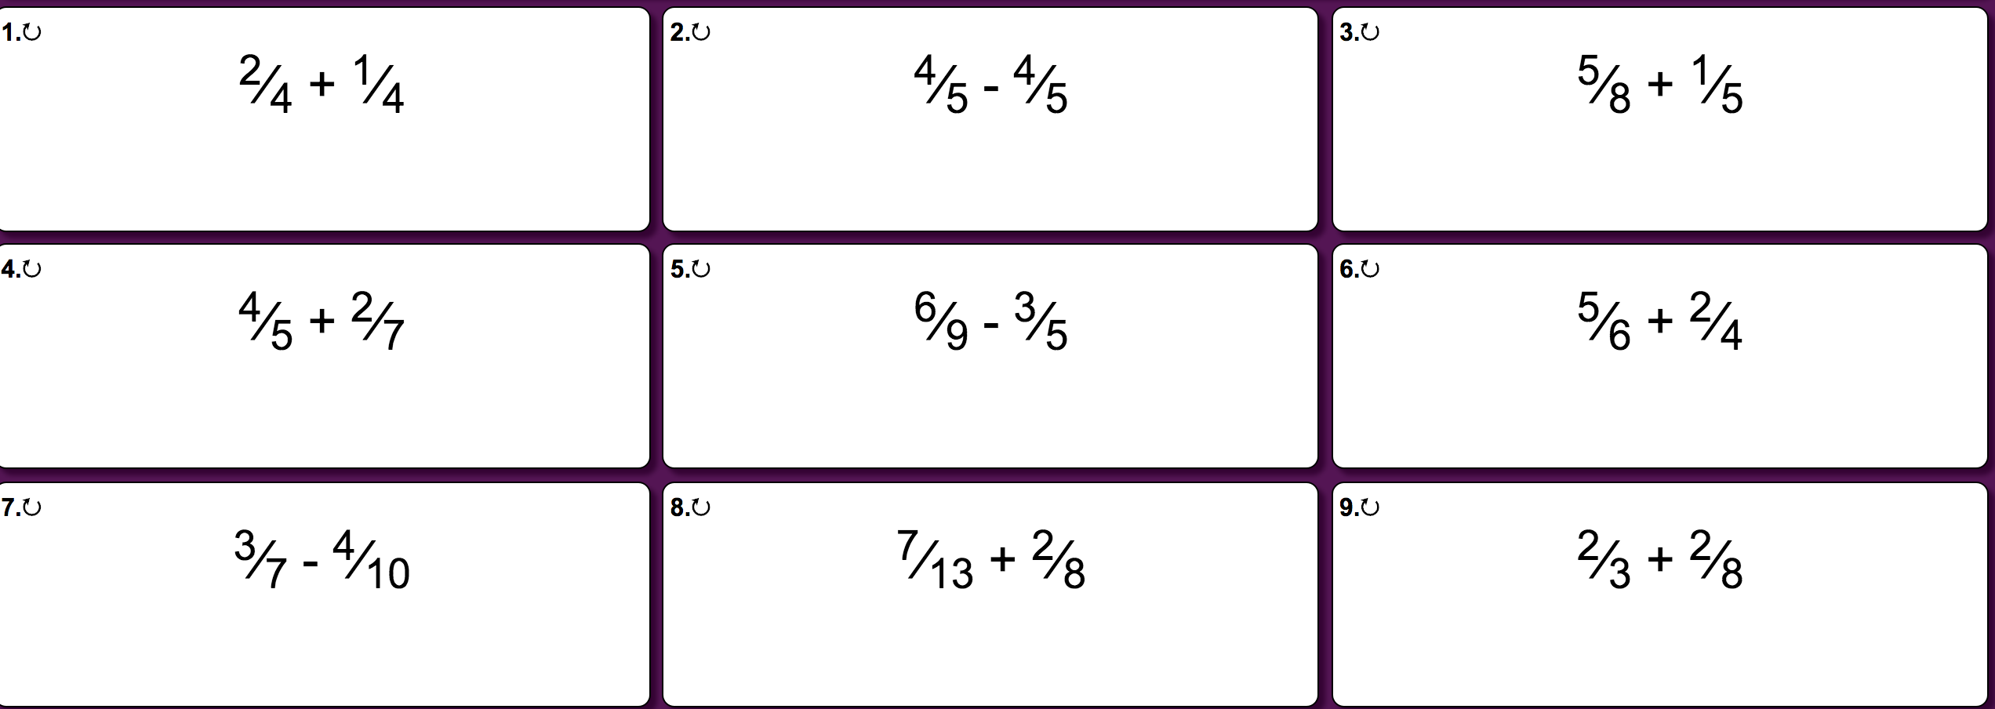
Tuesday - Questions

Slide 4
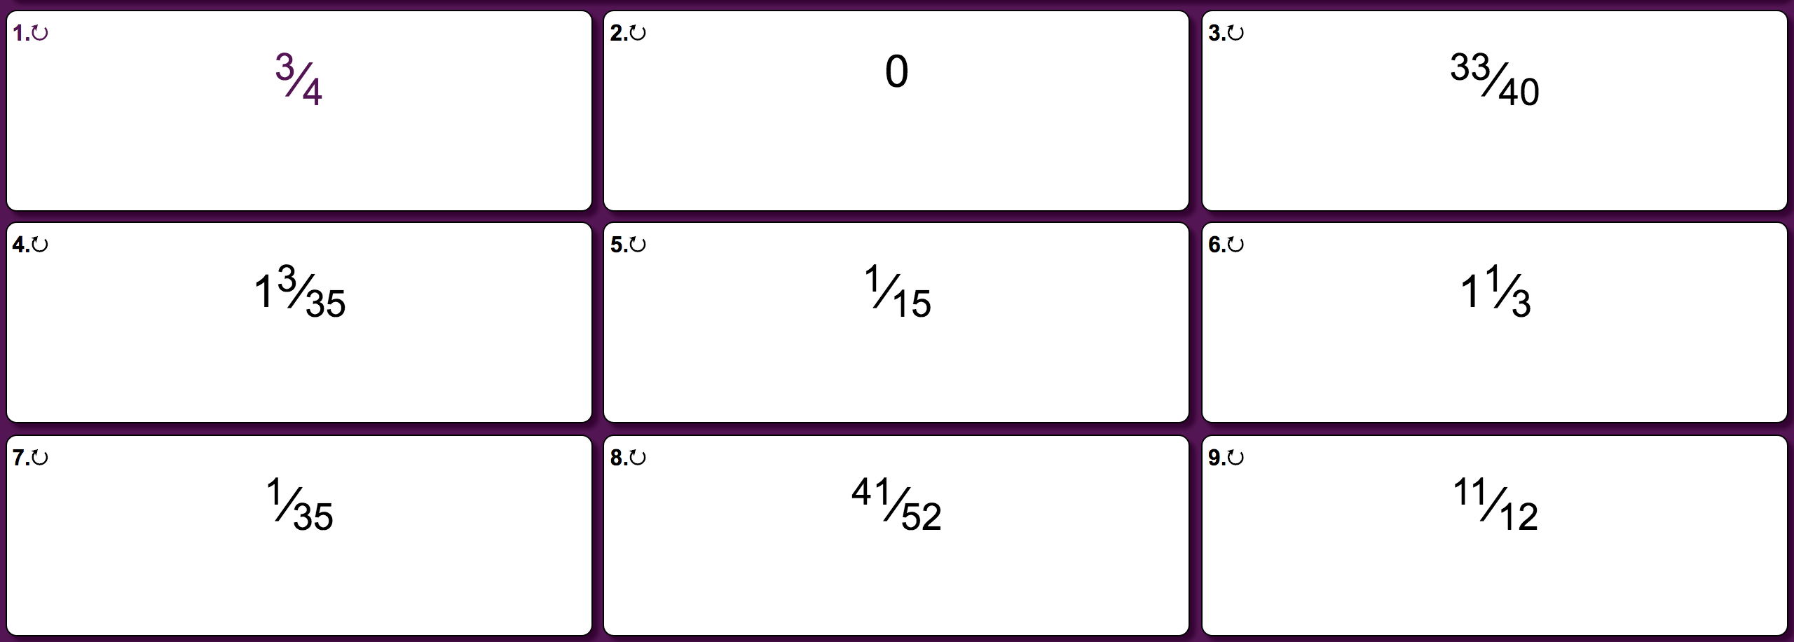
Tuesday - Answers

Slide 5
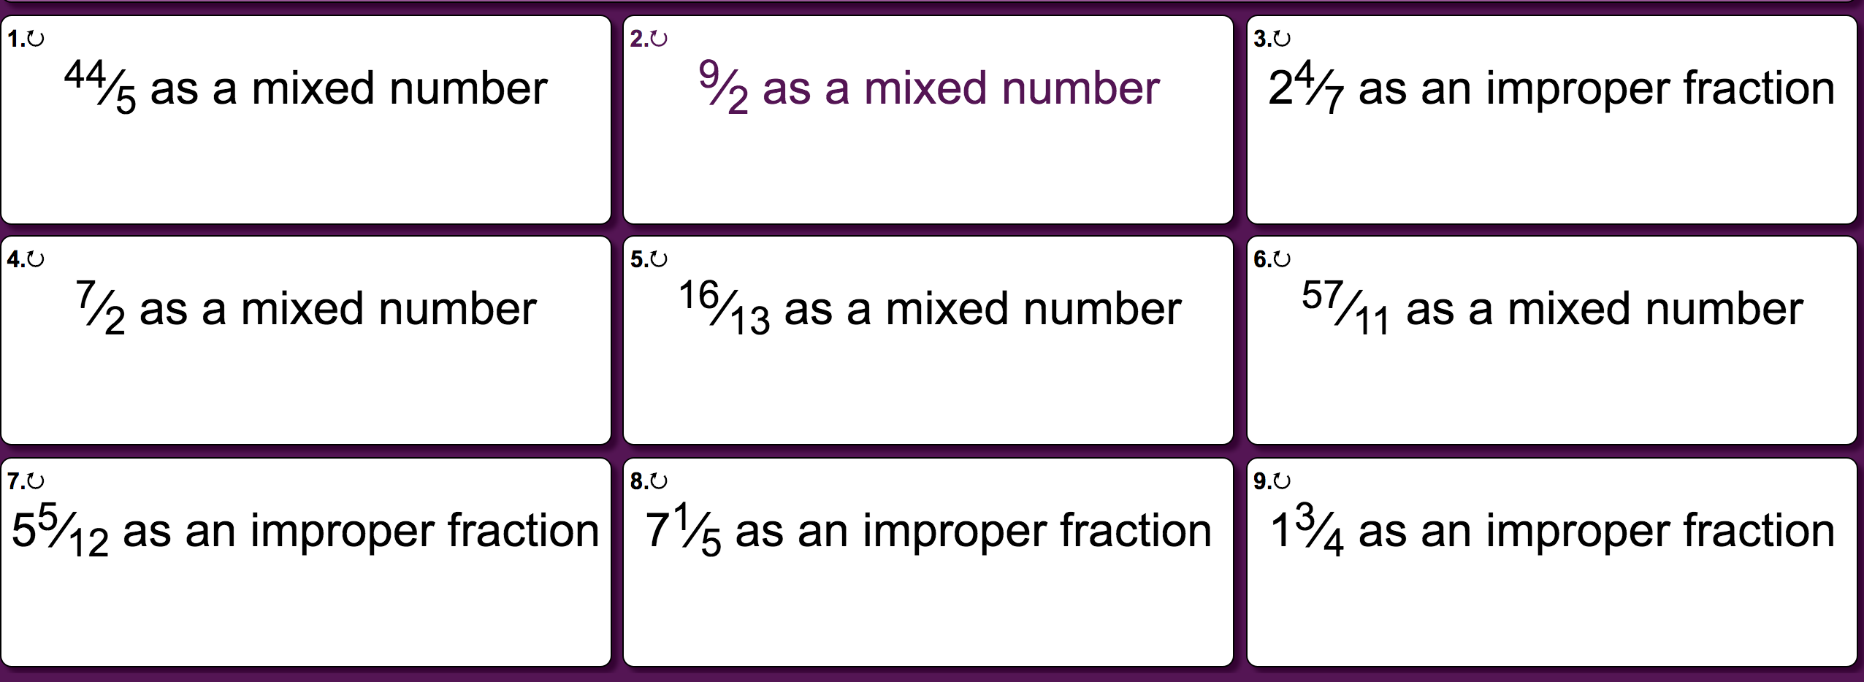
Wednesday - Questions

Slide 6
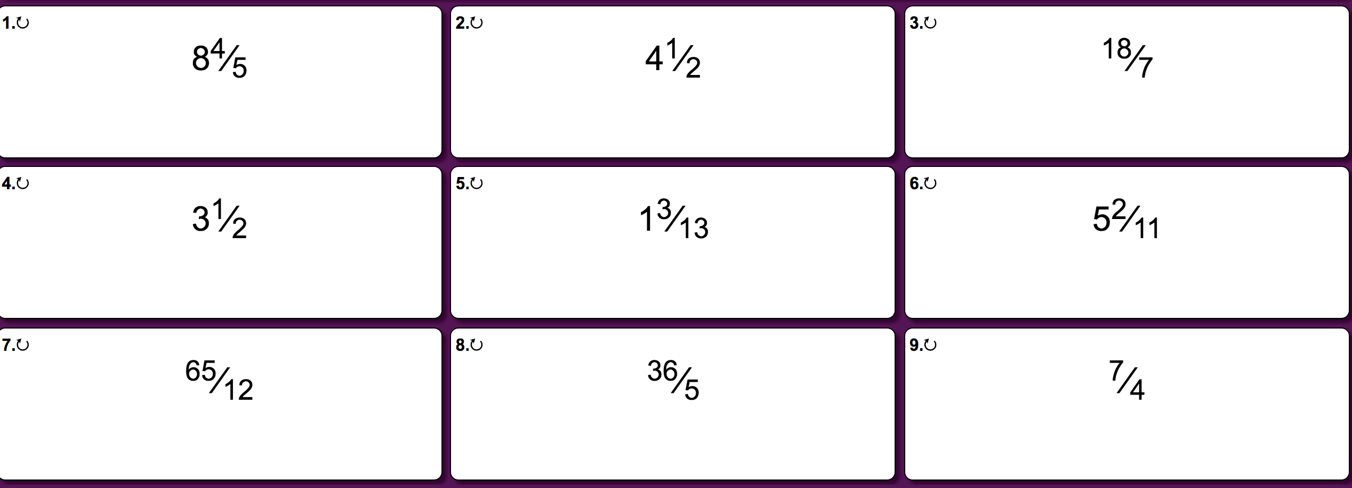
Wednesday - Answers

Slide 7
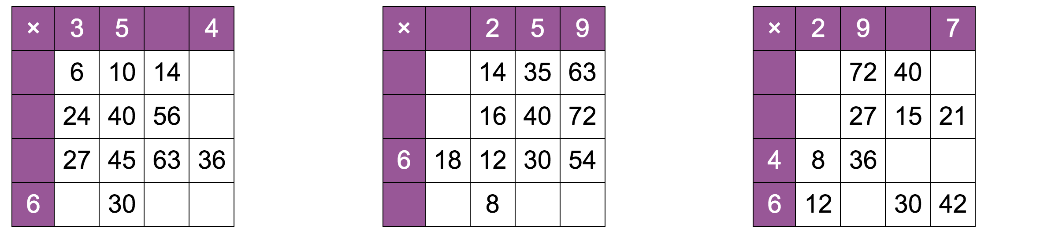
Thursday - Questions

Slide 8
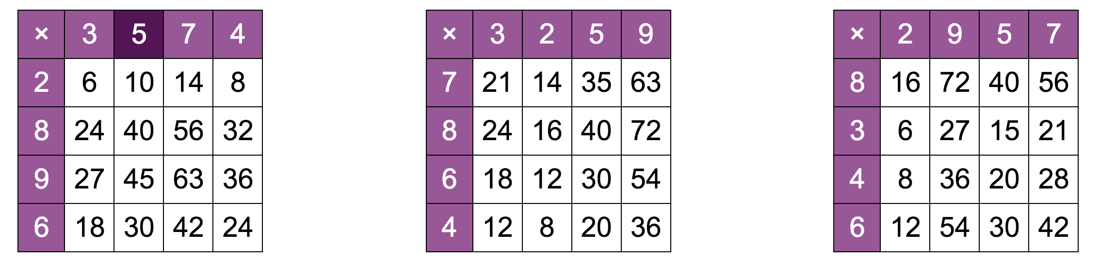
Thursday - Answers

Slide 9
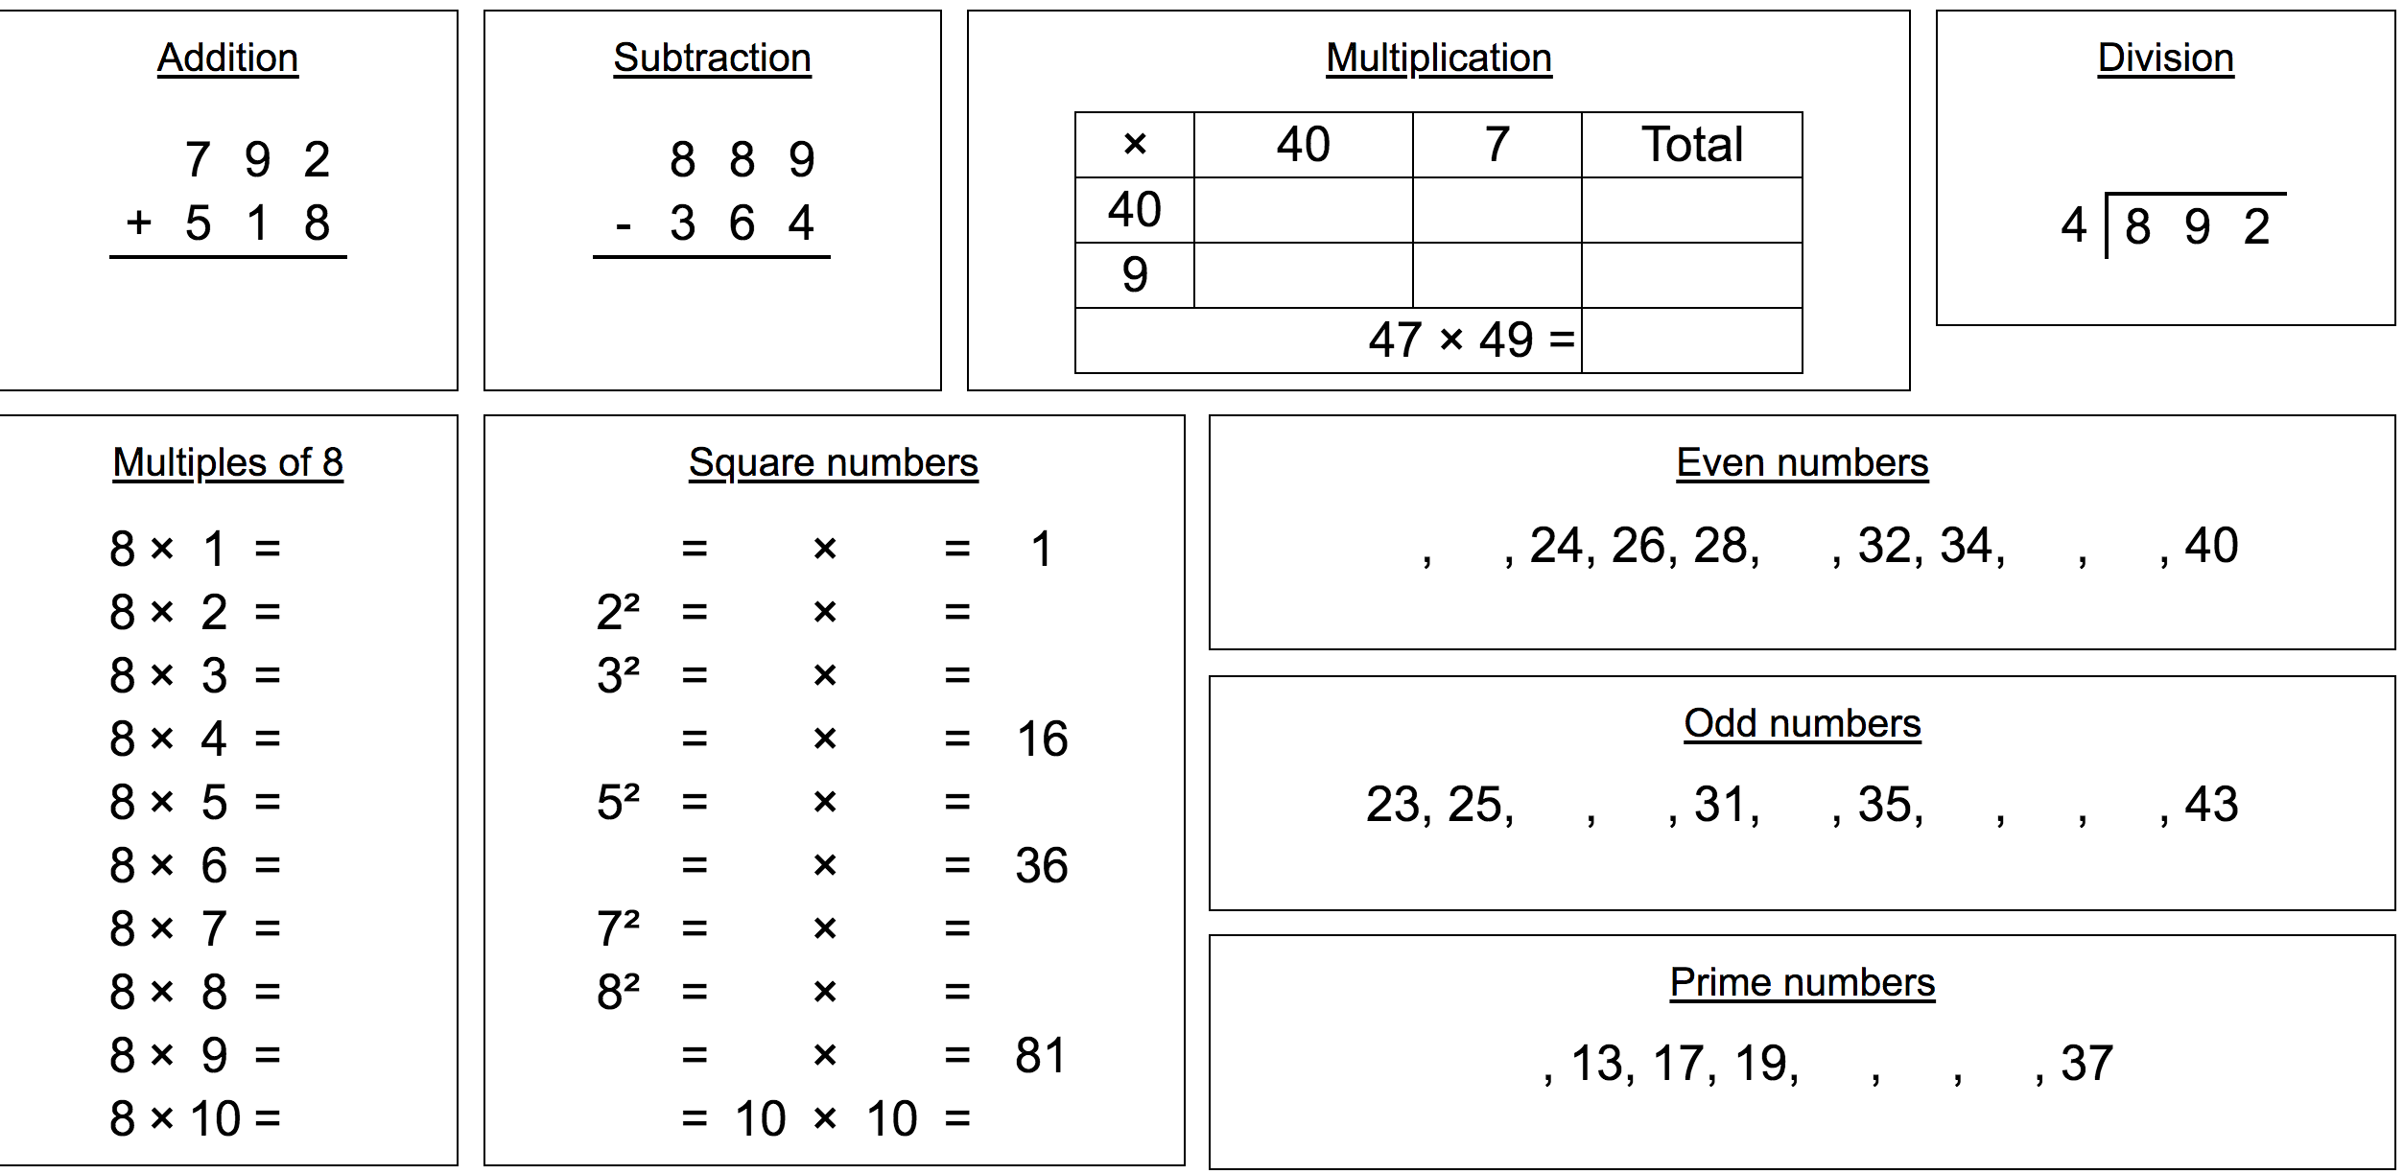
Friday - Questions

Slide 10
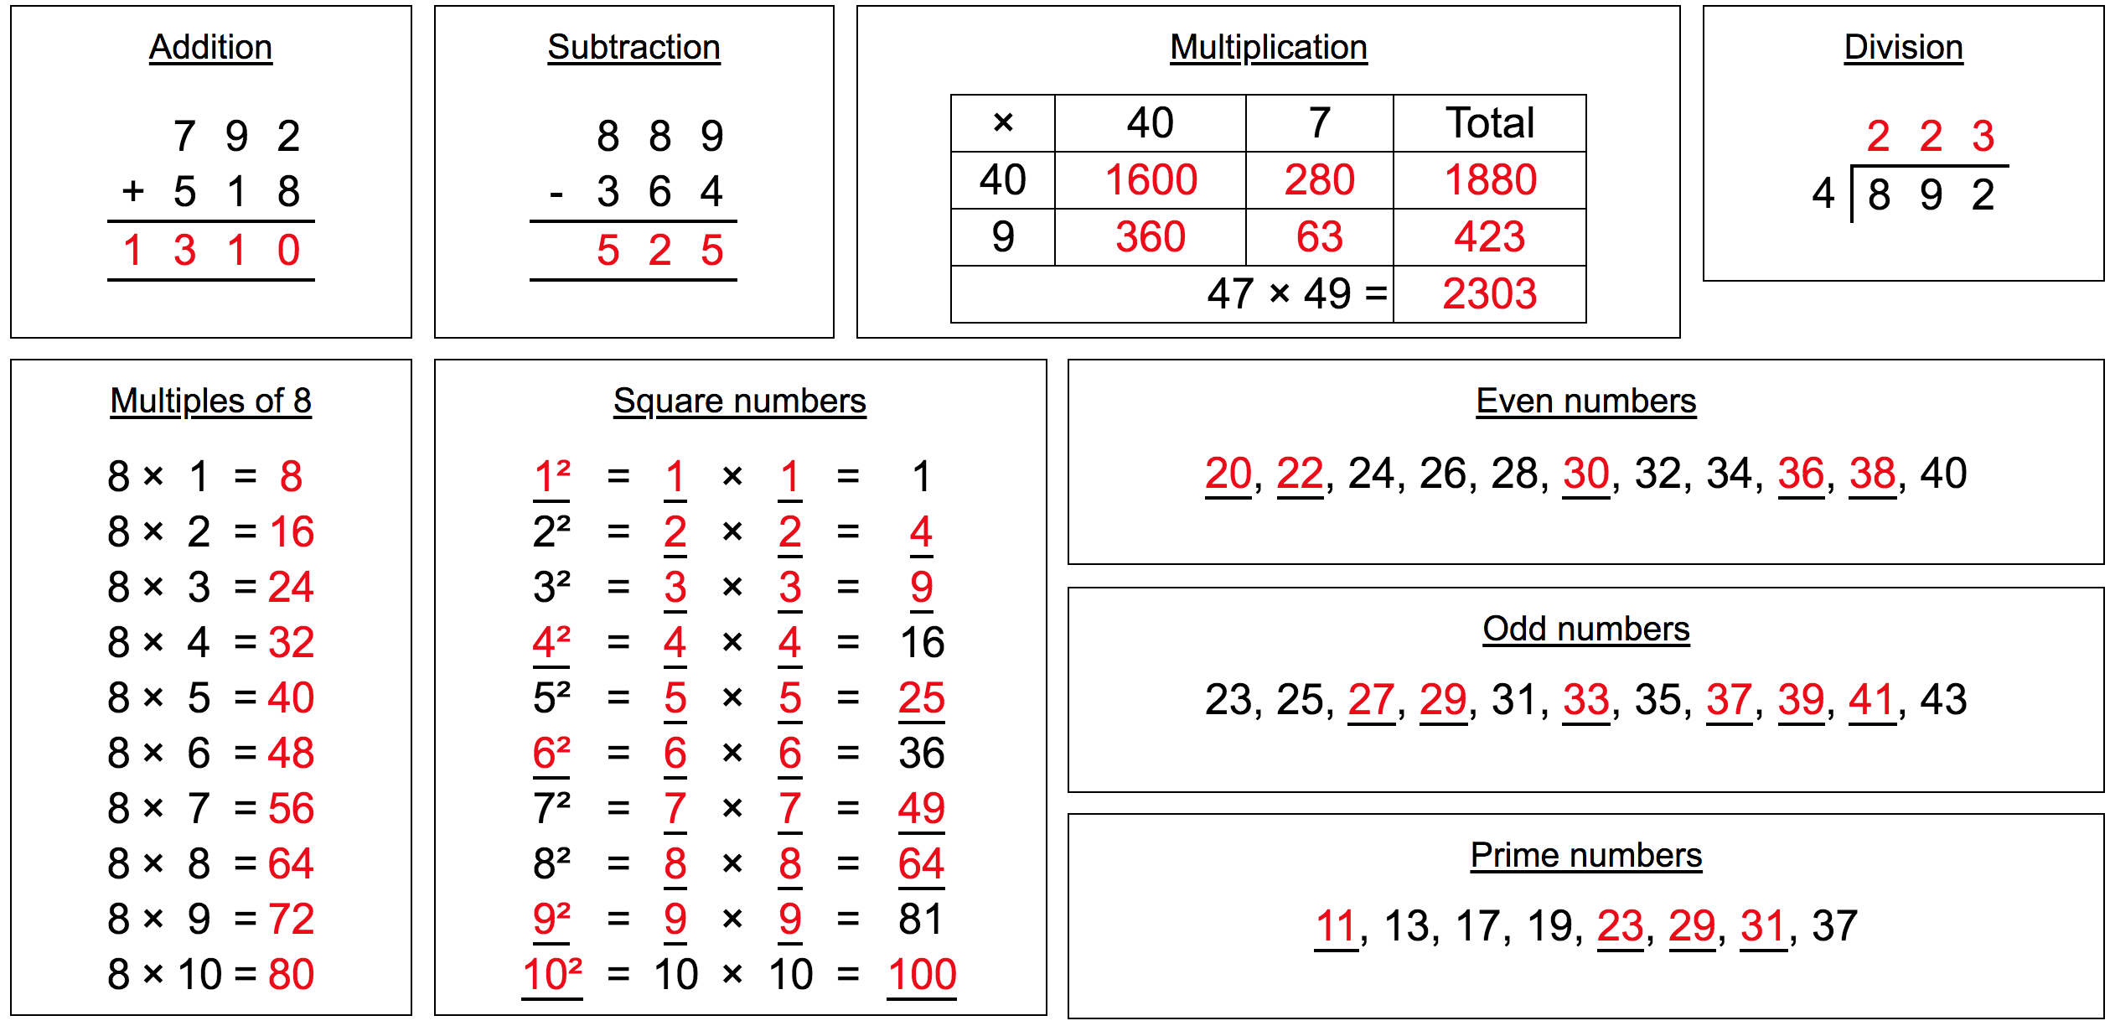
Friday - Answers

