Slide 1
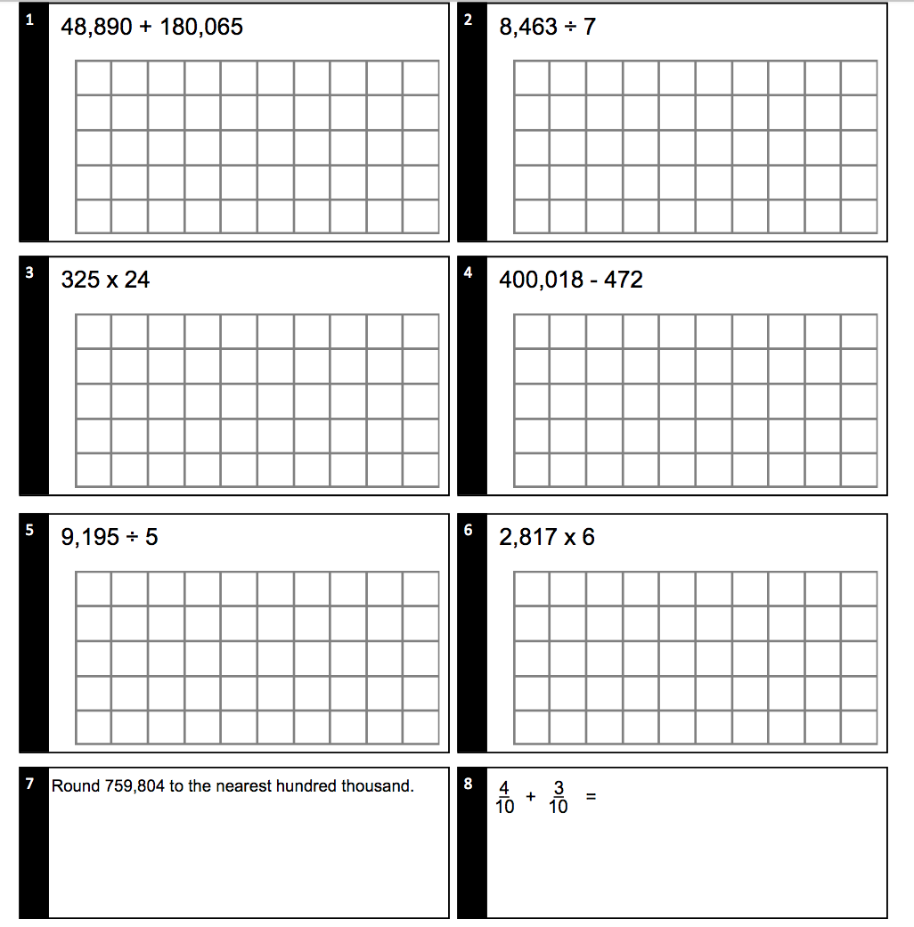
Monday
Questions

Slide 2
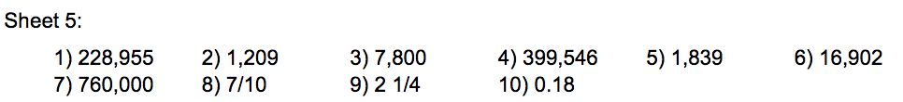
Monday
Answers

Slide 3
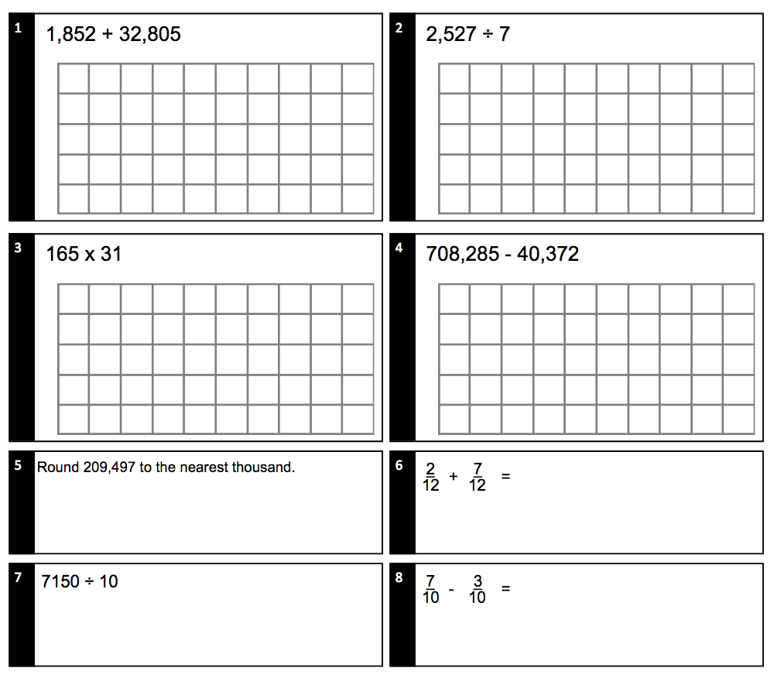
Tuesday
Questions

Slide 4
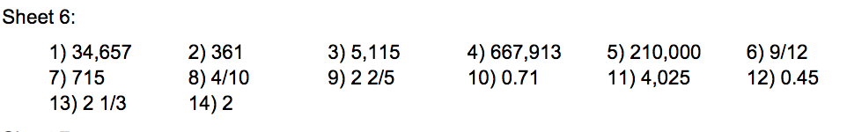
Tuesday
Answers

Slide 5
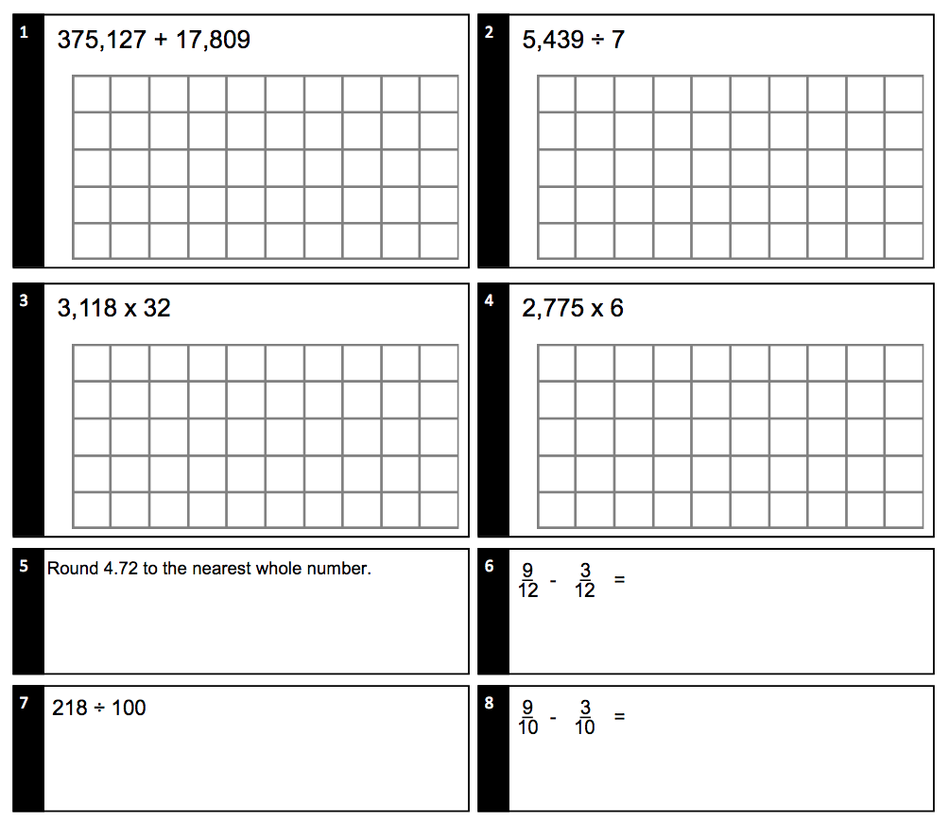
Wednesday
Questions

Slide 6
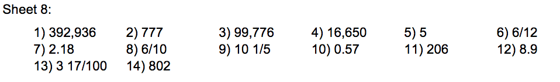
Wednesday
Answers

Slide 7
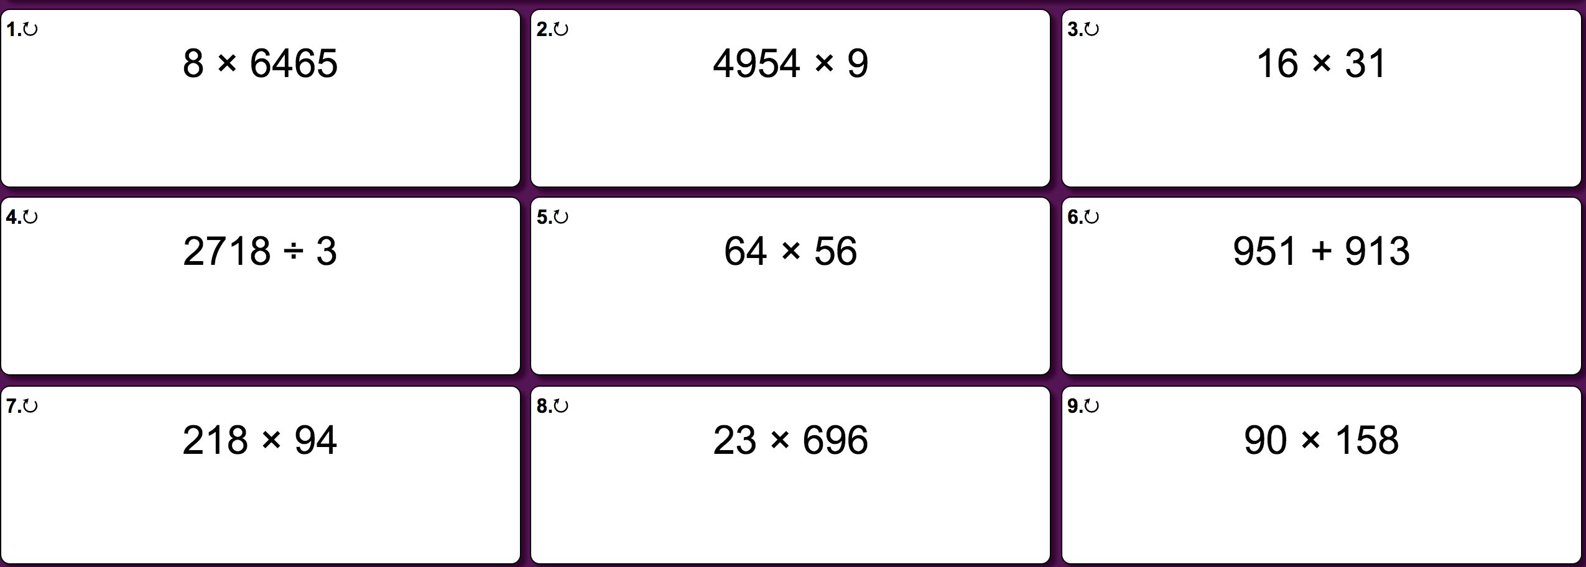
Thursday Questions

Slide 8
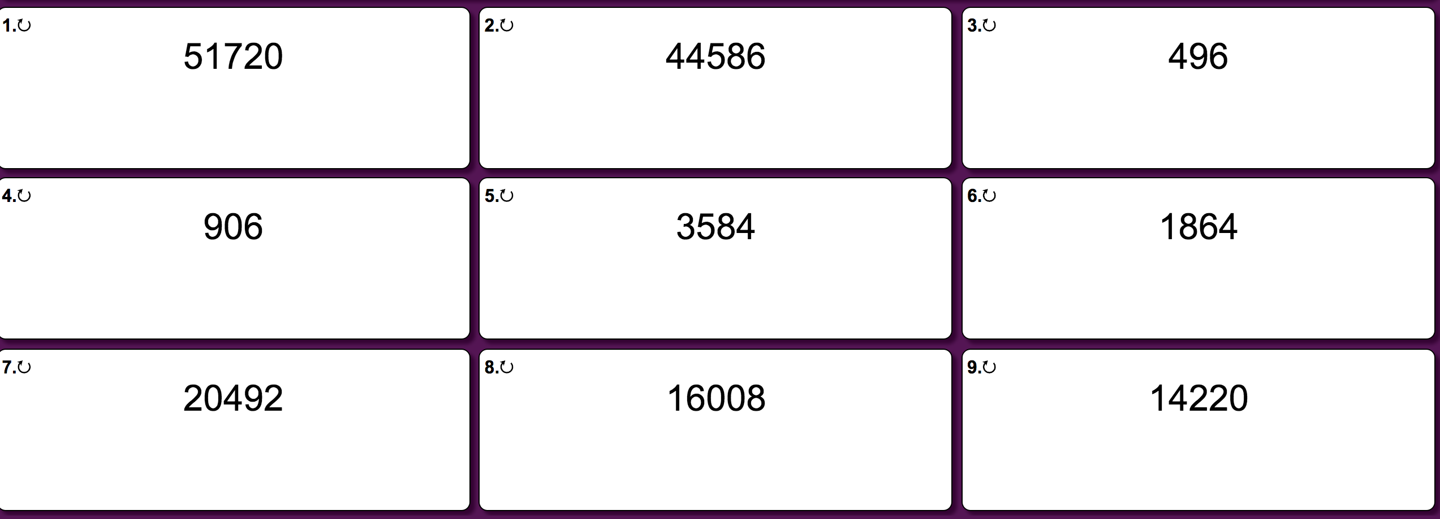
Thursday
Answers

Slide 9
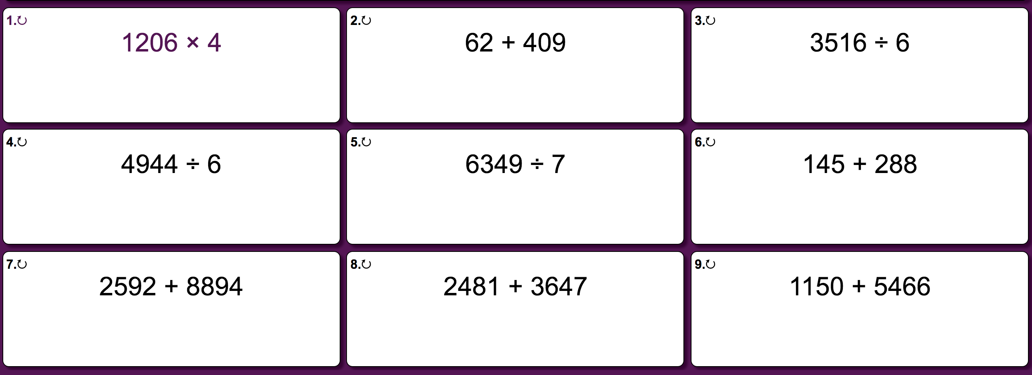
Friday Questions

Slide 10
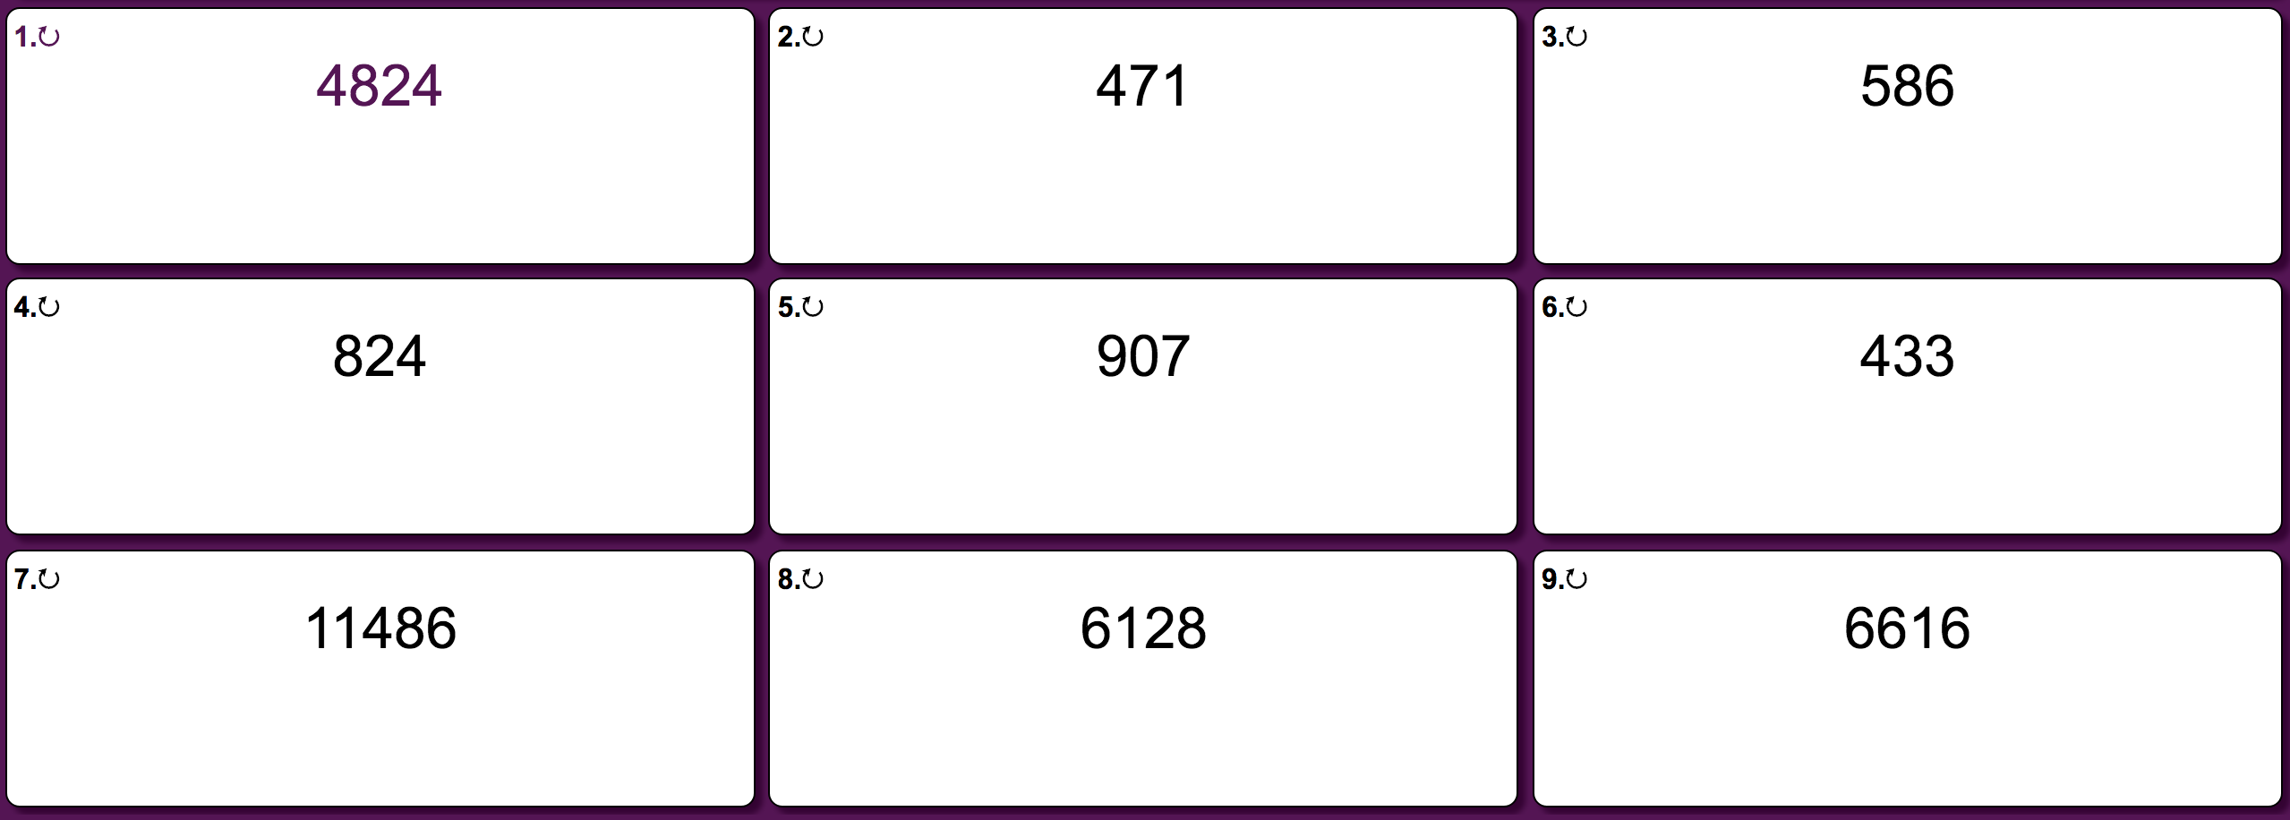
Friday Answers

