Slide 1
Maths Warm Ups
If you would like to warm up your maths brain before you tackle your main task, have a go at the arithmetic questions. Each day, there are 2 sets of questions – one set has a particular focus and the other set are mixed arithmetic questions. You may wish to complete one set or both sets.

Slide 2
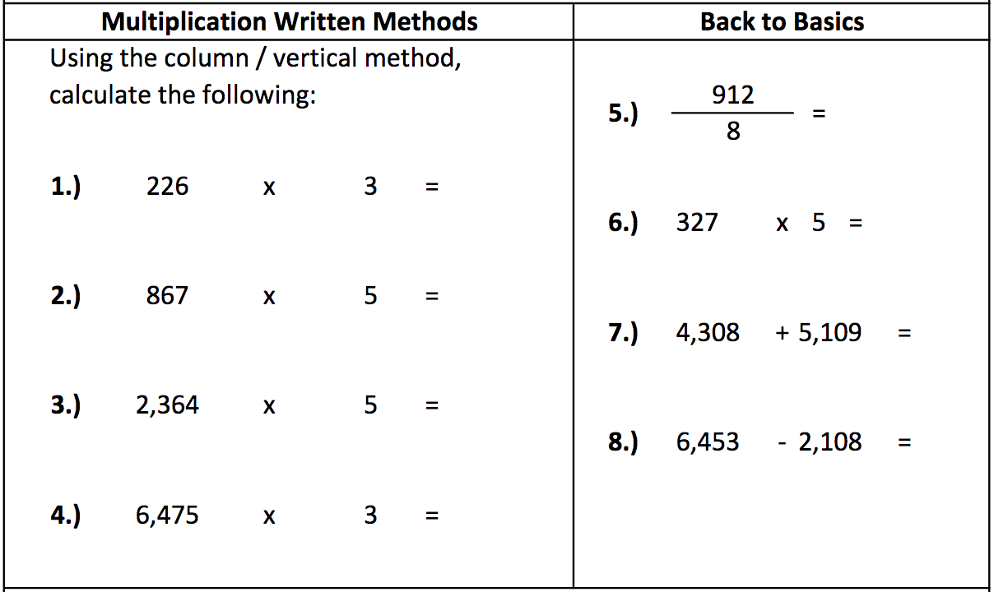
Monday - Questions

Slide 3
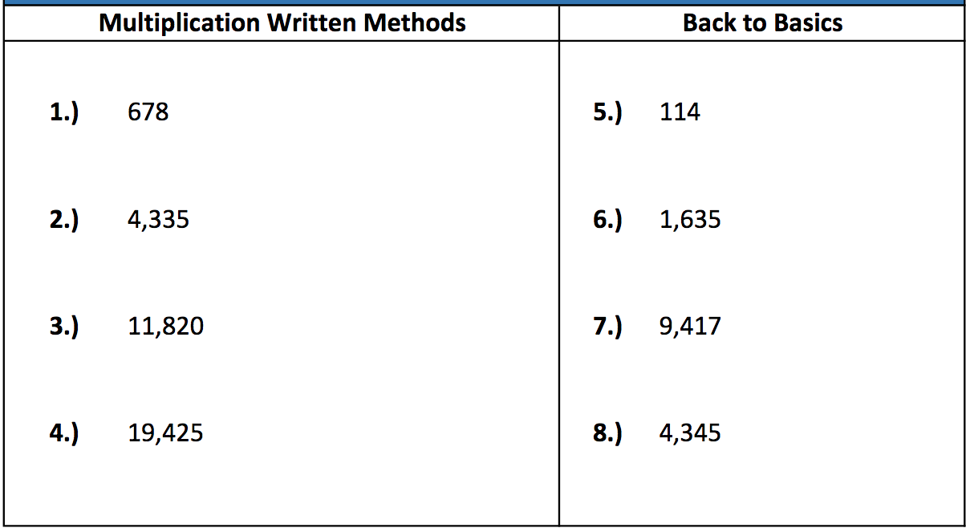
Monday - Answers

Slide 4
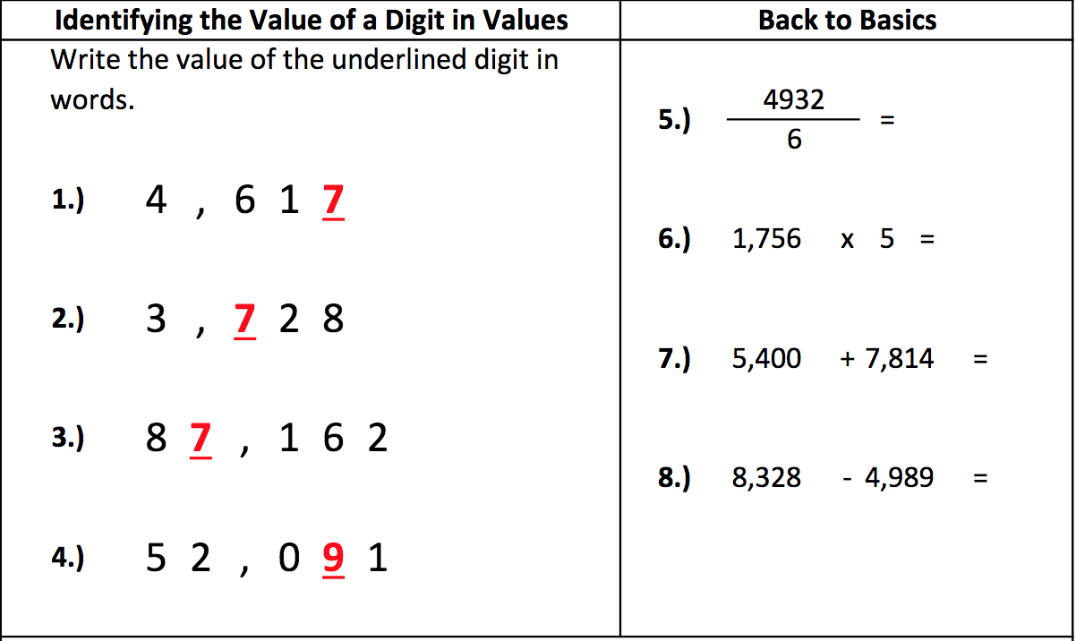
Tuesday - Questions

Slide 5
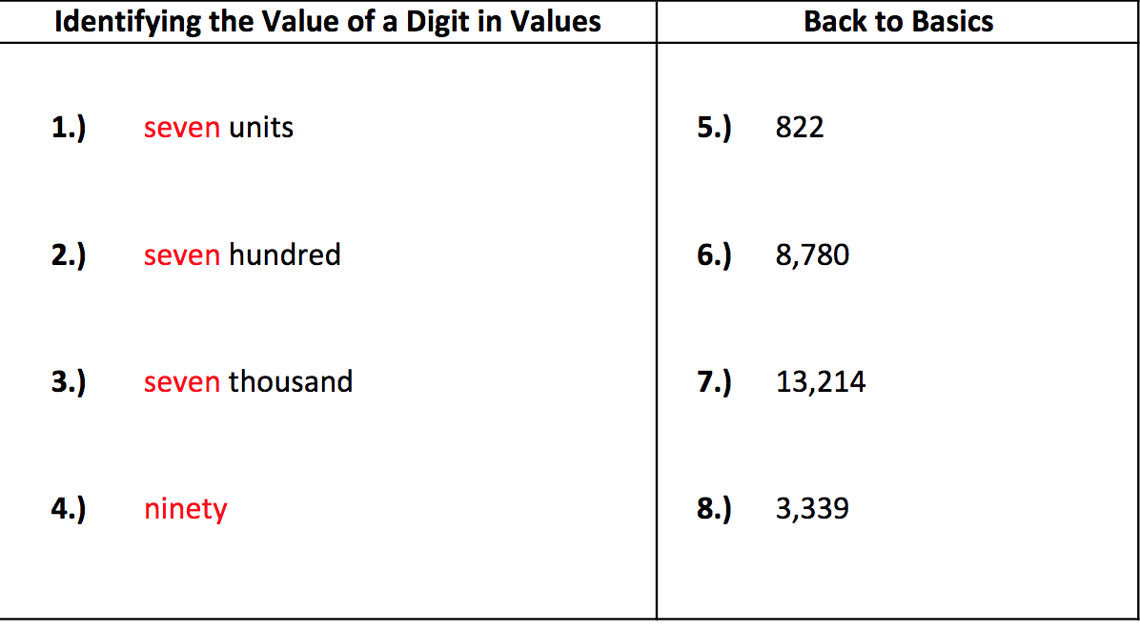
Tuesday - Answers

Slide 6
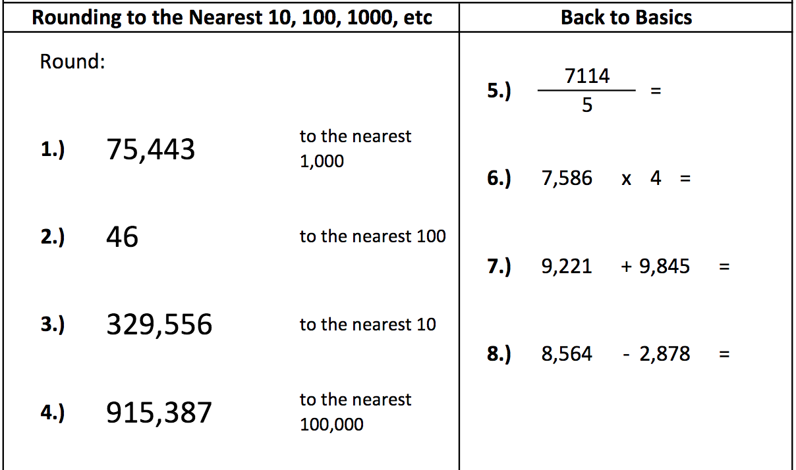
Wednesday - Questions

Slide 7
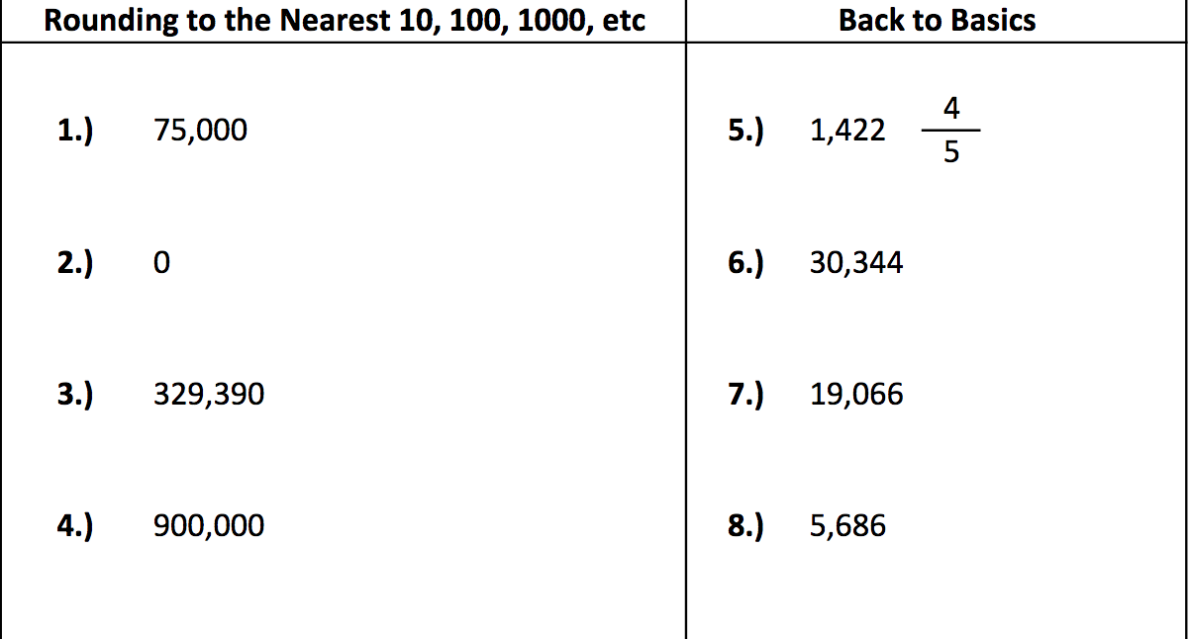
Wednesday - Answers

Slide 8
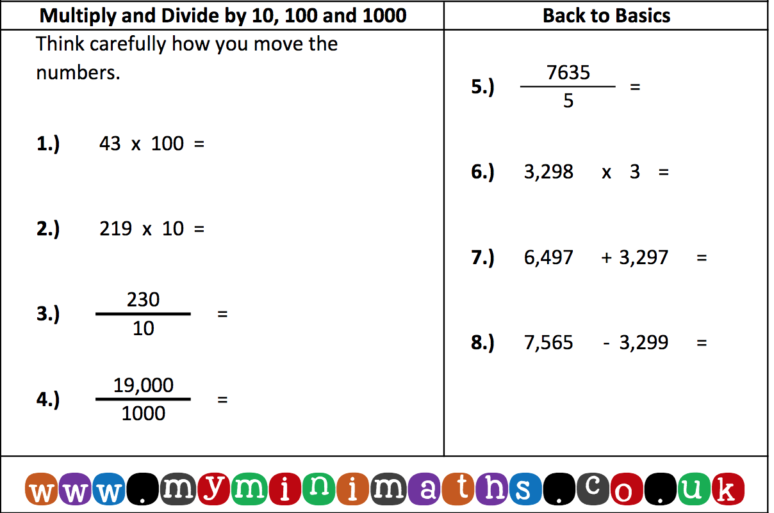
Thursday - Questions

Slide 9
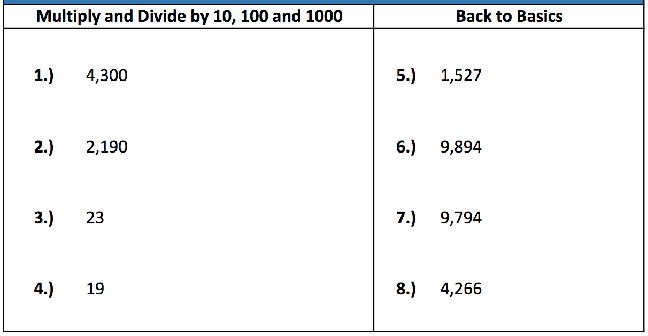
Thursday - Answers

Slide 10
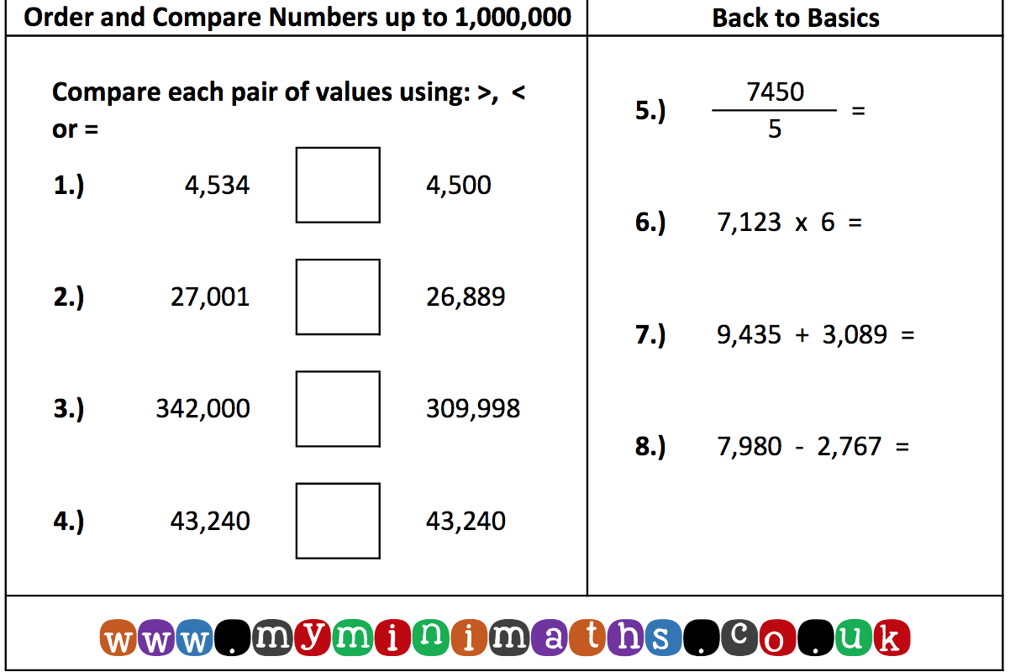
Friday - Questions

Slide 11
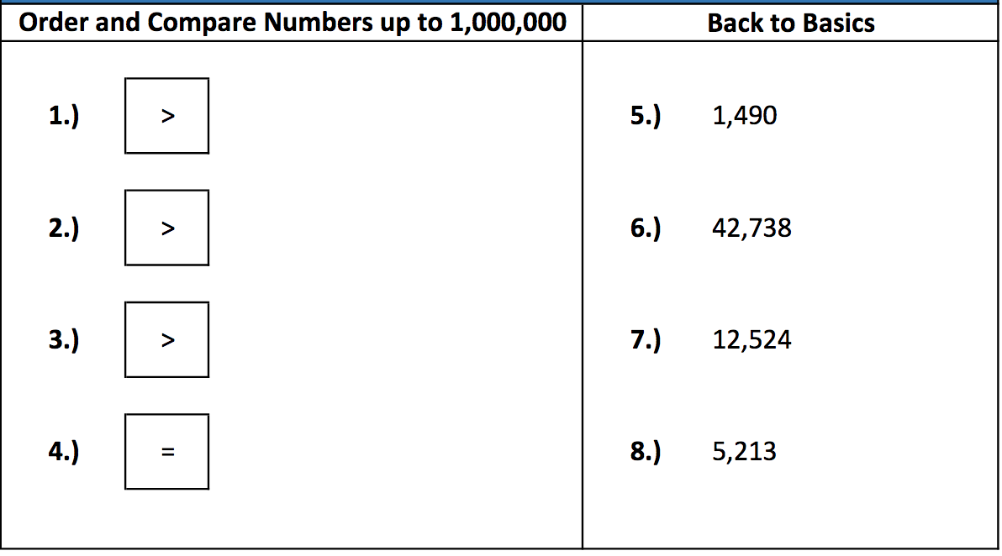
Friday - Answers

