Slide 1
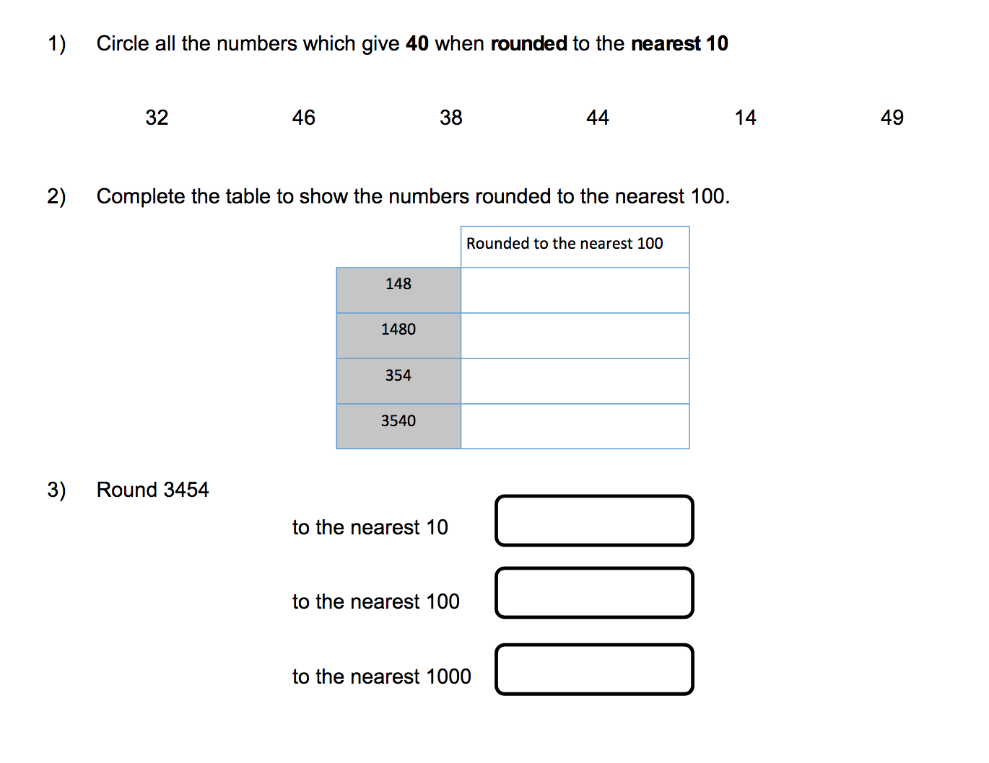
Monday

Slide 2

Monday

Slide 3
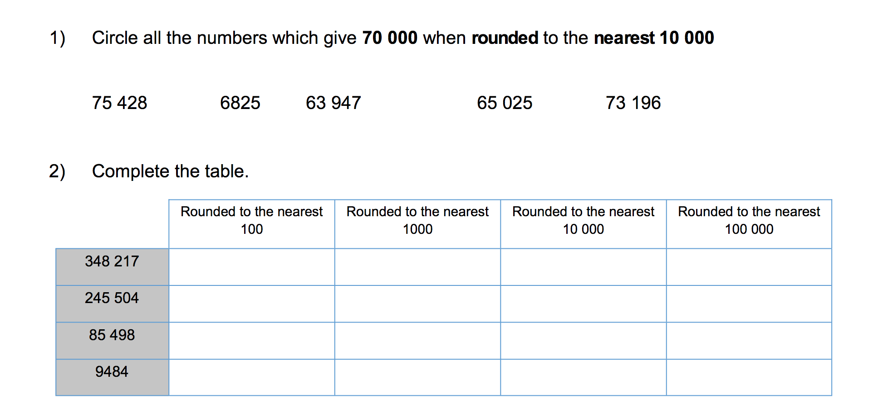
Tuesday

Slide 4

Tuesday

Slide 5
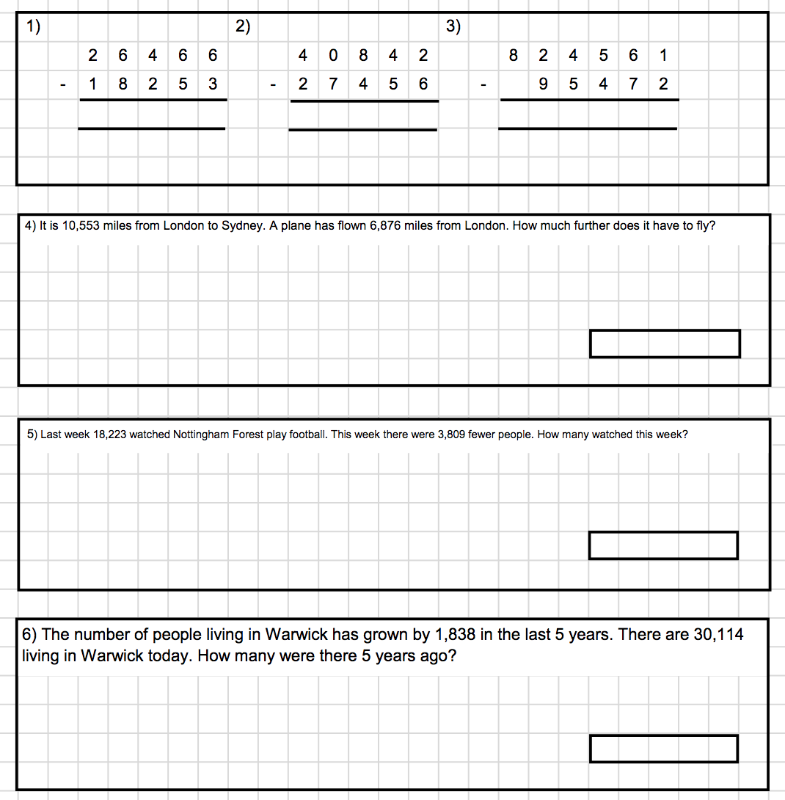
Wednesday

Slide 6

Wednesday

Slide 7
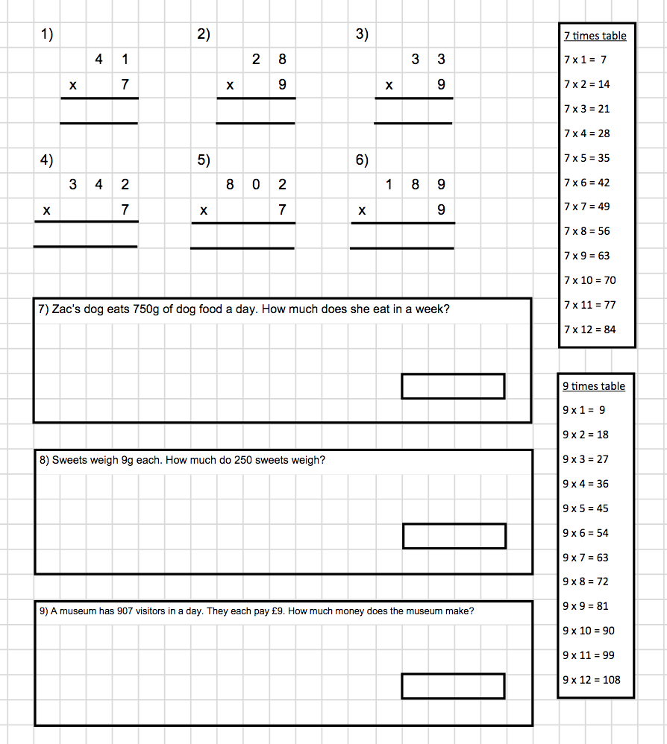
Thursday

Slide 8

Thursday

Slide 9
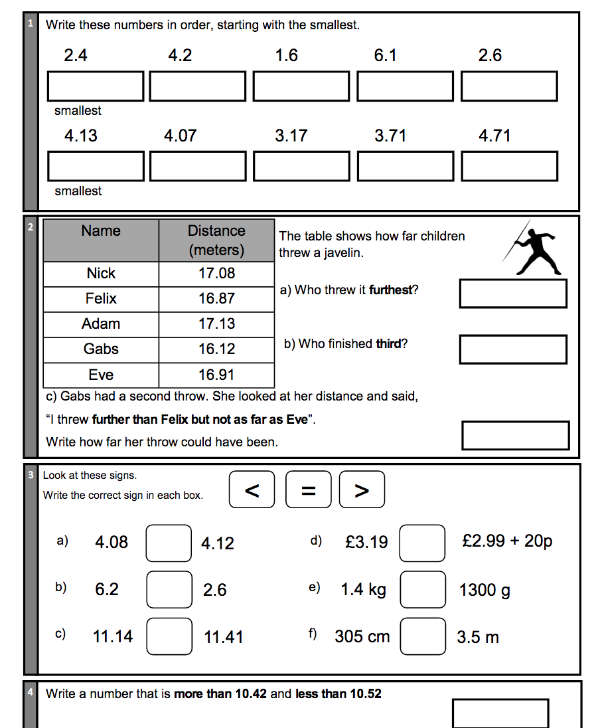
Friday

Slide 10

Friday

