Slide 2
THE SOLAR SYSTEM
By Sam

Slide 3
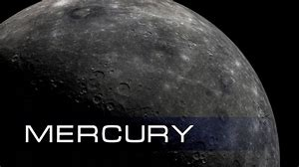
OVERVIEW
~ The size of the planet in diameter is 3,031 miles.
~ Mercury is 36 million miles away from the sun.
~ Mercury has got no moons.
~ The average temperature on Mercury is 167 degrees Celsius.
~ The length of a day on Mercury is 176 Earth days.
~ There is gravity on the planet.
~ The USA sent a spacecraft called Mariner 10 to study Mercury. Also, Europe and Japan sent a satellite called BepiColumbo to Mercury. The USA also sent a rocket to Mercury under the name of Messenger.
~ Did you know? Mercury is named after a Roman Winged Messenger God, Mercury, because it moves so quickly across the sky.

Slide 4
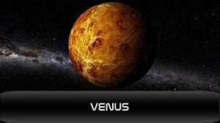
overview
~ The size of the planet in diameter is 7,520 miles.
~ Venus is 67 million miles away from the sun.
~ Venus has got no moons.
~ The average temperature on Venus is 465 degrees Celsius.
~ The length of a day on Mercury is 117 Earth days.
~ There is gravity on the planet.
~ The USSR sent four spacecraft to Venus. Their names were Venera 4, Venera 7, Venera 8 and Venera 9. The USA sent Mariner 10 on a fly-by to Mercury and Magellan to Venus. Europe sent Venus Express to Venus as well.
~ Did you know? Venus is named after the Goddess of love and beauty. This is because Venus shines brightly in the sky.

Slide 5
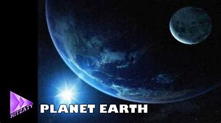
overview
~ The size of the planet in diameter is 7,926 miles.
~ Earth is 93 million miles from the sun.
~ Earth has got one moon called Luna.
~ The average temperature on Earth is 15 degrees Celsius.
~ The length of a day on Earth is 24 hours.
~ There is gravity on the planet.
~ The USA sent six spacecraft to observe Earth. They were called Explorer 1, TopexlPoseidon, Landset 7, Cluster, Cloudset and NOAA 19. USSR sent Sputnik 2 out to study Earth as well. France, Canada and Europe helped the USA with some of their satellites.
~ Did you know? `Earth’ comes from an Anglo-Saxon word `erda’, meaning ground and soil.

Slide 6
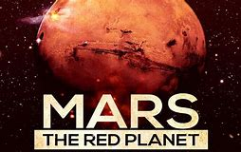
overview
~ The size of the planet in diameter is 4,198 miles.
~ Mars is 142 million miles away from the sun.
~ Mars has got 2 moons, Phobos and Delmos.
~ The average temperature on Mars is -60 degrees Celsius.
~ The length of a day on Mars is 25 hours.
~ There is gravity on the planet.
~ The USA has sent six different satellites to orbit Mars. They were Viking 1, Viking 2, Mars Pathfinder, Mars Odyssey, Spirit and Mars Reconnaissance Orbiter. Europe sent Mars Express to Mars too. The USSR sent Mars 1 to Mars as well.
~ Did you know? Mars is named after the Roman god of war because of its red colour.

Slide 7
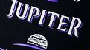
overview
~ The size of Jupiter in diameter is 89,000 miles.
~ Jupiter is 483 million miles away from the sun.
~ Jupiter has got 79 moons, the most famous ones being Iou, Callisto, Europa and Ganymede.
~ The average temperature on Jupiter is -150 degrees Celsius.
~ The length of a day on Jupiter is 10 hours.
~ There is gravity on the planet.
~ The USA built eight spacecrafts to go to Jupiter with help from Europe and Italy. Their names are Pioneer 10, Pioneer 11, Voyager 1, Voyager 2, Galileo, Ulysses, Cassini-Huygens and New Horizon.
~ Did you know? Jupiter was named after the Roman King of the Gods, because Jupiter is so huge.

Slide 8

overview
~ The size of Saturn in diameter is 74,898 miles.
~ Saturn is 891 million miles away from the Sun.
~ Saturn has got 61 moons, the most famous ones being Titan, Telesto, Dione and Prometheus.
~ The average temperature on Saturn is -180 degrees Celsius.
~ The length of a day on Saturn is 11 hours.
~ There is gravity on the planet.
~ The USA has sent one spacecraft to Saturn to observe its rings and three more on a fly-by. their names were Pioneer 2 (fly-by) , Voyager 1 (fly-by) , Voyager 2 (fly-by) and Cassini-Huygenes.
~ Did you know? Saturn is named after the Roman God, Saturn, the god of agriculture and father of Jupiter.

Slide 9

overview
~ The size of Uranus in diameter is 31,763.
~ Uranus is 1,783 million miles away from the Sun.
~ Uranus has got 27 moons, the most famous ones being Mab, Cordelia and Ophelia.
~ The average temperature on Uranus is -193 degrees Celsius.
~ The length of a day on Uranus is 17 hours.
~ There is gravity on the planet.
~ The USA sent Voyager 2 on a fly-by past Uranus.
~ Did you know? The name `Uranus’ comes from the Greek God of the sky. Uranus is also the father of Saturn, and Grandfather of Jupiter.

Slide 10
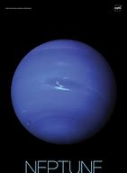
overview
~ The size of Neptune in diameter is 30,775 miles.
~ Neptune is 2,800 million miles away from the sun.
~ Neptune has got 13 moons, the most famous ones being, Nereid and Triton.
~ The average temperature on Neptune is -200 degrees Celsius.
~ The length of a day on Neptune is 16 hours.
~ There is gravity on the planet.
~ The USA sent Voyager 2 on a fly-by.
~ Did you know? Neptune is named after the Roman God of the Sea. The God carried a spear, which is Neptune’s symbol.

Slide 11
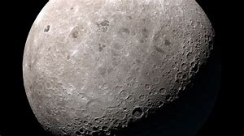
overview
THE MOON
~ The size of Luna (The Moon) in diameter is 2,159 miles.
~ Luna is 110 million miles away from the Sun.
~ Luna has got no moons.
~ The average temperature on Luna is -20 degrees Celsius.
~ The length of a day on Luna is 27 Earth days.
~ There is Gravity on the planet.
~ The USA sent Apollo 8, Apollo 11 and Apollo 15 to The Moon. SELENE was sent up by Japan, Chan’e 1 by China, Chandrayaan-1 by India and Luna 2 and Luna 3 by the USSR.
~ Did you know? The name moon comes from the Latin word for month, Mensis. It takes about a month for Luna to orbit the Earth.

Slide 12
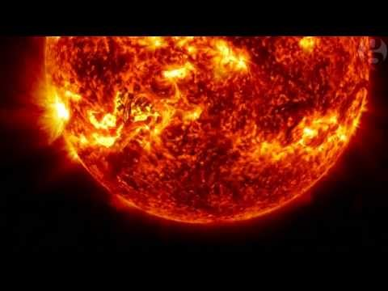
overview
THE SUN
~ The size of The Sun in diameter is 860,000 miles.
~ The Sun is 0 miles away from The Sun.
~ The Sun has got 0 moons.
~ The average temperature on the Sun is 8,003,000 degrees Celsius.
~ The length of a day on The Sun is 29 Earth days.
~ There is gravity on the star.
~ Helios 1, Helios 2, Solar Max, Ulysses, Yohkoh, SOHO, STEREO A, STEREO B and Hinode all made trips to the Sun. These spacecrafts were made by Germany, USA, Europe and Japan.
~ Did you know? The first day of the week, Sunday, is named after the Sun because it’s the brightest object in the sky.

Slide 13
PLUTO and Beyond
As well as the eight major planets of the solar system, there are many small planets. These include Pluto, a ball made of ice and rock and Ceres, a tiny planet that lies in the asteroid belt, while much further out lies the remote world of Eris. There are lots of other small planets out there, floating about, waiting to be found.

Slide 14


