Slide 1
Why does the moon change shape?
Why does the moon change shape every night?

Slide 2
About are moon!
Most planets in the solar system have a moon for example Jupiter 67 moons. Living on earth must mean we have a moon right? YES! We have one moon that can orbit us in 27 days, 7 hours, and 43 minutes. Our moon is called Luna so that’s why when we have a Luna eclipse it says Luna. Every day the moon goes down at the beginning of day and the sun comes up swapping places so the moon will be in around Australia and the sun will be around UK then at night time they will swap places again making it dark so we can sleep better. The moon is 4 billion and a half years old so nearly older then the earth.

Slide 3
What are the phases of the moon
When you look into the sky each night you will see the moon changes shape like one night it could be a full moon but the next night it’s a half moon. Every phase the moon is in has a name like all people all the moons phases are different all humans are different even if there twins like some of the moons just opposite here are all phases of the moon. It takes 29 and a half days for the moon to go through all through all the phases.

Slide 4
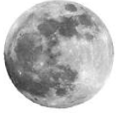
This is a full moon. We get these when we the moon gets direct sunlight from the sun causing a full moon

Slide 5
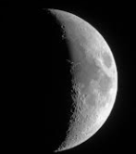
This is a waxing gibbous . A waxing gibbous is a phase of the moon that gets bigger instead of getting smaller.

Slide 6
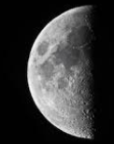
This is the first quarter of the moon it grows by the time its reached here it would of gone one transition from being a full moon

Slide 7
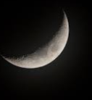
This is a waxing crescent this is like a waxing gibbous but the other way around.

Slide 8
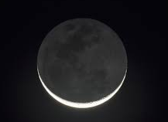
This is a new moon.
You get these when there is no sunlight shining at the front of the moon but there is at the back.

Slide 9

This is waning crescent. This happens when the shadow gets bigger instead of smaller.

Slide 10
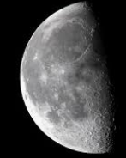
This is the first quarter. Exactly like the last quarter but on the other side

Slide 11
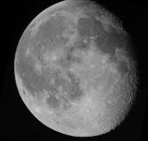
This is a waning gibbous this is a couple of meters away from being a full moon

Slide 12

How do we get a Luna eclipse !
We get a Luna eclipse in which the moon appears darkened as it passes into the earth's shadow.

Slide 13


