Slide 1
By Jack Blamire
THE SOLAR SYSTEM

Slide 2
MERCURY
. A day on mercury is 59 earth days and a year on mercury is 88 earth days.
. Mercury has 0 moons.
. The distance from the sun to mercury is 69.557 million kms.
. The size of mercury is 4879.4 km
. The average temperature on mercury is 332’f or 167’c.
. There is gravity on mercury but there is only 30%
.

Slide 3
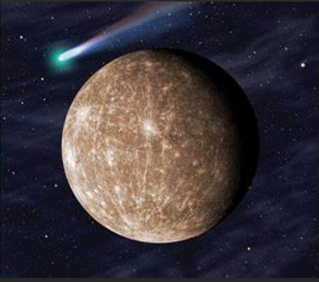
Did you know?
Did you know mercury is the smallest and innermost planet in the solar system. Its orbit around the sun takes 87.97 days, the shortest of all the planets. It is named after the roman deity “mercury”, the messenger of Gods.

Slide 4
Pluto
. A day on Pluto is 6.4 earth days.
. A year on Pluto is 248 earth years.
. Pluto has 5 moons which are called charon, nix, hydra, Styx and Kerberos.
. The distance from the sun to pluto is 3.67 billion km.
. The diameter of pluto is 2376.6km.
. The average temperature on pluto is minus 380’f or minus 229’c.
. There is gravity on pluto but there is only 1/12 the surface on earth.
. In 1992 NASA’s Jet Propulsion Laboratory (JPL) proposed the pluto fly by mission. This became known as the pluto express.

Slide 5
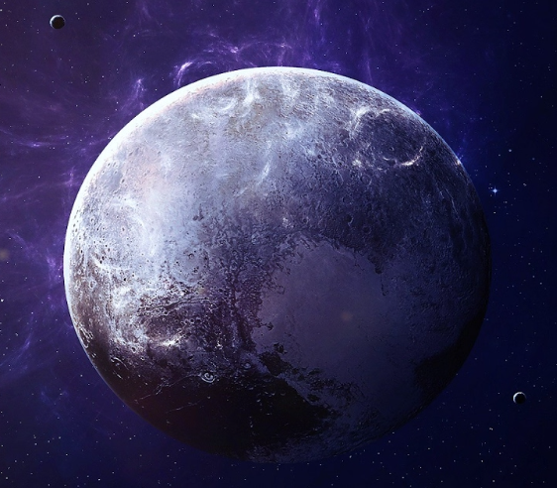
Did you know
Pluto takes 248 years to circle the sun and most of that time it is the farthest planet from the sun. But pluto has an oval-shaped and for 20 years of its orbit pluto is closer than Neptune. When pluto is closest to the sun its frozen surface turns from a solid to gases and the planet has an atmosphere.

Slide 6
Saturn
. The diameter of Saturn is 116,460 kms
. A Day on Saturn is 10.656 Earth hours. A year is as long as 29.5 Earth years.
. The distance from the sun is 1.4969 billion kms.
. Saturn has 53 moons that have been named. Saturn also has 29 moons awaiting confirmation. They’re unconfirmed because they’re waiting to get more information about them. If all of the moons get confirmed, Saturn will have 82 moons. This is not counting Saturns rings.
. The average temperature on Saturn is minus 288’F or minus 178’C.
. There is Gravity on Saturn, 107% of the surface gravity on Earth.
. There have been 3 missions to Saturn, they were solely performed by crewless probes. The 1981 Voyager space probe found that Saturns rings, which from Earth look like 3 rings, were actually thousands of narrow ringlets made up of millions of icy particles which stretch for thousands if kms into space in a paper thin disc.

Slide 7
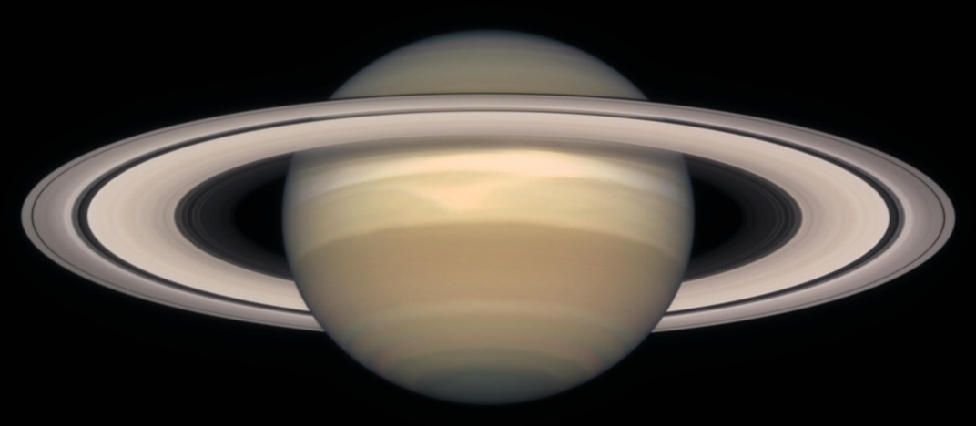
Did you know?
Saturn is a Gas Giant with an average radius of about 9 times of the Earths. It is mainly made up of hydrogen and helium.
The rings of Saturn formed long ago, perhaps when a moon or asteroid came too close to Saturn and was torn apart by the strong gravity of the planet, which is the second largest in the solar system.

Slide 8
NEPTUNE
. The diameter of Neptune is 49,244km
. The distance from the sun to Neptune is 4.4769 billion kms.
. Neptune has 14 moons.
. Neptune rotates on its axis faster than Earth. A day on Neptune is only 16 hours long.
. The average temperature on Neptune is minus 355’ F or minus 214’C.
. There is Gravity on Neptune.
. There has only been one mission to Neptune. The Voyager 2 in 1989. There are currently no approved future missions to visit Neptune.

Slide 9
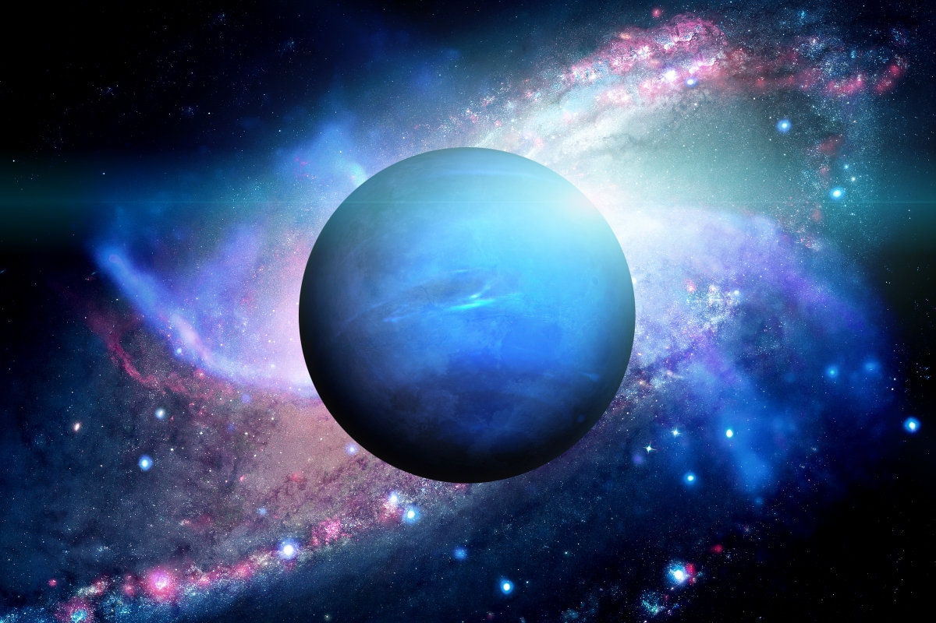
Did You Know?
Neptune is a deep blue planet. It is a bleak and windy place with poisonous clouds made of methane ice crystals swirling around it.
The planets rocky core (about the size of planet Earth) is surrounded by a frozen layer of water and ammonia.
Neptunes atmosphere consists mainly of hydrogen.

Slide 10
Earth
. Earths diameter is 12742 km
. Earth is 149.59 million km from the sun.
. Earth has one moon.
. The length of a day on Earth is officially 23 hours and 56 minutes.
. Earth does have Gravity, that is why we do not all float around on the planet.

Slide 11
Did You Know?
Earth is the only planet in our Solar System where life appears to exist.
Life on Earth is possible because our planet is just the right distance from the sun for water to exist as a liquid.
Our atmosphere is unique because it contains so much oxygen which is why we are able to breathe.
The Earths seasons Spring, summer, autumn and winter are caused by the way the Earth tilts as it orbits the sun.

Slide 12
Uranus
. The diameter of Uranus is 50,724 km.
. Uranus is 2.9631 billion km away from the sun.
. Uranus has 27 moons. Some of them are called Ariel, Cressida, Miranda, Oberon and Puck.
. A day on Uranus is 17.24 Earth hours.
. The average temperature in Uranus is minus 353’F
. There is gravity on Uranus but not as much as on Earth. It only has 86% of the surface gravity as on Earth. This is because Uranus is made up of gases and is not solid like Earth which makes it light for its size.
. Uranus has been explored mainly through telescopes. There was one lone probe mission. The only spacecraft to ever visit Uranus is the Voyager 2 probe. It was launched on 20 August 1977 and reached Uranus on 24 January 1986. It examined its ring system and discovered two new rings.

Slide 13
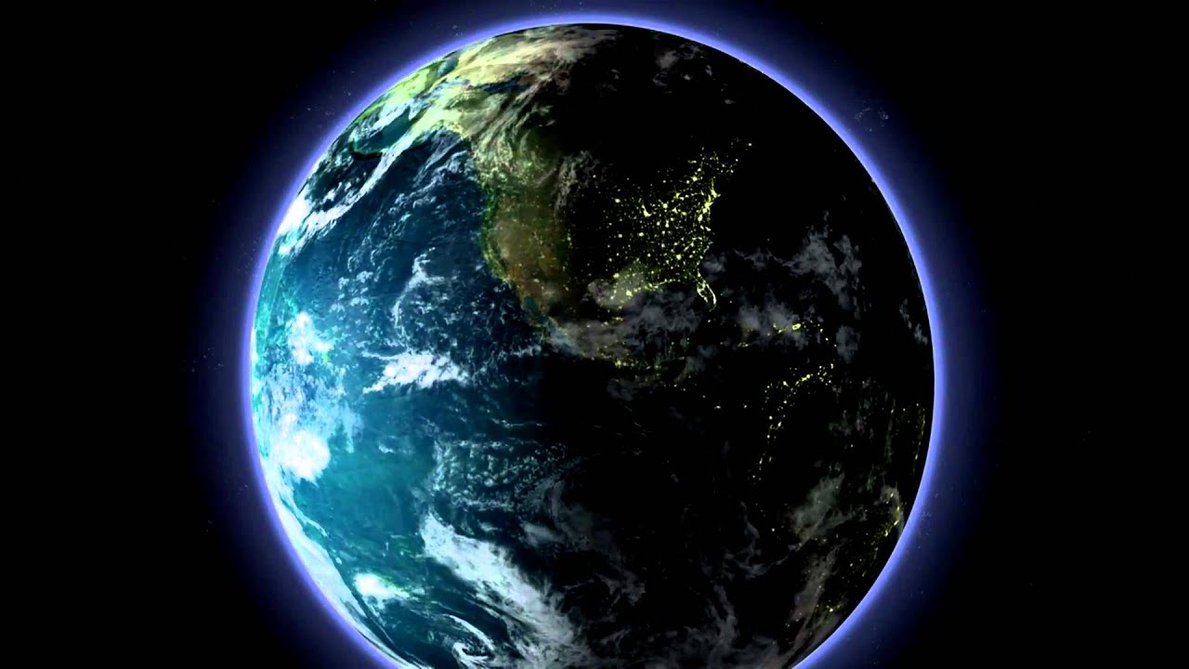
Did You Know?
Most of the planets in our solar system are tilted a little (Earth is tilted at 23 degrees) but Uranus is tilted completely on its side. It is believed that in the early days of the solar system, a large body may have crashed into Uranus tilting it so that it rolls through the sky on its side. This means that each pole has constant sunlight for 42 years. (No night time for 42 years)

Slide 14
MARS
. The diameter of Mars is 6779 km.
. Mars is 221.6 million km from the sun.
. Mars has 2 moons named Phobos and Deimos.
. Mars rotates on its axis at the same speed as Earth so a day on Mars is about the same as a day on Earth. A day on Mars is 24.62 Earth hours.
. The average temperature on Mars is about minus 80’F or minus 60’C.
. There is gravity on Mars but it is weaker than gravity on Earth because of the planets smaller mass.
. There have been 56 missions to Mars so far. 26 have been successful. Unmanned missions began in 1960, the first by the Soviet Union on 10th October 1960 but it failed in orbit. The first mission to land on Mars was “Mars 3” launched on 28th May 1971. It landed on 2nd December 1971 and the first partial image was transmitted but lost contact after 14.5 seconds after transmission started. On 4th December 1996 the NASA mission “sojourner” was successful in putting the first Rover on another planet and it operated for 84 days exploring the surface of Mars.

Slide 15
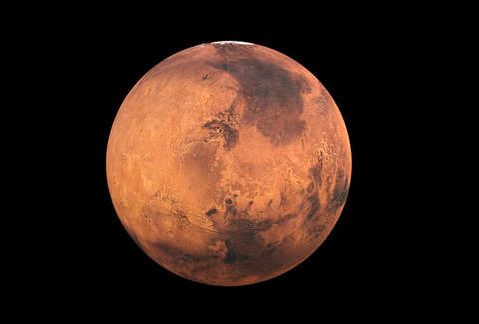
Did You Know?
The Romans called the orange-red planet Mars after the God of War.
The atmosphere on Mars is too thin to breathe.
Violent dust storms sweep across the surface of the planet.
Mars has changes in weather like our seasons in Earth.
The surface of Mars is covered by rusty red rock and is dotted with huge canyons and volcanoes.
The biggest volcano in our solar system (so far discovered) is Olympus Mons, and it is on Mars. It is as large as the American State of Arizona.

Slide 16
JUPITER
. The diameter of Jupiter is 139,820 km.
. Jupiter is 777.34 million km from the sun.
. Jupiter has 79 moons. The most well know moons are IO (said eye-oh), Europa and Callisto. It has the biggest moon in our solar system called Ganymede.
.A day on Jupiter is only 9 hours, 55 minutes of Earths time. Just over a third of a day on Earth.
. The average temperature on Jupiter is minus 234’F or minus 145’C.
. Nine spacecraft have been launched to Jupiter on missions. They are automated spacecraft (nobody on board). The first mission was Pioneer 10 into the Jovian system in 1973. Juno Spacecraft is a NASA space probe currently orbiting Jupiter and it is due to remain there until 2021. When it has completed its mission it will be de-orbited into Jupiters atmosphere.

Slide 17
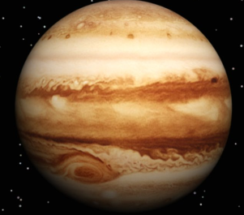
Did You Know?
Jupiter is named after the King of the Roman Gods.
Jupiter is the largest planet in our solar system.
It is 300 times heavier than the Earth and more than twice as heavy as all the other planets added together.

Slide 18
VENUS
. The diameter of Venus is 12104 kms.
. The distance from the sun is 107.7 million kms.
. Venus has no moons.
. The average temperature on Venus is 864’F or 462’C.
. There is gravity on Venus. 8.87 m/s
. There have been 20 Space missions to Venus.

Slide 19
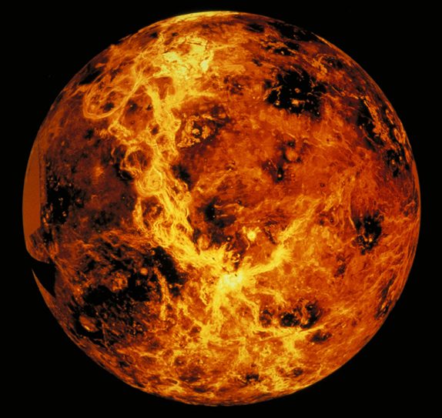
Did You Know?
Venus is the second planet from the Sun.
It is named after the Roman Goddess of Love and Beauty.
As the second-brightest night object in the night sky after the moon, Venus can cast shadows and, rarely, is visible to the naked eye in daylight.

