Slide 1
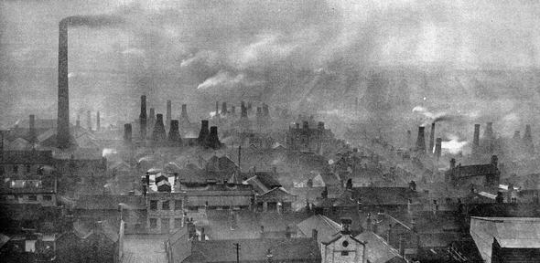
The Industrial Revolution
1760-1840
By Amber M

Slide 2
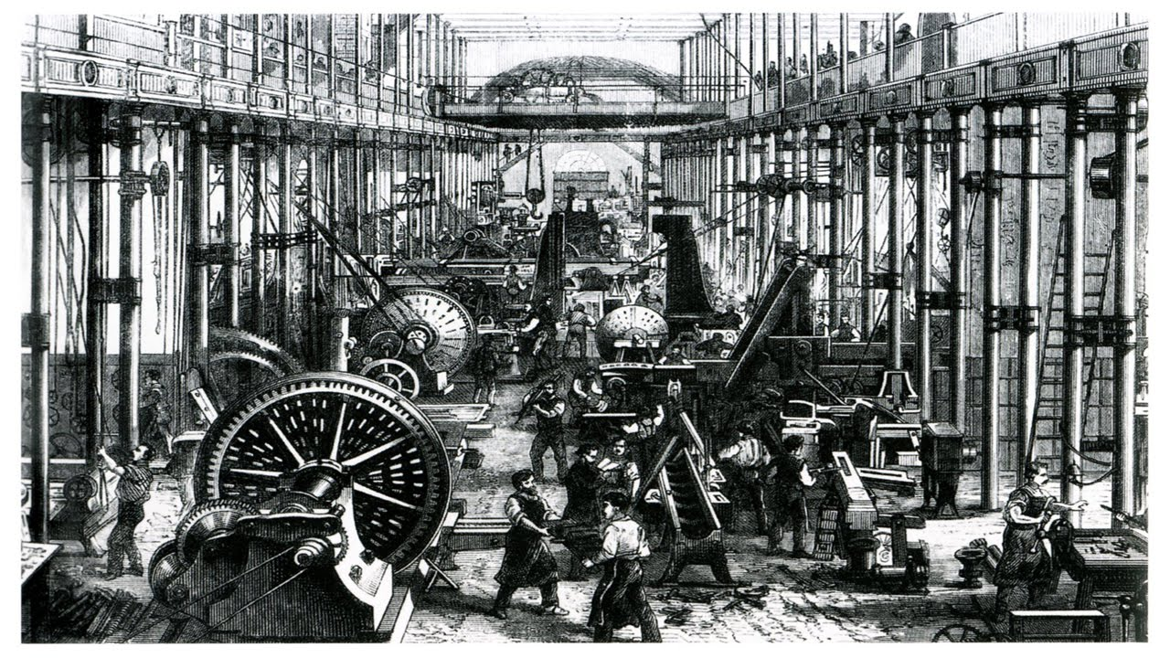
What was life like before the Industrial Revolution?
Prior the 18th century Britain was dominated by an agrarian society. Rural farmers would work the land or rent land from a wealthy land owner. They would graze animals, and produce goods which were a necessity for survival.

Slide 3
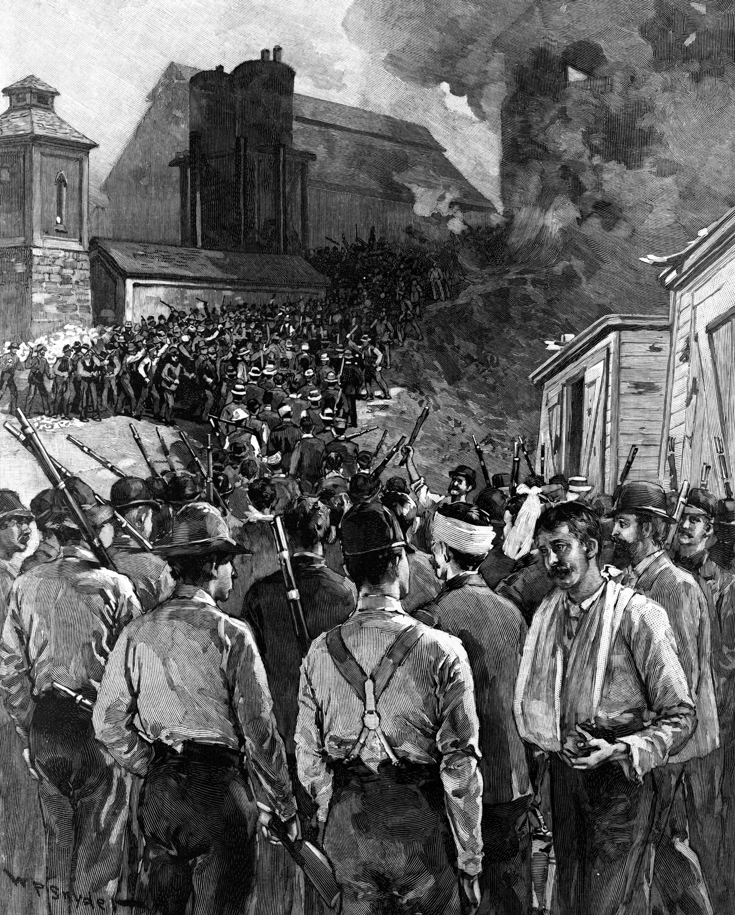
What was Life like for adults during the Industrial Revolution?
In the first sixty years or so of the Industrial Revolution, working-class people had little time or opportunity for recreation. Workers spent all the light of day at work and came home with little energy, space, or light to play sports or games.
This Photo by Unknown Author is licensed under CC BY-SA

Slide 4
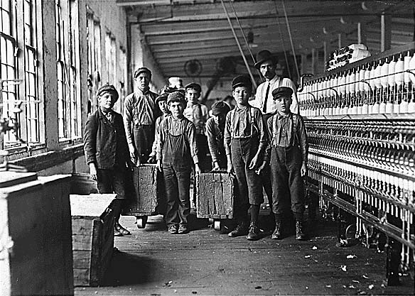
What was Life like for children during the Industrial Revolution
For the working class, the Industrial Revolution introduced harsh new ways to make ends meet. Children had always helped on farms or assisted in making textiles at home. However, as life became more urban and industrial there were fewer domestic job opportunities. This forced many children to work outside of the home in places like factories and mines
This Photo by Unknown Author is licensed under CC BY-SA

Slide 5
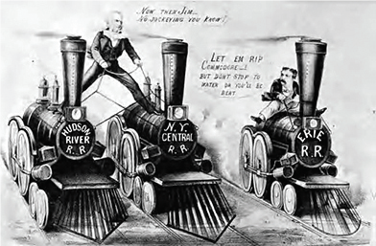
How was Transport Affected by the Industrial Revolution?
There were three main types of transportation that increased during the Industrial Revolution: waterways, roads, and railroads. Transportation was important because people were starting to live in the West. During this time period, transportation via water was the cheapest way to move heavy products (such as coal and iron).

Slide 6
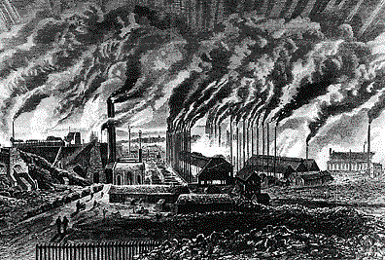
What impact did the Industrial Revolution have on Britain?
The first changes began in Great Britain in the 1780’s and spread across Europe and North America by the 19th century leaving a profound effect on the entire world. The Industrial Revolution effected every aspect of human society including the nature of work, child labor, and health conditions of the workers
This Photo by Unknown Author is licensed under CC BY-SA

